Slide 1
Module 4: VPC Assignment-1
You have been asked to:
Create a VPC with 120.0.0.0/16 CIDR block
Create 1 public subnet, 2 private subnets and make sure you connect a NAT gateway for internet connectivity to private subnet

Slide 2
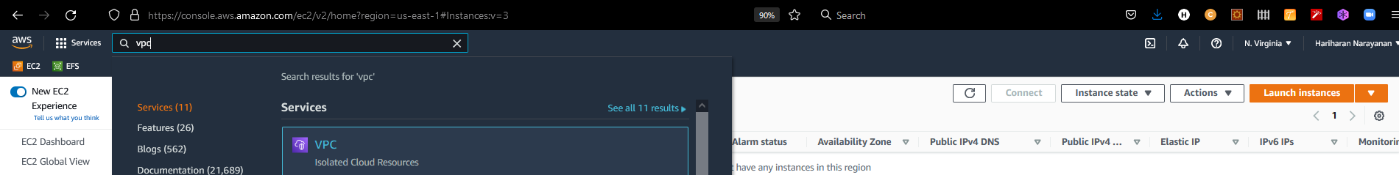
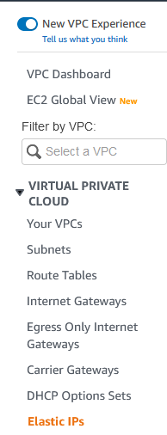
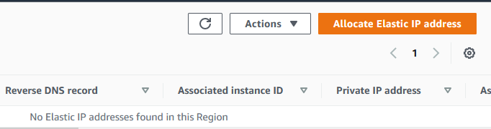
2. Type “VPC” in the search box
1. Login into AWS. Select N. Virginia
3. Select VPC
5. Create a new Elastic IP
4. Select Elastic IPs

Slide 3
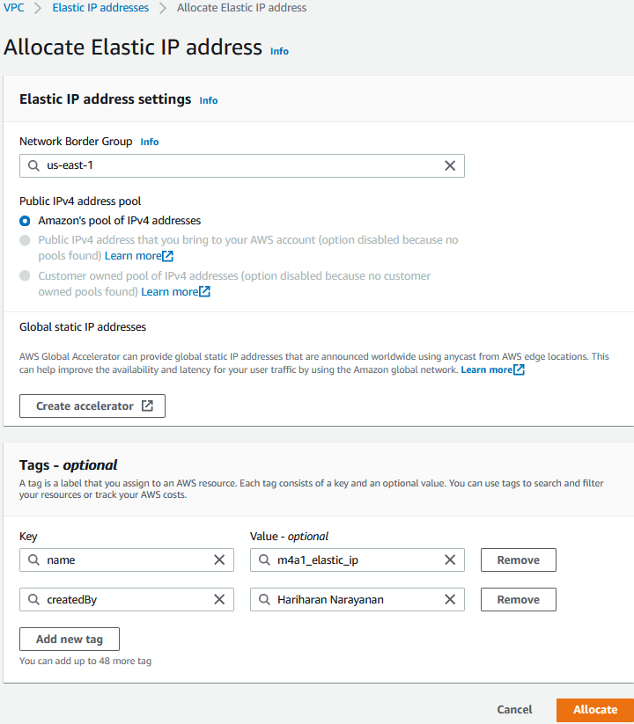
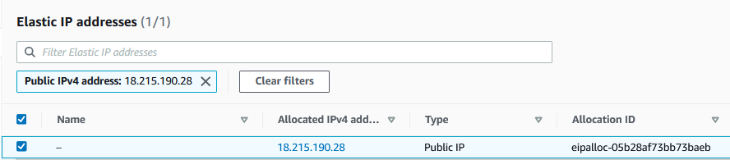
6. Select region
12. Verify that new elastic IP is created
7. Leave default pool of IPv4 addresses
8. Leave name tag as it is
10. Create more Tags as needed
8. Add createdBy tag
11. Allocate

Slide 4
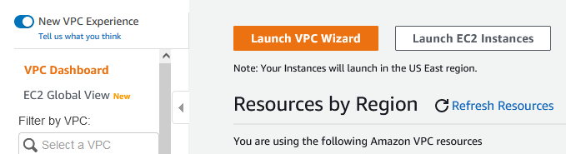
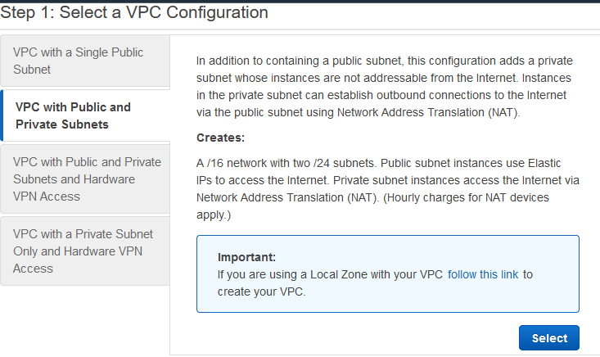
13. Launch the VPC wizard
14. Choose to create one public and one private subnet
15. Select

Slide 5
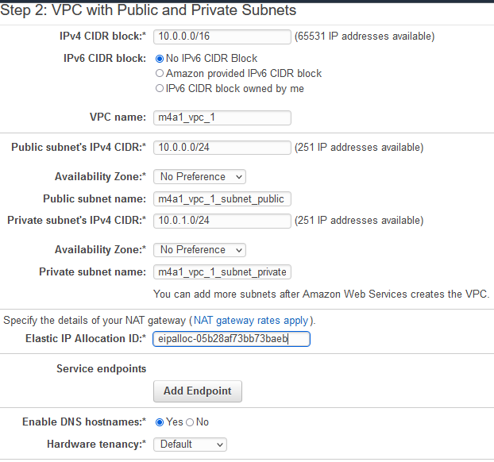
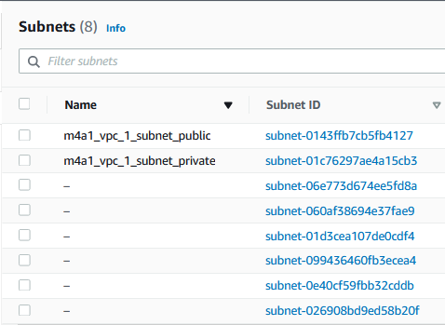
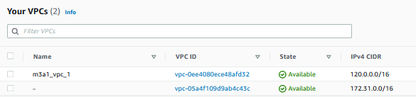
16. Give a name to the VPC
17. Name the public subnet
18. Name the private subnet
22. Verify that subnets are created as expected.
19. Select the elastic IP created in (7)
20. Create VPC. Wait for the process to complete
21. New VPC must be visible in the view “Your VPCs”

Slide 6
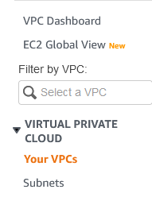
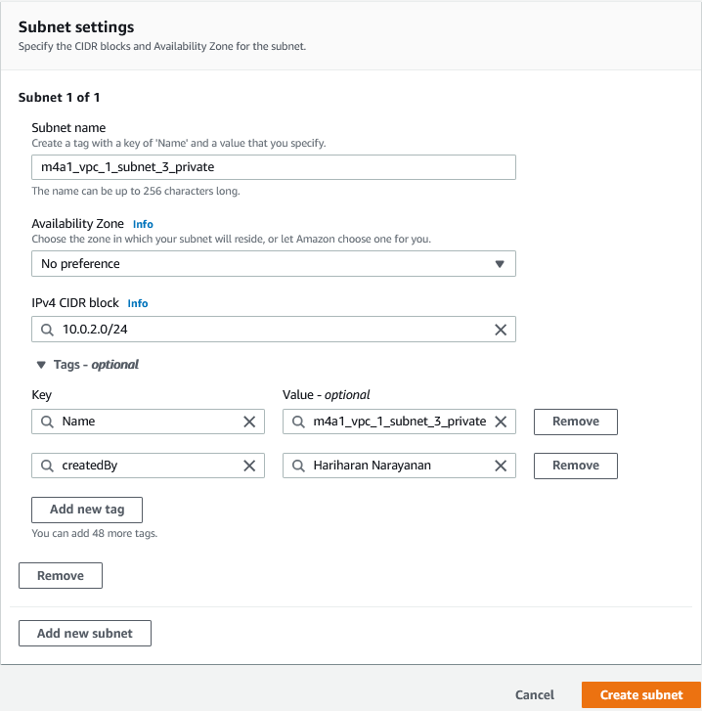
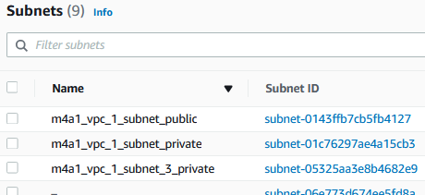
23. Create new subnet
25. Select VPC created in (9)
24. Click to view subnets
26. Select CIDR
29. Verify that subnets are created
27. Create tags as needed
28. Create subnet

Slide 7
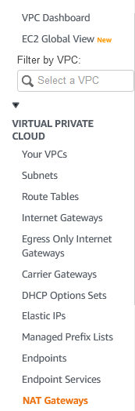
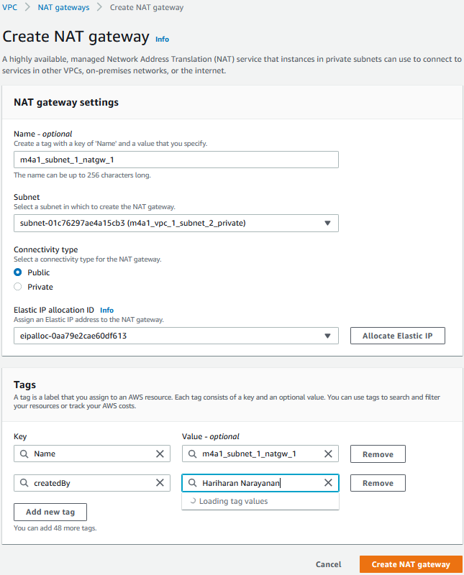
31. Name the NAT gateway
32. Link to a private subnet
33. Choose public
34. Allocate an elastic IP
35. Create tags
30. Open NAT Gateway page
36. Create NAT gw

