Slide 1
Module 8 Assignment 5 - CloudWatch
You have been asked to:
Create a CloudWatch Billing Alarm which goes off when the Estimated Charges goes above 500$
Create a CloudWatch Alarm which goes off to an Alarm state when the CPU utilization of an EC2 instance goes above 65%
Also add an SNS topic so it notifies the person when the threshold is crossed

Slide 2
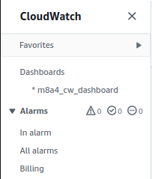
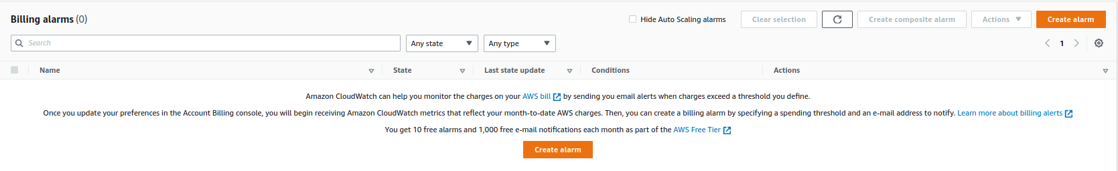
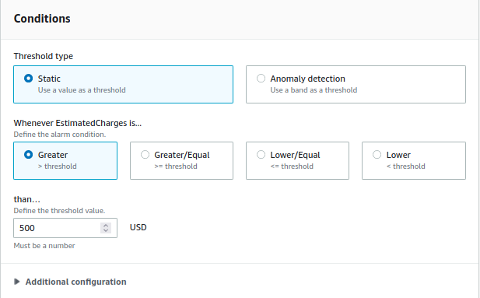
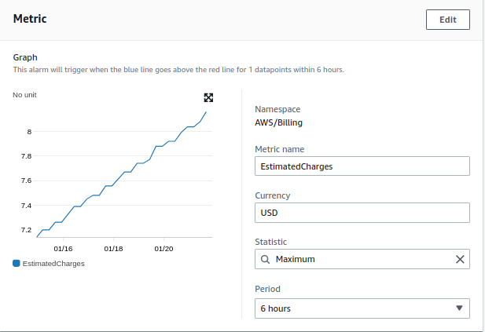
2
1
3
4
1. Open “CloudWatch” Console. Click on “Alarms” -> “Billing
2. Click on “Create Alarm”
3. Select “EstimatedCharges”. Currency as “USD”. Statistic as “Maximum”.
4. Select “Static”, “Greater”, and “500” USD

Slide 3
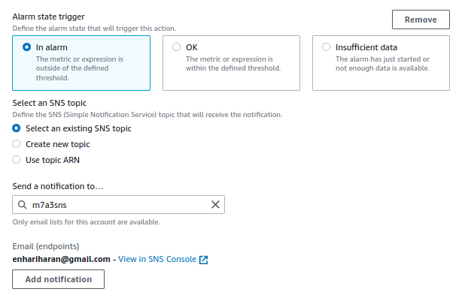
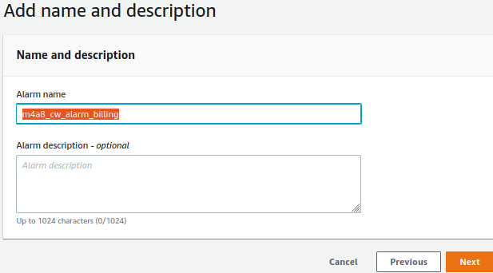
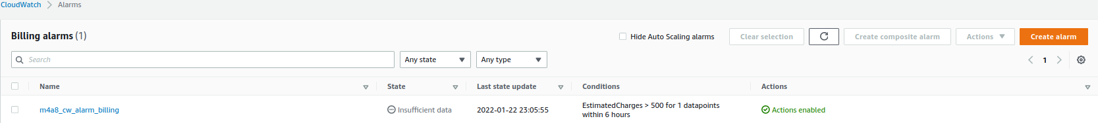
6
5
5. Add SNS notification
6. Name the alarm, review and create.
7. Verify that alarm is created successfully
7

Slide 4
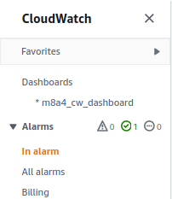
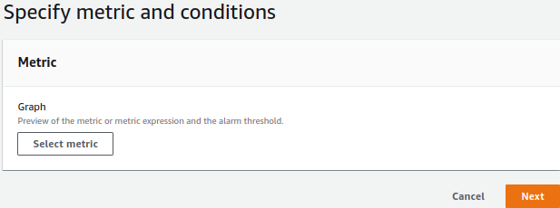
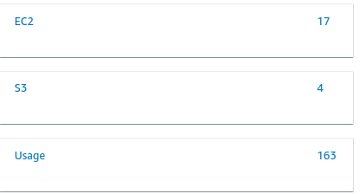
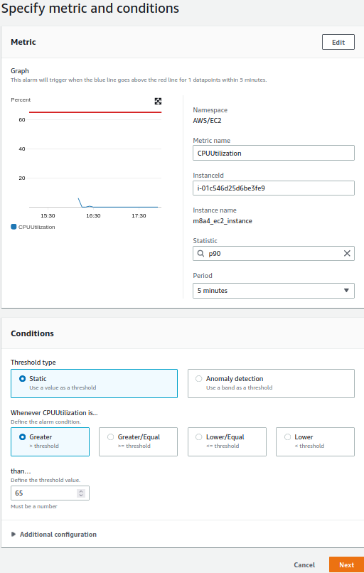
10
9
8
11
8. From CloudWatch console, select “In alarm” and then select “Create alarm”
9. Select metric
10. Select EC2
11. Select “CPUUtilization”
12. Setup threshold metric to >65%
12

Slide 5
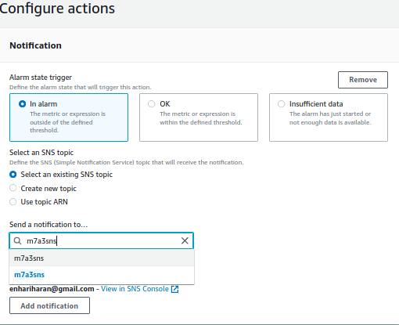
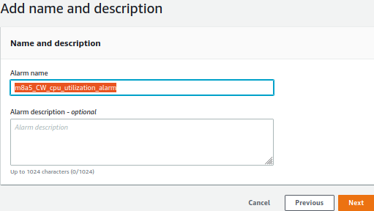
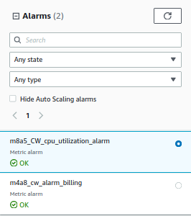
14
13
8. From CloudWatch console, select “In alarm” and then select “Create alarm”
9. Select metric
10. Select EC2
11. Select “CPUUtilization”
12. Setup threshold metric to >65%
13. Setup SNS notifications
14. Name the alarm, review, and create
15. Go to Alarms Console and verify that all alarms are created successfully.
15

