Slide 1
Module 7 – Assignment 1 – Cloudformation
You have been asked to:
Create a template which can create an S3 bucket named “Intellipaat<<your-name>>”
The template should be able to enable versioning for the bucket created

Slide 2
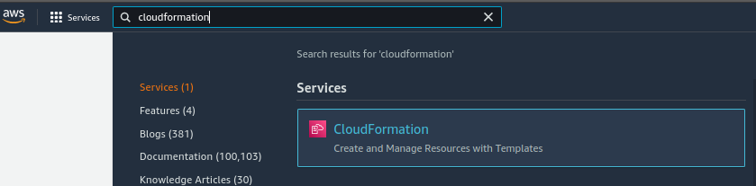
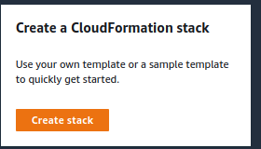
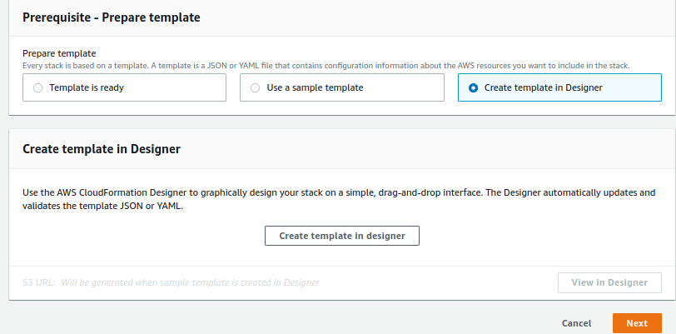
2. Open CloudFormation
1. Type “cloudformation”
4. Select to create CF template in designer
3. Click to create new stack
5. Click to open CF designer

Slide 3
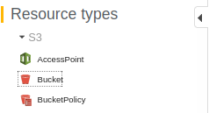
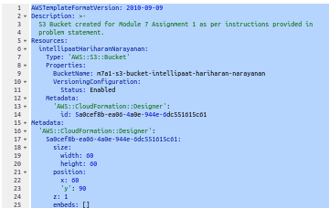
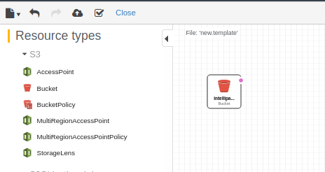
6. Select S3 from the left-pane
7. Select Bucket
9. Type out the template
Add Description, BucketName,
enable Versioning configuration
8. Type this YAMLconfiguration
12. Create resource
10. Validate syntax
11. Verify that S3 bucket is refelcted correctly in Designer window

Slide 4
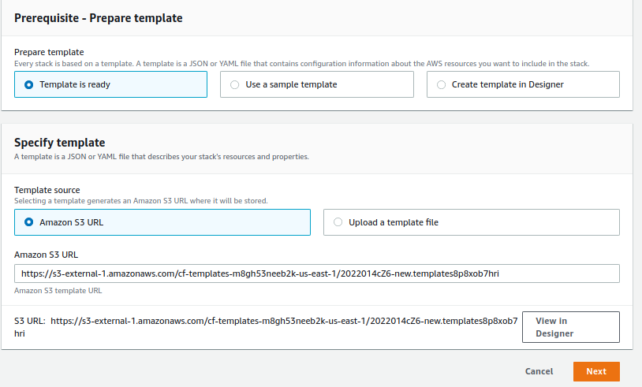
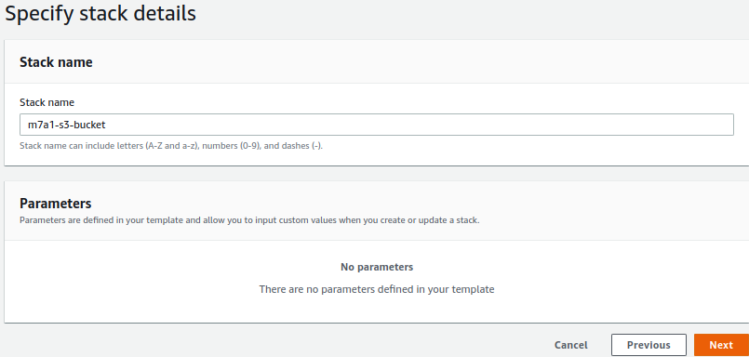
13. Ensure you are using template created in designer
14. Name the stack

Slide 5
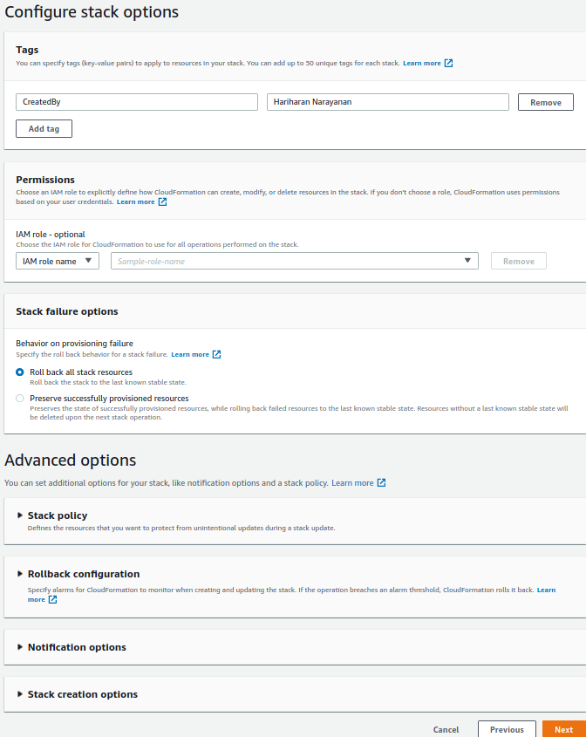
15. Add tags as needed and Finish

Slide 6
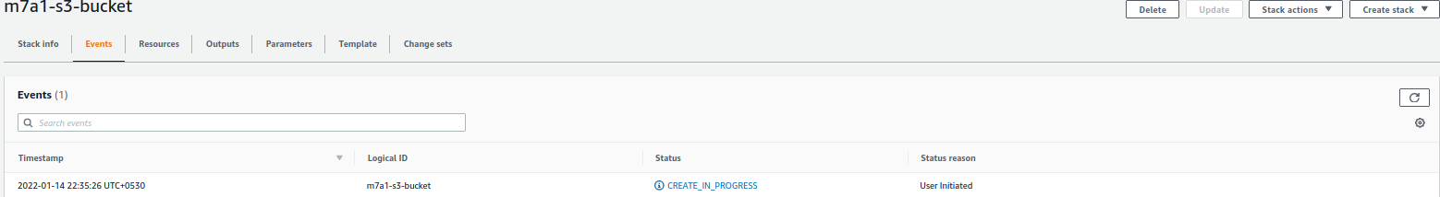
16. Verify that stack is created successfully

