Slide 1
Module 5: S3 Assignment - 3
You have been asked to:
Now, make the same bucket to be Static website host and upload an index.html and error.html page
Also, add a lifecycle rule for the bucket:
a. Transition from Standard to Standard-IA in 60 days
b. Expiration in 200 days

Slide 2
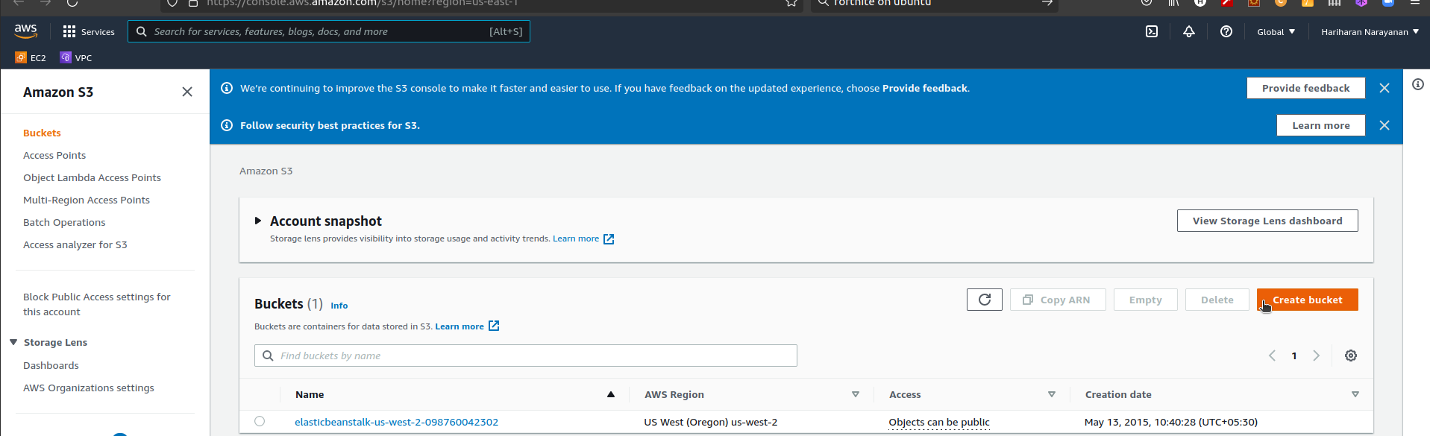
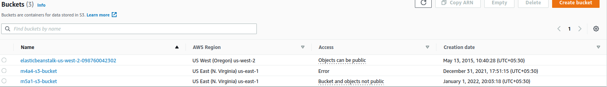
1. Type S3 in search bar. Open S3 dashboard
2. Note that region changes to Global
3. Select m5a1-s3-bucket

Slide 3
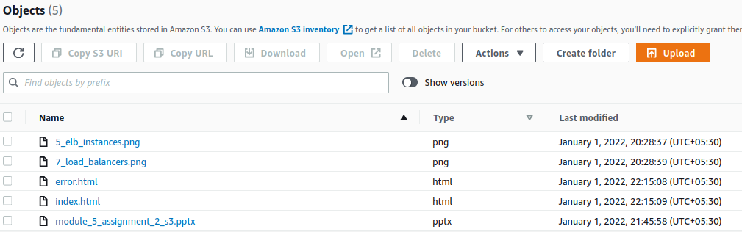
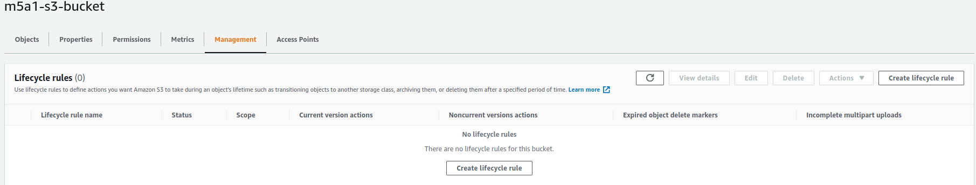
4. Upload index.html and error.html
5. Select bucket --> Management
6. Select lifecycle role

Slide 4
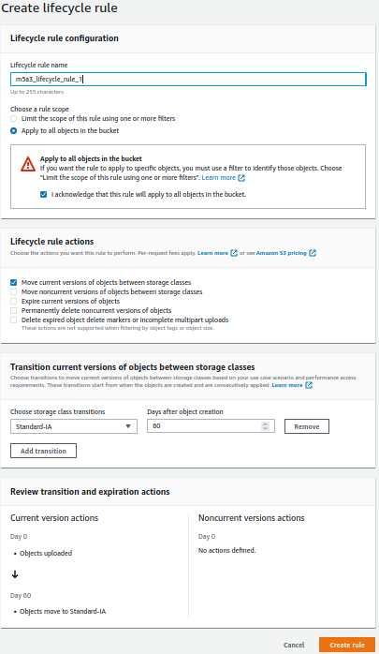
7. Give a name
8. Apply to all objects
9. Choose first option
10. Choose Standard-IA
11. Review and adjust
12. Create rule

Slide 5
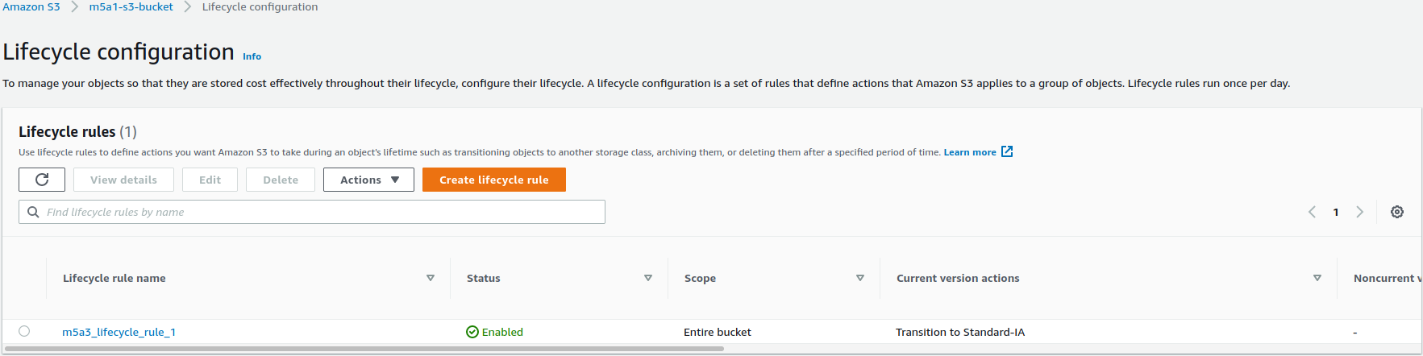
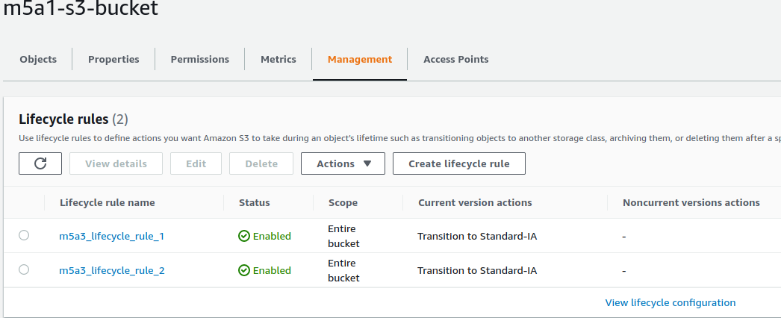
13. Verify rule created
14. Create a new rule.
Steps wil be similar to 7..12
Select expiration days to be 200
15. Verify both lifecycle rules are visible in S3 bucket

Slide 6
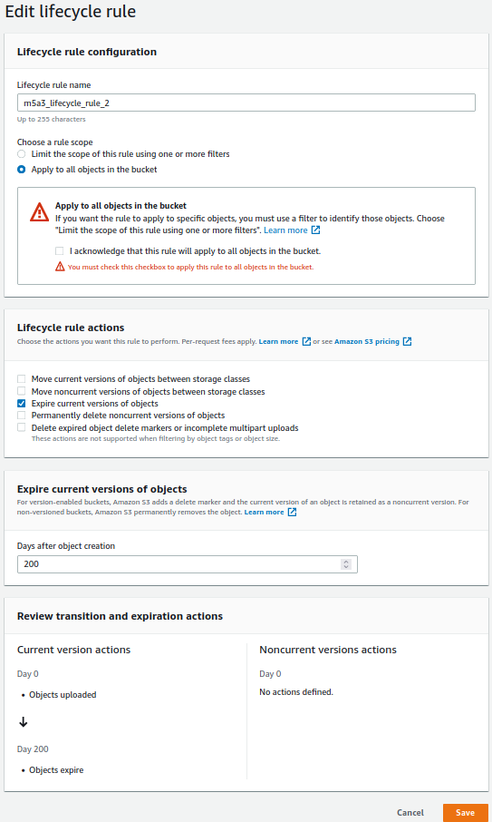
15. Give a name
16. Apply to all objects
17. Choose 3rd option
18. Choose 200 days
19. Review and adjust
20. Create rule

Slide 7
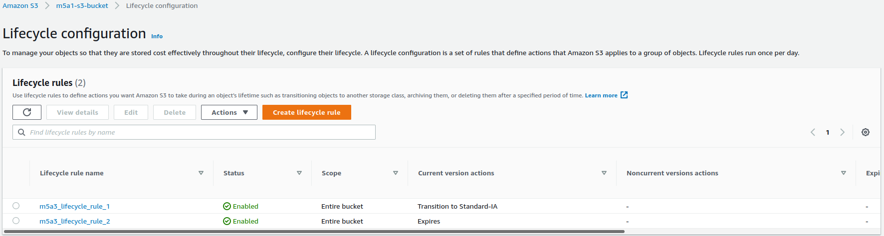
21. Verify both lifecycle rules are visible in S3 bucket

