Slide 1
Module-2: EC2 and EBS Assignment - 2
You have been asked to:
Launch a Linux EC2 instance
Create a EBS volume with 20 GB of storage and attach it the created EC2 instance
Resize the attached volume and make sure it reflects in the connected instance

Slide 2
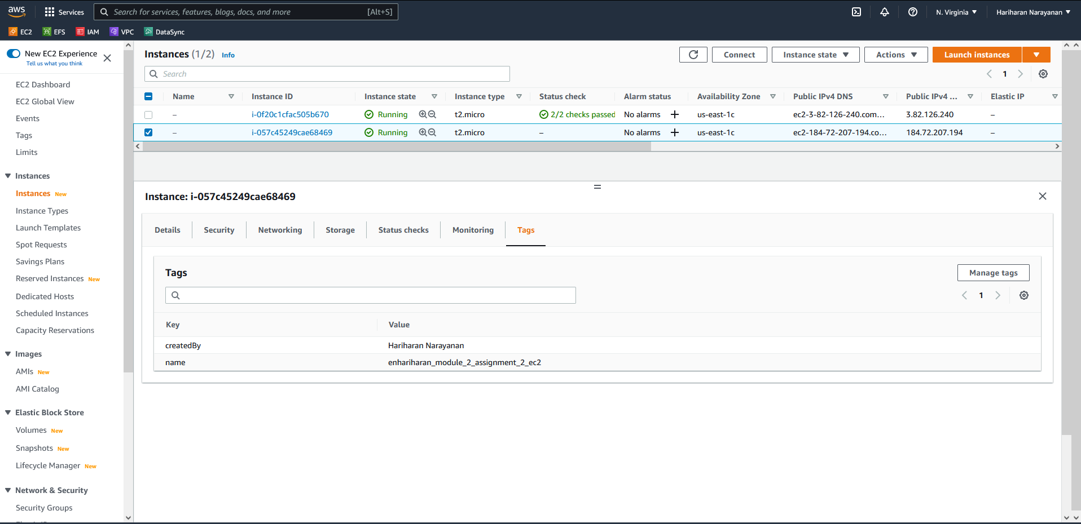
1. Use the same steps mentioned in module_2_assignment_1 to create a new EC2 instance
2. Open EBS Volumes view

Slide 3
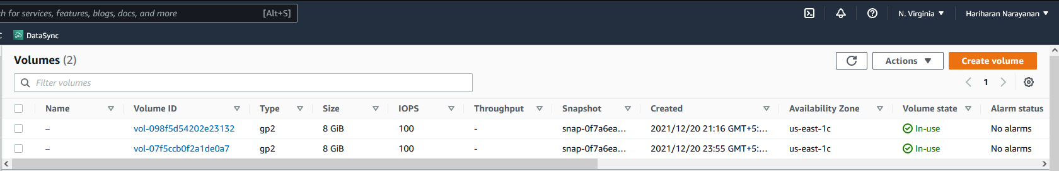
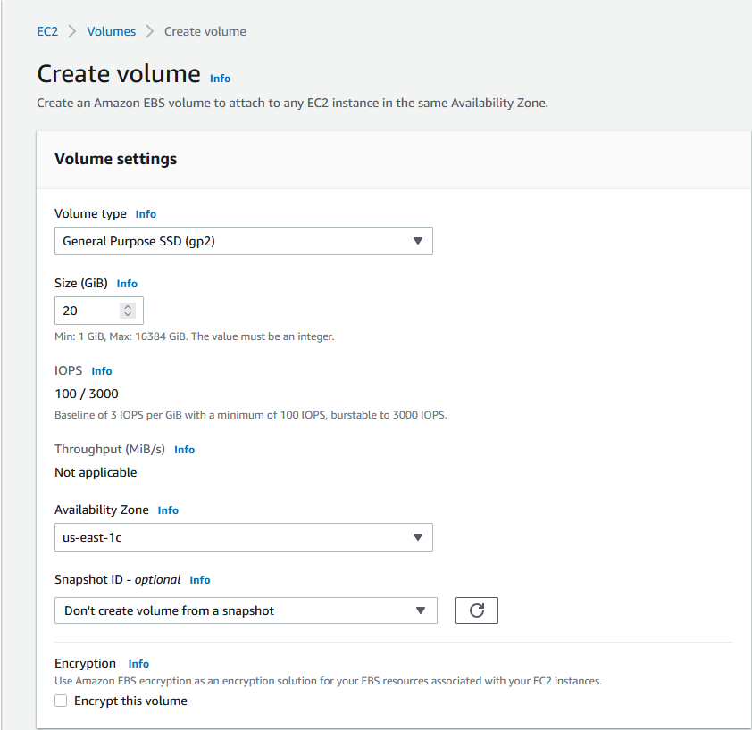
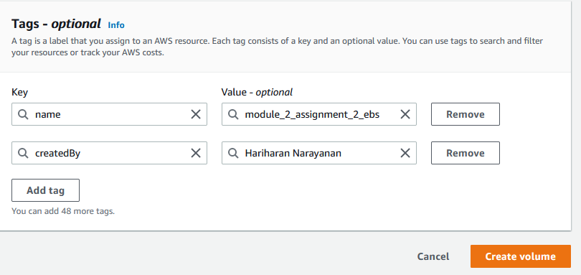
3. Select to create a Create volume
4. Set size to 20GiB
6. Create tags as needed
5. Ensure availability zone is same as the EC2 instance
7. Create volume

Slide 4
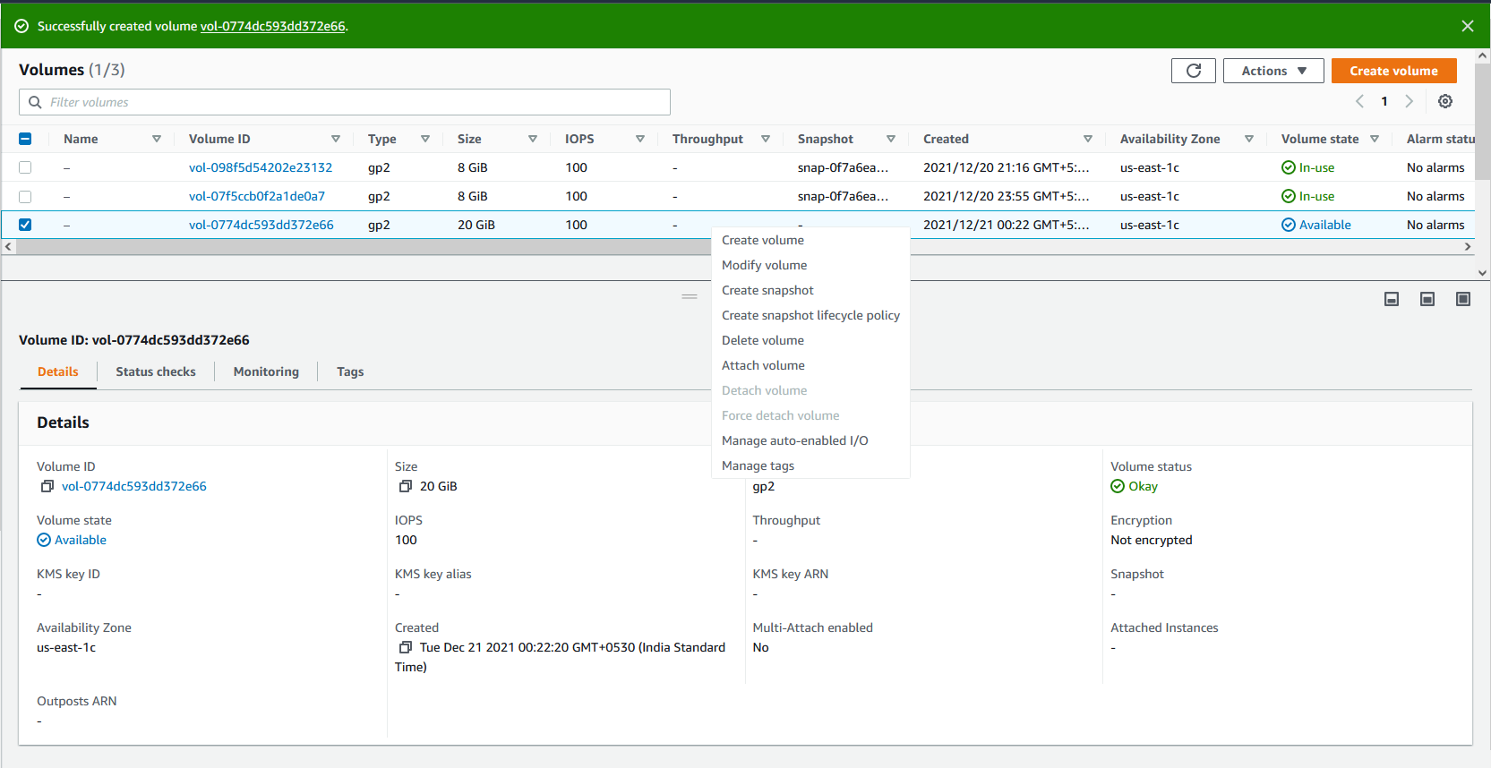
8. Verify that volume is visible in Volumes page and that AZ is same as the EC2 instance.
Wait until status becomes “Available”
9. Select to attach volume

Slide 5
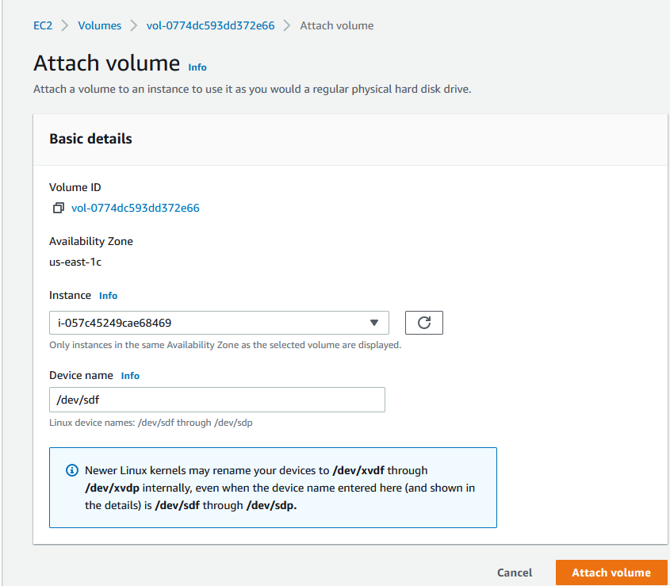
10. Select the EC2 instance created in step 1
11. Select to Attach volume

Slide 6
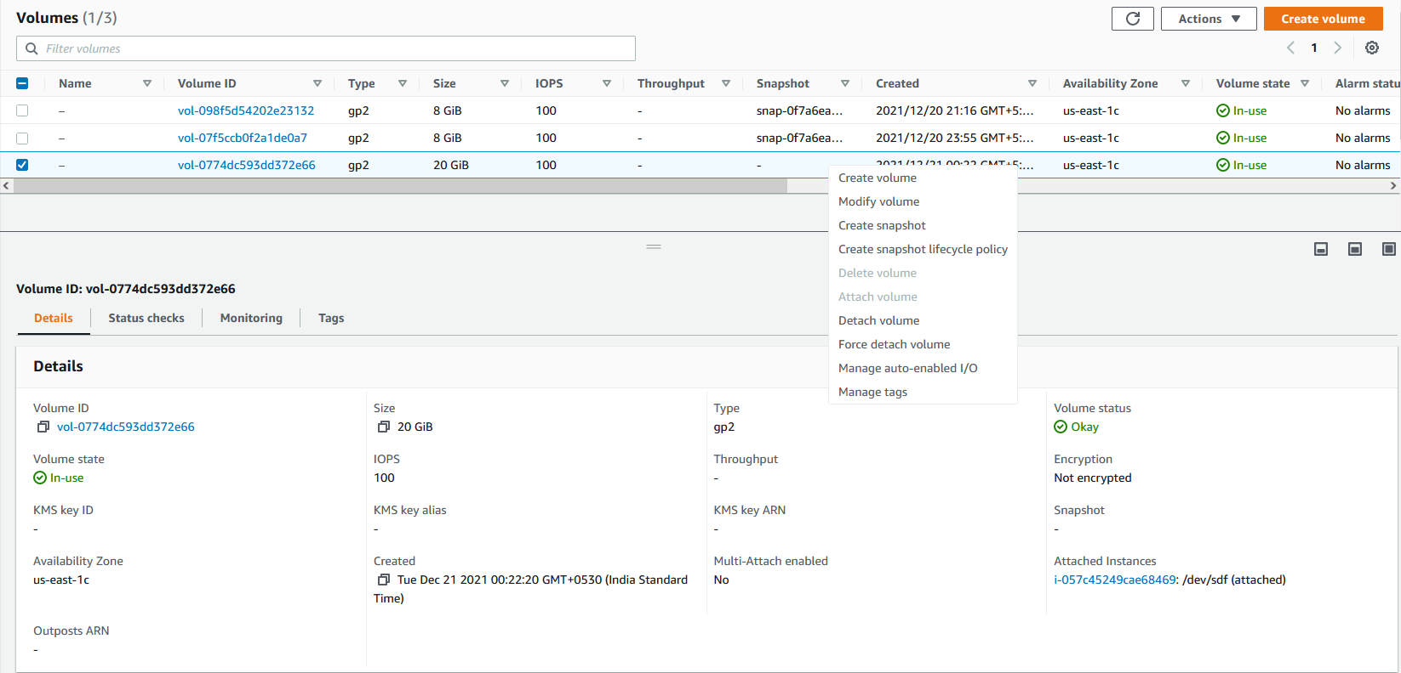
14. Select Modify Volume
12. In Volumes page, Select the attached volume
13. And verify that attached instance is visible here

Slide 7
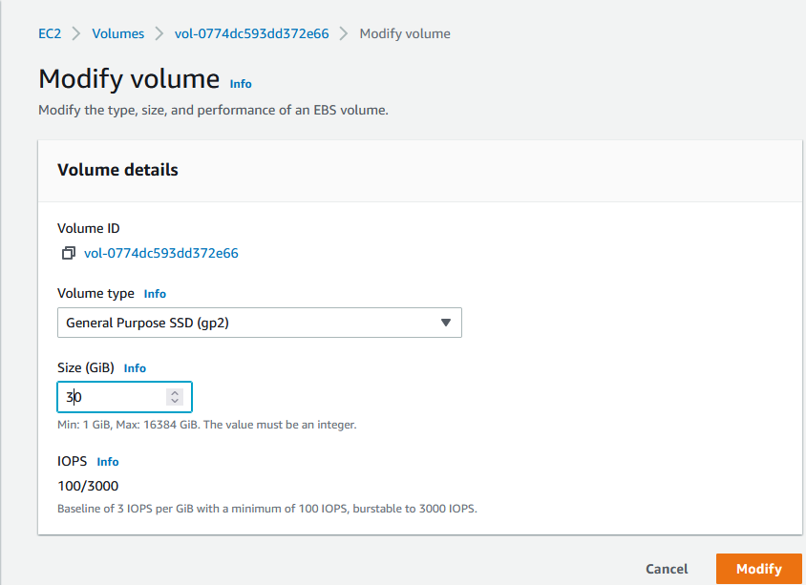
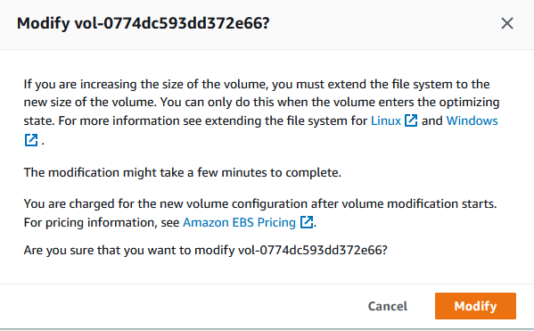
15. Resize Volume to 30 GiB
16. Click on Modify
17. Click on Modify

Slide 8
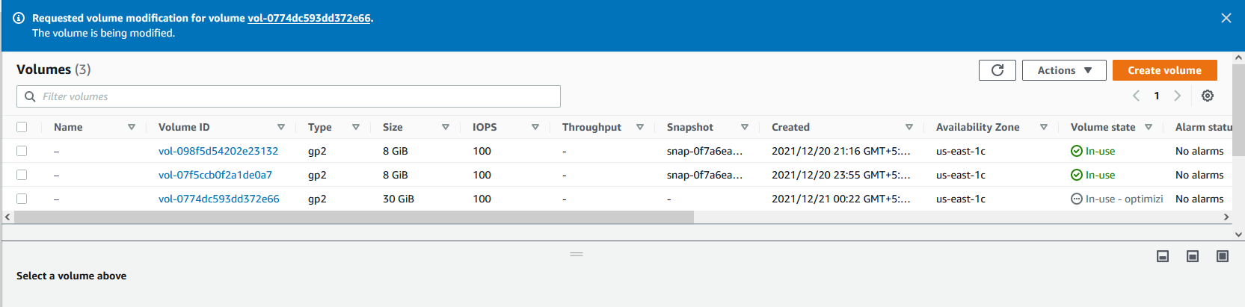
18. In Volumes view verify that size has changed to 30 GiB. Wait until “Volume state” becomes “Available”

