Slide 1
Module 4: VPC Assignment - 4
You have been asked to:
Create a VPC Endpoint for an S3 bucket of your choice

Slide 2
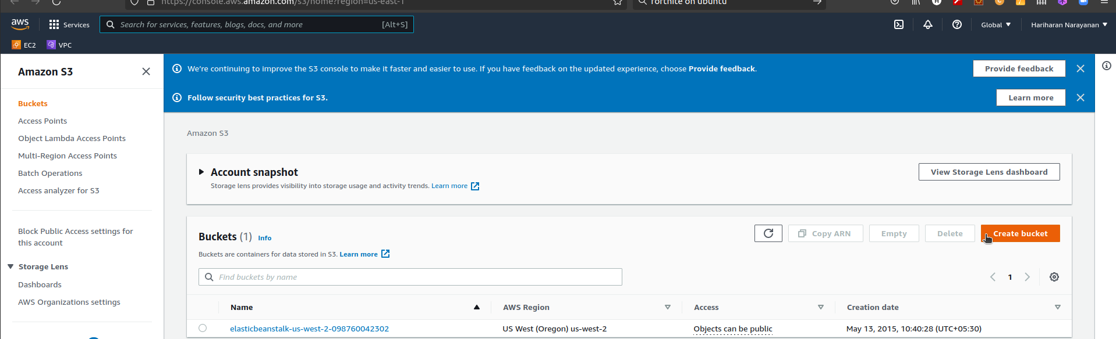
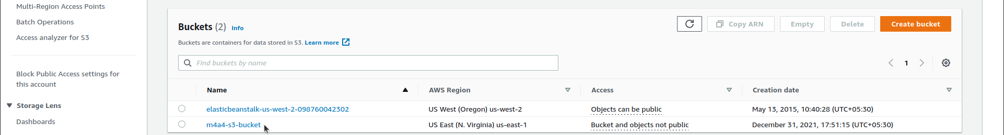
1. Type S3 in search bar. Open S3 dashboard
2. Note that region changes to Global
3. Create bucket
4. Verify new S3 bucket in dashboard

Slide 3
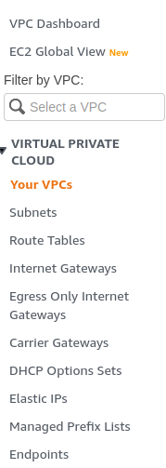

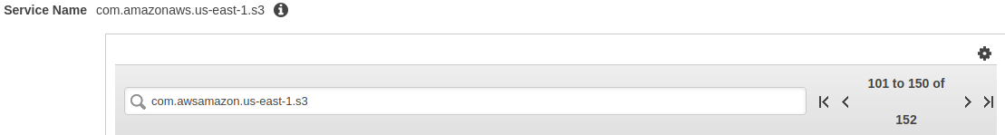
5. Create a VPC
7. Select AWS Service
8. Search & select com.awsamazon.us-east-1.s3 gateway
9. Select the VPC created earlier
6. Select to create an endpoint

Slide 4
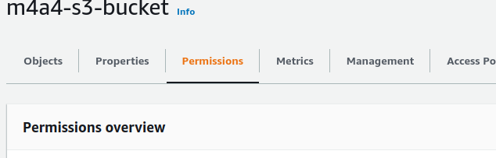
11. Click on the bucket and open details
10. Created endpoint must be visible in Endpoints dashboard
12. View permissions
13. Edit bucket policy

Slide 5
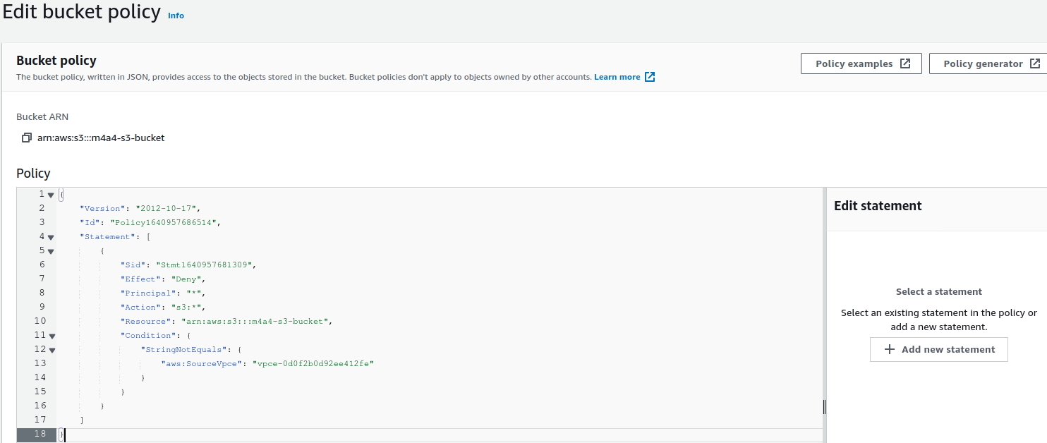
14. Replace existing policy with above text in Policy editor and save changes

