Slide 1
Module 9 Assignment 1: Lambda
You have been asked to:
Create a sample Python Lambda function
Set the Lambda Trigger as SQS and send msg to test invocations

Slide 2
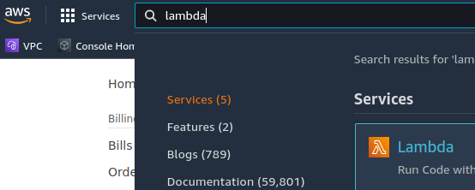
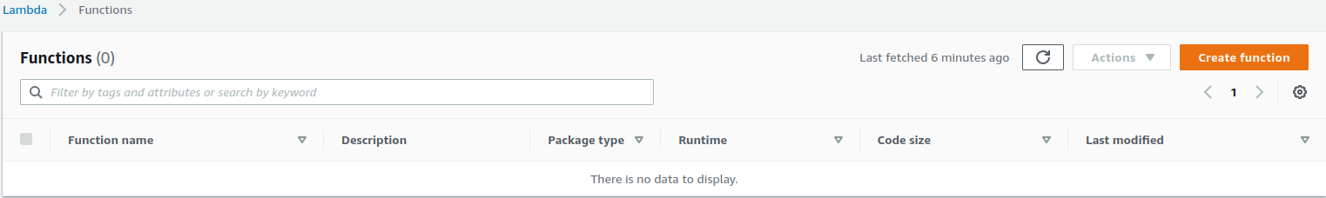
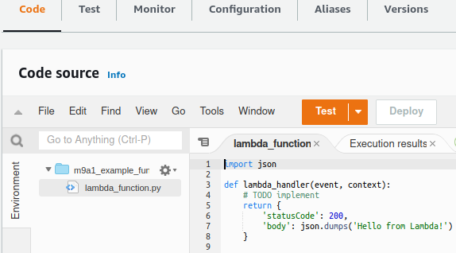
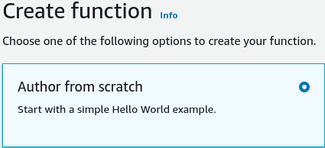
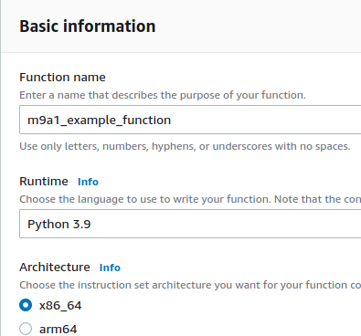
2
1
3
5
1. Open AWS Console. Search for “Lambda”. Open Lambda console.
2. Select “Create function”
3. Select “Author from scratch”
4. Type function name, select “Python 3.9”. Leave other values as it is
5. Enter the code in the editor
6. Click on “Add trigger”
6
4

Slide 3
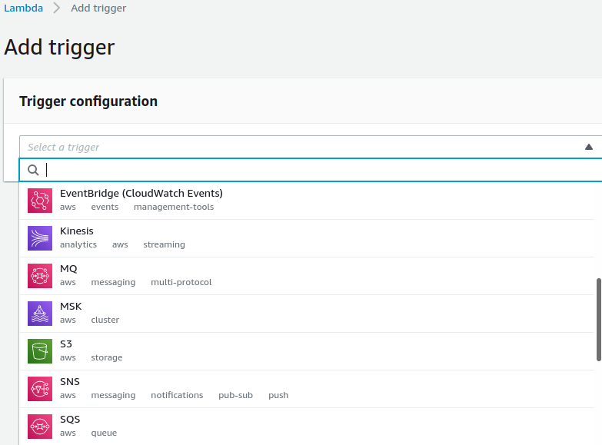
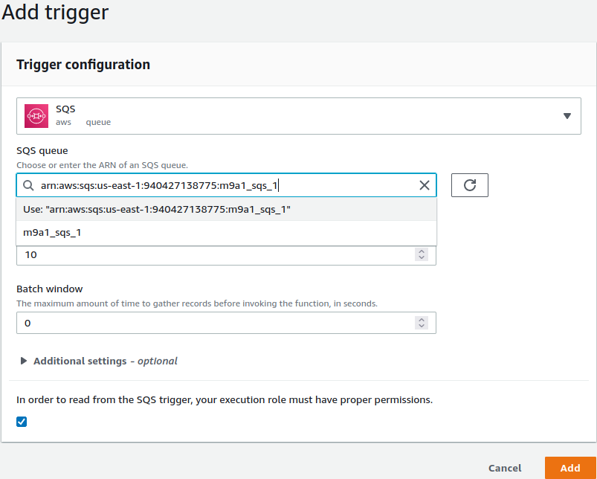
6
7
8
6. Click on “Add trigger”
7. Select SQS for Trigger configuration
8. Select the ARN of the SQS entity already created for this assignment in SQS console. Click “Add”

Slide 4
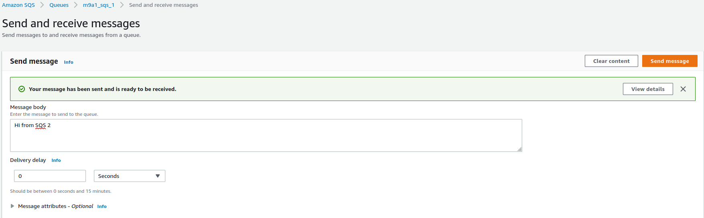
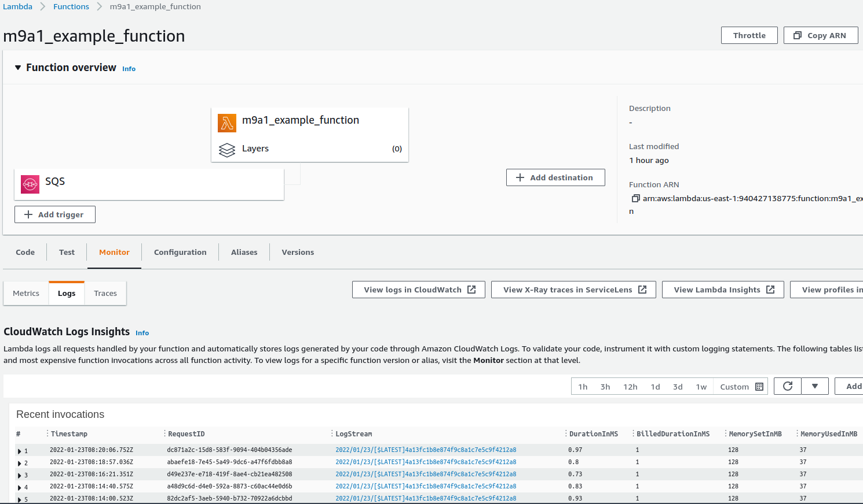
9
9. In the SQS console, choose the configured SQS and select “Send message”
10. In the Lambda console, verify from “Logs” that the SQS message indeed triggered the Lambda
10

