Slide 1
Module – 3: Docker – I Assignment – 3
You have been asked to:
Use the saved image in the previous assignment
Upload this image on Dockerhub
On a separate machine pull this dockerhub image, and launch it on port 80
Start the apache2 service
Verify if you are able to see the apache2 service

Slide 2
$ sudo apt remove -y docker docker-enginr docker.io containerd runc
$ sudo apt update
$ sudo apt install -y ca-certificates curl gnupg lsb-release
$ sudo apt autoremove -y
$ curl -fsSL https://download.docker.com/linux/ubuntu/gpg | sudo gpg --dearmor -o /usr/share/keyrings/docker-archive-keyring.gpg
$ sudo apt update
$ sudo apt install -y docker-ce docker-ce-cli containerd.io
$ sudo docker run hello-world
Unable to find image 'hello-world:latest' locally
latest: Pulling from library/hello-world
2db29710123e: Pull complete
Digest: sha256:97a379f4f88575512824f3b352bc03cd75e239179eea0fecc38e597b2209f49a
Status: Downloaded newer image for hello-world:latest
Hello from Docker!
This message shows that your installation appears to be working correctly.
01
Install Docker on Ubuntu using commands as shown

Slide 3
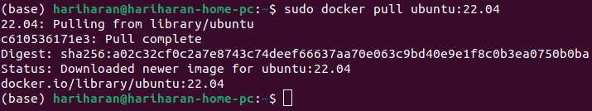
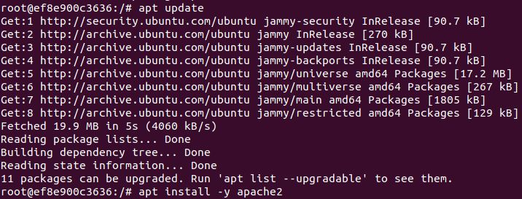
02
03
04
2. Pull Ubuntu Docker container
3. Run it with port 80 of container mapped to port 80 of local
4. Install apache within the container

Slide 4
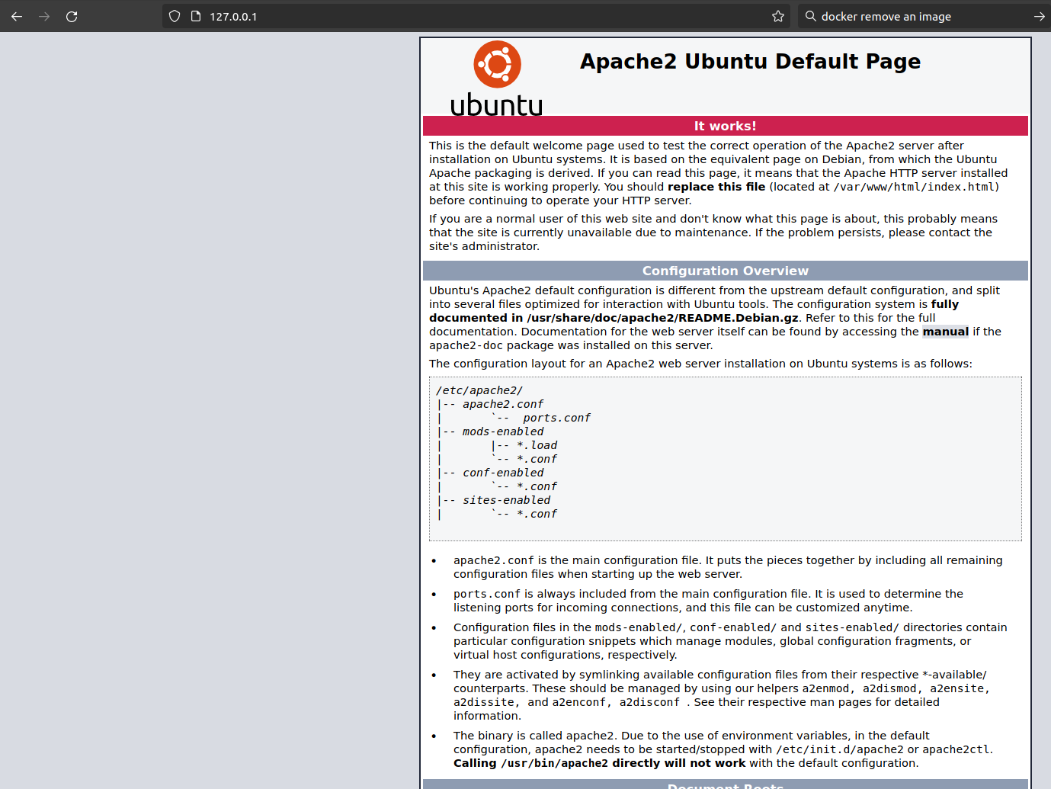
05
06
5. Check staus of apache2 service and Start it if not already started
6. Now, from out of the container, open http://127.0.0.1 in a browser. You should see the Apache2 default page.
This confirms that apache2 webserver is...
Running in the container
Publishing to port 80 in the contianer
Container port 80 is mapped to port 80 on host machine

Slide 5

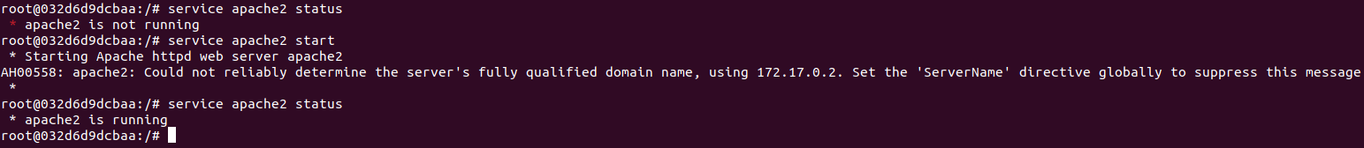
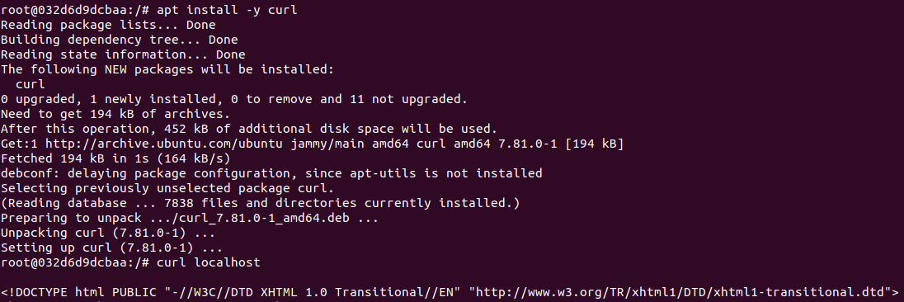
07
08
09
7. Exit the container, note the container-id, and commit this container with a new name “ubuntu_with_apache2”
8. Run the new container “ubuntu_with_apache2” with publishing the container’s port 80 as port 81 on the host machine
9. Start apache2 service in the container and verify that it is running
10. Verify that port 80 within container opens the default apache2 webpage
10

Slide 6
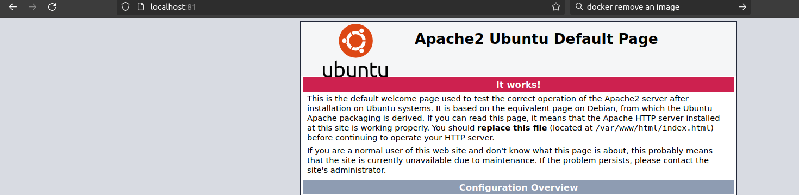
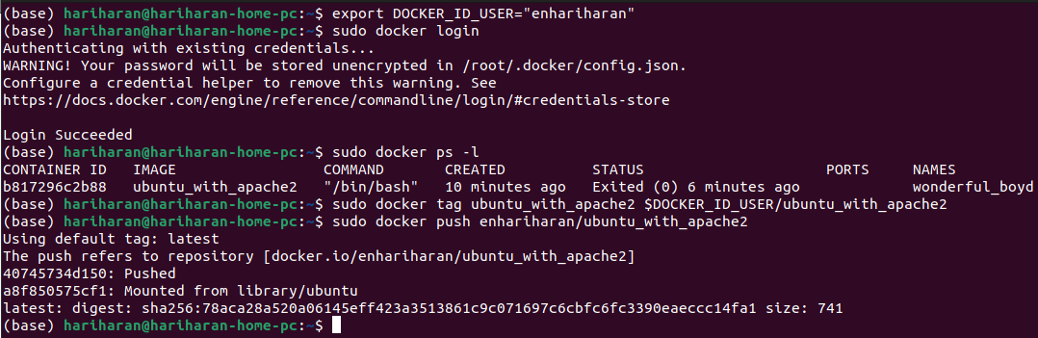
11
12
11. Open http://localhost:81 on host machine and verify that the default apache2 web page hosted within the container started in 10 is served in the host machine throughport 81
12. Tag this image, login into dockerhub, and upload this image to dockerhub

Slide 7
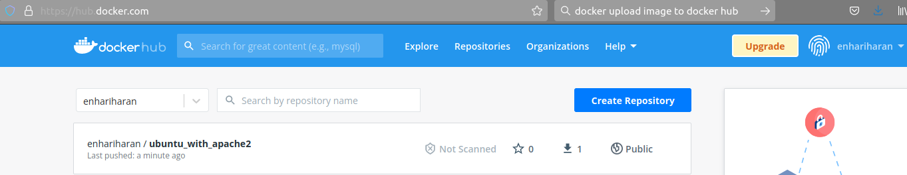
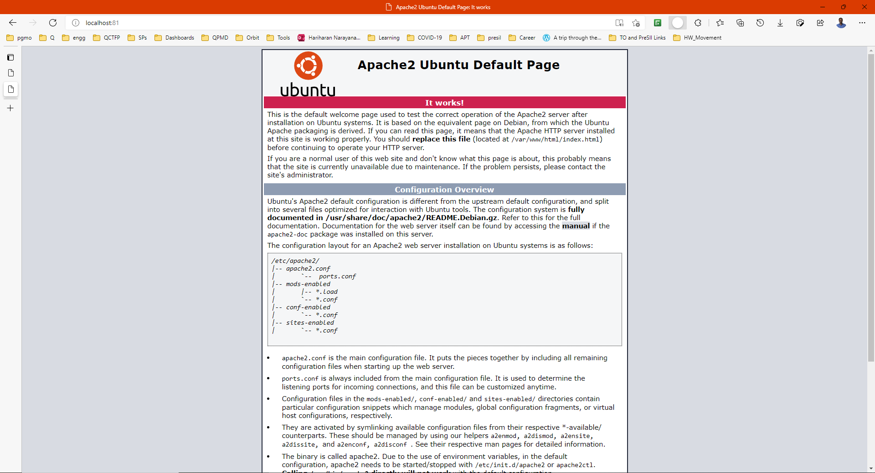
13
14
13. Login into dockerhub using the browser and verify that image is uploaded correctly
14. I opened my work laptop running Windows 11, docnloaded Docker Desktop, logged in into Dockerhub using Docker Desktop, pulled this image in (13) and ran it with port 80 of container mapped to port 81 of host. Finally, opened the browser to http://localhost:81 to verify that default Apache page is shown

