Slide 1
Module-2: GIT Assignment - 2
Do the following tasks:
Create a git working directory with feature1.txt and feature2.txt in the master branch
Create 3 branches develop, feature1 and feature2
In develop branch create develop.txt, do not stage or commit it
Stash this file, and checkout to feature1 branch
Create new.txt file in feature1 branch, stage and commit this file
Checkout to develop, unstash this file and commit
Please submit all the git commands used to do the above steps

Slide 2
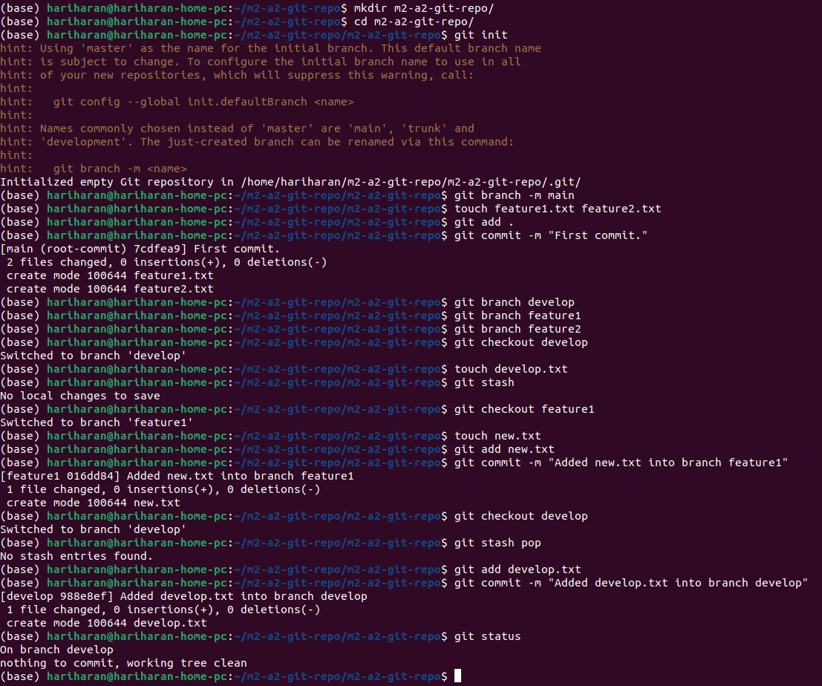
01
1. Execute the commands in the order as typed to achieve the outcomes of this assignment.
Please note that in the “git stash” command there will be no file stashed since the file “develop.txt” was noit staged/added beforehand.
Likewise, “git stash pop” will not return anytthing since the file was not stashed.

