Slide 1
Module-2: GIT Assignment - 1
Based on what you have learnt in the class, do the following steps:
Create a new folder
Put the following files in the folder
  Code.txt
  Log.txt
  Output.txt
Stage the Code.txt and Output.txt files
Commit them
And finally push them to github
Please share the commands for the above points

Slide 2
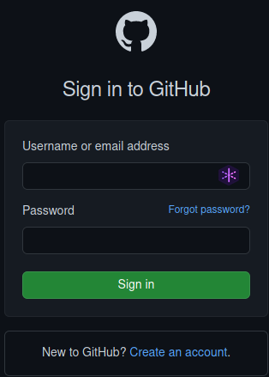
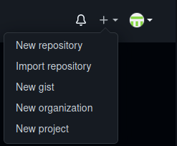
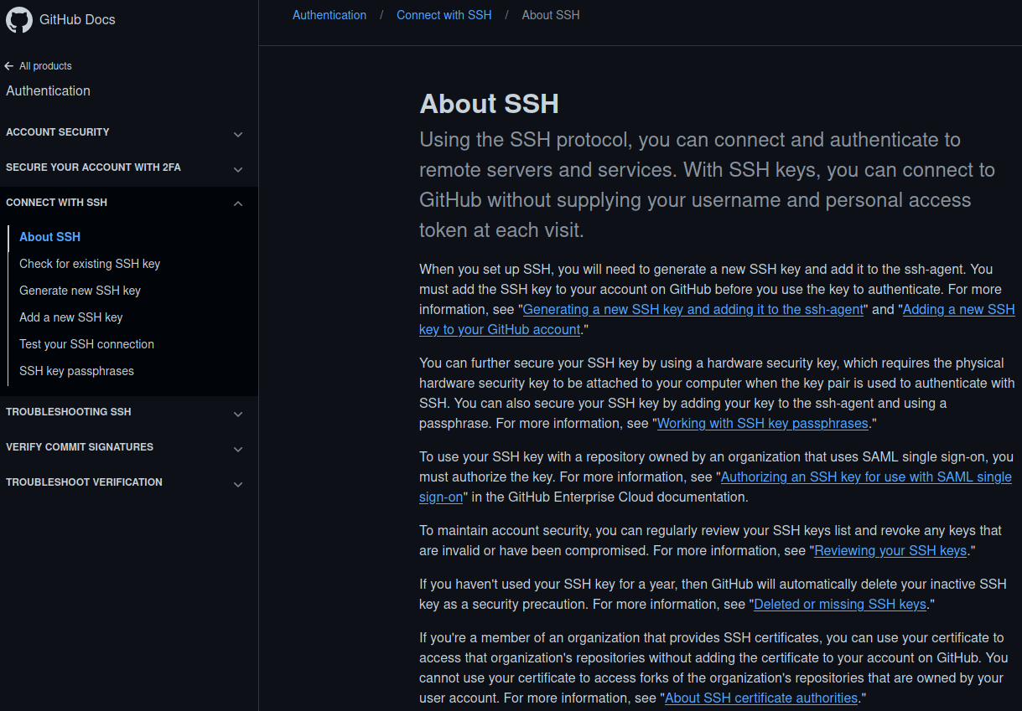
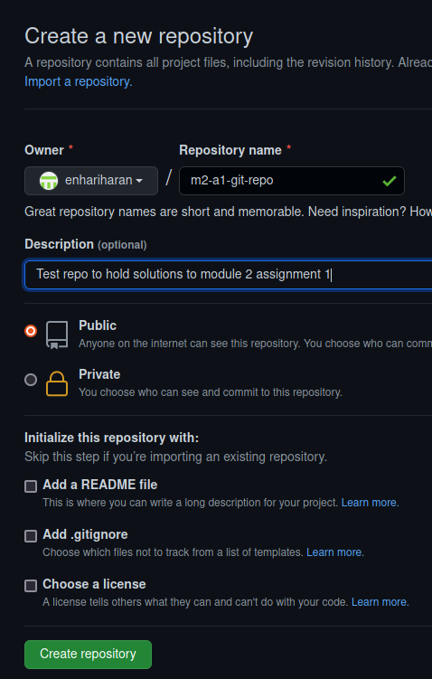
01
02
03
04
1. Go to https://github.com/login and login into GitHub
2. Select “New Repository”
3. Name the new repo “m2-a1-git-repo”. Keep it Public. Click on “Create repository”.
4. Go to https://docs.github.com/en/authentication/connecting-to-github-with-ssh/about-ssh and create SSH keys to do SSH logins into GitHub.

Slide 3
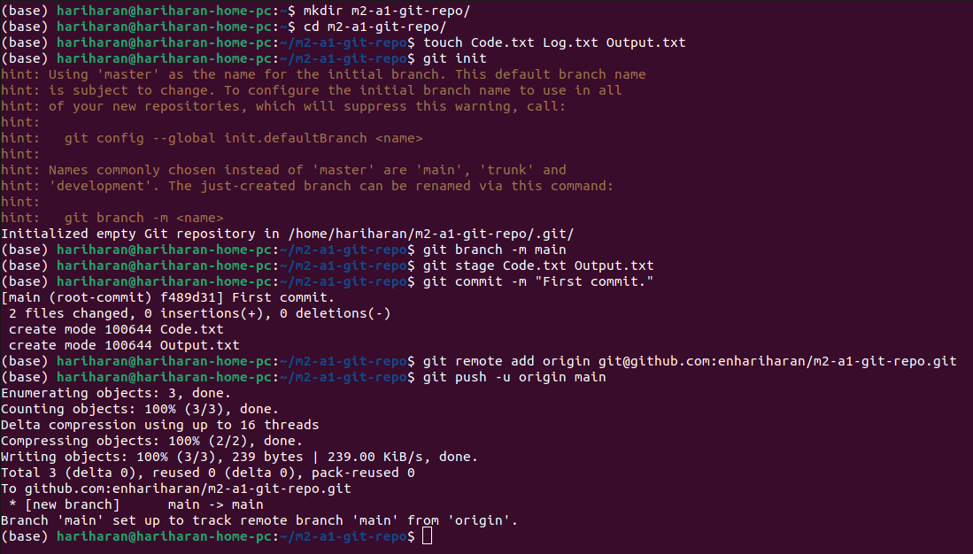
05
5. Execute the commands in the order shown to:
a. Create a new directory “m2-a1-git-repo” and go into it
b. Create empty files “Code.txt”, “Log.txt”, and “Output.txt”
c. Initialize a Git repository in this directory
d. Rename the default “master” branch created to “main”
e. Stage the files “Code.txt” and “Output.txt”
f. Commit them
g. Create a remote “origin” that points to the GitHub repository created in (3)
h. And finally push the local repo to github

Slide 4
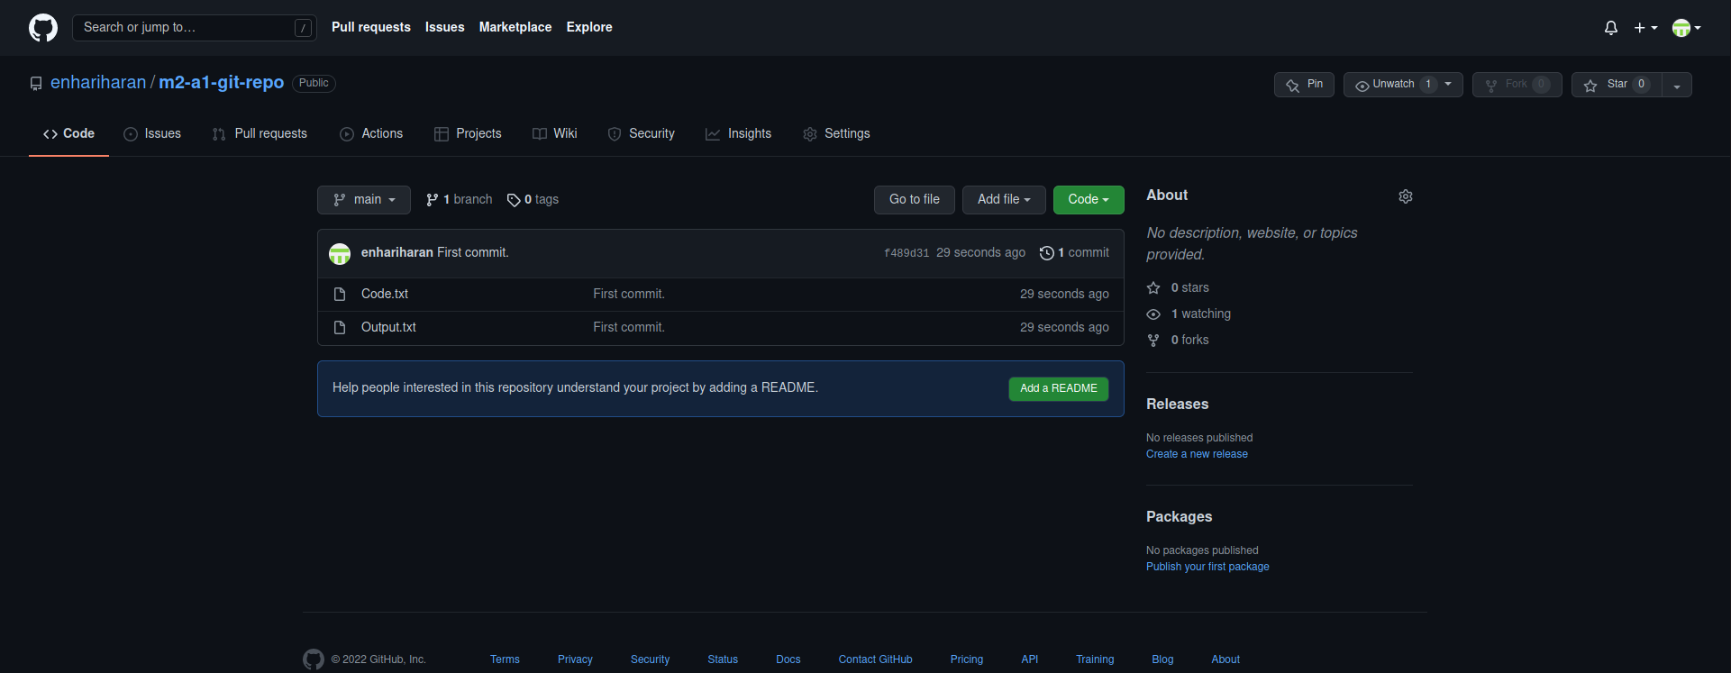
06
6. Refresh the repo in Github to verify that the files were pushed correctly.

