Slide 1
Module-2: GIT Assignment - 3
You have been asked to:
Create a git working directory, with the following branches
  Develop
  F1
  f2
In the master branch, commit main.txt file
Put develop.txt in develop branch, f1.txt and f2.txt in f1 and f2 respectively
Push all these branches to github
On local delete f2 branch
Delete the same branch on github as well

Slide 2
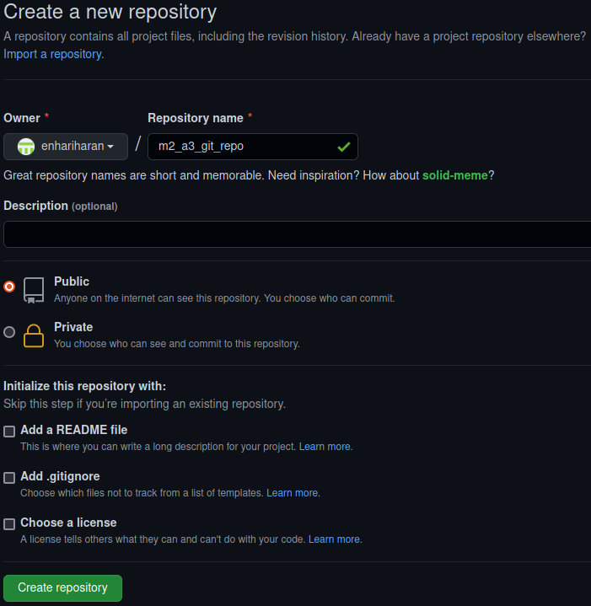
01
1. Create this repo in GitHub – “m2-a3-git-repo.git”

Slide 3
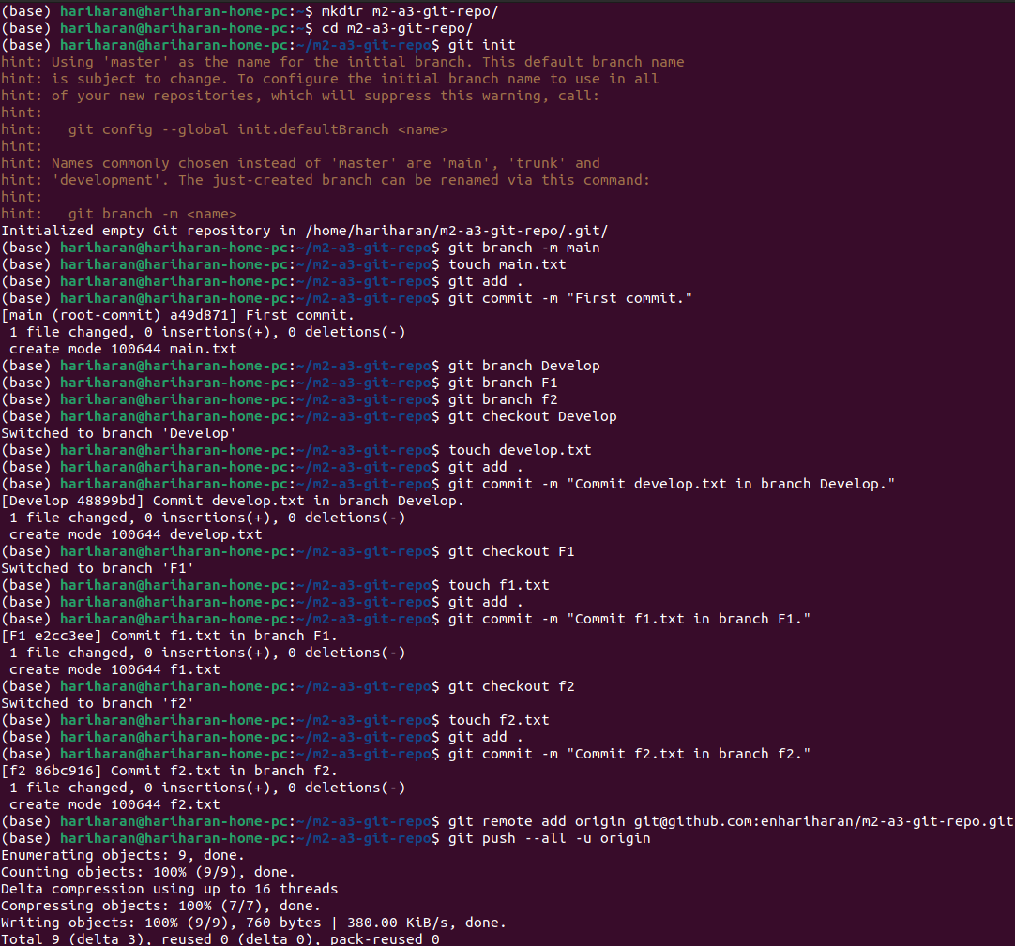
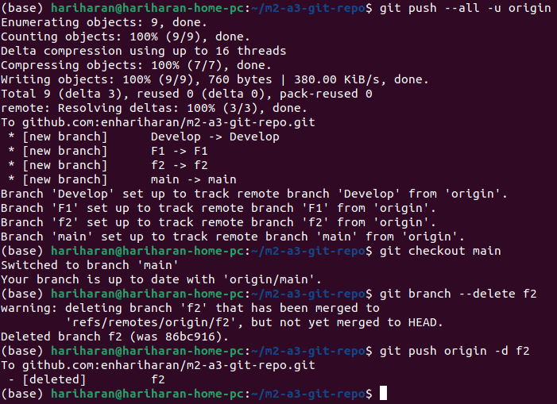
03
02
2 and 3. Execute the commands in order to achieve the outcomes of this assignment.

Slide 4
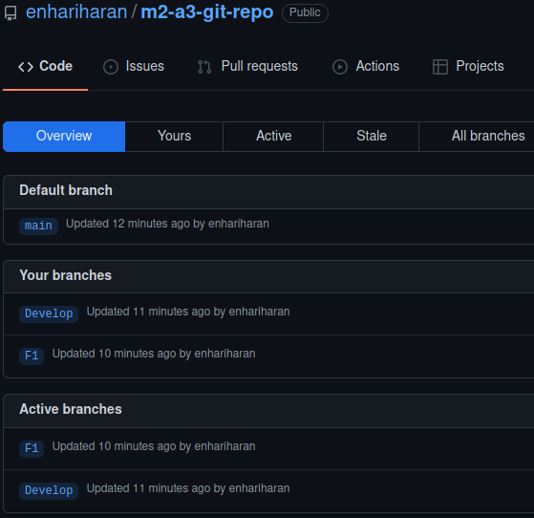
04
4. Got to Github to verify that the branch “f2” is deleted while other branches “Develop” and “F1” are intact.

