Slide 1
Module – 3: Docker – I Assignment – 4
You have been asked to:
Create a dockerfile with the following specs:
Ubuntu container
Apache2 installed
Apache2 should automatically run once the container starts
Submit the dockerfile, for assignment completion

Slide 2
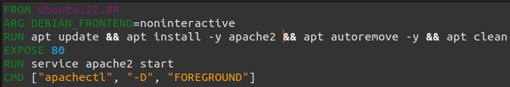
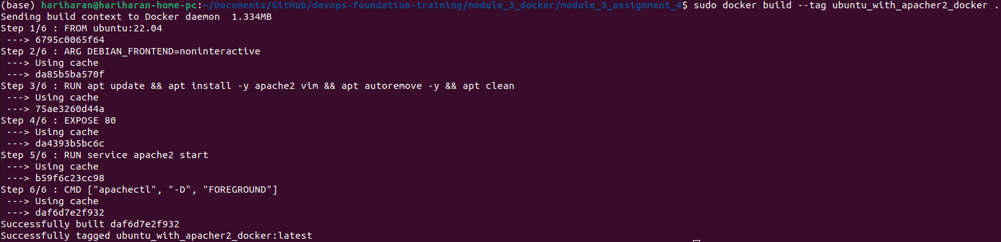
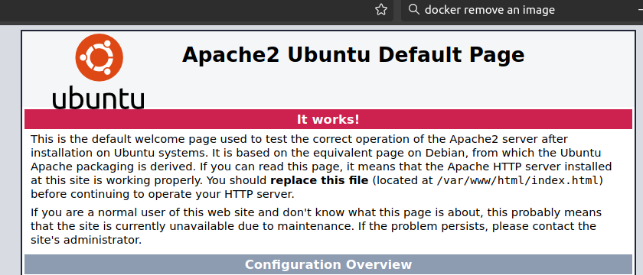
01
02
03
Prepare this Dockerfile
Build the Dockerfile. This will take some time.
Run the Docker container in detached mode with command to start apache2 service in foreground
In the hot maching, open the browser and point to http://localhost:82 and the default apache2 page must be shown.

