Slide 1
Module-2: GIT Assignment - 4
You have been asked to:
Put master.txt on master branch, stage and commit
Create 3 branches: public1, public2 and private
Put public1.txt on public 1 branch, stage and commit
Merge public 1 on master branch
Merge public 2 on master branch
Edit master.txt on private branch, stage and commit
Now update branch public 1 and public 2 with new master code in private
Also update new master code on master
Finally update all the code on the private branch

Slide 2
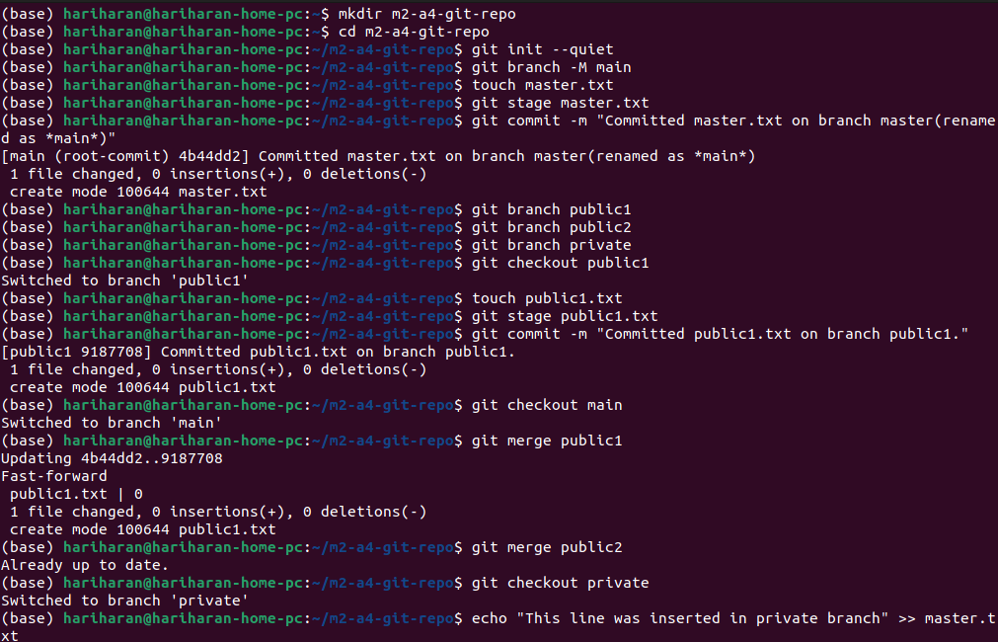
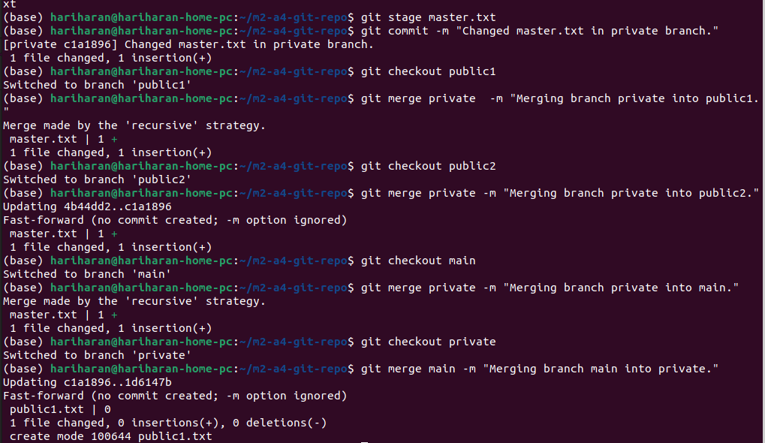
01
02
1 and 2. Execute the commands in the order provide to achieve the outcomes of this assignment.

