Slide 1
Module – 3: Docker – I Assignment – 5
You have been asked to:
Create a sample HTML file
Use the Dockerfile from the previous task
Replace this sample HTML file inside the docker container with the default page

Slide 2
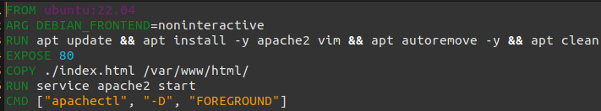
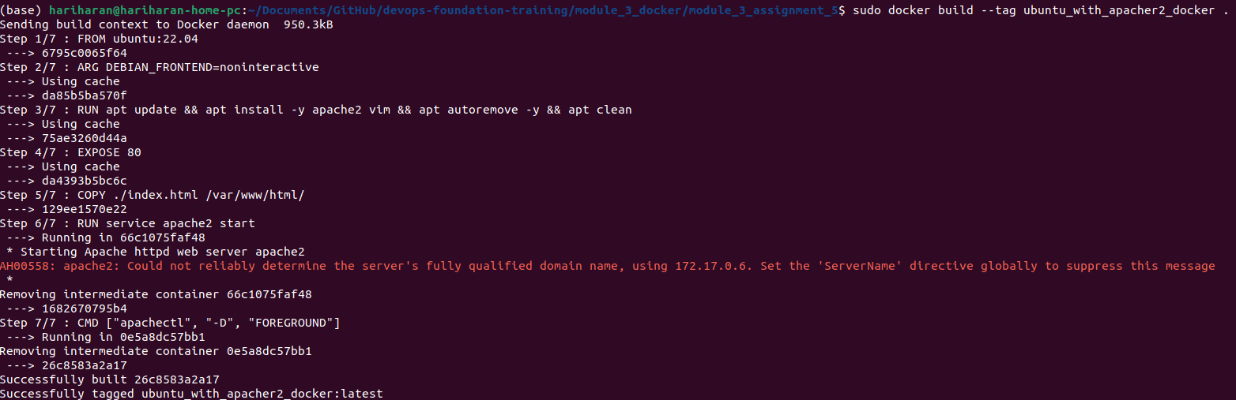

01
02
Prepare this Dockerfile
Build the Dockerfile. This will take some time.
Run the Docker container in detached mode with command to start apache2 service in foreground
In the hot maching, open the browser and point to http://localhost:90 and the default apache2 page must be shown.
03
04

