Slide 1
Module – 3: Docker – I Assignment – 2
You have been asked to:
Save the image created in Assignment 1 as a Docker image
Launch container from this new image and map the port to 81
Go inside the container and start the apache2 service
Check if you are able to access it on the browser

Slide 2
$ sudo apt remove -y docker docker-enginr docker.io containerd runc
$ sudo apt update
$ sudo apt install -y ca-certificates curl gnupg lsb-release
$ sudo apt autoremove -y
$ curl -fsSL https://download.docker.com/linux/ubuntu/gpg | sudo gpg --dearmor -o /usr/share/keyrings/docker-archive-keyring.gpg
$ sudo apt update
$ sudo apt install -y docker-ce docker-ce-cli containerd.io
$ sudo docker run hello-world
Unable to find image 'hello-world:latest' locally
latest: Pulling from library/hello-world
2db29710123e: Pull complete
Digest: sha256:97a379f4f88575512824f3b352bc03cd75e239179eea0fecc38e597b2209f49a
Status: Downloaded newer image for hello-world:latest
Hello from Docker!
This message shows that your installation appears to be working correctly.
01
Install Docker on Ubuntu using commands as shown

Slide 3
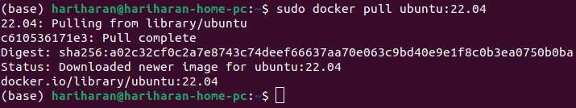
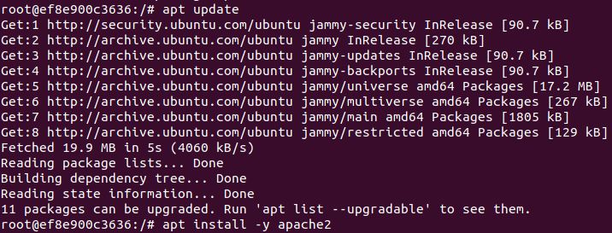
02
03
04
2. Pull Ubuntu Docker container
3. Run it with port 80 of container mapped to port 80 of local
4. Install apache within the container

Slide 4
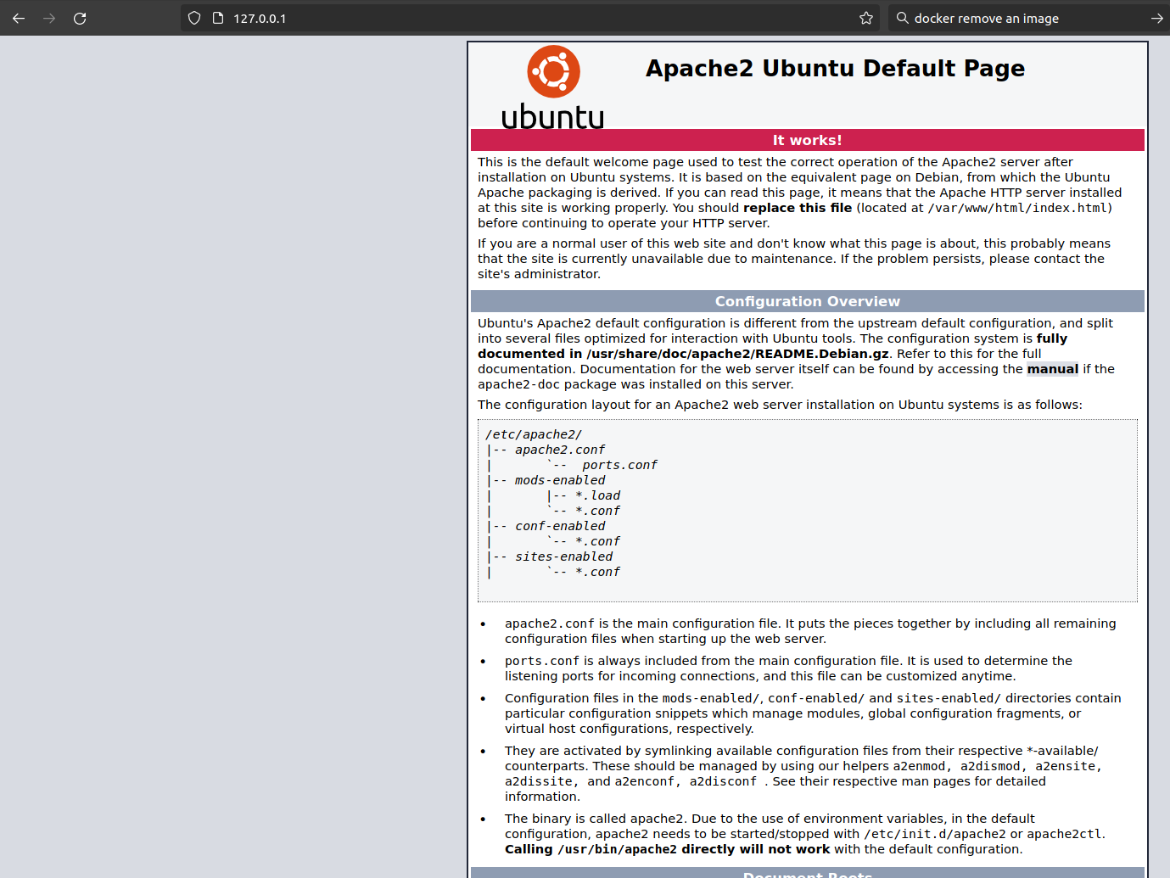
05
06
5. Check staus of apache2 service and Start it if not already started
6. Now, from out of the container, open http://127.0.0.1 in a browser. You should see the Apache2 default page.
This confirms that apache2 webserver is...
Running in the container
Publishing to port 80 in the contianer
Container port 80 is mapped to port 80 on host machine

Slide 5

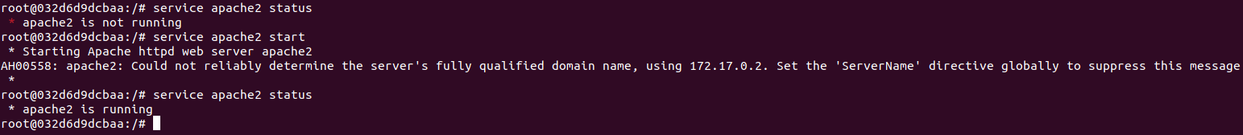
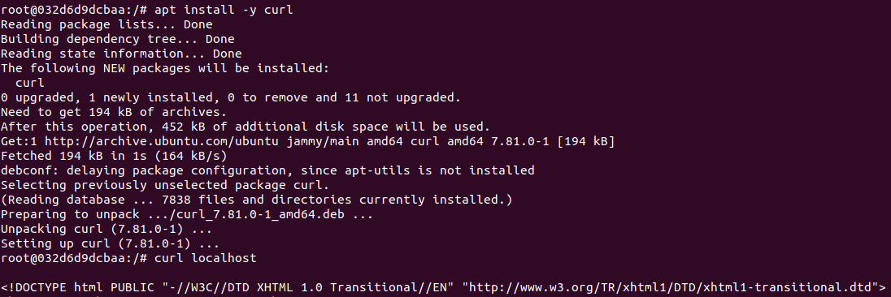
07
08
09
7. Exit the container, note the container-id, and commit this container with a new name “ubuntu_with_apache2”
8. Run the new container “ubuntu_with_apache2” with publishing the container’s port 80 as port 81 on the host machine
9. Start apache2 service in the container and verify that it is running
10. Verify that port 80 within container opens the default apache2 webpage
10

Slide 6
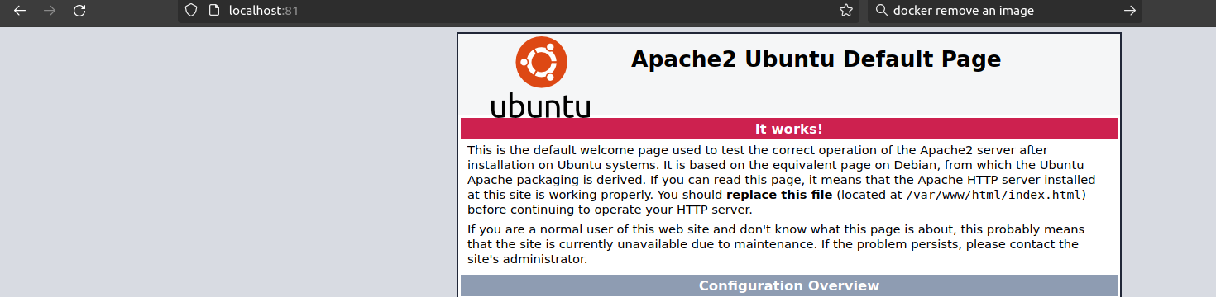
11
11. Open http://localhost:81 on host machine and verify that the default apache2 web page hosted within the container started in 10 is served in the host machine throughport 81

