Slide 1
Module-3: Docker – I Assignment - 1
You have been asked to:
Pull ubuntu container
Run this container, and map port 80 on the local
Install apache2 on this container
Check if you are able to access the apache page on your browser

Slide 2
$ sudo apt remove -y docker docker-enginr docker.io containerd runc
$ sudo apt update
$ sudo apt install -y ca-certificates curl gnupg lsb-release
$ sudo apt autoremove -y
$ curl -fsSL https://download.docker.com/linux/ubuntu/gpg | sudo gpg --dearmor -o /usr/share/keyrings/docker-archive-keyring.gpg
$ sudo apt update
$ sudo apt install -y docker-ce docker-ce-cli containerd.io
$ sudo docker run hello-world
Unable to find image 'hello-world:latest' locally
latest: Pulling from library/hello-world
2db29710123e: Pull complete
Digest: sha256:97a379f4f88575512824f3b352bc03cd75e239179eea0fecc38e597b2209f49a
Status: Downloaded newer image for hello-world:latest
Hello from Docker!
This message shows that your installation appears to be working correctly.
01
Install Docker on Ubuntu using commands as shown

Slide 3
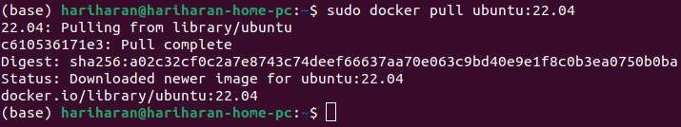
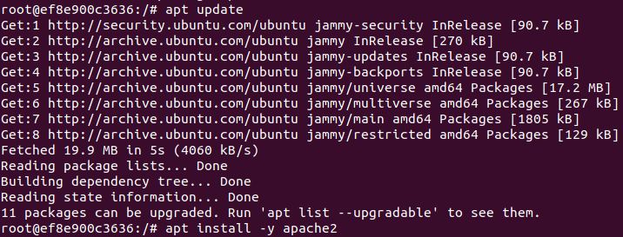
02
03
04
2. Pull Ubuntu Docker container
3. Run it with port 80 of container mapped to port 80 of local
4. Install apache within the container

Slide 4
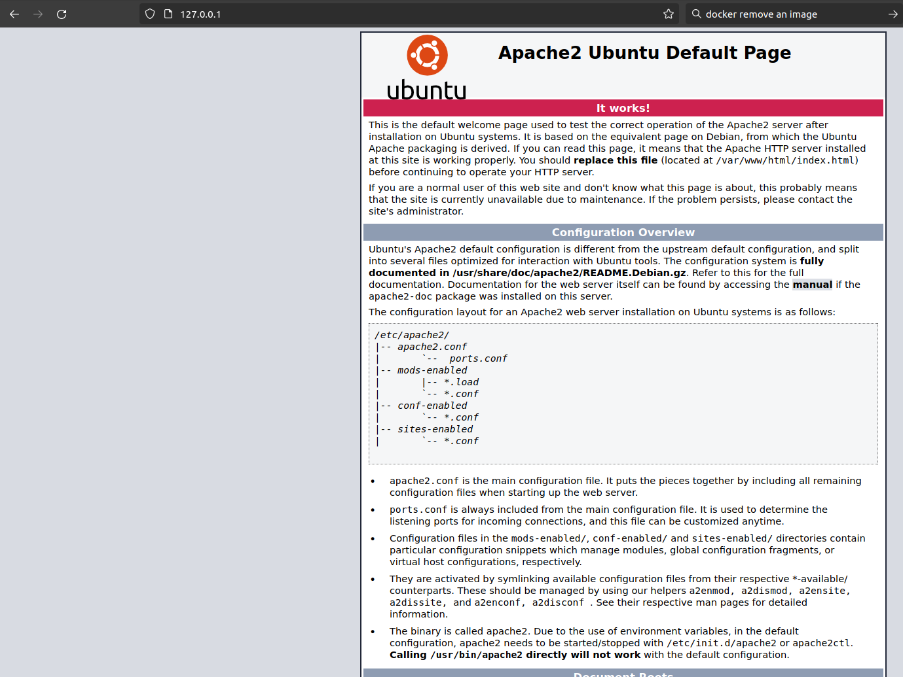
05
06
5. Check staus of apache2 service and Start it if not already started
6. Now, from out of the container, open http://127.0.0.1 in a browser. You should see the Apache2 default page.
This confirms that apache2 webserver is...
Running in the container
Publishing to port 80 in the contianer
Container port 80 is mapped to port 80 on host machine

