Slide 1
Module-2: GIT Assignment - 5
You have been asked to:
Create a gitflow workflow architecture on git
Create all the required branches
Starting from the feature branch, push the branch to the master, following the architecture
Push a urgent.txt on master using hotfix

Slide 2
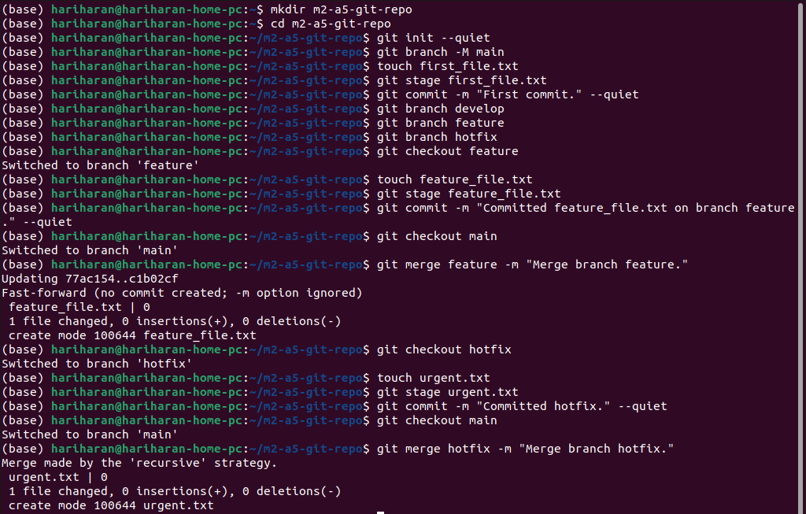
01
1. Execute the commands in the order provide to achieve the outcomes of this assignment.

