Slide 1
Introduction to CS 106A
Eric Roberts
CS 106A
January 4, 2016

Slide 2
Why Study Computer Science
Phil Levis, http://csl.stanford.edu/~pal/ed/
Doctorate
161,857
Master’s
Bachelor’s
Job openings
129,045
94,889
49,200
57,127
55,208
31,357
10,075
Physical Sciences
Biological Sciences
Engineering
Computer Science
The educational data comes from the National Center for Education Statistics IPEDS (Integrated Postsecondary Education Data System) Data Center. The data used is for degrees granted in the 2008-2009 academic year.
The employment data comes from the Department of Labor’s Occupational Outlook Handbook for 2010-11. This handbook includes employment for 2008 as well as a 10-year projection to 2018. I manually selected which occupations mapped to which degrees. I calculated job openings per year as 10% of the expected job growth over 2008-2018 plus 2.5% of the number of jobs in 2008. This second term describes the number of jobs opening as people retire. It assumes that people work for 40 years and leave a job at a uniform rate; the latter is of course not true in difficult economic times.
We are very happy with the students that we get from this university. . . . We just wish we could hire two to three times as many of them.
—
Bill Gates at Stanford, February 19, 2008

Slide 3
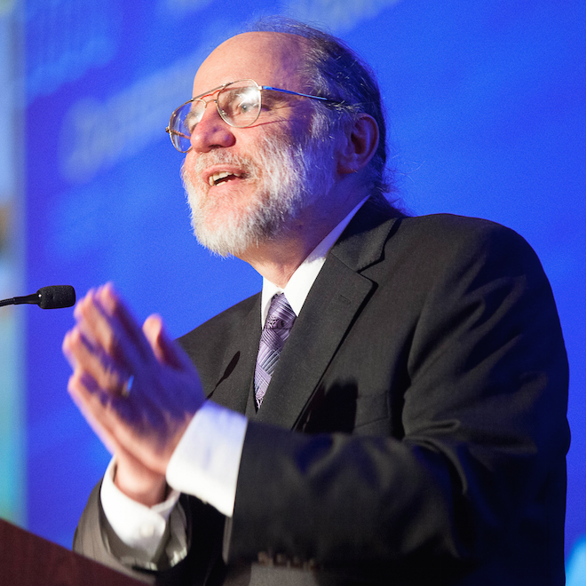
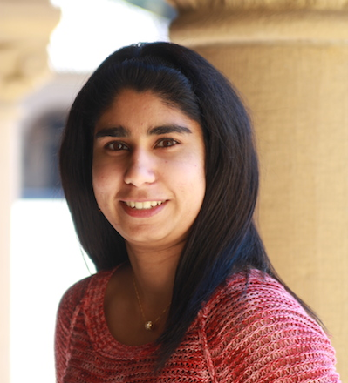
CS 106A Staff
Professor: Eric Roberts
eroberts@cs.stanford.edu
Office Hours (Gates 202):
Tuesdays 9:30–11:00
Wednesdays 4:00–5:00
Head TA: Alisha Adam
aadam@stanford.edu
Office Hours (Gates B-02):
TBA

Slide 4
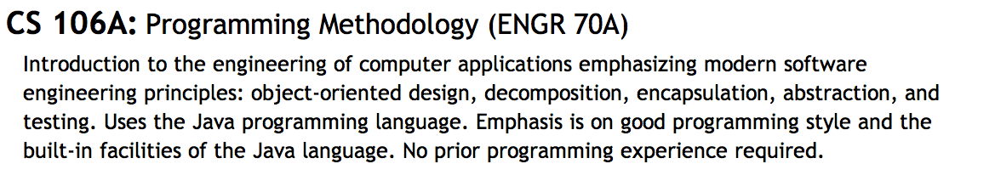
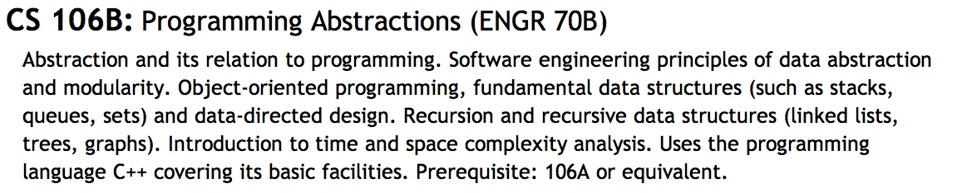
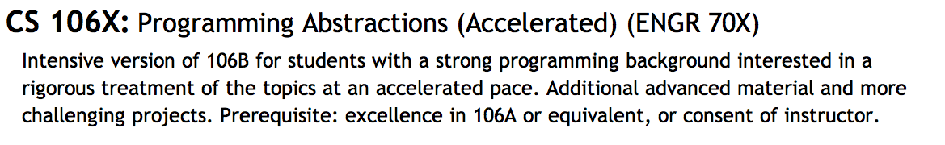
Is CS 106A the Right Course?

Slide 5
Important Administrative Notes
You must sign up for a section to be enrolled in the course. Section signups will start at 5:00P.M. on Thursday and close at 5:00P.M. on Sunday. Be sure to sign up during that time at
http://cs198.stanford.edu/section/
Undergraduates must take CS 106A for 5 units. Unfortunately, the default on Axess is 3 units, so make sure that you change this value as you register.
All handouts, assignments, lecture slides, and announcements are posted on the course web site at
http://cs106a.stanford.edu/
The midterm is given at two scheduled times as shown in Handout #2. Special arrangements can be made for those who cannot make either time.

Slide 6


Syllabus—Week 1
January 4
6
8
Administration
CS and the Honor Code
Meet Karel the Robot
Simple Karel programs
Extending the Karel class
The concept of inheritance
Control structures in Karel
Problem-solving in Karel
Program decomposition
The idea of an algorithm
Read: Karel, Chapters 1-3
Read: Karel, Chapters 4-6

Slide 7
Syllabus—Week 2
11
13
15
Programming by example
Classes and objects
The Program hierarchy
Simple graphical objects
Variables and values
Arithmetic expressions
Common idioms
Control statements
Boolean data
Simple animations
Read: Java, Chapter 1
Read: Chapters 2 and 3
Read: Chapter 4
Due: HW #1 (Karel)

Slide 8
Syllabus—Week 3
18
20
22
Martin Luther King, Jr. Day
Optional film:
Dr. King’s 1963 speech
“I Have A Dream”
Methods
The role of parameters
Objects and classes
Constructors
Inheritance
Read: Sections 6.1-6.2
Due: Karel contest
Read: Chapter 6
Due: HW #2 (Simple Java)

Slide 9
Syllabus—Week 4
25
27
29
The acm.graphics package
Responding to mouse events
The Java listener model
Graphical structures
GPolygon and GCompound
Creating compound objects
Character data
Using Java’s String class
Read: Sections 9.1-9.3
Read: Sections 10.1-10.3
Read: Section 9.4
Due: Parameter Problem Set
Read: Sections 8.1-8.4

Slide 10
Syllabus—Week 5
February 1
3
5
String manipulation
Problem-solving with strings
Cryptography
Overview of Assignment #4
The ArrayList class
The HashMap class
Read: Section 8.5
Due: HW #3 (Breakout)
Read: Draft chapter handout

Slide 11
Syllabus—Week 6
8
10
12
Debugging strategies
Data representation
Arrays
Midterm Exam
Tuesday, February 9
9:00 A.M. or 3:00 P.M.
Due: Graphics contest
Read: Chapter 7
Read: Section 11.1-11.4

Slide 12
Syllabus—Week 7
15
17
19
Presidents’ Day
(no class)
Multidimensional arrays
Pixel arrays
Image manipulation
Swing interactors
The JComponent hierarchy
Action listeners
Read: Sections 11.6-11.7
Due: HW #4 (Cryptography)
Read: Sections 10.5-10.7

Slide 13
Syllabus—Week 8
22
24
26
Using data files
Java collection classes
Iterators
Large-scale data structures
Data-driven programs
Read: Section 12.4
Read: Chapter 13
Due: HW #5 (ImageShop)

Slide 14
Syllabus—Week 9
29
March 2
4
Overview of Adventure!
Sorting and searching
Algorithmic analysis
Layout managers
Designing GUIs
Read: Adventure handout
Read: Sections 12.1-12.3
Due: Sections 10.5-10.8

Slide 15
Dead Week and Beyond
7
9
11
Looking ahead
Concurrency
Programming patterns
Frontiers of computing
(optional)
Read: Chapter 14
Due: HW #6 (Adventure)
Due: Adventure contest
Review session:
Sunday, March 13
7:00-9:00 P.M.
Final exam:
Monday, March 14
8:30-11:30 A.M.

Slide 16
Assignments in CS 106A
Assignments in CS 106A are due at 5:00P.M. Assignments that come in after 5:00 will be considered late.
Everyone in CS 106A starts the quarter with two “late days” that you can use at any time you need some extra time. In my courses, late days correspond to class meetings, so that, if an assignment is due on Wednesday and you turn it in on Friday, that counts as one late day.
Extensions can be approved only by the TA, Alisha Adam.
Assignments are graded by your section leader, who discusses your work in an interactive, one-on-one grading session.
Each assignment is given two grades: one on functionality and one on programming style. Style matters. Companies in Silicon Valley expect Stanford graduates to understand how to write code that other programmers can maintain.

Slide 17


The CS 106A Grading Scale
Functionality and style grades for the assignments use the following scale:
A submission so good it “makes you weep.”
Exceeds requirements.
Satisfies all requirements of the assignment.
Meets most requirements, but with some problems.
Some more serious problems.
Even worse than that.
Why did you turn this in?

Slide 18
Contests
CS 106A will have three contests as follows:
The Karel Contest associated with Assignment #1
The Graphics Contest associated with Assignment #3
The Adventure Contest associated with Assignment #6
First prize in the contest is a score of 100% on one of the graded components of the course, typically the final exam.
As an additional incentive, entering any of the contests gives you chances to win an additional grand prize in a random drawing at the end of the quarter.
Entering a contest also earns “house points” for your class in the style of the Hogwarts School from Harry Potter.
Securing a runner-up prize or an honorable mention on any contest gives you additional chances in the random drawing, as does having an assignment submitted as a + + candidate.

Slide 19
Honor Code Rules
Rule 1:
You must not look at solutions or program code that is not your own.
Rule 2:
You must not share your solution code with other students.
Rule 3:
You must indicate on your submission any assistance you received.

Slide 20
Meet Karel the Robot
Karel the Robot was developed here at Stanford by Richard Pattis over 30 years ago. Since then Karel has given many generations of CS 106A students a “gentle introduction” to programming and problem solving.
Karel’s world is composed of streets and avenues numbered from the southwest corner. (As in Manhattan, streets run east-west and avenues run north-south.) In this world, Karel is facing east at the corner of 1st Street and 1st Avenue.
Karel’s world is surrounded by a solid wall through which it cannot move. Depending on the problem, there may also be walls in the interior of the world that block Karel’s passage.
The only other objects that exist in Karel’s world are beepers, which are small plastic cones that emit a quiet beeping noise. In this world, for example, I’ve added a beeper to the corner of 1st Street and 2nd Avenue.
Initially, Karel understands only four primitive commands:
move()
Move forward one square
turnLeft()
Turn 90 degrees to the left
pickBeeper()
Pick up a beeper from the current square
putBeeper()
Put down a beeper on the current square
3
+
+
+
+
+
2
+
+
+
+
+
1
+
+
+
+
+
1
2
3
4
5

Slide 21
Your First Challenge
How would you program Karel to pick up the beeper and transport it to the top of the ledge? Karel should drop the beeper at the corner of 2nd Street and 4th Avenue and then continue one more corner to the east, ending up on 5th Avenue.
3
+
+
+
+
+
2
+
+
+
+
+
1
+
+
+
+
+
1
2
3
4
5

Slide 22
The End

