Slide 1

Segmentation and Classification of Diabetic Retinopathy
SRM INSTITUTE OF SCIENCE AND TECHNOLOGY
SCHOOL OF COMPUTING
DEPARTMENT OF COMPUTING TECHNOLOGIES
18CSP107L / 18CSP108L - MINOR PROJECT / INTERNSHIP
Batch ID: B561
Student 1 Reg. No: RA2011003010950
Student 1 Name: SHIVANSH SINGH
Student 2 Reg. No: RA2011003010951
Student 2 Name: SAYAN KUMAR BAG
Guide name: Dr. Sankara Narayanan S
Designation: Assistant Professor Department of Computing Technologies

Slide 2
Abstract
The project utilizes advanced deep learning techniques, employing Convolutional Neural Networks (CNNs) and sophisticated image processing methods, to diagnose diabetic retinopathy.
Retinal images are classified into five stages: No Diabetic Retinopathy (No DR), Mild Diabetic Retinopathy (Mild DR), Moderate Diabetic Retinopathy (Moderate DR), Severe Diabetic Retinopathy (Severe DR), and Proliferative Diabetic Retinopathy (Proliferative DR).
The process involves comprehensive data preprocessing, precise image segmentation using U-Net and thresholding, and feature extraction with Gabor filters.
While the CNN model excels in identifying cases without diabetic retinopathy, challenges exist in accurately classifying moderate to severe stages.

Slide 3
Problem Statement
The project targets accurate segmentation and classification of diabetic retinopathy (DR) in retinal images.
Early detection is crucial for effective intervention, necessitating precise segmentation of retinal regions of interest to isolate pathological features essential for diagnosis.
Existing segmentation methods often struggle with the intricate structures of retinal images, leading to inaccuracies and challenges in subsequent classification tasks.
The complexity arises from subtle feature variations and overlapping symptoms among different DR stages, making classification daunting.
The project aims to develop an advanced system utilizing state-of-the-art segmentation techniques and deep learning classifiers.
Ultimately, the goal is to enhance outcomes for individuals affected by diabetic retinopathy, emphasizing the project's potential impact on public health and vision care.

Slide 4
Objectives
Automated Diabetic Retinopathy Detection: Develop an automated system capable of accurately detecting and classifying diabetic retinopathy in retinal images.
Multi-Class Classification: Implement a robust classification system that categorizes retinal images into distinct classes, such as 'No Diabetic Retinopathy,' 'Mild Diabetic Retinopathy,' 'Moderate Diabetic Retinopathy,' 'Severe Diabetic Retinopathy,' and 'Proliferative Diabetic Retinopathy'.
Integration of Deep Learning Models: Integrate state-of-the-art deep learning architectures such as U-Net, MobileNetV2, and EfficientNetB0 to leverage their capabilities in image segmentation, feature extraction, and classification. By combining these models, create a comprehensive pipeline for accurate diabetic retinopathy analysis.
Performance Optimization: Fine-tune and optimize the deep learning models to achieve high accuracy, sensitivity, and specificity. Implement techniques such as data augmentation, transfer learning, and hyperparameter tuning to enhance the models' performance across diverse retinal images and pathological conditions.

Slide 5
Proposed Methodology
Data Acquisition: Gathering a diverse dataset of retinal images labeled with diabetic retinopathy stages for training and evaluation.
Data Preprocessing: Resize, normalize, and perform one-hot encoding on the images to prepare them for model input.
Image Segmentation:
-> Utilize a pre-trained CNN model for semantic segmentation to identify
regions of interest within retinal images accurately.
-> Apply thresholding techniques to further refine the segmented regions and enhance feature extraction.
Feature Extraction: Implement filters to capture intricate textures and patterns within segmented regions, enhancing feature representation.

Slide 6
Proposed Methodology
CNN Architecture:
-> Design a deep CNN architecture incorporating convolutional and pooling layers to process segmented features.
-> Utilize transfer learning from pre-trained models to leverage existing knowledge for improved feature extraction.
Training and Optimization:
-> Train the CNN model using the segmented and extracted features, optimizing hyperparameters for enhanced accuracy.
Validation and Testing:
-> Validate the model using a separate dataset to ensure its generalizability.
-> Evaluate the model's accuracy and efficiency in classifying diabetic retinopathy stages, emphasizing correct identification of moderate to severe cases.

Slide 7
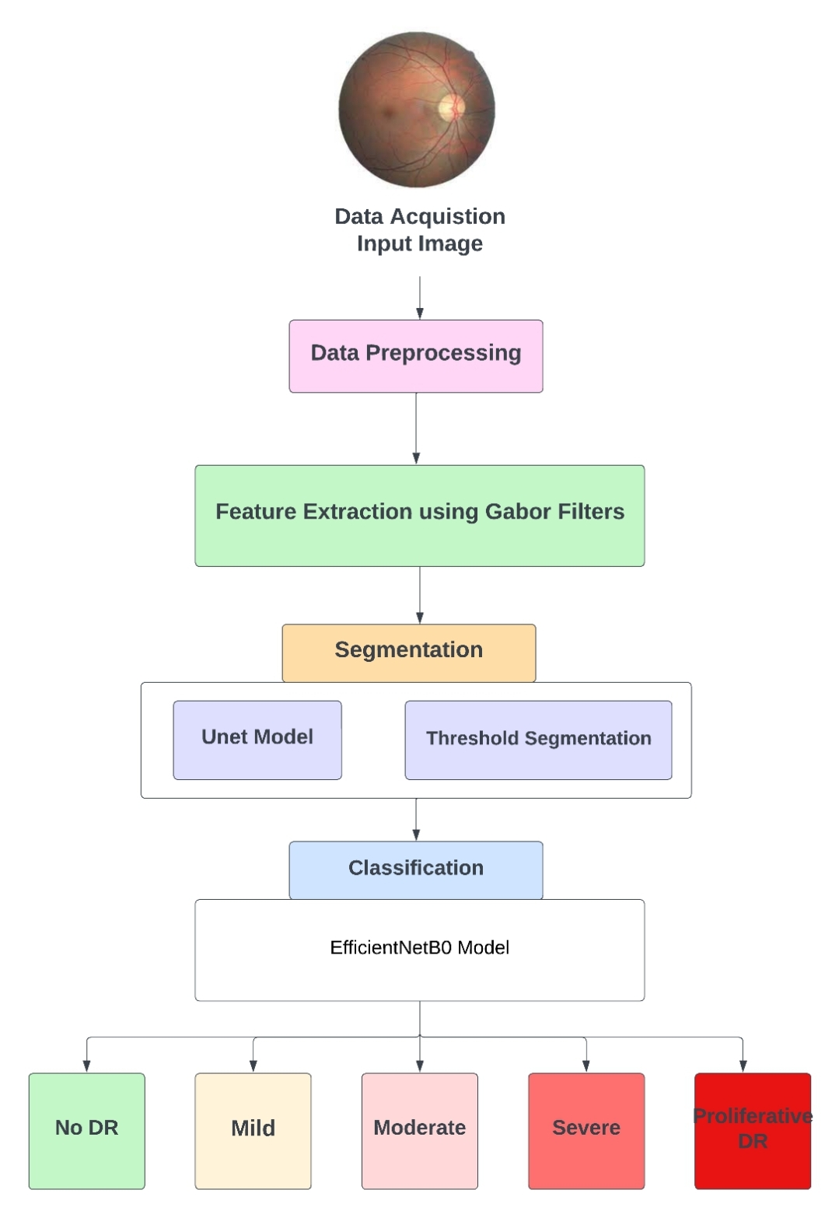
Architecture Diagram

Slide 8
Modules Description and Implementation
Data Loading and Preprocessing:
-> Loaded and pre-processed the dataset, including resizing and normalizing the images.
-> Converted labels into a suitable format for classification.
-> Split the dataset into training and testing sets.
Image Segmentation:
-> Utilized a pre-trained U-Net model for image segmentation.
-> Applied thresholding techniques to refine the segmented regions and enhance feature separation.
->Used morphological operations and the watershed algorithm for detailed segmentation of retinal lesions.

Slide 9
Modules Description and Implementation
Feature Extraction using Gabor Filters:
-> Applied Gabor filters to capture intricate texture patterns within segmented regions.
-> Used varying orientations, frequencies, and scales to extract diverse texture features.
-> Generated a set of filtered images representing different textural characteristics.
CNN Model Creation:
->Utilized a pre-trained EfficientNetB0 as the base model for feature extraction.
-> Added custom layers for classification, including global average pooling, dense, and dropout layers.
-> Compiled the model using categorical cross-entropy loss and Adam optimizer.
Data Augmentation:
-> Applied data augmentation techniques such as rotation, shifting, shearing, zooming, and horizontal flipping.
-> Augmented the training data to increase its diversity and improve model generalization.

Slide 10
Modules Description and Implementation
Model Training and Validation:
-> Trained the CNN model using the augmented training data.
-> Validated the model's performance using the validation dataset.
-> Monitor accuracy and loss metrics over epochs to assess training progress.
Model Evaluation and Visualization:
-> Evaluated the trained model on the test data to measure its accuracy.
-> Generated predictions for the test set and convert predictions into class labels.
-> Created a confusion matrix to analyze model performance across different classes.
-> Plotted training and validation accuracy to visualize the model's learning progress.

Slide 11
Results and Discussion
The proposed model achieved a test accuracy of 60.10% .
The model demonstrated a commendable performance in identifying cases with no diabetic retinopathy.
But the model struggled with classes representing progressive stages of diabetic retinopathy (classes 2, 3, and 4).
Improving the accuracy for these stages is crucial, as early and accurate diagnosis of disease progression is vital for timely medical interventions.
Potential strategies for improvement include augmenting the dataset with more diverse samples from these specific classes, fine-tuning the model architecture, and exploring advanced techniques such as ensemble learning to enhance the overall classification accuracy.
Addressing these challenges and iteratively refining the model through additional data and advanced techniques can enhance its accuracy and reliability, making it a valuable tool for diabetic retinopathy diagnosis and contributing significantly to improved patient care.

Slide 12
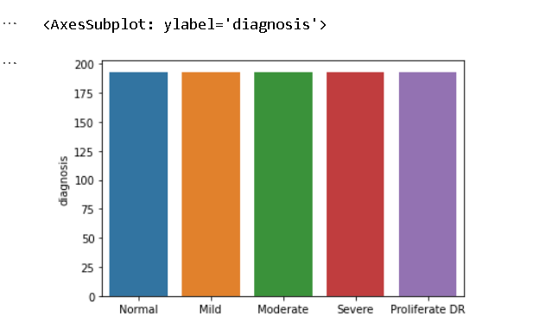
Output Screenshots

Slide 13
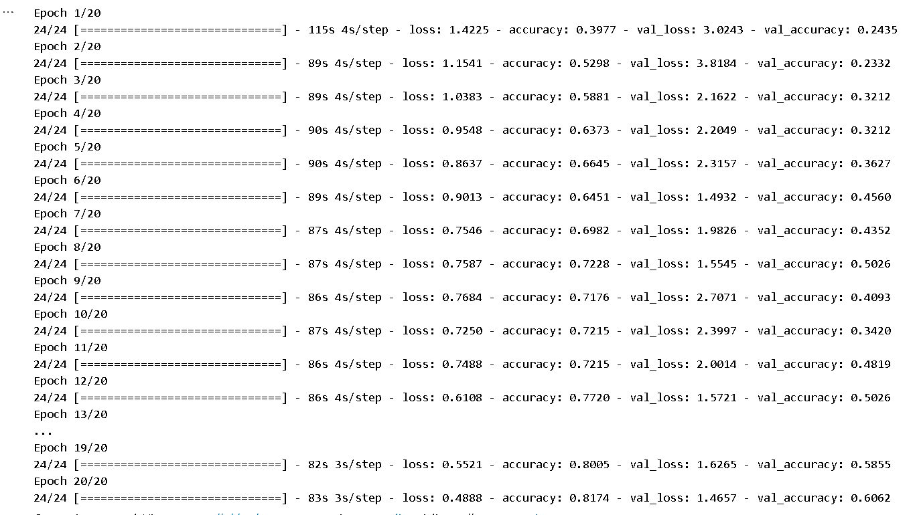
Output Screenshots

Slide 14
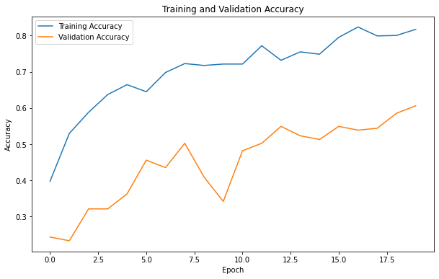
Output Screenshots

Slide 15
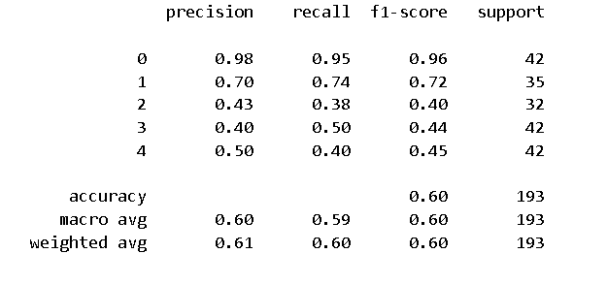
Output Screenshots

Slide 16
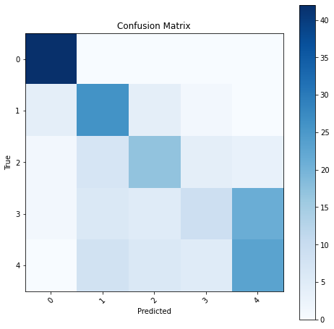
Output Screenshots

Slide 17
References
Classification and Segmentation of Diabetic Retinopathy: A Systemic Review by Natasha Shaukat , Javeria Amin , Muhammad Imran Sharif, Muhammad Irfan Sharif, Seifedine Kadry and Lukas Sevcik .
Detection and Classification of Diabetic Retinopathy using Retinal Images By Kanika Verma, Prakash Deep and A. G. Ramakrishnan
Diabetic Retinopathy Detection using Pre-trained EfficientNetB3 Model by Praveen B ,Guduru Mahesh Babu,Parvatareddy Ramakrishnareddy,Mani
A Diabetic Retinopathy Grade Classification based on Fractal Analysis and Random Forest by Farrikh Alzami; Abdussalam; Rama Arya Megantara; Ahmad Zainul Fanani; Purwanto

