Slide 1
IFRS 18 Adoption
SAP Implementation Project Plan — Executive Summary
Demand 288 - IFRS 18 | Updated Jul 14, 2026
TOTAL EFFORT
DURATION
ACTIVITIES
GO-LIVE TARGET
TOTAL EFFORT
DURATION
ACTIVITIES
GO-LIVE TARGET
~105 PD
~22 weeks
60
10 Nov 2026
was ~95 PD before SAP Note review
mid-Jul to early Dec 2026
across 8 phases
ahead of 1 Jan 2027 effective date
• Restructure the Financial Statement Versions (ZHFM, ZCPL, ZUKV) for the new IFRS 18 categories and subtotals — the foundation all other work depends on.
• Update HFM consolidation mapping, financial statement export/AMANA, P&L and working capital reporting, and IFRS 16 lease data classification.
• New this update: review/implement SAP Note 3670330 and verify treasury (TRM) G/L account classification.
1 / 5
INNOVATING TOGETHER

Slide 2
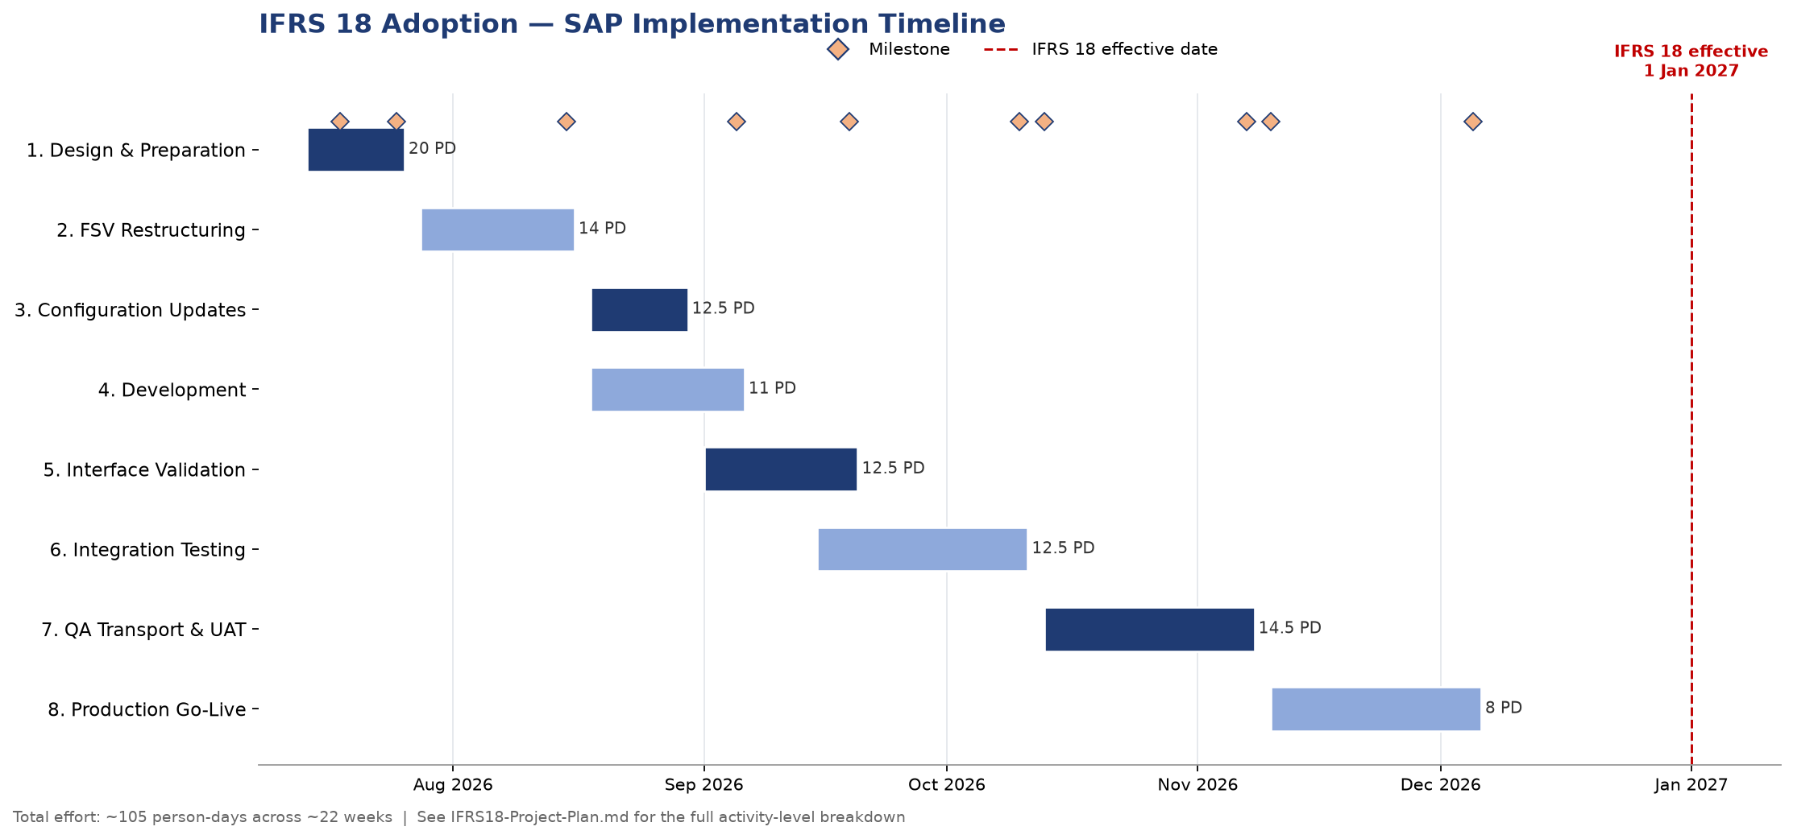
Project Timeline
2 / 5
INNOVATING TOGETHER

Slide 3
Effort Breakdown
3 / 5
INNOVATING TOGETHER

Slide 4
Key Milestones
Date | Milestone
Jul 18, 2026 | SAP Note 3670330 reviewed and child notes identified (NEW)
Jul 25, 2026 | Design complete — FSV node structures and HFM positions defined
Aug 15, 2026 | FSV restructuring complete in CSD (ZHFM, ZCPL, ZUKV)
Sep 5, 2026 | All configuration and development complete in CSD
Sep 19, 2026 | Interface validation complete (HFM, AMANA)
Oct 10, 2026 | Integration testing complete — all defects resolved
Oct 13, 2026 | Transport to CSQ
Nov 7, 2026 | UAT sign-off
Nov 10, 2026 | Transport to CSP (Production)
Dec 5, 2026 | Hypercare ends
Jan 1, 2027 | IFRS 18 effective — system fully operational
4 / 5
INNOVATING TOGETHER

Slide 5
Top Risks & Next Steps
Top Risks
Next Steps
• HFM-side changes delayed (external team dependency) — blocks end-to-end validation of the consolidation interface.
• SAP's own solution approach (Note 3670330) doesn't cover third-party (HFM) consolidation — HFM alignment remains fully this project's responsibility.
• R8: SAP Note 3670330 corrections may not be valid for the current release — could require an upgrade or manual backport.
• R9: Treasury G/L accounts may not be correctly classified under IFRS 18 if SAP TRM is in use — now addressed by Activities 1.10 and 5.9.
• IAS 7 cash-flow reclassification (dividends/interest) may affect existing cash-flow CDS views — checked in Activity 5.8.
• Transport conflicts in CSQ/CSP could delay go-live.
• Kick off Phase 1 (Activities 1.1-1.11): design workshop, FSV/HFM structure definition, SAP Note review, and treasury G/L account review.
• Read SAP Note 3696338 (Private Cloud/On-Premise advisory) — the most relevant of the confirmed companion notes for this landscape.
• Confirm whether SAP TRM is in use for loans/deposits/FX/derivatives with Finance/Treasury (Activity 1.10).
• Consider raising a Customer Influence Request with SAP, per their own recommendation in Note 3670330.
• Get sign-off on the restructured FSVs (Activity 2.5) before starting downstream configuration/development work (Exec. Order 8+).
5 / 5
INNOVATING TOGETHER

