Slide 1
DePaul University
Student Application Data
Final Presentation - Week 4 | Excelerate Data Analytics Internship
Prepared by: Enimabasi Ukpong | Date: 30 June 2026 | Tool: MS Excel · Power BI
Notes:
Introduce yourself and the internship programme. Mention this was a 4-week data analytics project with Excelerate using real DePaul University student application data.

Slide 2
Project Overview
The Dataset
The Objectives
Tools Used
7,543 student application records from DePaul University.
80 original columns across demographics, programs, admissions & outreach.
Data spanning May 2023 – June 2025
Explore & understand the raw dataset.
Clean and standardise the data.
Build an interactive dashboard.
Derive actionable recruitment insights
MS Excel - EDA & Visualizations.
Google Sheets - Data cleaning.
Power BI - Interactive dashboard.
PowerPoint - Dashboard background design and Presentation
Notes:
Briefly describe the dataset, the goal of the internship, and the tools used across the four weeks.

Slide 3
Week 1 - Data Exploration & EDA
Dataset at a Glance
Key EDA Findings
7,543
Total Records
→ India accounts for 61.2% of all applicants (4,617 of 7,543)
80
Original Columns
→ Business Analytics MS (1,080) & Computer Science MS (1,055) are top programs
96
Countries Represented
→ Jarvis College of Computing received 50.8% of first-choice selections
0
→ 86.5% of applicants came through Non Study Group channels
Duplicate Rows
38
→ Admissions grew 176.3% from 2023 (1,377) to 2024 (3,805)
Completely Empty Columns
→ 42.3% of applicants - 3,194 students were never contacted
3
Unreadable Timestamp Columns
Notes:
Walk through what the raw dataset looked like. Highlight the key numbers — 7,543 rows, 80 columns, 38 empty columns. Share the top EDA findings before cleaning.

Slide 4
Week 1 - Data Quality Report
Category | Issue Found | Recommendation
Missing Values | 38 columns 100% empty; 32 columns partially missing | Drop empty columns; label meaningful blanks
Duplicate Rows | 0 duplicate rows found | No action needed
Spelling Errors | Recieved_At and Counsler misspelled in column names | Rename to Received_At and Counselor
Timestamps | Received_At, Created_At, Modified_At stored as 13-digit Unix numbers | Convert to readable date format
Text Inconsistencies | Country names inconsistently capitalised; Application_Source mixed case | Standardise using PROPER() and Find & Replace
Combined Columns | College and Intake each pack multiple values in one cell | Split into separate columns during cleaning
Phone Numbers | Mixed formats; some corrupted to scientific notation | Flag corrupted rows - unrecoverable
Duplicate Columns | 12 columns ending in -2 or -3 from merged table export | Review and drop confirmed duplicates
Notes:
Walk through each data quality issue category. Emphasise that identifying issues before cleaning is what makes the cleaning process informed and professional.

Slide 5
Week 2 - Data Cleaning Process
17 documented cleaning steps across 6 sections - executed in Google Sheets
Column Removal Steps 1-3
Text Standardization Steps 9-11
A
D
Deleted 38 empty, 5 zero-variance
and 6 duplicate columns → 49 removed
Country names - PROPER() function
Application_Source - Find & Replace
Phone numbers - flagged corrupted rows
Column Renaming Steps 4-5
Column Splitting Steps 12-13
B
E
Recieved_At → Received_At
Counsler → Counselor
Intake → Program + Intake_Term
College - flagged, not split (inconsistent)
Format Correction Steps 6-8
Missing Value Handling Steps 14-17
C
F
Converted 3 Unix timestamp columns
Formatted Admit_Date & Start_Date
Outcome_1 blanks = 'Not Contacted'
Slate_Form_Filled blanks = 'Not Recorded'
Remark, Street_2, Comments - retained
Notes:
Walk through all six cleaning sections. Emphasise that every step was documented in a Cleaning Log before execution — this is professional data cleaning practice.

Slide 6
Week 2 - Before & After: Cleaning Impact
Metric | Before Cleaning | After Cleaning | Change
Total Columns | 80 | 33 | 47 removed
Empty Columns | 38 | 0 | 38 removed
Unusable Columns | 49 | 0 | 49 removed
Unreadable Timestamp Columns | 3 | 0 | 3 converted
Column Name Spelling Errors | 2 | 0 | 2 fixed
Blank Cells in Outcome_1 | 42.3% | 0% | Labelled
Blank Cells in Slate_Form_Filled | 42.3% | 0% | Labelled
Overall Data Quality Score | 2.4 / 5 | 4.6 / 5 | +2.2 pts
Notes:
Walk through the measurable impact of the cleaning work. Highlight the overall data quality score improvement from 2.4 to 4.6 out of 5 as the headline result.

Slide 7
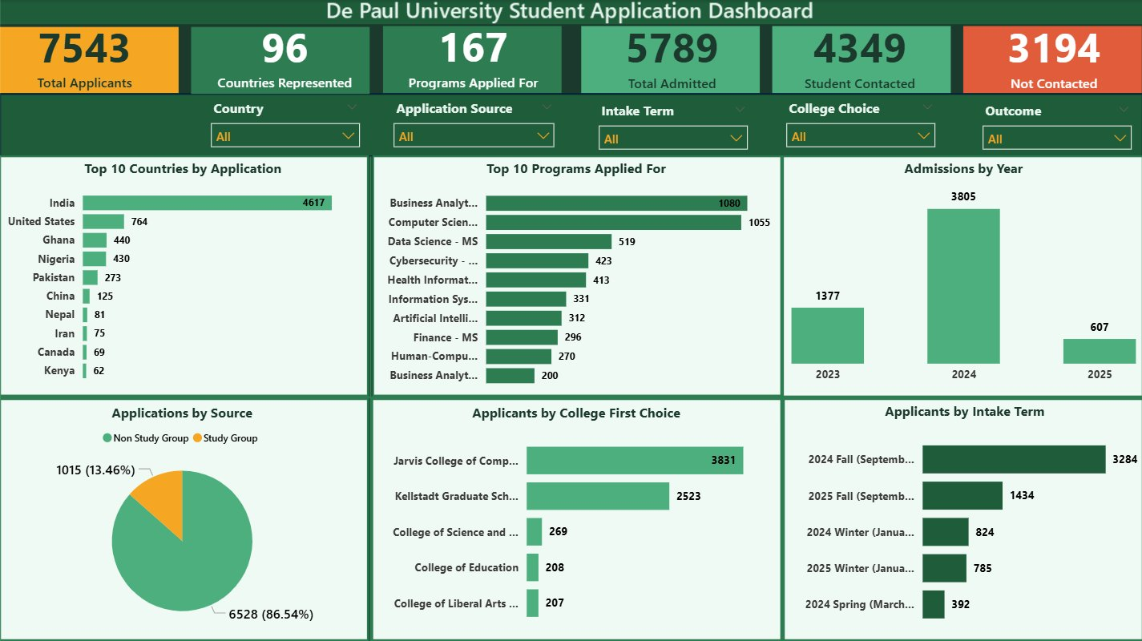
Week 3 - Interactive Dashboard Page 1: Applicant Overview
Page 1 Highlights
▸ 6 KPI cards - instant headline metrics
▸ 5 dropdown slicers - cross-page interactive filters
▸ Top 10 Countries chart - India at 4,617 (61.2%)
▸ Top 10 Programs - Business Analytics leads at 1,080
▸ Admissions by Year - 176% growth 2023→2024
▸ Applications by Source - 86.5% Non Study Group
▸ College First Choice - Jarvis at 3,831 (50.8%)
Notes:
Show the Page 1 dashboard screenshot. Walk through each chart and explain what it shows. Mention the slicers and how they filter all visuals simultaneously.

Slide 8
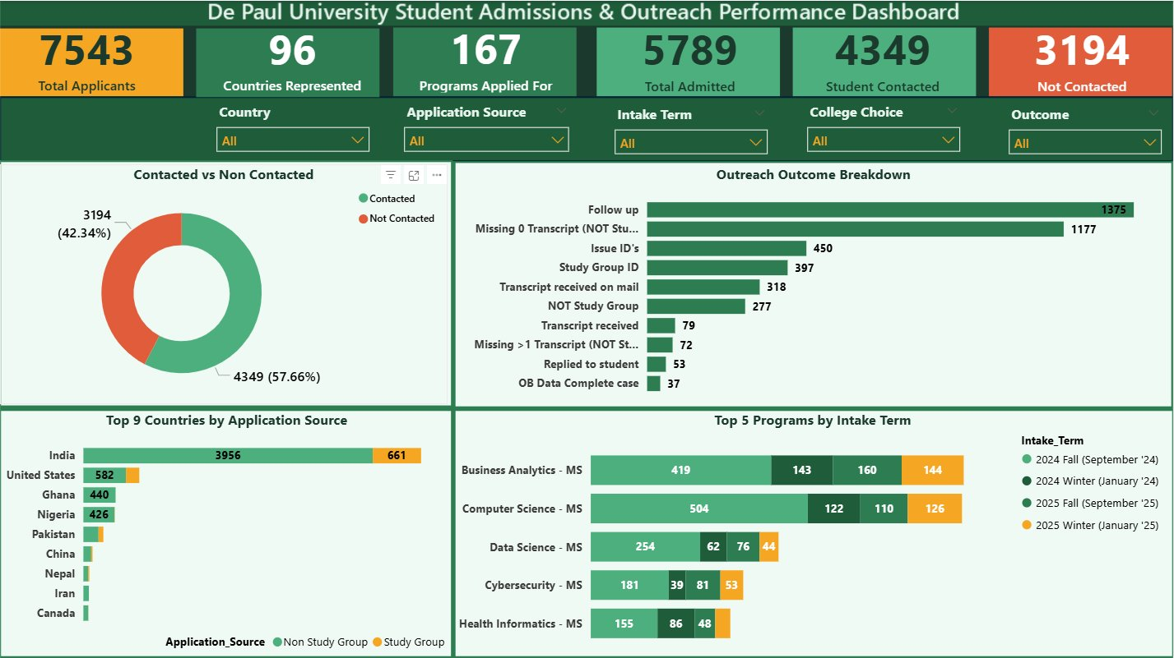
Week 3 - Interactive Dashboard Page 2: Admissions & Outreach Performance
Page 2 Highlights
▸ Contacted vs Not Contacted - 57.7% vs 42.3%
▸ Outreach Outcome Breakdown - Follow up leads at 1,375
▸ Missing Transcript - 2nd biggest issue at 1,177
▸ Top 9 Countries by Source - India: 3,956 Non Study Group + 661 Study Group
▸ Top 5 Programs by Intake Term - Fall dominates all programs
▸ Slicers synced across both pages automatically
Notes:
Show the Page 2 dashboard screenshot. Explain that this page focuses on what happened after students applied — outreach effectiveness and outcome patterns.

Slide 9
Key Insights & Trends
01
Geographic Concentration Risk
02
Technology Programs Drive Demand
India accounts for 61.2% of all applicants. Four countries - India, USA, Ghana, Nigeria represent 83% of the entire pipeline. This concentration means any policy or interest shift in India could significantly impact DePaul's intake numbers.
7 of the top 10 programs are technology or data-focused. Business Analytics MS and Computer Science MS together account for 27.9% of all applications. Jarvis College of Computing received 50.8% of all first-choice college selections.
03
176% Admissions Growth in 2024
04
Outreach Coverage Gap
Admitted students grew from 1,377 in 2023 to 3,805 in 2024 nearly tripling in one year. 2025 shows 607 on a partial year. Understanding what drove this spike is a priority for strategic planning.
3,194 students (42.3%) were never contacted. Every contacted student received exactly one outreach attempt; no multi-touch follow-up exists in the data. Transcript collection (1,177 cases) is the single biggest bottleneck.
Notes:
These are the four headline insights from the entire analysis. Spend time on each one and connect them back to the dashboard charts.

Slide 10
Actionable Recommendations
Recruitment Targeting
Diversify beyond India
Develop targeted campaigns in Ghana (440), Nigeria (430) and Pakistan (273) which already show strong organic interest. Reduce dependence on a single country market.
Channel Strategy
Expand Study Group partnerships strategically
Study Group activity is concentrated in India and USA only. Evaluate whether partnerships in Ghana and Nigeria would increase conversion from those growing markets.
Counselor Engagement
Implement multi-touch outreach protocol
Replace the current single-contact model with a structured two-attempt minimum. Prioritise the 3,194 uncontacted students as an immediate re-engagement opportunity.
Process Improvement
Automate transcript reminders
Missing transcripts (1,177 cases) is the biggest resolved outreach issue. An automated reminder triggered at application submission would reduce manual counselor follow-ups.
Capacity Planning
Scale resources for Fall intake peaks
Fall 2024 (3,284) and Fall 2025 (1,434) dominate all intake terms across every top program. Counselor staffing and visa processing support must be scaled ahead of Fall peaks.
Notes:
For each recommendation, connect it directly to the data that supports it. These are evidence-based decisions, not opinions.

Slide 11
Conclusion & Next Steps
Key Takeaways
Potential Next Steps
✓ Raw data is never ready for analysis, structured cleaning is essential before any insight can be trusted.
1
Clean the College column, split into Previous Country, University, and Degree for richer origin analysis.
✓ 61.2% concentration in India is the single biggest strategic risk in DePaul's applicant pipeline.
2
Investigate what drove the 176.3% admissions growth in 2024 through time-series analysis.
✓ Technology programs drive demand; 7 of top 10 programs are tech or data-focused.
Profile the 3,194 uncontacted students by country, program and year to plan targeted re-engagement.
3
✓ 42.3% outreach gap represents a significant missed engagement opportunity
Build a predictive model to identify which applicants are most likely to convert to enrolled students
4
✓ A data quality score improvement from 2.4 to 4.6 out of 5 demonstrates the value of systematic cleaning.
5
Integrate real-time data pipeline from DePaul's admissions system for live dashboard updates
✓ The interactive dashboard enables DePaul to make real-time, evidence-based recruitment decisions
Notes:
Summarise the internship journey and what was achieved. The next steps show analytical maturity — demonstrating you see beyond what was asked.

