Slide 1
Analiza i implementacija Single Sign On metode autentifikacione šeme
Šta je Single Sign On (SSO)?

Slide 2
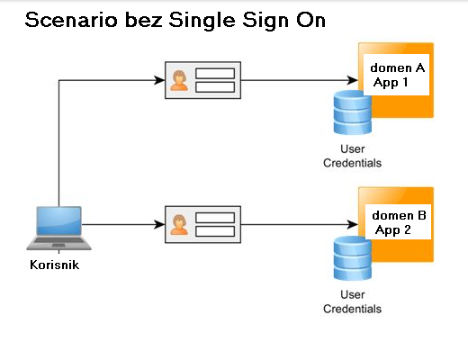
Scenario bez Singe Sign On-a

Slide 3
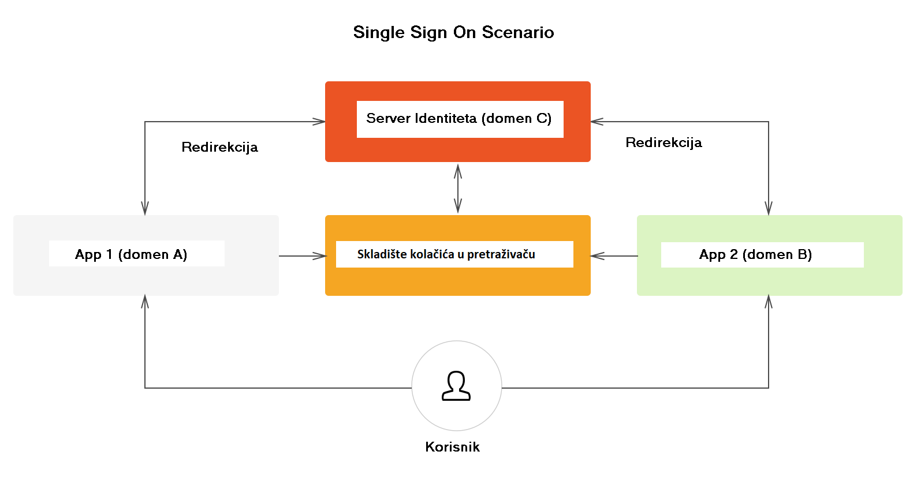
Scenario sa Singe Sign On-om

Slide 4
Ujedinjeni sistemi identiteta (Federated Identity)
Ujedinjeni sistemi identiteta rešavaju nekoliko problema:
Autentifikacija
Pravo pristupa resursima
Razmena korisničkih podataka
Upravljanje korisnicima

Slide 5
Single Sign On
Prednosti Single Sign On-a
Pamćenje desetina lozinki
Jedan Interfejs
Zaštita samo na jednom mestu
Problemi Single Sing On-a
Sistem identiteta postaje usko grlo
Pad kredencijala u pogrešne ruke

Slide 6
OpenID Connect (OIDC)
Šta je OAuth2?
Šta je OIDC?

Slide 7
Koncepti OIDC i OAuth2 protokola
Vlasnik Resursa (Resource Owner)
OAuth Klijent
OAuth server (IdP)
Server Resursa (Resource Server)
Token Identiteta (ID Token)
Dodela Odobrenja (Authorization Grant)

Slide 8
Dodela i tokovi odobrenja (Authorization Flow Grants)
Tok Autorizacionim kodom (eng. Authorization Code Flow)
Implicitni Tok (eng. Implicit Flow)
Hibridni Tok (eng. Hybrid Flow)
Tok Autorizacionim kodom sa dokazom ključa za razmenu kodova (eng. Authorization Code Flow with Proof Key for Code Excange - PKCE)

Slide 9
Tok Autorizacionim kodom (eng. Authorization Code Flow)
Zahtev za Autentikaciju
GET/oidc/authorize? response_type=code &scope=openid%20profile%20email &client_id=s6BhdRkqt3 &state=af0ifjsldkj &redirect_uri=https%3A%2F%2Fclient.example.org%2Fcb HTTP/1.1 &nonce=fjsjsellesldska... Host: server.example.com
Uspešan odgovor nakon potvrde identiteta
HTTP/1.1 302 Found Location: https://client.example.org/cb? code=SplxlOBeZQQYbYS6WxSbIA &state=af0ifjsld

Slide 10
Tok Autorizacionim kodom (eng. Authorization Code Flow)
Zahtev za dobijanje tokena
POST /oidc/token HTTP/1.1 Host: server.example.com Content-Type: application/x-www-form-urlencoded grant_type=authorization_code& code=SplxlOBeZQQYbYS6WxSbIA& redirect_uri=https%3A%2F%2Fclient.example.org%2Fcb& client_id=s6BhdRkqt3& client_secret=secret_1234
Odgovor Token metode
“access_token”: “SlAV32hkKG”, “token_type”: “Bearer”, “expires_in”: 3600, “id_token”: “eyJhbGciOiJSUzI1NiIsImtpZCI6IjFlOWdkazcifQ.ewogImlzc…”

Slide 11
Implicitni Tok
Zahtev za autentikaciju
GET /oidc/authorize? response_type=id_token%20token &client_id=s6BhdRkqt3 &redirect_uri=https%3A%2F%2Fclient.example.org%2Fcb &scope=openid%20profile &state=af0ifjsldkj &nonce=n-0S6_WzA2Mj HTTP/1.1
Uspešan odgovor nakon potvrde identiteta
HTTP/1.1 302 Found Location: https://client.example.org/cb# access_token=SlAV32hkKG &token_type=bearer &id_token=eyJ0 ... NiJ9.eyJ1c ... I6IjIifX0.DeWt4Qu ... ZXso &expires_in=3600 &state=af0ifjsldkj

Slide 12
Tok Autorizacionim kodom sa dokazom ključa za razmenu kodova - PKCE
Zahtev za autentikaciju
GET /oidc/authorize?response_type=code &scope=openid%20profile%20email &client_id=s6BhdRkqt3 &state=af0ifjsldkj &code_challange= PCBxoCJMdDloUVl1ctjvA6VNbY6fTg1P7PNhymbydM &code_challenge_method=S256 &redirect_uri=https%3A%2F%2Fclient.example.org%2Fcb HTTP/1.1 Host: server.example.com
Uspešan odgovor nakon potvrde identiteta
GET https://client.example.org/cb? code=SplxlOBeZQQYbYS6WxSbIA &state=af0ifjsldkj

Slide 13
Tok Autorizacionim kodom sa dokazom ključa za razmenu kodova - PKCE
Zahtev za dobijanje tokena
POST /oidc/token HTTP/1.1 Host: server.example.com Content-Type: application/x-www-form-urlencoded grant_type=authorization_code& code=SplxlOBeZQQYbYS6WxSbIA& redirect_uri=https%3A%2F%2Fclient.example.org%2Fcb& client_id=s6BhdRkqt3& code_verifier=shekrslsnj4kfdksfksk

Slide 14
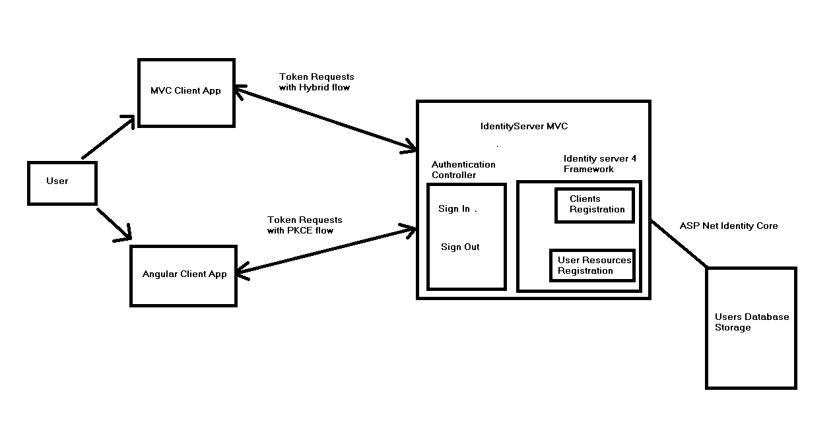
Arhitektura Sistema

Slide 15
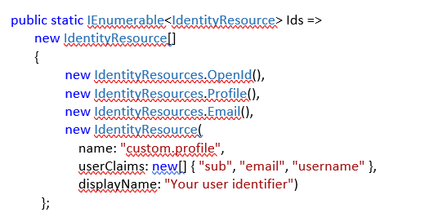
Identity Server 4 resources
API Resources
Identity Resources
API resources

Slide 16
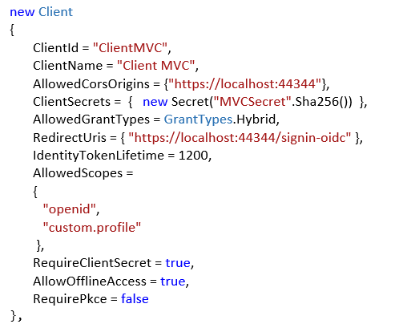
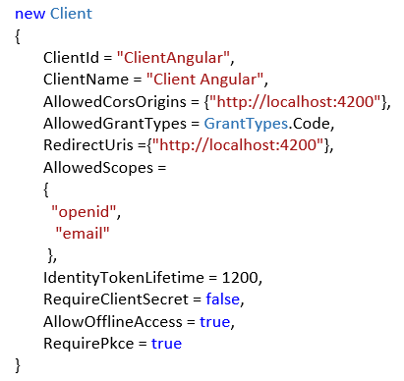
Identity Server 4 Clients

Slide 17
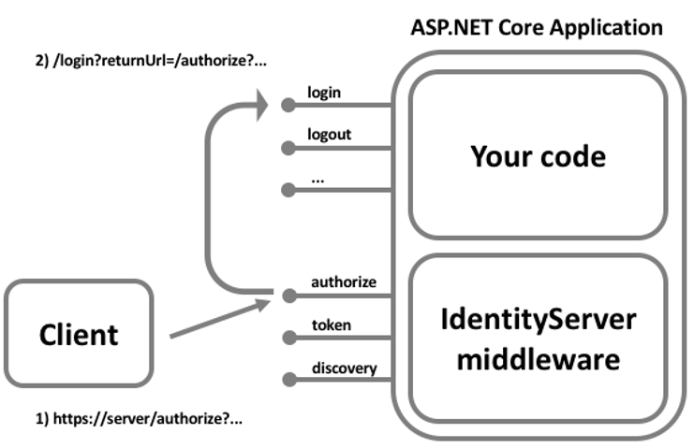
Identity Server Login

Slide 18
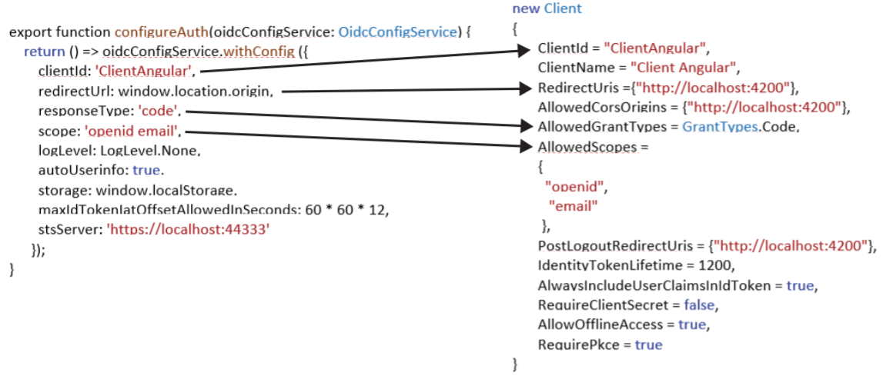
Angular Client
Angular Lib for OpenID Connect & OAuth2
npm install angular-auth-oidc-client

Slide 19
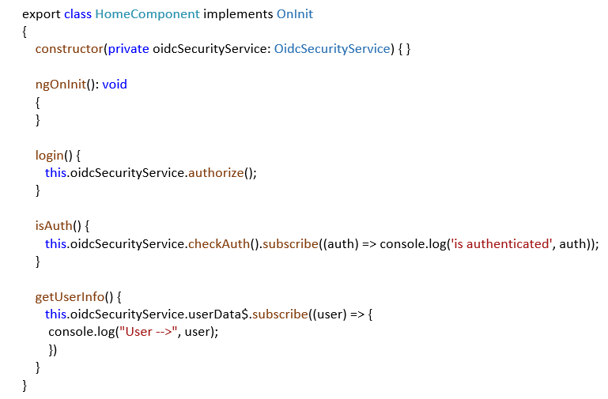
Angular Client

Slide 20
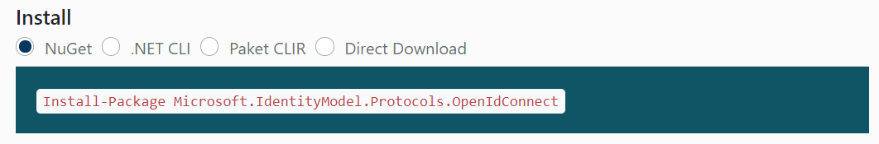
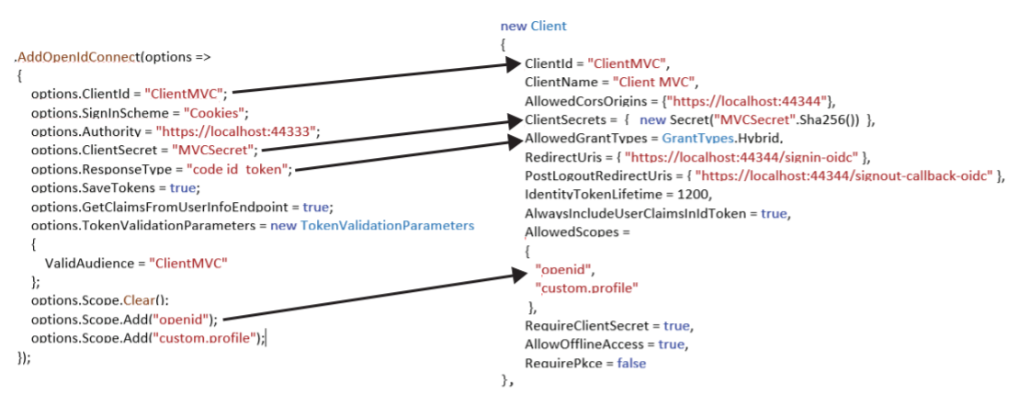
MVC Client

Slide 21
Zaključak
Alternative
Komparativne Tehnike

