Slide 1
Analiza i implementacija Single Sign On metode autentifikacione šeme
Sta je Single Sign On (SSO) ?

Slide 2
Ujedinjeni sistemi identiteta (Federated Identity)
Ujedinjeni sistemi identiteta rešavaju nekoliko problema:
Autentifikacija
Pravo pristupa resursima
Razmena korisnickih podataka
Upravljanje korisnicima

Slide 3
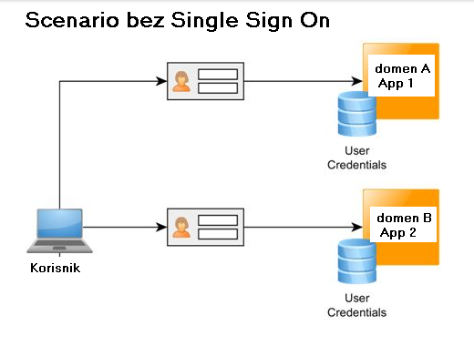
Scenario bez Singe Sign On-a

Slide 4
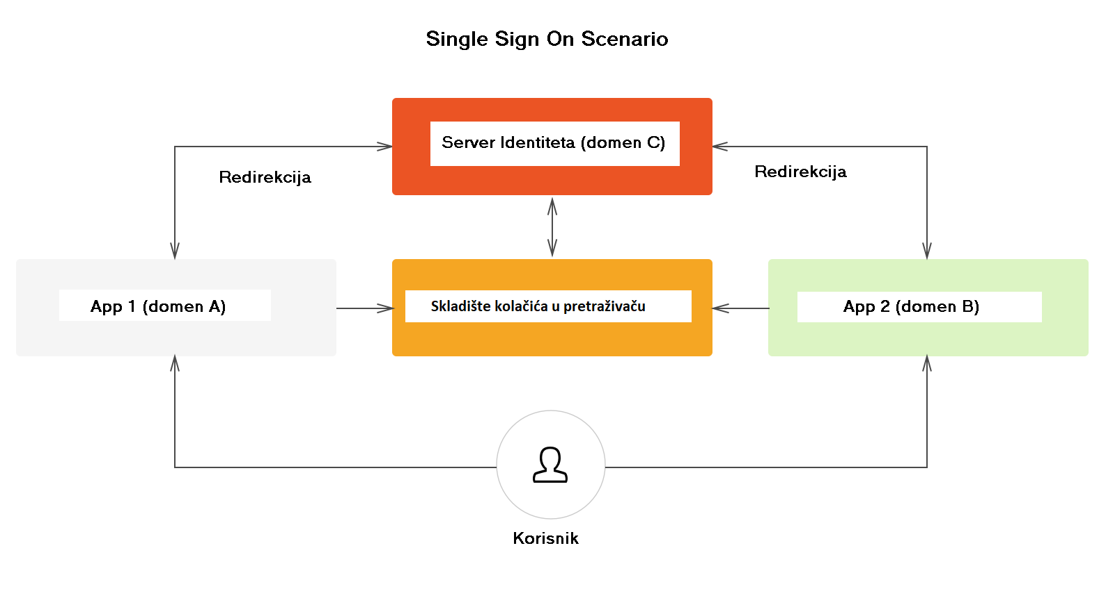
Scenario sa Singe Sign On-om

Slide 5
Singl Sign On
Prednosti Singe Sign On-a
Problemi Single Sing On-a

Slide 6
OpenId Connect (OIDC)
Sta je OAuth2 ?
Sta je OIDC ?

Slide 7
Koncepti OAuth2
Vlasnik Resursa (Resource Owner)
OAuth Klijent
OAuth server (IdP)
Server Resursa (Resource Server)
Token Identiteta (ID Token)
Dodela Odobrenja (Authorization Grant)

Slide 8
Dodela I Tokovi Odobrenja (Authorization Flow Grants)
Tok Autorizacionim kodom (eng. Authorization Code Flow)
Implicitni Tok (eng. Implicit Flow)
Hibridni Tok (eng. Hybrid Flow) – Dodatno uveden od strane OIDC sa posebnim namenama
Tok Autorizacionim kodom sa dokazom kljuca za razmenu kodova (eng. Authorization Code Flow with Proof Key for Code Excange - PKCE)

Slide 9
Tok Autorizacionim kodom (eng. Authorization Code Flow)
Zahtev za Autentikaciju
GET/oidc/authorize? response_type=code &scope=openid%20profile%20email &client_id=s6BhdRkqt3 &state=af0ifjsldkj &redirect_uri=https%3A%2F%2Fclient.example.org%2Fcb HTTP/1.1 &nonce=fjsjsellesldska... Host: server.example.com
Uspešan odgovor nakon potvrde identiteta
HTTP/1.1 302 Found Location: https://client.example.org/cb? code=SplxlOBeZQQYbYS6WxSbIA &state=af0ifjsld

Slide 10
Tok Autorizacionim kodom (eng. Authorization Code Flow)
Zahtev za dobijanje tokena
POST /oidc/token HTTP/1.1 Host: server.example.com Content-Type: application/x-www-form-urlencoded grant_type=authorization_code& code=SplxlOBeZQQYbYS6WxSbIA& redirect_uri=https%3A%2F%2Fclient.example.org%2Fcb& client_id=s6BhdRkqt3& client_secret=secret_1234
Odgovor Token metode
“access_token”: “SlAV32hkKG”, “token_type”: “Bearer”, “expires_in”: 3600, “id_token”: “eyJhbGciOiJSUzI1NiIsImtpZCI6IjFlOWdkazcifQ.ewogImlzc…”

Slide 11
Implicitni Tok
Zahtev za autentikaciju
GET /oidc/authorize? response_type=id_token%20token &client_id=s6BhdRkqt3 &redirect_uri=https%3A%2F%2Fclient.example.org%2Fcb &scope=openid%20profile &state=af0ifjsldkj &nonce=n-0S6_WzA2Mj HTTP/1.1
Uspešan odgovor nakon potvrde identiteta
HTTP/1.1 302 Found Location: https://client.example.org/cb# access_token=SlAV32hkKG &token_type=bearer &id_token=eyJ0 ... NiJ9.eyJ1c ... I6IjIifX0.DeWt4Qu ... ZXso &expires_in=3600 &state=af0ifjsldkj

Slide 12
Tok Autorizacionim kodom sa dokazom kljuca za razmenu kodova (Authorization Code Flow with Proof Key for Code Excange - PKCE)
Zahtev za autentikaciju
GET /oidc/authorize?response_type=code &scope=openid%20profile%20email &client_id=s6BhdRkqt3 &state=af0ifjsldkj &code_challange= PCBxoCJMdDloUVl1ctjvA6VNbY6fTg1P7PNhymbydM $ code_challenge_method=S256 &redirect_uri=https%3A%2F%2Fclient.example.org%2Fcb HTTP/1.1 Host: server.example.com
Uspešan odgovor nakon potvrde identiteta
GET https://client.example.org/cb? code=SplxlOBeZQQYbYS6WxSbIA &state=af0ifjsldkj

Slide 13
Tok Autorizacionim kodom sa dokazom kljuca za razmenu kodova (Authorization Code Flow with Proof Key for Code Excange - PKCE)
Zahtev za dobijanje tokena
POST /oidc/token HTTP/1.1 Host: server.example.com Content-Type: application/x-www-form-urlencoded grant_type=authorization_code& code=SplxlOBeZQQYbYS6WxSbIA& redirect_uri=https%3A%2F%2Fclient.example.org%2Fcb& client_id=s6BhdRkqt3& code_verifier=shekrslsnj4kfdksfksk

Slide 14
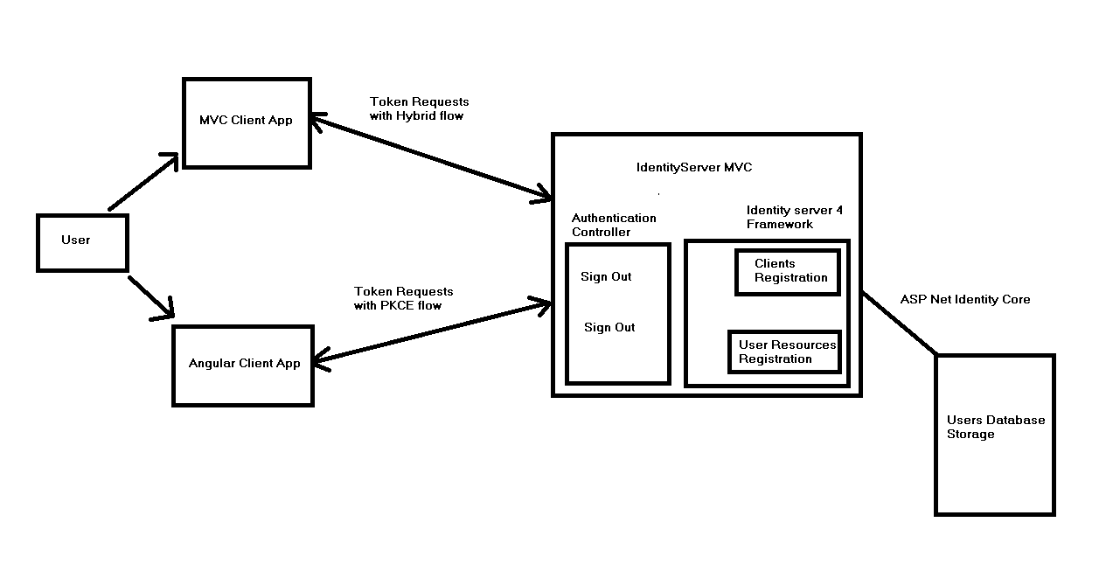
Arhitektura Sistema

Slide 15
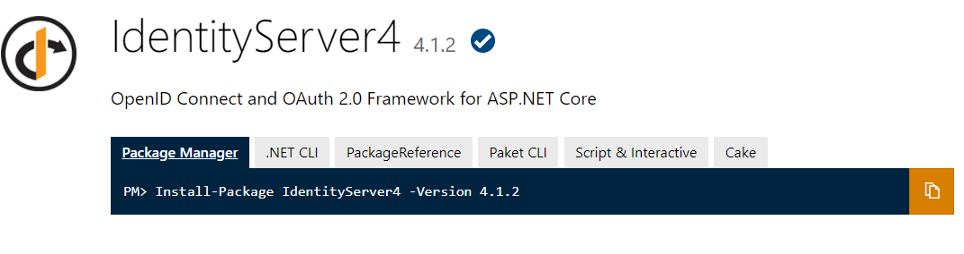
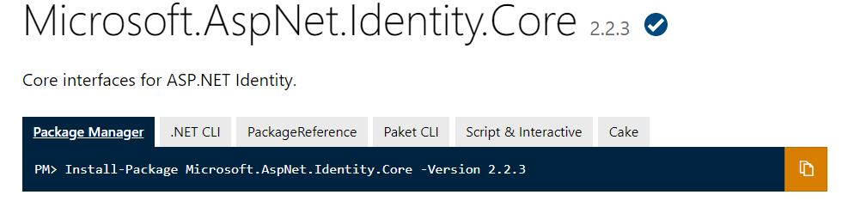
Identity Server Solution
Oidc implementation
Validacija kredencijala i kreiranje kolačića sesije

Slide 16
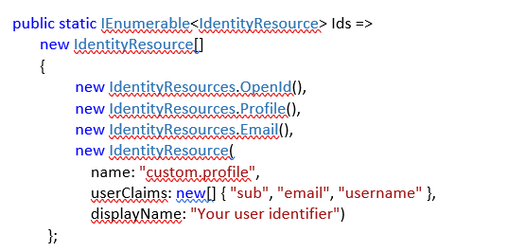
Identity Server 4 resources
Identity Resources
API resources

Slide 17
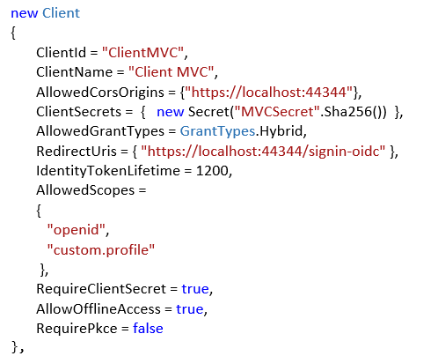
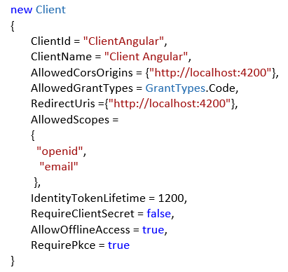
Identity Server 4 Clients

Slide 18
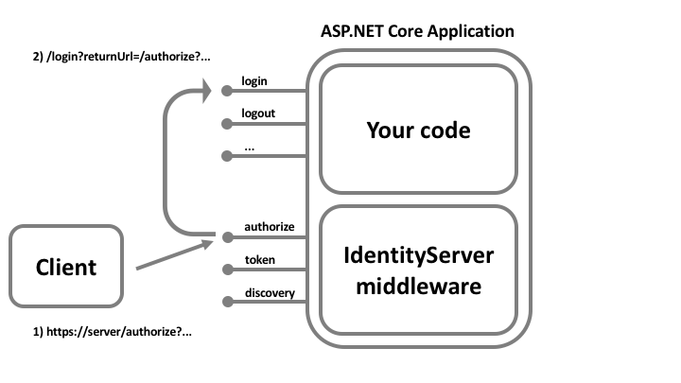
Identity Server Login

Slide 19
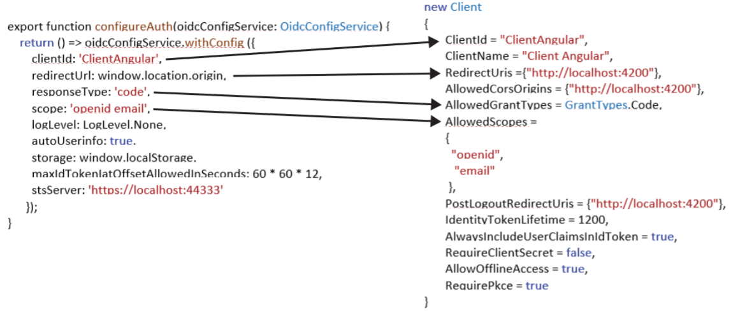
Angular Client
Angular Lib for OpenID Connect & OAuth2
npm install angular-auth-oidc-client

Slide 20
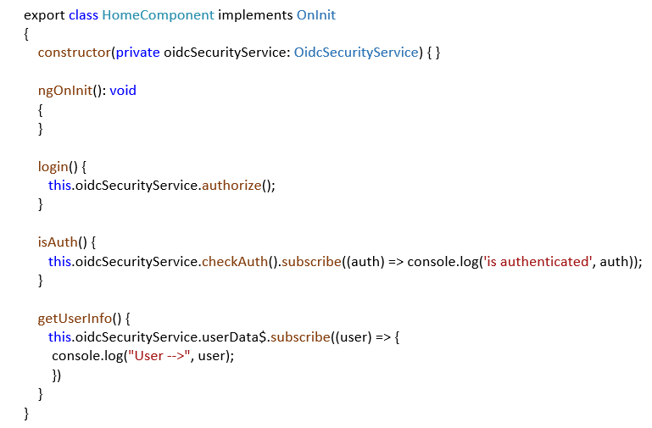
Angular Client

Slide 21
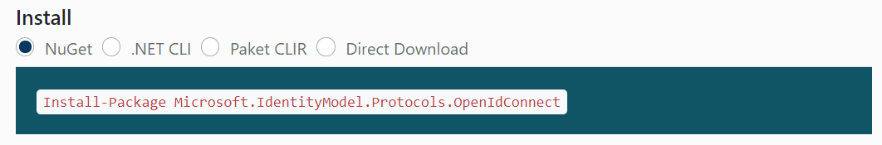
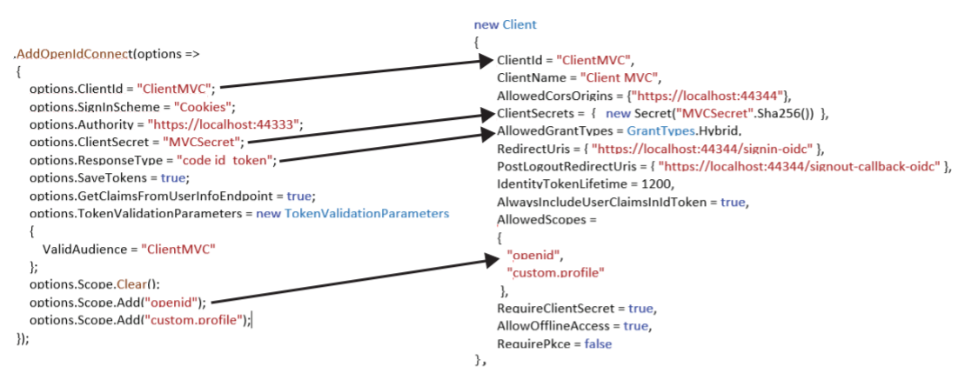
MVC Client

Slide 22
Zakljucak
Alternative
Komparativne Tehnike

