Slide 1
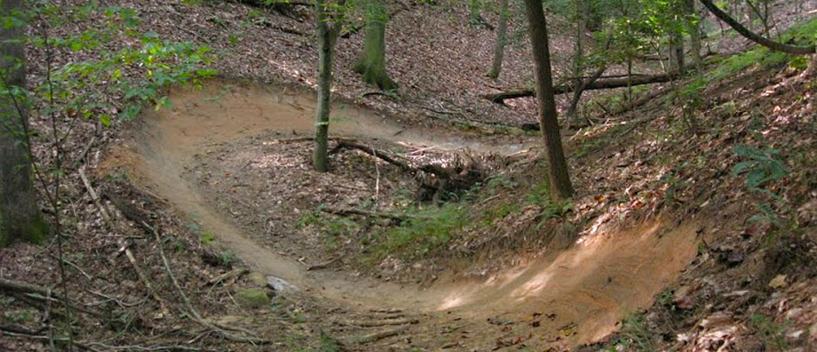
CrankHeads
A hub for north Carolina Mountain biking

Slide 2
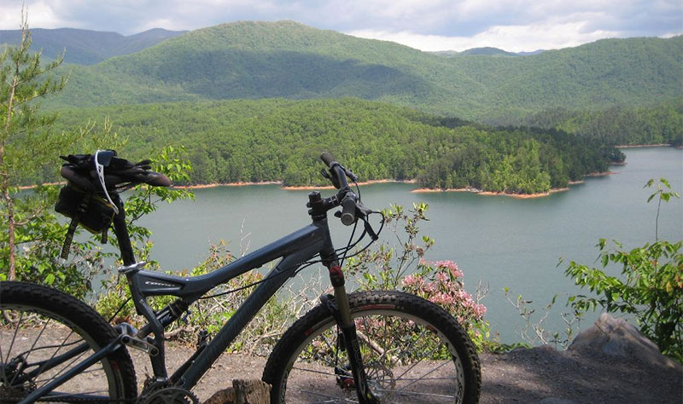
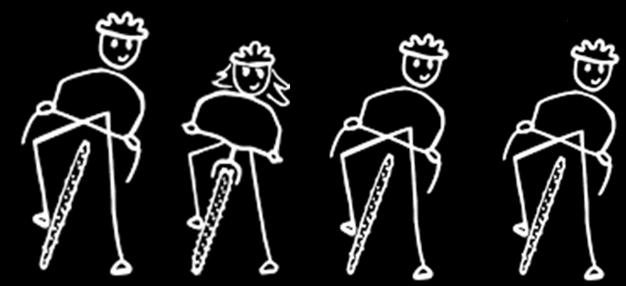


MOTIVATION
+
Berk
Sharon
Ned
Henry
=

Slide 3
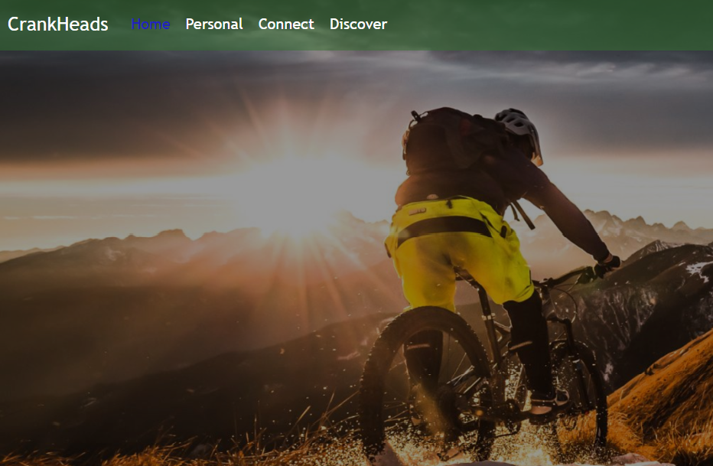

Slide 4
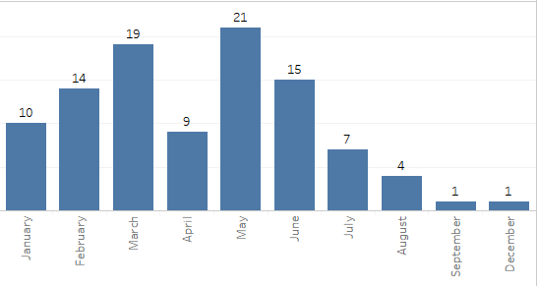
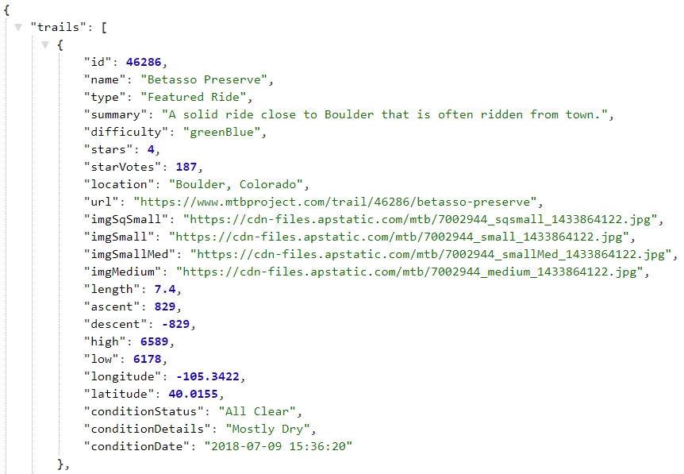

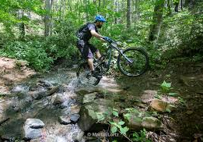
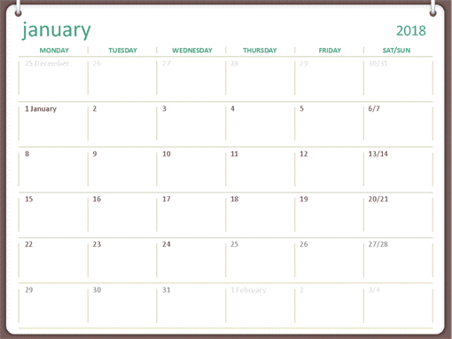
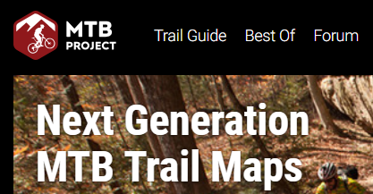

The Concept

Slide 5
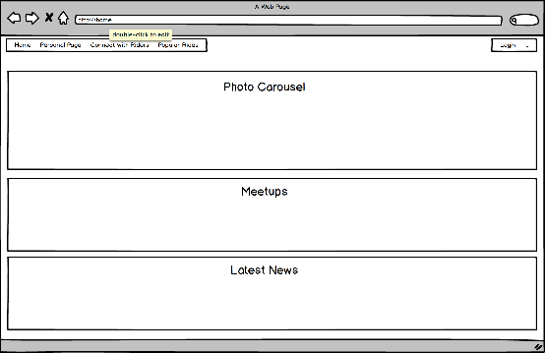
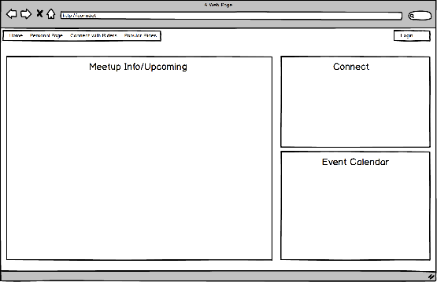
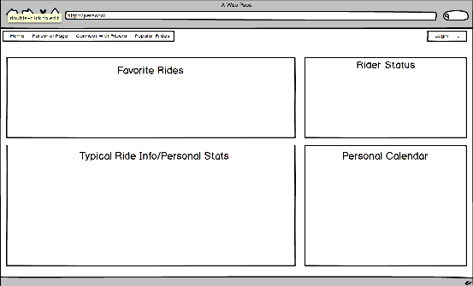
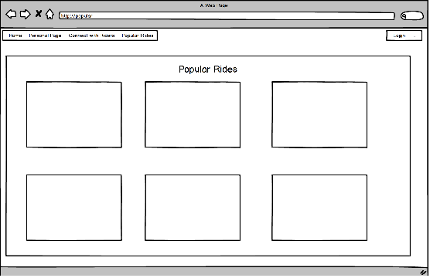
The Proposal Process

Slide 6
THE Design Process
Berk & Henry
Ned & Sharon
Authentication:
Passport.js & bcrypt
MongoDB
API’s:
Meetup.com & mtbproject.com
Researched Calendars
Styling & Layout
Rejoined efforts to pull all
of our research together

Slide 7
The Technologies
HTML / CSS / JavaScript
Passport.js / bcrypt
Node.js / Express.js
MongoDB / Mongoose
React.js
Bootstrap
"dependencies": {
"axios": "^0.16.2",
"bcrypt": "^3.0.0",
"body-parser": "^1.17.2",
"express": "^4.15.4",
"express-session": "^1.15.6",
"if-env": "^1.0.4",
"moment": "^2.22.2",
"mongoose": "^5.0.17",
"passport": "^0.4.0",
"passport-local": "^1.0.0",
"react-star-ratings": "^2.3.0",
"reactstrap": "^6.3.0"
}

Slide 8
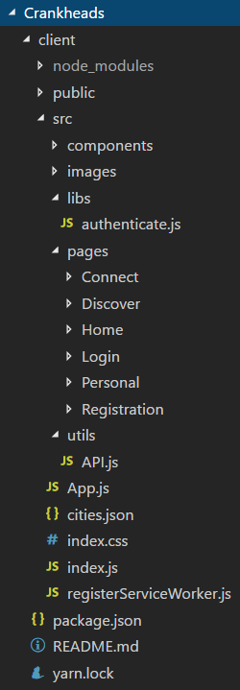
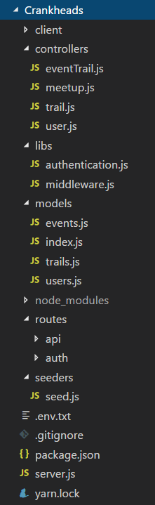
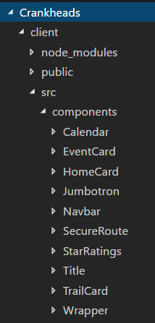
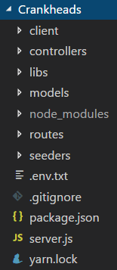
The file structure

Slide 9
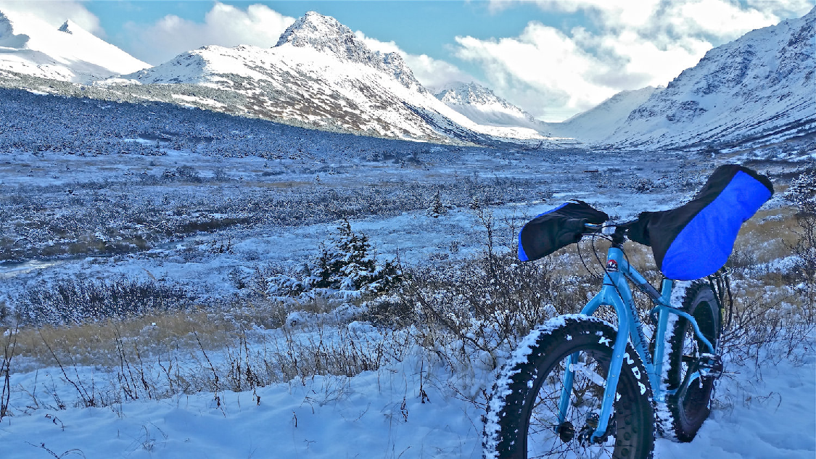

The Functionality
https://peaceful-anchorae-48128.herokuapp.com/

Slide 10
future Improvements
Photo Upload Functionality: Allow users to upload and display pictures to a photo carousel on their profile page.
Open/Closed Trails: Real time access to see if a trail is open or closed due to weather.
Trail Check-in: Logged in users will be able to see what trails are currently being ridden by other authorized riders (of course can opt out) and post comments to a trail wall about conditions or wildlife.
GPS Connection to Mobile Device: Mobile device tracking can automatically track and upload to your profile page (track speed) and show where you are on the trail course.
Expand Geography Served: Currently limiting the API call by NC cities but the data available is throughout the U.S.
Include Other Outdoor Activities: The data exists – might as well use it and get outdoors!

