Slide 1
FORECASTING EQUITY PRICES
02/07/22
SUHEYL ENIS ARAS

Slide 2
Motivations
Trying to identify trends in the equity data.
Predicting the future of the data using time series forecasting.
Better understanding the data for the next steps in the project.

Slide 3
Smoothing based models
Removes outliers to make patterns more visible.
Specifically, random variation in the data.

Slide 4
Moving-average model
Uses the window average to figure out trends in the data.
Double Exponential Smoothing Model
Alpha: Smoothing factor for level.
Beta: Smoothing factor for the trend.
By using numerical optimization on these two parameters we can find the

Slide 5
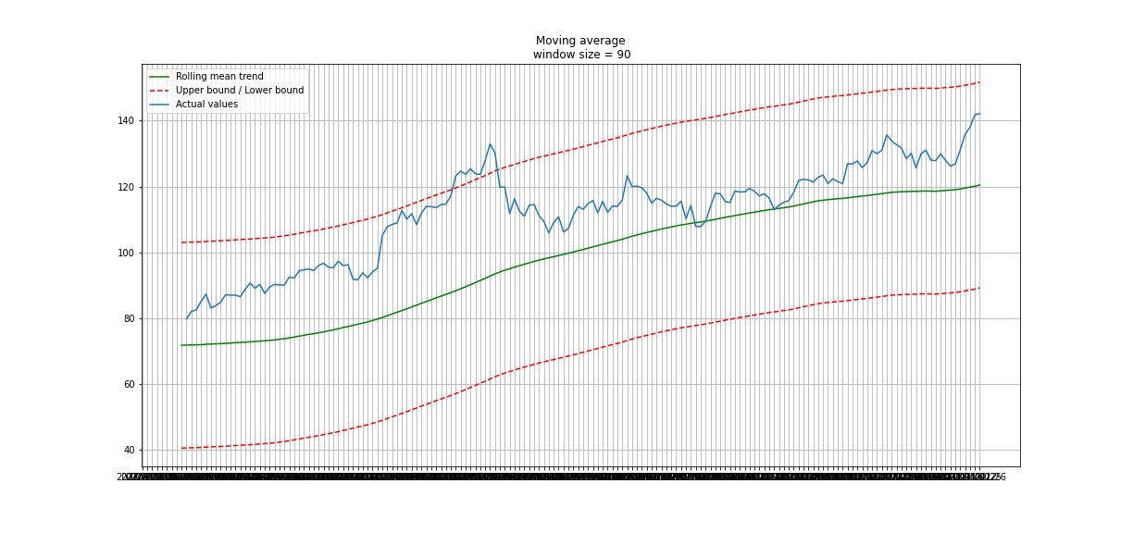
Plot of moving average model on MMM

Slide 6
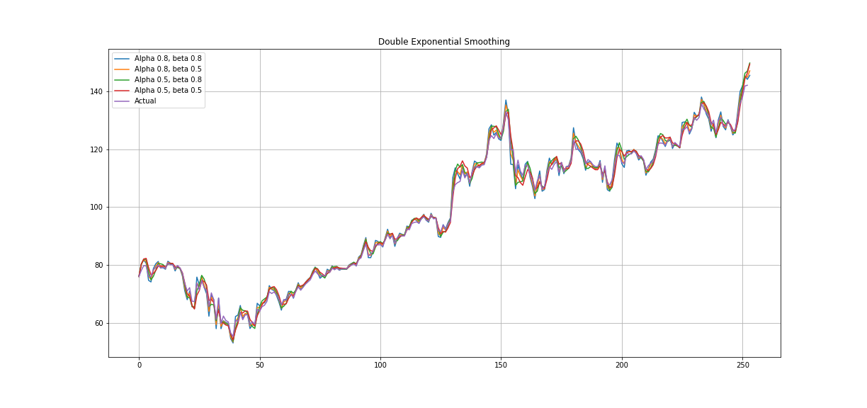
Plot of DOUBLE exponential moving average on mmm

Slide 7
ARIMA(Autoregressive integrated moving average)
Linear regression model that accounts for the moving average.
p: The lag order.
d: Degree of differencing.
q: The size of the moving average window.

Slide 8
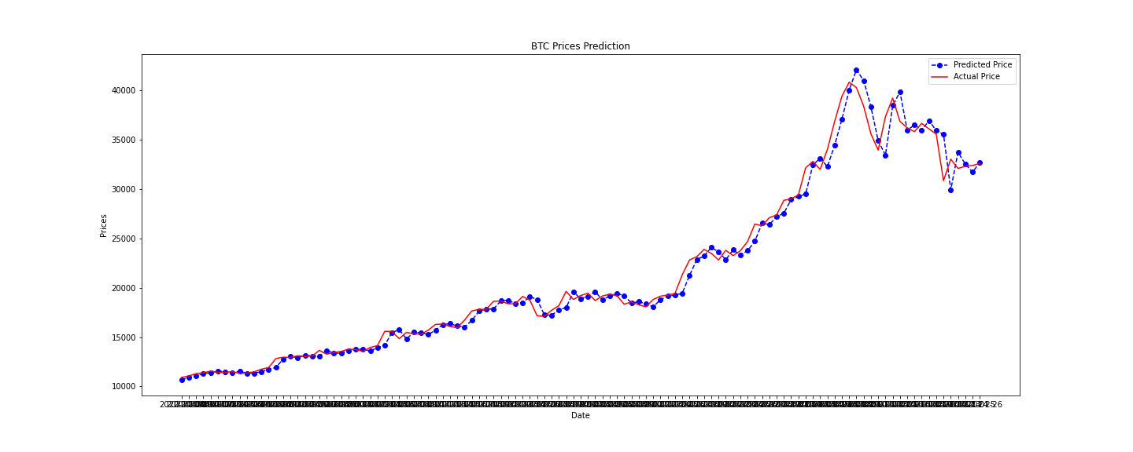
Plot of arima on bitcoin data

Slide 9
SARIMA
Seasonal ARIMA, adds 4 new hyperparameters.
P: Seasonal autoregressive order.
D: Seasonal difference order.
Q: Seasonal moving average order.
m: The number of time steps for a single seasonal period.
SARIMA(p,d,q)(P,D,Q)m

Slide 10
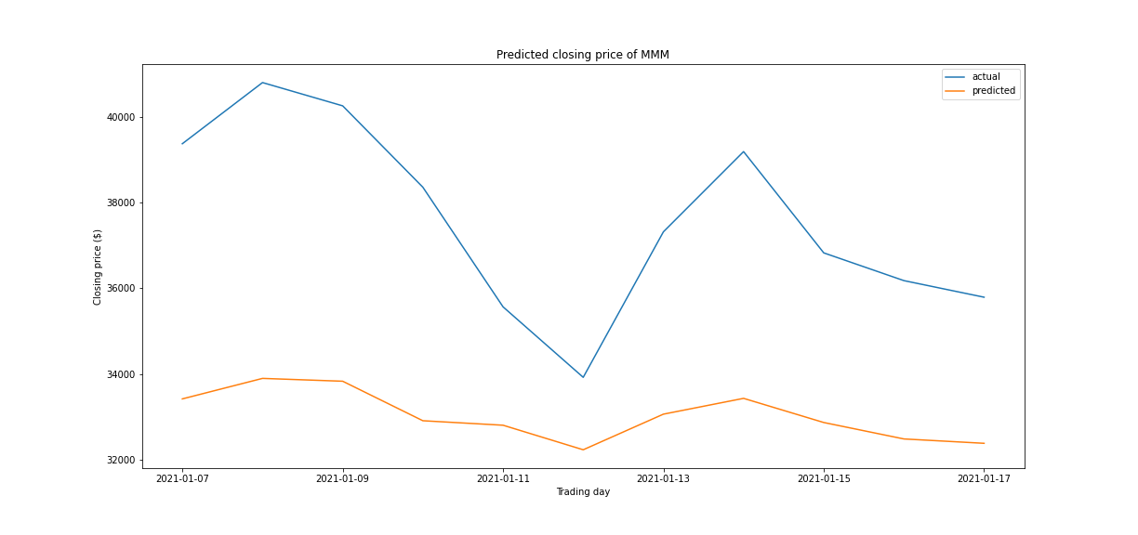
Plot of SARIMA PREDICTIONS on bitcoin data

Slide 11
Research paper of the week
Selene Yue(Berkeley): Stock-Price-Forecasting
Demonstrates methods of stock price forecasting and compares each method.

Slide 12
Next steps
Try to make predictions using Deep Neural Networks(LSTM, Bayesian)
Financial Technical Analysis to forecast the data.
Read more about reinforcement learning and its applications to financial data.

