Slide 1


Financial Technical Analysis
Suheyl Enis Aras

Slide 2
Motivations
Identify trading opportunities.
Build on forecasting methods to produce trading strategies.
Figure out how to combine Reinforcement Learning with technical analysis.

Slide 3
Strategy #1
SMA Cross
Short Period v. Long Period
Buy when short period > long period
Sell when long period > short period

Slide 4
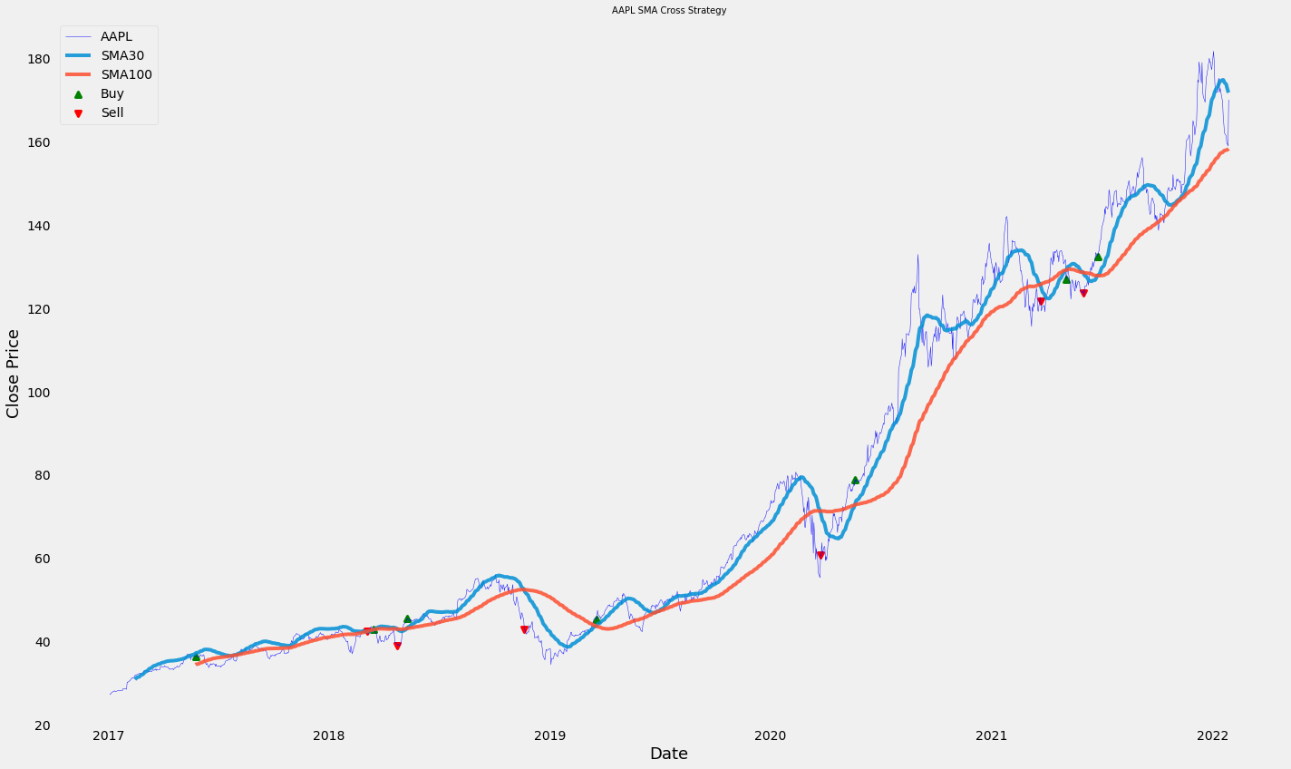
SMA Cross Graph

Slide 5
Strategy #2
Bollinger Bands
Positive and negative standard deviation and the SMA is considered.
When the price touches the negative standard deviation, we buy.
When the price touches the positive standard deviation, we sell.

Slide 6
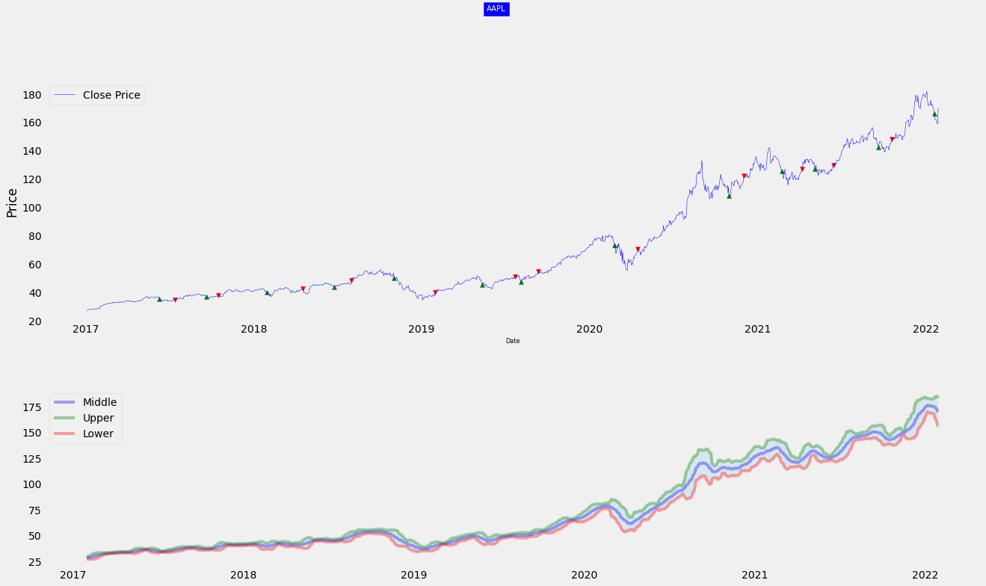
Bollinger Bands Cross Graph

Slide 7
Ideas for using Financial Analysis with Machine Learning
Instead of using the price as input for the algorithms, use the values obtained by the technical indicators.
Optimize the model by adding the technical indicators as a parameter to the algorithms.
Create portfolios of similar stocks by using Gaussian Clustering with the help of technical indicators.

Slide 8
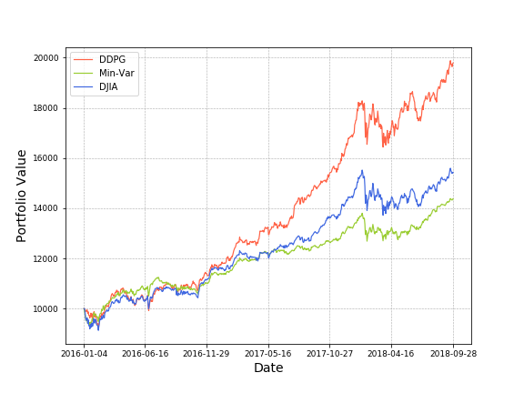
Research Paper of the Week
Practical Deep Reinforcement Learning for Stock Trading(2018) by Zhuron Xiong
Formulates the stock trading problem as a Markow Chain Process.
Uses DDPG as the main model.
Compares profits with buy and hold and Min-Var methods.

Slide 9
Next Steps
Implement a trading environment and test trading strategies on it to find profitable ones.
Incorporate technical indicators into some deep learning algorithms using the forementioned ideas.
Compare the results using plain technical analysis and machine learning with technical analysis.

