Slide 1


Financial Technical Analysis
Suheyl Enis Aras

Slide 2
Motivations
Identify trading opportunities.
Build on forecasting methods to produce trading strategies.
Figure out how to combine Reinforcement Learning with technical analysis.

Slide 3
Strategies
SMA Cross
Short Period v. Long Period
Buy when short period > long period
Sell when long period > short period

Slide 4
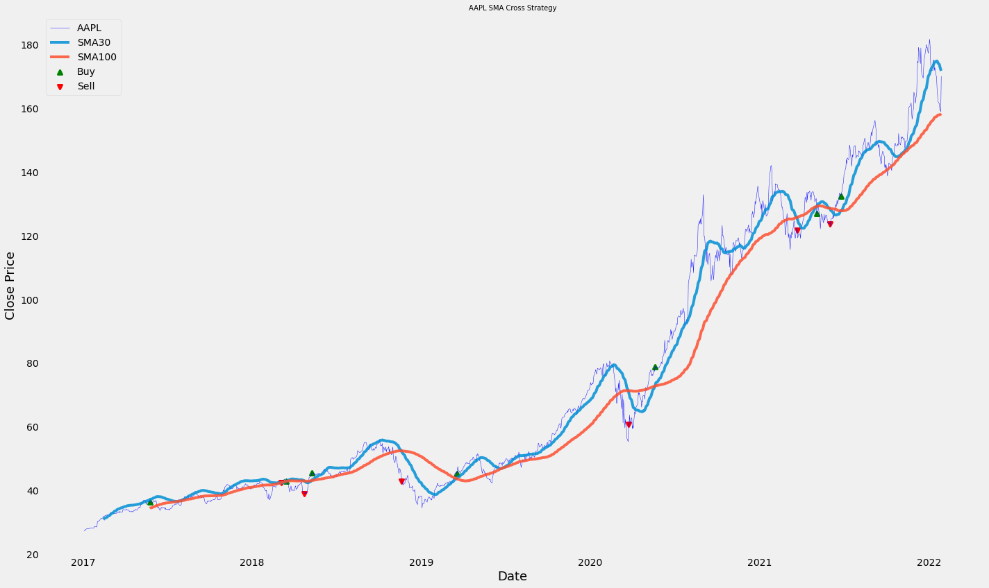
SMA Cross Graph

Slide 5
Strategies
MACD Cross
Tracks upward and downward momentum
Enter a trade when MACD line > Signal line (moving average of MACD line),
Sell when MACD line < Signal line

Slide 6
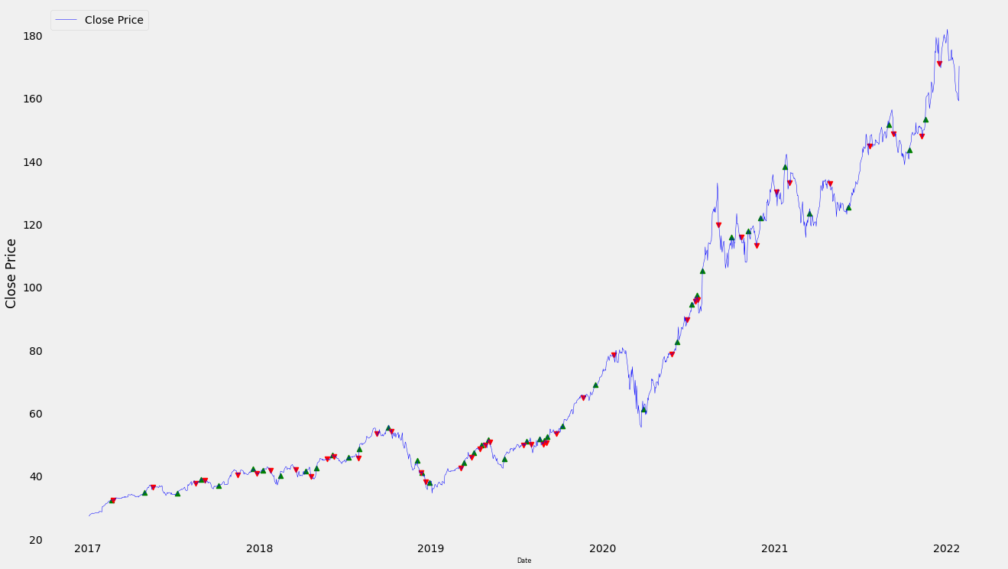
MACD Cross Graph

Slide 7
Strategies
Bollinger Bands

Slide 8
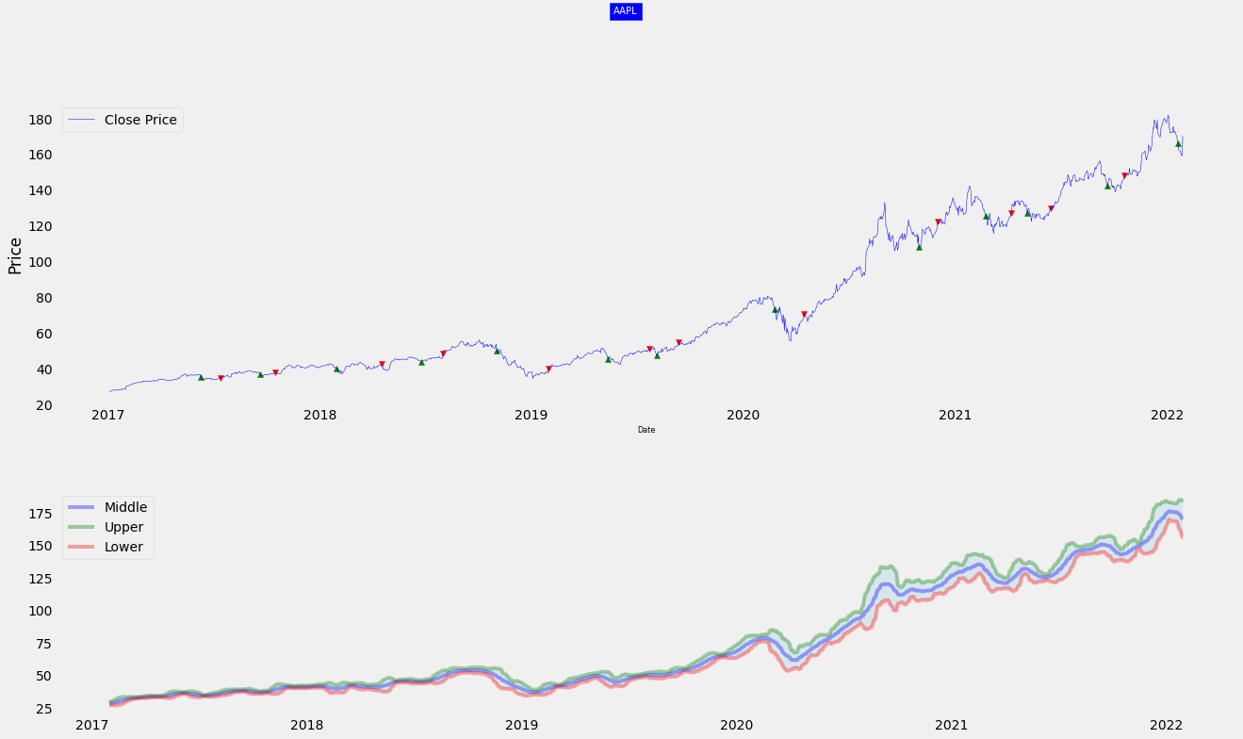
Bollinger Bands Cross Graph

