Slide 1

Structuring System Requirements: Process Modeling
Chapter 5
This lecture is based on materials in Essentials of Systems Analysis and Design by Valacich, George, and Hoffer and the summary slides available on their website. However, some material herein also represents the perspective of Gregory Rose of Washington State University. Where materials are taken verbatim from the textbook slides, they represent the views of the book and are copyrighted by the authors and the publisher. Where the sequence or content differ, the content is considered the work of Gregory Rose with all copyrights reserved.

Slide 2
Notes
Note 1: Make sure to bring a print out of the notes pack for ch5pt1 to class. I will need to be referring to various pages back and forth and working on the board with you. So it would be best if we simply worked from the notes packet individually and used the front of the room for the white board and for me to write. Please print off the packet the day of the lecture to make sure you have the most current version. Also, please print off pages 51-55 on full sized sheets. We will basically be working with these up on the board as our example and then use the lecture to explain how the diagrams were derived and what they mean.
Note 2: On page 165, Figure 5-8 has two “D2: Goods Sold File” data stores. The lower one should be “D1: Inventory File”

Slide 3
Modeling Data and Processes in Information Systems
As indicated before, systems have inputs that are used to perform a function and create outputs
Four key components of an information system
  External entities (outside data sources and sinks)
  Data Stores (data at rest)
  Data Flows (data in motion)
  Processing Logic
Each needs to be understood in context in order to automate or improve a physical system with an information system
One way of understanding comes through capturing system via process modeling

Slide 4
System Modeling with the Process-Oriented Approach
Process-Oriented Approach
  Focus is on flow, use and transformation of data in an information system
  Involves creating graphical representations such as data flow diagrams and charts
  Data are tracked from sources, through intermediate steps and to final destinations
Data flow diagramming is one example of a method
Will be one of the primary discussions of this class
So what do is meant by “data”?

Slide 5
Data and Processes in Information Systems
Data vs. Information
  Data
    Raw facts
  Information
    Derived from data
    Organized in a manner that humans can
    understand
    A result of processing data

Slide 6
Data and Processes in Information Systems
Data
  Understanding the source and use of data is key to good system design
  Various techniques are used to describe data and the relationship amongst data

Slide 7
Data and Processes in Information Systems
Data Flows
  Groups of data that move and flow through the system
  Include description of sources and destination for each data flow
Data Stores
  Data at rest
Processing Logic
  Describe steps that transform data and events that trigger the steps
Sources and Sinks
  Outside of the system. Give or get information
This is review of what you want to capture in model. How do we model a system???

Slide 8
Process Modeling
One way is process modeling
  A graphical technique to represent processes that capture, manipulate, store, and distribute data
  Method for this course will be data flow diagramming
  Again, is just exemplar of modeling

Slide 9
Data Flow Diagramming (DFD)
a picture of the movement of data between external entities and the process and data within a system
lead to accurate and well structure process models
most popular tool for documenting processes
shows how a system’s environment, processes, and data are interconnected

Slide 10
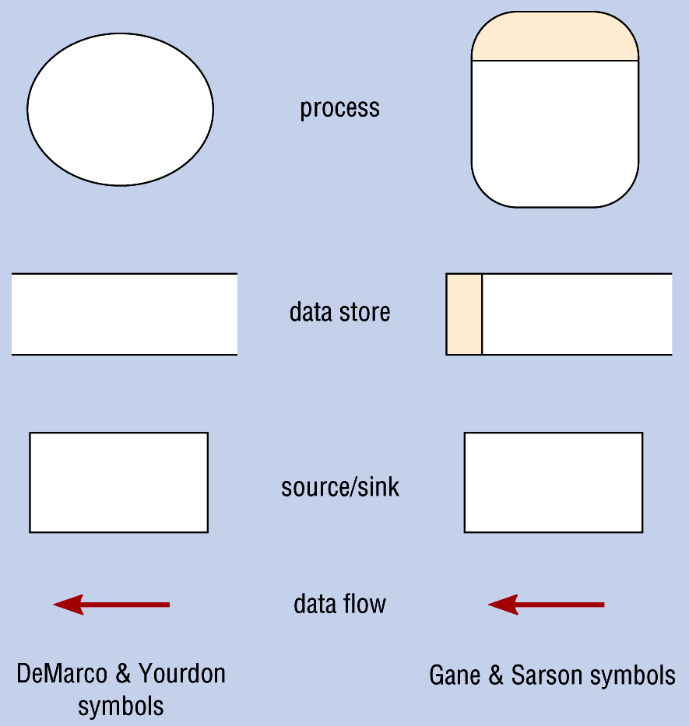
DFD Terms & Symbols
Process
  Manual or computerized actions performed on data
  stores, distributes, or transforms data
Data Store
  place where data is kept (manual or computerized)
Source/Sink
  environmental elements (i.e. external agents)
  we don’t care about what it does after we get information to it, or do not care about how it arrived at the information we are getting from it.
Data Flow
  data that travels together (i.e., a report, a form, a fax)

Slide 11
Context Diagram describes the system within the context of its environment; shows boundaries, external environment and major information flows
Sales orders
Customers
Accepted
sales order file
0
Order
Entry
System
Rejected
sales order report
Item numbers
Inventory
System
President
Item prices

Slide 12
Important System Concept- Going from Context to Detail
Decomposition (or “factoring”)
  The process of breaking down a system into smaller components
  Allows the systems analyst to:
    Break a system into small, manageable subsystems
    Focus on one area at a time
    Concentrate on component pertinent to one group of users
    Build different components at independent times
  Example, highest system for a fully integrated company is simply “the organization.” Factored sub units are Marketing, Finance, etc. Sub-factors in Marketing are Public Relations, Customer Service, Sales, etc..
  Each can be factored into sub-functions until atomic level (e.g., compute invoice total)

Slide 13
Designing Level-0
Rule of thumb:
  no more than 7 processes in one diagram
Include all the following from the Context Diagram
  all environmental elements
    (i.e. source/sinks)
  all data flows
Then expand detail of the processes and internal data flows and stores

Slide 14
Level-0 Diagram
Sales orders
Customers
1.0
Screen
sales
orders
Accepted
sales order file
Rejected
sales order file
2.0
Sort
rejected
sales order
file
Item numbers
Sorted rejected
sales order file
Inventory
System
3.0
Prepare
rejected
sales order
report
Item prices
Rejected
sales order report
President

Slide 15
Level-n Diagrams
Functional decomposition
  iterative process of breaking the description of the system into finer and finer detail
Functional Primitive DFD
  the point where no sub-process can logically be broken down any further (e.g., could be something like a diagram of process 3.2.2 broken into its 5 sub-processes)

Slide 16
Level-n Diagrams
Multiple DFDs are call Leveled DFDs
  developed in a systematic, top-down manner
  maintaining consistency from one level to the next
Balanced DFD
  A process must have the same number of inputs & outputs it had at a higher level in any decomposed diagrams

Slide 17
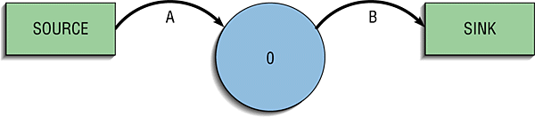
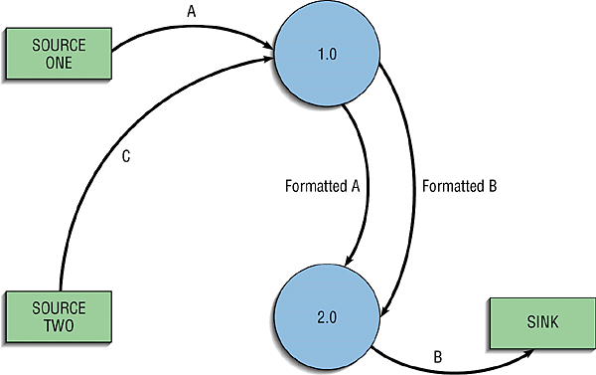
Unbalanced DFDs Example

Slide 18
Level 1 Diagram (for Process 1.0)
Sales orders
Customers
1.1
Verify
item
number
Item numbers
Accepted
sales order file
Verified item numbers
1.2
Verify
price
Inventory
System
Item prices
Rejected
sales order file

Slide 19
Rules for DFDs
No process can have only outputs. It is making data from nothing (miracle). If an object has only outputs, it must be a….miracle
No process can have only inputs (black hole). If an object has only inputs, it must be a …black hole
A process has a verb phrase label.
Data cannot move directly among stores, sinks or sources. Data may be moved by a process only. If not, the data is coming from an external entity, not a data store.

Slide 20
Rules for DFDs
A data store, source/sink has a noun phrase label.
A data flow has only one direction of flow between symbols. It may flow in both directions between a process and a data store to show a read before an update. The latter is usually indicated by two separate arrows since these happen at different times.
A fork in data flow means that exactly the same data goes from a common location to two or more different processes, stores, sources/sinks (this usually indicates copies going different places).

Slide 21
Rules for DFDs
A join in data flow means that exactly the same data comes from any two or more different processes, stores, sources/sinks, to a common location.
A data flow cannot go directly back to the same process it leaves. There must be another process which does something with the data before returning it.
A data flow to a data store means update (delete or change).

Slide 22
Rules for DFDs
A data flow from a data store means to retrieve or use (read).
A data flow has a noun phrase label. More than one data flow (phrase) may appear as one line/arrow as long as they move together as one package.
At the lowest level of DFDs, new data flows may be added for data transmitted for exceptional conditions (typically these are error messages like “printer not found” or “login incorrect”)
You may repeat sinks/stores/sources on a diagram if it helps avoid overlapping lines. Indicate there is more than one copy of the entity by marking with some symbol like a double lines or a dog-eared corner, etc.

Slide 23
Rules for DFDs
A composite data flow on one level can be split into component data flows at the next level, but no new data can be added and all data in the composite must be accounted for in one or more subflows
The input to a process must be sufficient to produce the outputs (including data placed in data stores) from the process. Thus all outputs can be produced, and all data in inputs move somewhere, either to another process or to a data store outside the process or on a more detailed DFD showing a decomposition of that process.

Slide 24
One Last Word on Data Flows
Common error
  A data flow is a single data item or a combination of them
  If a data flow exists on multiple DFD level diagrams, the flows MUST be identical in name and content
  If you have the two data flows with slightly different data fields, they are NOT the same and should be documented as different

Slide 25
Some general rules about diagramming follows:

Slide 26
Wrong

Slide 27
Right

Slide 28
Wrong

Slide 29
Right

Slide 30
Wrong

Slide 31
Right

Slide 32
Wrong

Slide 33
Right

Slide 34
Wrong

Slide 35
Right

Slide 36
Wrong

Slide 37
Right

Slide 38
Wrong

Slide 39
Right

Slide 40
Wrong
A
B

Slide 41
Right
A
A

Slide 42
Right

Slide 43
Wrong
A
B

Slide 44
Right
A
A

Slide 45
Right

Slide 46
Wrong
A

Slide 47
Right
B
A
A
A
C

Slide 48
DFD guidelines
Completeness
  the extent to which all necessary components of a data flow diagram have been included and fully described.
Consistency
  the extent to which information contained on one level of a set of nested data flow diagram is also included on other levels.

Slide 49
DFD guidelines (cont.)
Iterative development
  keep working and revising
Primitive DFDs
  the lowest level of decomposition for a data flow diagram. “ready for coding”

Slide 50
DFD guidelines (cont.)
Missing from DFDs
  Timing
    DFDs do not really address this issue. Use a State-Transition Diagram (see appx A) if you feel you must model this aspect of the system.
  Internal logic
    DFDs do not show internal logic to modules. This includes constraints and decision trees. Use logical modeling techniques (e.g., pseudo code).
  Data relationships and structure. Use data modeling like ERDs for this.

Slide 51
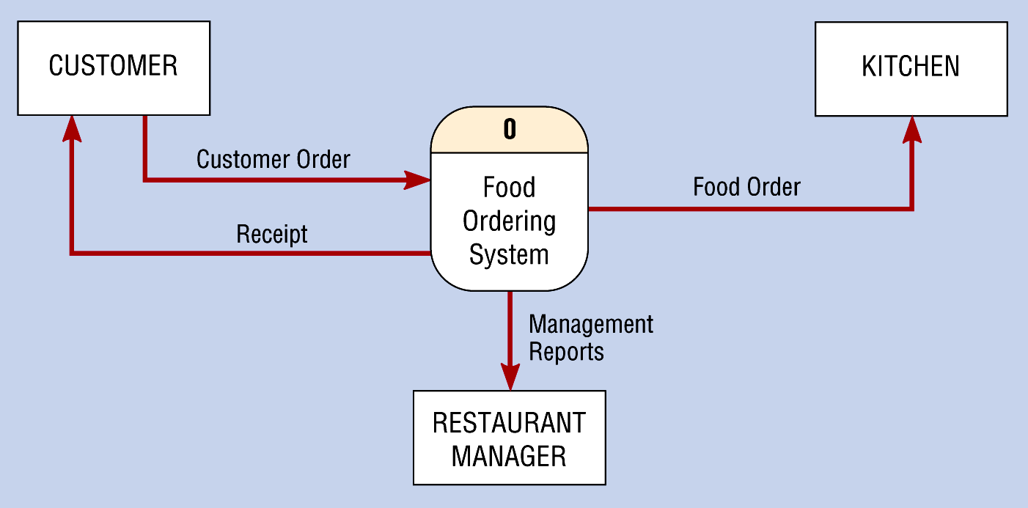
Context Diagram of Food Ordering System

Slide 52
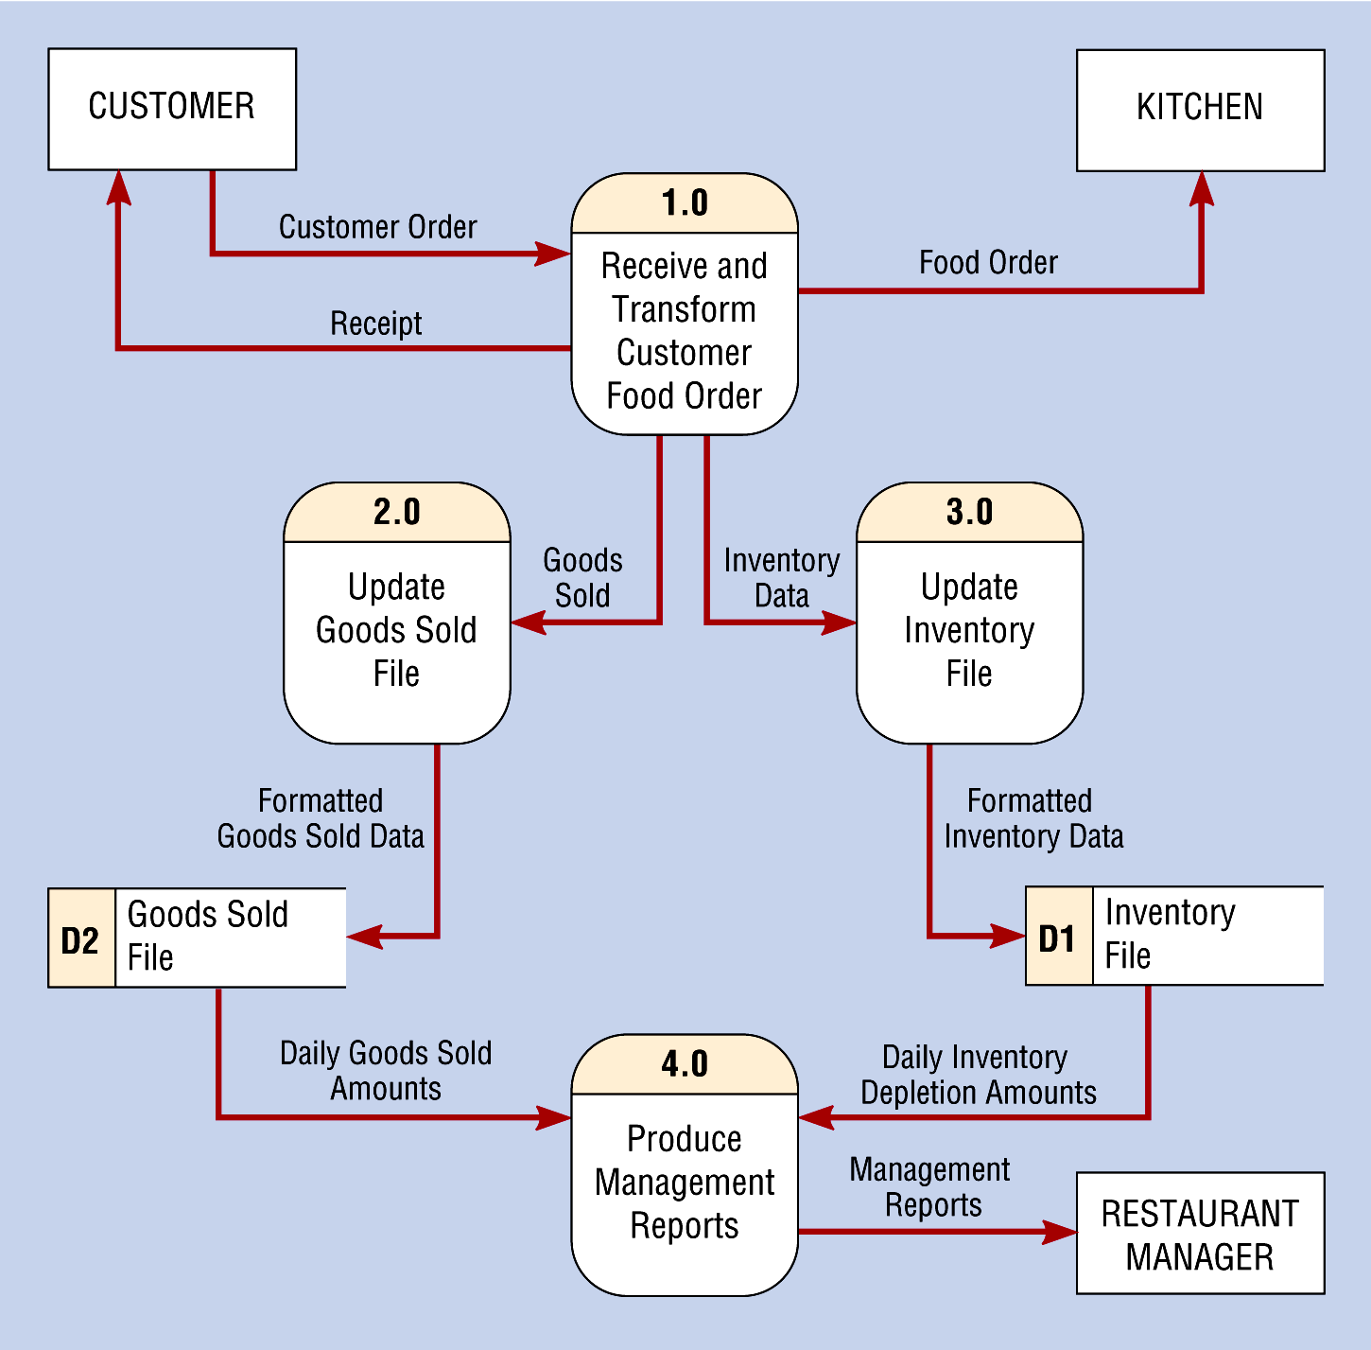
Level-0 DFD of Food Ordering System
Note that the food isn’t on here. It isn’t data.

Slide 53
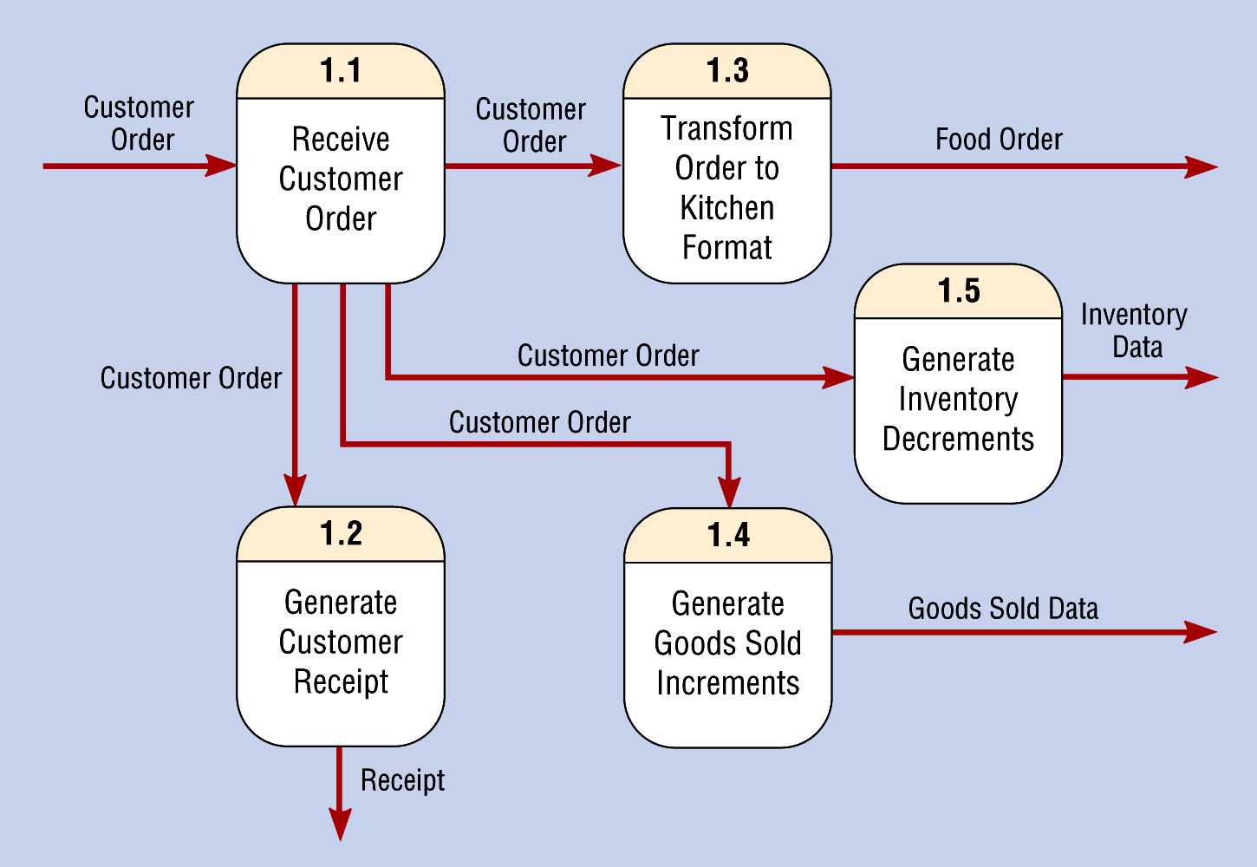
Level-1 Diagram Showing Decomposition of Process 1.0 from the Level-0 Diagram
Note: Sources and sinks are optional on level-n diagrams

Slide 54
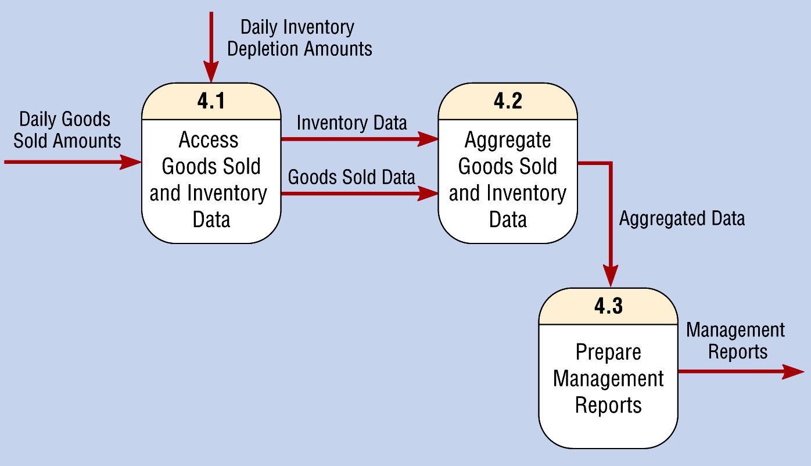
Level-1 Diagram Showing the Decomposition of Process 4.0 from the Level-0 Diagram

Slide 55
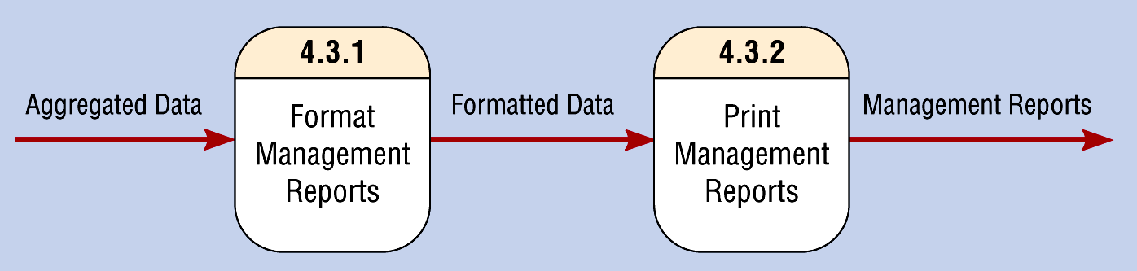
Level-2 Diagram Showing the Decomposition of Process 4.3 from the Level-1 Diagram for Process 4.0

Slide 56
External Databases
If you get data from an external database instead of an entity, you can choose to put these on the context diagram as indicated in the next slides
This conforms with Yourdon but conflicts with book text (but not their graphics in figures 5-12 and 5-13 that contradict the text on page 160)

Slide 57
Context Diagram
With Alternative Scenario of External Data Files per Youdon http://www.yourdon.com/books/msa2e/CH09/CH09.html
Sales orders
Customers
Item numbers
Master item
number list
Accepted
sales order file
0
Order
Entry
System
Item prices
Master price
list
Rejected
sales order report
Inventory
System
President

Slide 58
Level-0 Diagram
Sales orders
Item numbers
Master item
number list
Customers
1.0
Screen
sales
orders
Item prices
Master price
list
Accepted
sales order file
Rejected
sales order file
2.0
Sort
rejected
sales order
file
Sorted rejected
sales order file
Inventory
System
3.0
Prepare
rejected
sales order
report
Rejected
sales order report
President

Slide 59
Level 1 Diagram (for Process 1.0)
Sales orders
Customers
1.1
Verify
item
number
Item numbers
Master item
number list
Verified item numbers
Accepted
sales order
file
1.2
Verify
price
Inventory
System
Item prices
Master price
list
Rejected
sales order file

