Slide 1
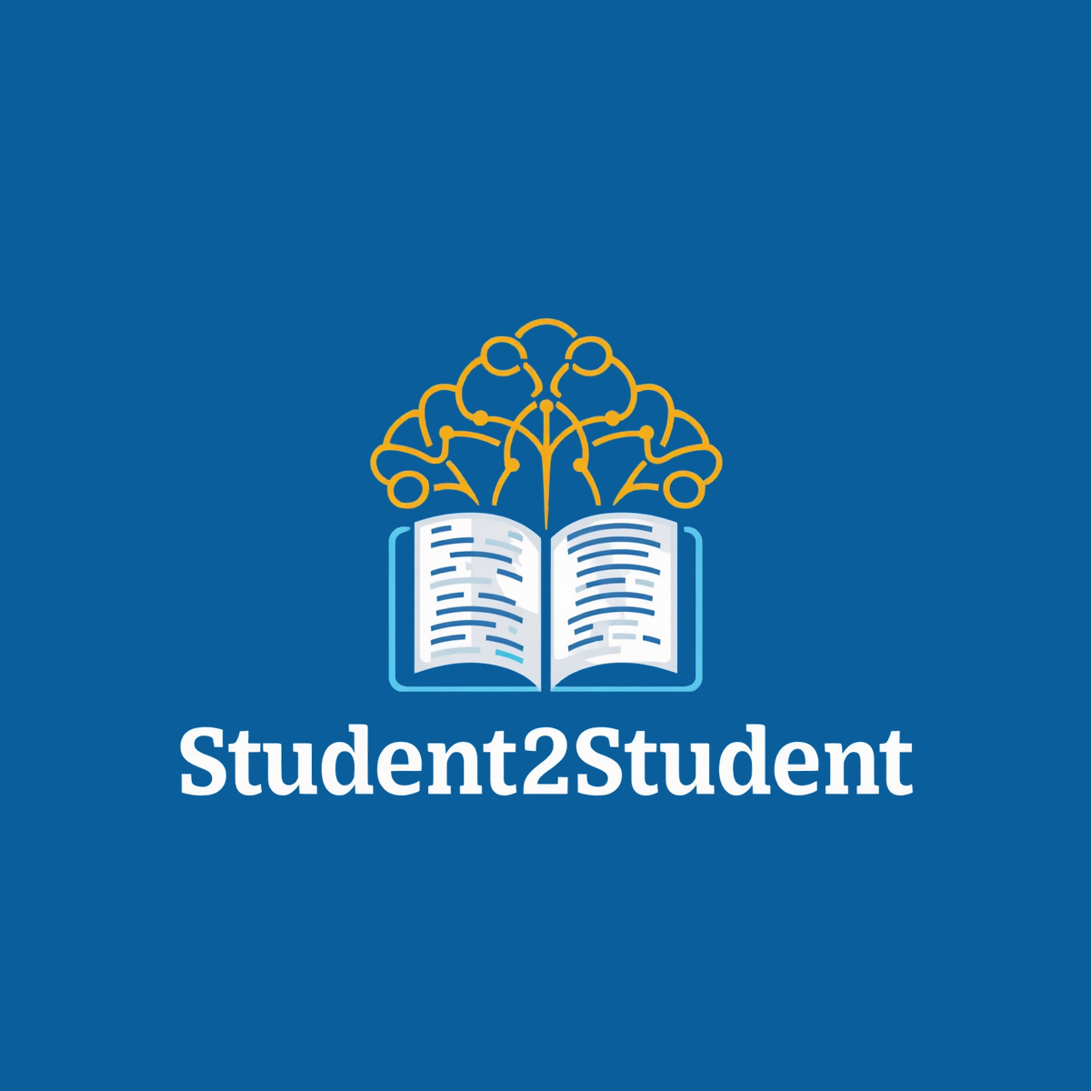
Student2Student
Connecting Learners. Empowering Futures.

Slide 2
“
Our goal is to make high-quality education accessible and affordable by connecting talented students with learners worldwide through an innovative online learning platform.
OUR
MISSION
Accessible
Affordable
Innovative
Education for everyone, everywhere
Learn without financial barriers
Peer-powered online learning
02

Slide 3



THE TEAM
03
Enis Ögdüm
Dinis Marquez
Andreas Merter
CEO & Founder
Chief Technology Officer
Chief Academic Officer
Computer Engineering student & platform founder
Co-founder and technology lead
Co-founder and academic operations lead
Identified the gap in affordable peer-to-peer education
Platform architecture, development & cybersecurity
Tutor recruitment, course quality & standards
Experienced in software dev & EdTech projects
Experienced in web technologies & digital products
Experienced in mentoring & academic support
Erasmus participant with international academic experience
Building a scalable, user-friendly learning platform
Ensures quality and effectiveness of all content
✶ Founding Story
Student2Student began as a friendship between three university students who shared a common vision: making quality education affordable and accessible. What started as helping classmates succeed academically evolved into the idea of creating a global student-to-student learning platform.

Slide 4
MARKET SUMMARY
04
◷
PAST
◉
PRESENT
◈
FUTURE
Schools, universities & private tutoring dominated education
Online platforms are increasingly popular
Global online education market growing rapidly
High-quality tutoring was expensive & inaccessible
Students seek affordable, flexible, personalized learning
Students prefer digital & community-driven learning
Learning limited by location and availability
Gap remains for peer-to-peer learning platforms
Peer-to-peer models gain popularity for affordability
Rising costs drive demand for lower-cost alternatives
Student2Student aims to lead globally
✶ Why Student2Student Can Succeed
Lower prices than traditional tutoring services
Global reach through a fully online platform
High-quality instruction from academically successful students
Strong demand for affordable educational support

Slide 5
OPPORTUNITIES
05
Consumer Problems
Product / Service Opportunities
📌 Lack of Personalized Support
Large online courses often do not provide individual guidance.
📌 Difficulty Finding Reliable Tutors
Students struggle to identify qualified and trustworthy instructors.
📌 Knowledge Gap Between Students
High-achieving students have valuable knowledge that often remains unused outside their immediate circles.
✅ Affordable Learning
High-quality courses at lower prices than traditional services.
✅ Peer-to-Peer Education
Learn from academically successful peers who understand your challenges.
✅ Verified Academic Experts
Tutors selected based on academic performance and expertise.
✅ Flexible Online Access
Access courses and tutoring sessions anytime, from anywhere.
✅ Community-Based Learning
A global network where students help students succeed.
★ Student2Student transforms the knowledge of top-performing students into an affordable and accessible learning opportunity for learners worldwide.

Slide 6
BUSINESS CONCEPT
06
Student2Student is a peer-to-peer online learning platform connecting academically successful university students with learners seeking affordable, high-quality educational support. Top-performing students can create courses, provide tutoring, and share study materials while earning income from their expertise.
💻 Key Technology
📈 Business Strategy
• Cloud-based web & mobile platform, accessible worldwide
• Secure authentication & profile verification
• Video conferencing for live tutoring sessions
• AI-powered recommendation engine for tutor matching
• Online payment & subscription system
• Learning analytics dashboard for progress tracking
• Recruit outstanding students from leading universities
• Offer courses & tutoring at lower prices than traditional services
• Revenue via course sales, tutoring commissions & memberships
• Build trust through tutor verification, ratings & reviews
• Expand internationally via university partnerships
🏆 Competitive Advantage
3-in-1
Courses • Tutoring • Study Materials
One platform. All you need.
• Peers who recently mastered the same subjects
• Lower costs vs. professional tutoring platforms
• More relatable & engaging learning experience
• Global accessibility through a fully online platform
★ Student2Student combines technology, peer-to-peer learning, and affordability to create a scalable educational ecosystem where students help students succeed.

Slide 7
COMPETITION
07
Main Competitors
Student2Student Advantage
📚 Udemy
Large course marketplace · Thousands of courses · Limited personalized support
✅ Affordable Pricing Lower costs than traditional tutoring and premium platforms.
🎓 Coursera
University-backed courses · Higher costs · Institution-focused, not peer learning
✅ Peer-to-Peer Learning Learn from successful peers who understand your challenges.
✅ Global Accessibility Fully online platform available anytime, anywhere.
👨‍🏫 Private Tutors
Personalized experience · Expensive & location-dependent · Not scalable
✅ Verified Student Experts Tutors selected based on academic achievement and expertise.
🌐 Other Tutoring Platforms
Connect students with tutors · High commissions and fees
✅ Community-Driven Approach A supportive network where students help students succeed.
Feature Student2Student Udemy Coursera Private Tutors
Affordable ✅ ✅ ❌ ❌
Personalized Support ✅ ❌ ❌ ✅
Peer-to-Peer Learning ✅ ❌ ❌ ❌
Global Access ✅ ✅ ✅ ❌
Community Focus ✅ ❌ ❌ ❌
★ Student2Student combines affordability, accessibility, and peer-powered learning to create a unique educational experience.

Slide 8
GOALS & OBJECTIVES
07
5-Year Goals
Key Objectives
🎯 Become a leading global student-to-student learning platform
🎯 Reach students in 50+ countries worldwide
🎯 Build a community of 10,000+ active tutors and learners
🎯 Offer courses across major academic subjects and skills
🎯 Establish Student2Student as a trusted EdTech brand
📈 User Growth
• 5,000 registered users in Year 1
• 25,000 users by Year 3
• 100,000+ users by Year 5
📚 Course Expansion
• Launch 50+ courses in the first year
• Expand to 500+ courses within five years
🌍 Market Reach
• Partner with universities and student organizations
• Expand across Europe, Asia, and North America
💰 Revenue Targets
• Achieve profitability within 3 years
• Reach €500,000 annual revenue by Year 5
★
Our objective is to create an affordable global learning ecosystem where students teach, learn, and succeed together.

Slide 9
FINANCIAL PLAN
09
Financial Model
Expected Annual Sales & Profits
💻 Course Sales
Students purchase online courses created by verified student tutors.
Year Sales Revenue Profit
Year 1 €25,000 -€5,000
👨‍🏫 Tutoring Sessions
Revenue from one-to-one tutoring sessions booked through the platform.
Year 2 €80,000 €10,000
📋 Premium Membership
Monthly subscription with exclusive resources and learning benefits.
Year 3 €180,000 €45,000
Year 4 €350,000 €110,000
🤝 Partnerships & Sponsorships
Collaboration with universities, student organizations, and educational partners.
Year 5 €600,000 €220,000
Revenue Growth (€)
Pricing Assumptions
• Average course price: €20
• Average tutoring session: €15/hour
• Premium membership: €5/month
• Platform commission: 20% of tutor earnings
• Low operational costs — fully online business model
Y1 Y2 Y3 Y4 Y5
Key Financial Objectives
📈 Achieve profitability by Year 2 🌍 Expand user base internationally 💰 Reach €600,000 revenue in 5 years 🚀 Scalable digital growth
★ Student2Student’s online business model enables rapid growth, low operating costs, and long-term profitability.

Slide 10
RESOURCE REQUIREMENTS
10
👥 Personnel
💻 Technology
💰 Finances
• Qualified student tutors & course creators
• Platform management team
• Marketing & social media specialists
• Customer support representatives
• Software developers & IT support
• Online learning platform & website
• Secure payment processing system
• Video conferencing & communication tools
• Cloud hosting & data storage
• Cybersecurity & user verification
• Initial platform development costs
• Marketing & advertising budget
• Website maintenance & hosting
• Operational & administrative costs
• Emergency reserve fund
🌐 Distribution
📢 Promotion
📚 Products & Services
• Web-based platform accessible worldwide
• Mobile-friendly user experience
• Integration with online learning tools
• Digital delivery of courses & tutoring
• Social media marketing campaigns
• University & student org partnerships
• Referral & ambassador programs
• Email marketing & community engagement
• Online courses & recorded video lessons
• Study guides & practice tests
• 1-to-1 & group tutoring sessions
• Academic mentoring & course support
★
Student2Student combines talented people, modern technology, and scalable digital services to deliver affordable education worldwide.

Slide 11
RISKS & REWARDS
11
⚠️ Potential Risks
🌟 Expected Rewards
📈 Investment Potential
• Qualified student tutors & course creators
• Platform management team
• Marketing & social media specialists
• Customer support representatives
• Software developers & IT support
• Online learning platform & website
• Secure payment processing system
• Video conferencing & communication tools
• Cloud hosting & data storage
• Cybersecurity & user verification
• Initial platform development costs
• Marketing & advertising budget
• Website maintenance & hosting
• Operational & administrative costs
• Emergency reserve fund
★ Key Message
📢 Promotion
📚 Products & Services
• Web-based platform accessible worldwide
• Mobile-friendly user experience
• Integration with online learning tools
• Digital delivery of courses & tutoring
• Social media marketing campaigns
• University & student org partnerships
• Referral & ambassador programs
• Email marketing & community engagement
• Online courses & recorded video lessons
• Study guides & practice tests
• 1-to-1 & group tutoring sessions
• Academic mentoring & course support
★
Student2Student combines talented people, modern technology, and scalable digital services to deliver affordable education worldwide.

Slide 12
KEY ISSUES
12
📌 Near‑Term Priorities
🌍 Long‑Term Priorities
💰 Future Investment Needs
• Qualified student tutors & course creators
• Platform management team
• Marketing & social media specialists
• Customer support representatives
• Software developers & IT support
• Online learning platform & website
• Secure payment processing system
• Video conferencing & communication tools
• Cloud hosting & data storage
• Cybersecurity & user verification
• Initial platform development costs
• Marketing & advertising budget
• Website maintenance & hosting
• Operational & administrative costs
• Emergency reserve fund
★ Key Message
📢 Promotion
📚 Products & Services
• Web-based platform accessible worldwide
• Mobile-friendly user experience
• Integration with online learning tools
• Digital delivery of courses & tutoring
• Social media marketing campaigns
• University & student org partnerships
• Referral & ambassador programs
• Email marketing & community engagement
• Online courses & recorded video lessons
• Study guides & practice tests
• 1-to-1 & group tutoring sessions
• Academic mentoring & course support
★
Student2Student combines talented people, modern technology, and scalable digital services to deliver affordable education worldwide.

