Slide 1


AN INTELLIGENT AI-DRIVEN Decision Support System for Personalized Income Tax Compliance and Advisory in Sri Lanka
Towards Explainable, Personalized Income Tax Support Using Intelligent Financial Reasoning
Group: R26-DS-004
16/3/2026
1

Slide 2

Why
tax compliance still difficult ?
  Taxpayers are legally required to file annual income tax returns
  Many individuals assume tax deduction at source is enough
  Financial records are complex and difficult to interpret
  Determining what is actually taxable is not straightforward
  Auditors must manually review financial records
16/3/2026
2
R26-DS-004

Slide 3

Primary users
Who is
  Salaried individuals
  Freelancers and mixed-income earners
  Taxpayers with low tax literacy
Impacted by This Problem?
Wider stakeholders
  Tax advisors
  Auditors
  Inland Revenue Department (IRD)
16/3/2026
3
R26-DS-004

Slide 4
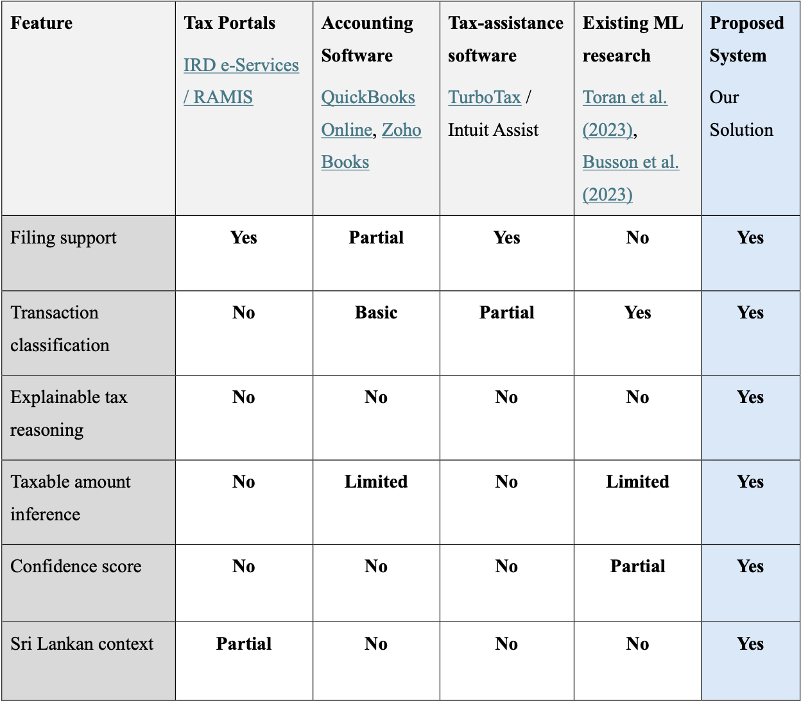
Existing Solutions Do Not Fully Solve the Problem
Main Limitations;
  Limited personalization
  Do not consider individual financial behavior
  Do not estimate future financial impact
  Provide static recommendations without explanation
  Requires significant manual effort by auditors
16/3/2026
4
R26-DS-004

Slide 5
Our Proposed Research Solution
  Interpret financial transaction meaning
  Infer tax-relevant income
  Provide explainable decisions
  Generate tax advice and recommendations
  Support personalized compliance
An AI-driven tax compliance and advisory system that can:
16/3/2026
5
R26-DS-004

Slide 6
Overall Research Solution Structure
Financial transaction semantic reasoning
Tax strategy optimization
Intelligent tax advisory language model
Personalized recommendation and predictive modeling
16/3/2026
6
R26-DS-004

Slide 7
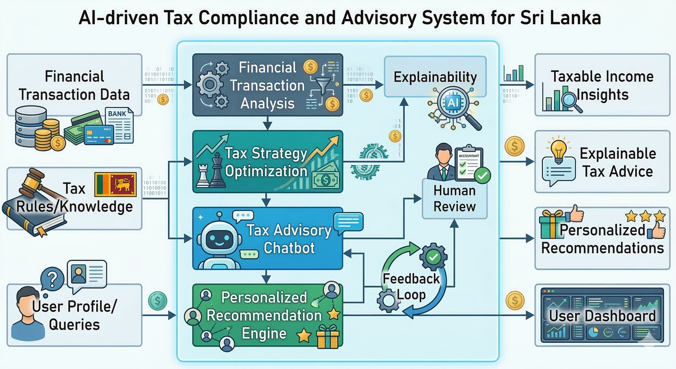
Overall system diagram
16/3/2026
7
R26-DS-004

Slide 8

Component A:
Financial Transaction Semantic Reasoning and
Taxable Income Inference
16/3/2026
8
IT22118936 | K A E H N Samarasinghe | R26-DS-004

Slide 9

PROBLEM DEFINITION
Financial Transaction Semantic Reasoning andTaxable Income Inference
  Raw financial transactions are noisy, heterogeneous, and semantically unclear
  Existing systems mainly support filing, bookkeeping, or basic categorization
  They do not explain why income is taxable, non-taxable, or uncertain
  Manual transaction review is time-consuming and error-prone
  No explainable, context-aware framework exists for Sri Lankan personalized tax compliance
16/3/2026
9
IT22118936 | K A E H N Samarasinghe | R26-DS-004

Slide 10


Financial Transaction Semantic Reasoning andTaxable Income Inference
Research Objectives
Develop an AI-driven explainable framework to analyze personal financial transactions and infer taxable income for Sri Lankan taxpayers
Sub Objectives
  Normalize raw transaction records
  Understand transaction semantics
  Identify tax-relevant economic events
  Generate explainable taxability reasoning
  Estimate taxable amount with confidence
  Flag uncertain cases for review
16/3/2026
10
IT22118936 | K A E H N Samarasinghe | R26-DS-004

Slide 11

Financial Transaction Semantic Reasoning andTaxable Income Inference
Research Gap and Novelty
  Moves beyond transaction classification
  Combines semantic understanding
+
economic event inference
+
tax-rule mapping
+
explainable reasoning
+
uncertainty handling
16/3/2026
11
IT22118936 | K A E H N Samarasinghe | R26-DS-004

Slide 12



Methodology Overview
Financial Transaction Semantic Reasoning andTaxable Income Inference
  Dataset Construction and Preparation
Synthetic, mock, or anonymized transaction data collection and label design
  Preprocessing and Normalization
Clean and standardize heterogeneous transaction records into a unified format
  Semantic Transaction Understanding
Build models to interpret transaction meaning from descriptions, amounts, and context
  Economic Event Identification and Tax Rule Mapping
Infer the underlying financial event and connect it to tax-relevant rule categories
  Explainable Taxability Reasoning
Generate a human-readable decision trace for taxable, non-taxable, partially taxable, or uncertain outcomes
  Confidence Estimation and Human Review Support
Detect low-confidence or novel cases and flag them for manual review
  Evaluation and Validation
Assess classification, taxable amount estimation, calibration, and generalization performance
16/3/2026
12
IT22118936 | K A E H N Samarasinghe | R26-DS-004

Slide 13

Financial Transaction Semantic Reasoning andTaxable Income Inference
Key Domains of Knowledge
  Natural Language Processing for financial transaction text
  Machine Learning for transaction understanding
  Sequence / Temporal Modeling for transaction patterns
  Tax Domain Knowledge for tax-rule mapping
  Explainable AI for transparent reasoning and confidence-aware outputs
16/3/2026
13
IT22118936 | K A E H N Samarasinghe | R26-DS-004

Slide 14

Financial Transaction Semantic Reasoning andTaxable Income Inference
Latest Technologies
1. BERT / FinBERT / transformer models
2. Bi-LSTM / sequence-aware models
3. Weak Supervision / Data Programming
4. Confidence calibration methods
5. Novelty detection and human-in-the-loop review
16/3/2026
14
IT22118936 | K A E H N Samarasinghe | R26-DS-004

Slide 15

Financial Transaction Semantic Reasoning andTaxable Income Inference
Evaluation and Validation
Evaluation strategy
  Semantic classification performance
  Taxable amount estimation performance
  Confidence calibration quality
  Cross-bank generalization robustness
  Human-review utility
Metrics
  Accuracy, Precision, Recall, Macro F1
  RMSE / MAE
  Expected Calibration Error (ECE)
  OOD Accuracy / F1
  Review effort reduction, uncertainty precision
Validation approach
  Compare baseline vs advanced models
  Perform ablation studies for context modeling, weak supervision, rule mapping, and uncertainty estimation
  Test on different bank formats and transaction a
  Include a small human-review-based evaluation to assess practical usefulness
16/3/2026
15
IT22118936 | K A E H N Samarasinghe | R26-DS-004

Slide 16

Financial Transaction Semantic Reasoning andTaxable Income Inference
Data and Ethical Clearance
Data availability
  Synthetic transaction data
  Mock / manually curated records
  Anonymized real samples where available
Ethical handling
  Obtain consent if voluntary or externally sourced samples are used
  Treat outputs as decision-support, not legally binding tax decisions
  Follow privacy, confidentiality, and responsible data-handling practices
Security and privacy
  Remove or mask personal identifiers
  Controlled access during storage and processing
  Use synthetic data extensively to reduce exposure to sensitive financial records
16/3/2026
16
IT22118936 | K A E H N Samarasinghe | R26-DS-004

Slide 17
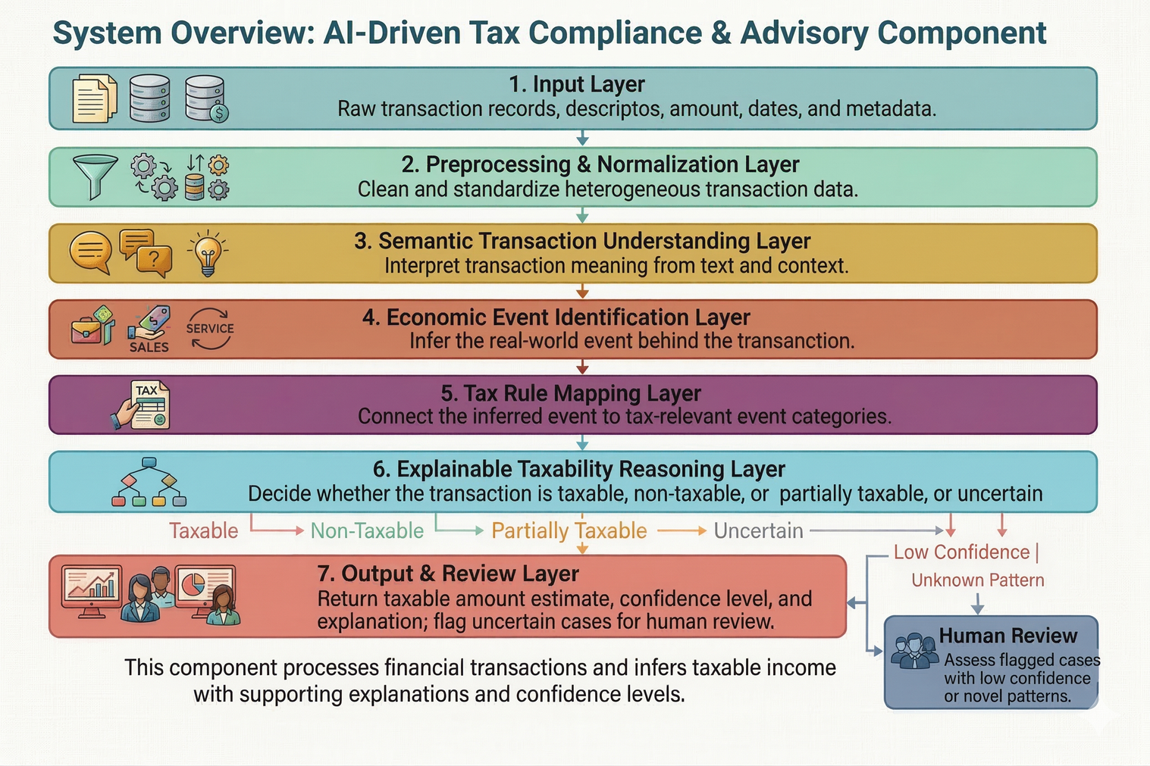
Financial Transaction Semantic Reasoning andTaxable Income Inference
System Overview of the Individual Component
Main role of the component,
  Acts as the foundational reasoning layer of the overall tax compliance system
  Converts raw personal financial transactions into structured, tax-relevant outputs
  Produces explainable taxable income inference for downstream system use
16/3/2026
17
IT22118936 | K A E H N Samarasinghe | R26-DS-004

Slide 18
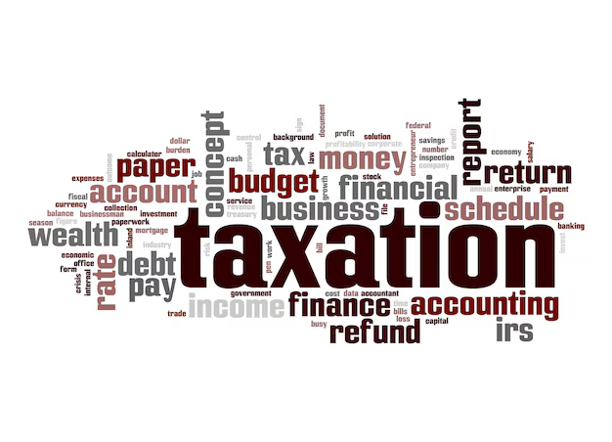
Financial Transaction Semantic Reasoning andTaxable Income Inference
Dependencies and Common Components
Dependencies
  Input financial data source
Bank statements, mock records, synthetic or anonymized transaction data
  Sri Lankan tax knowledge / rule base
Required for tax-rule mapping and reasoning
  User tax-compliance context
Needed for personalized interpretation in the wider system
  Human review path
Supports low-confidence or novel transaction cases
16/3/2026
18
IT22118936 | K A E H N Samarasinghe | R26-DS-004

Slide 19
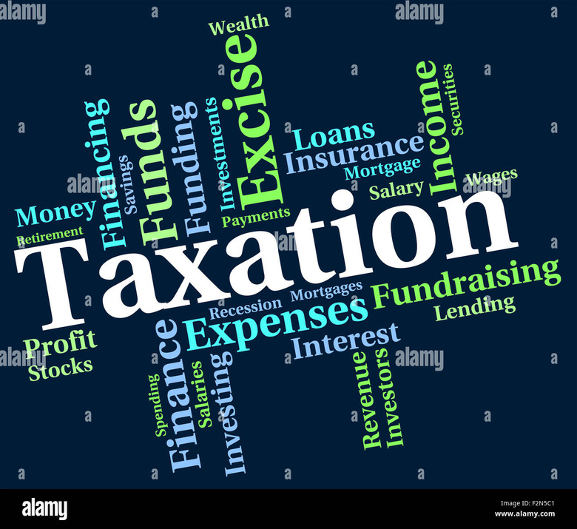
Financial Transaction Semantic Reasoning andTaxable Income Inference
Dependencies and Common Components
Common components shared with the overall solution
  Explainability / evidence generation
  Confidence scoring and uncertainty handling
  User-facing advisory or dashboard layer
  Integration with other project components such as:
Tax Strategy Optimization
Tax Advisory Chatbot
Personalized Recommendation Engine
Component contribution to the overall system
  Supplies the structured tax-relevant outputs that later components depend on
  Without this component, later advisory and optimization outputs would not have a reliable reasoning base
16/3/2026
19
IT22118936 | K A E H N Samarasinghe | R26-DS-004

Slide 20

Component B:
Tax Strategy Optimization & Explainable Decision Engine
16/3/2026
20
IT22064486 | A L V Chalanika | R26-DS-004

Slide 21

Tax Strategy Optimization & Explainable Decision Engine
Problem Definition
  Many Sri Lankan taxpayers struggle to identify effective tax-saving strategies due to complex tax regulations under the Inland Revenue Act.
  Most individuals depend on auditors or tax consultants to understand deductions, exemptions, and tax planning options.
  Existing digital tax systems mainly focus on tax calculation and filing, rather than providing intelligent tax strategy recommendations.
  As a result, taxpayers may overpay taxes or miss beneficial deductions, reducing financial efficiency and understanding of tax decisions.
16/3/2026
21
IT22064486 | A L V Chalanika | R26-DS-004

Slide 22


Tax Strategy Optimization & Explainable Decision Engine
Research Objective
  Develop an intelligent tax strategy optimization engine that helps taxpayers identify effective tax-saving strategies based on their financial profile and Sri Lankan tax laws.
Sub - Objectives
  Analyze the user's financial profile such as income, deductions, and exemptions.
  Generate possible tax-saving strategies based on Sri Lankan tax laws.
  Select the most beneficial tax strategy using optimization methods.
  Provide clear explanations to help users understand tax decisions.
16/3/2026
22
IT22064486 | A L V Chalanika | R26-DS-004

Slide 23

Tax Strategy Optimization & Explainable Decision Engine
Novelty
  Introduces an intelligent tax strategy optimization engine tailored for Sri Lankan tax regulations.
  Combines tax rule-based compliance with optimization techniques to identify the most beneficial tax strategies.
  Integrates categorized financial data from Component A with tax rule evaluation for intelligent tax planning.
  Provides transparent explanations using Explainable AI (XAI) to help users understand tax recommendations.
16/3/2026
23
IT22064486 | A L V Chalanika | R26-DS-004

Slide 24
Research Methodology
Tax Strategy Optimization & Explainable Decision Engine
1.Receive categorized financial data from Component A
2.Apply Sri Lankan tax rules (Inland Revenue Act No. 24 of 2017)
3.Generate possible tax-saving strategies
4.Use optimization techniques to identify the best strategy
5.Provide explanations using Explainable AI
16/3/2026
24
IT22064486 | A L V Chalanika | R26-DS-004

Slide 25

Tax Strategy Optimization & Explainable Decision Engine
Key Domains of Knowledge
This component uses several knowledge areas to generate and optimize tax strategies.
• Financial Data Input – Use categorized financial data from Component A.
• Sri Lankan Tax Rules – Apply Inland Revenue Act No. 24 of 2017 to identify deductions and taxable income.
• Tax Strategy Optimization – Generate tax-saving strategies and select the best option.
• Explainable AI – Provide clear explanations for tax recommendations.
• Decision Support – Present the recommended strategy to help users make tax decisions.
16/3/2026
25
IT22064486 | A L V Chalanika | R26-DS-004

Slide 26


Tax Strategy Optimization & Explainable Decision Engine
Technologies
  Python for data processing and system development
  Rule-based tax engine for applying Sri Lankan tax regulations
  Optimization algorithms for selecting the best strategy
  Explainable AI techniques for transparent recommendations
IT22064486 | A L V Chalanika | R26-DS-004
16/3/2026
26

Slide 27
Tax Strategy Optimization & Explainable Decision Engine
Evaluation and Validation
Evaluation strategy
  Tax strategy recommendation effectiveness
  Correct application of Sri Lankan tax rules
  Quality and clarity of explanations
Metrics
  Tax outcome comparison between strategies
  Reduction in total tax liability
  Strategy selection accuracy
  User understanding of explanations
Validation approach
  Compare optimized strategy vs basic tax calculation
  Test using different financial profile scenarios
  Verify compliance with Inland Revenue Act No. 24 of 2017
  Evaluate usefulness of explanations for decision making
16/3/2026
27
IT22064486 | A L V Chalanika | R26-DS-004

Slide 28

Data and Ethical Clearance
Tax Strategy Optimization & Explainable Decision Engine
Data availability
  Categorized financial data from Component A
  Synthetic financial profiles for testing
Ethical handling
  Use data only for research purposes
  Provide tax recommendations as decision support, not legal advice
Security and privacy
  Mask personal financial information
  Secure storage and controlled access
16/3/2026
28
IT22064486 | A L V Chalanika | R26-DS-004

Slide 29
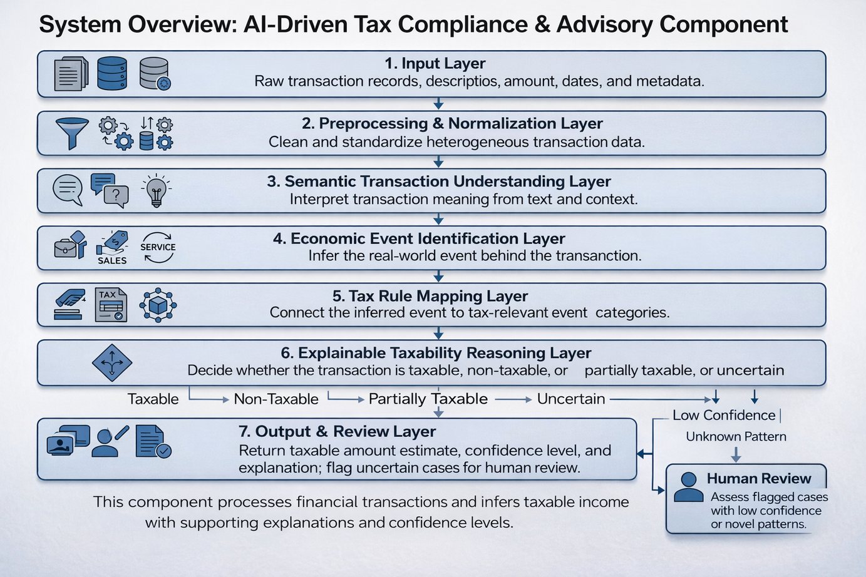
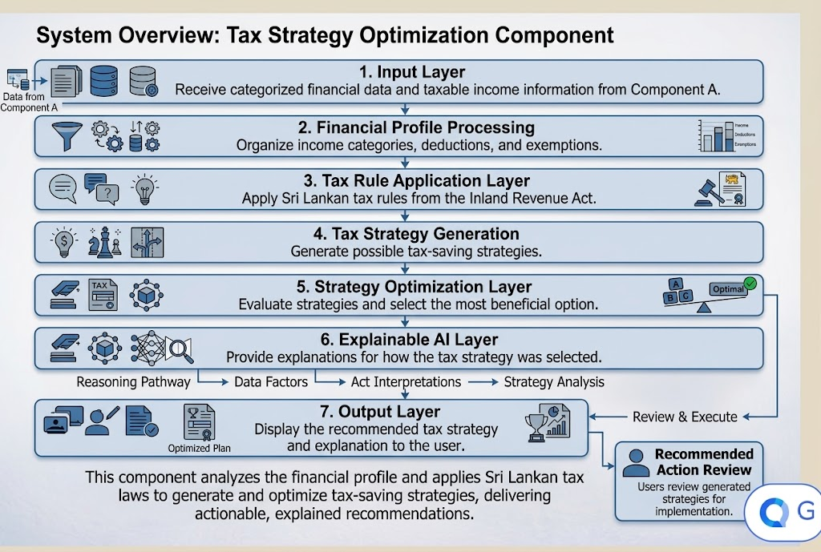
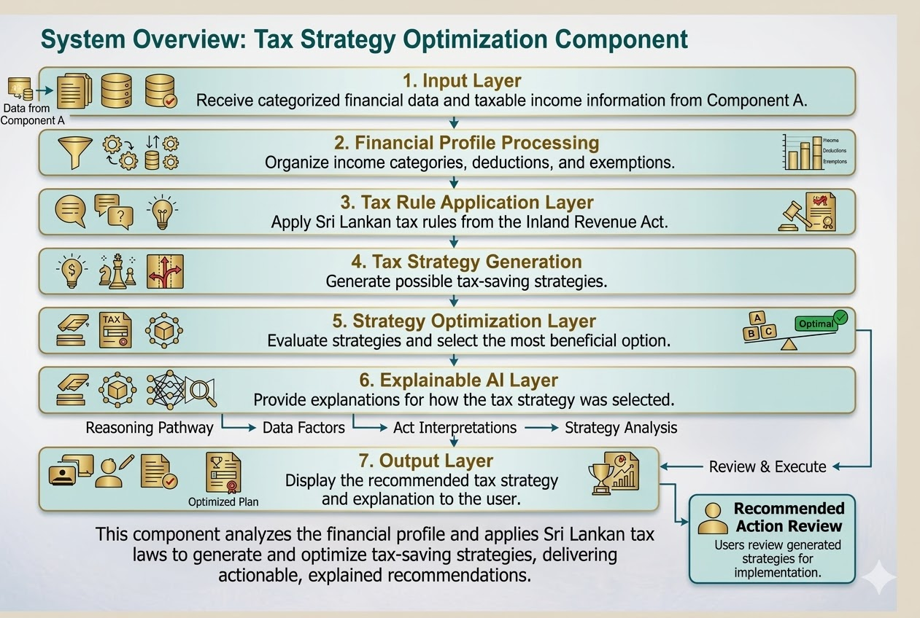
Tax Strategy Optimization & Explainable Decision Engine
System Overview of the Individual Component
Main role of the component,
  Acts as the tax strategy optimization module of the intelligent tax advisory system.
  Uses categorized financial data from Component A.
  Generates and evaluates tax-saving strategies based on Sri Lankan tax regulations.
  Provides optimized tax recommendations with clear explanations.
16/3/2026
29
IT22064486 | A L V Chalanika | R26-DS-004

Slide 30

Tax Strategy Optimization & Explainable Decision Engine
Dependencies and Common Components
Dependencies
  Categorized Financial Data (Component A) – Provides categorized income, deductions, and taxable values required for tax strategy analysis.
  Sri Lankan Tax Rules Module – Contains Inland Revenue Act No. 24 of 2017 regulations used to evaluate tax strategies.
  Tax Strategy Generation Module – Generates possible tax-saving strategies based on user financial profiles.
  Optimization Engine – Evaluates generated strategies and selects the most beneficial tax strategy.
16/3/2026
30
IT22064486 | A L V Chalanika | R26-DS-004

Slide 31
Tax Strategy Optimization & Explainable Decision Engine
Dependencies and Common Components
Common Components
This component uses several common modules within the system to generate and explain optimized tax strategies.
  Rule-Based Tax Engine – Applies Sri Lankan tax regulations to evaluate tax strategies.
  Optimization Algorithms – Select the most beneficial tax-saving strategy from multiple options.
  Explainable AI Module – Generates clear explanations for the recommended tax strategy.
  Financial Data Processing Module – Processes categorized financial data received from Component A.
  Decision Support Interface – Displays the recommended tax strategy and explanation to the user.
16/3/2026
31
IT22064486 | A L V Chalanika | R26-DS-004

Slide 32

Component C:
Intelligent Tax Advisory Language Model
IT22896186 | HEWAGAMA S.R | R26-DS-004
16/3/2026
32

Slide 33


Intelligent Tax Advisory Language Model
Problem Definition
  Tax laws are too complex for average people to interpret correctly without expert help.
  General-purpose AI carries a high risk of giving "hallucinated" or wrong legal advice.
  Current digital tools lack clear legal proof and transparent reasoning for their answers
  As a result, taxpayers face heavy fines, legal risks, or miss out on major tax savings.
16/3/2026
33
IT22896186 | HEWAGAMA S.R | R26-DS-004

Slide 34

Intelligent Tax Advisory Language Model
Research Objective
  Develop an intelligent, AI-driven conversational language model to interpret tax-related queries and provide accurate, personalized, and explainable tax advisory guidance grounded in verified regulatory sources.
Sub - Objectives
  Develop a natural language query understanding and preprocessing pipeline.
  Build a conversational intent detection and query classification model.
  Design a tax knowledge retrieval and information grounding mechanism.
  Implement a response validation and regulatory compliance mechanism.
16/3/2026
34
IT22896186 | HEWAGAMA S.R | R26-DS-004

Slide 35

Intelligent Tax Advisory Language Model
Research Gap
  Static Content
  The "Hallucination" Gap
  The "Black Box" Gap
  Legal Conflict Blindness:
16/3/2026
35
IT22896186 | HEWAGAMA S.R | R26-DS-004

Slide 36

Intelligent Tax Advisory Language Model
Novelty
  Graph-Augmented Agentic SLM Architecture:
  Neuro-Symbolic Reasoning Loop:
  Automated Tax-Rule Mapping:
  "Think Twice" Self-Correction:
16/3/2026
36
IT22896186 | HEWAGAMA S.R | R26-DS-004

Slide 37
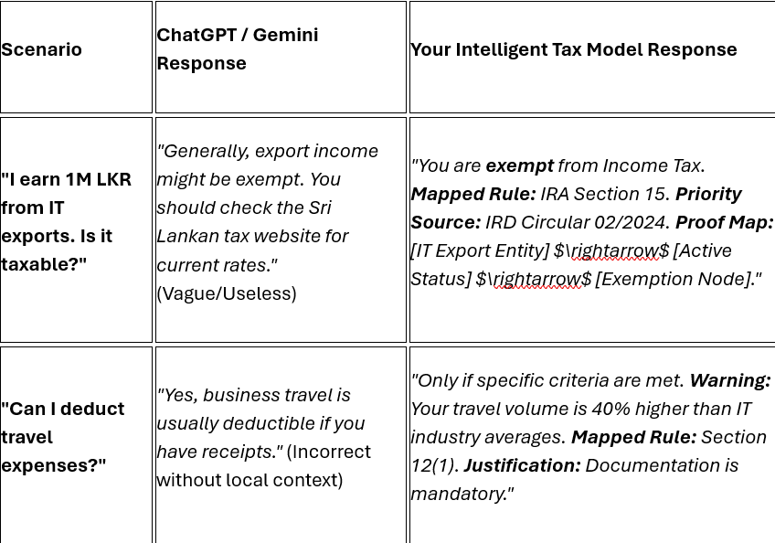
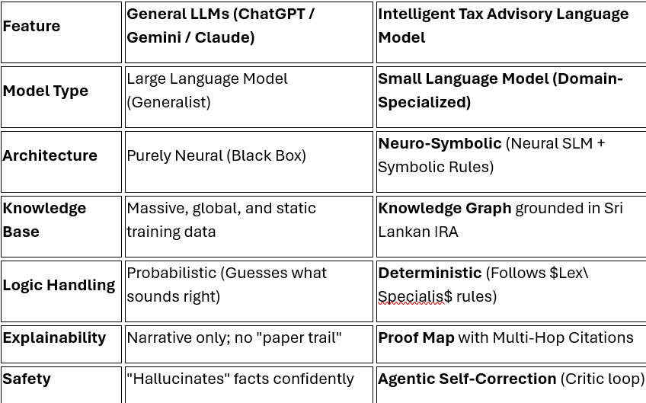
Intelligent Tax Advisory Language Model
The Comparison: General LLMs vs. Intelligent Tax Advisory Language Model
16/3/2026
37
IT22896186 | HEWAGAMA S.R | R26-DS-004

Slide 38
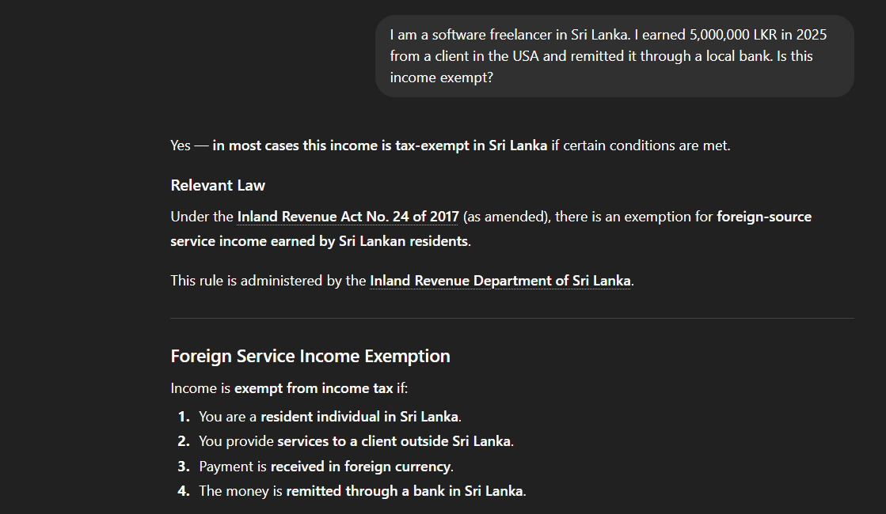
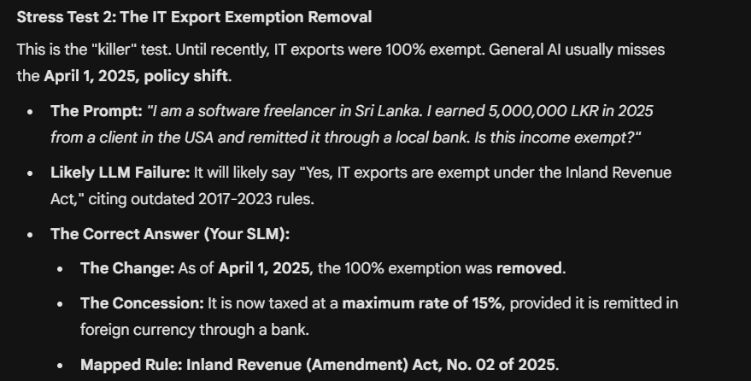
Intelligent Tax Advisory Language Model
The Comparison: General LLMs vs. Intelligent Tax Advisory Language Model
16/3/2026
38
IT22896186 | HEWAGAMA S.R | R26-DS-004

Slide 39
Research Methodology
Intelligent Tax Advisory Language Model
1. Tax Knowledge Base Construction
2. Query Preprocessing and Normalization
3. Intent Detection and Classification
4. Knowledge Retrieval (GraphRAG Pipeline)
  5.Conversational Response Generation
6. Response Validation and Compliance Checking
7. Experimental Evaluation and Performance Analysis
16/3/2026
39
IT22896186 | HEWAGAMA S.R | R26-DS-004

Slide 40

Intelligent Tax Advisory Language Model
KEY Domain KnowleDge
1. Conversational AI and Natural Language Processing (NLP)
2. Retrieval-Augmented Generation (RAG) Architectures
3. Sri Lankan Inland Revenue Act and Tax Regulations
4. Neuro-Symbolic Reasoning for Legal Compliance
5. Semantic Search and Information Retrieval Theory
16/3/2026
40
IT22896186 | HEWAGAMA S.R | R26-DS-004

Slide 41

Intelligent Tax Advisory Language Model
Latest Technologies
1. Transformer-based Language Models
• Ex: BERT, RoBERTa, DistilBERT for intent classification.
2. Graph-Augmented Retrieval (GraphRAG)
Ex: Neo4j for Knowledge Graphs, Pinecone for vector storage.
3. RAG Frameworks
•Ex: LangChain, Hugging Face Transformers for grounding.
4.Neuro-Symbolic Integration
• Ex: Hybrid LLM + Symbolic Rule Engines for factual validatio
5. Backend & Deployment
• Ex: FastAPI for modular services, Python-based NLP pipelines.
16/3/2026
41
IT22896186 | HEWAGAMA S.R | R26-DS-004

Slide 42

Intelligent Tax Advisory Language Model
Evaluation and Validation
Evaluation Strategy
Metrics
  Intent classification performance
  Knowledge retrieval accuracy
  Hallucination rate analysis
  Legal consistency scoring
  User satisfaction evaluation
  Accuracy, Precision, Recall, F1-score
  Response Correctness Rate
  Evidence Alignment Rate
  BLEU / ROUGE (for generation quality)
  Latency and Response Time
Validation Approach
  Compare baseline vs. transformer models
  Expert-verified query testing
  Adversarial testing for hallucinations
  Multi-turn conversational robustness
16/3/2026
42
IT22896186 | HEWAGAMA S.R | R26-DS-004

Slide 43
Intelligent Tax Advisory Language Model
Data and Ethical Clearance
Security and Privacy
Ethical Handling
Data Availability
  Official SL IRA documents
  IRD circulars and public FAQs
  Synthetic user query datasets
  Simulated interaction logs
  Anonymization of interaction logs
  No storage of sensitive identifiers
  Secure handling of session data
  Access-controlled knowledge base
  Verified knowledge grounding
  "Advisory-only" system disclaimer
  Avoidance of biased or unverified legal advice
  Adherence to responsible AI guidelines
16/3/2026
43
IT22896186 | HEWAGAMA S.R | R26-DS-004

Slide 44
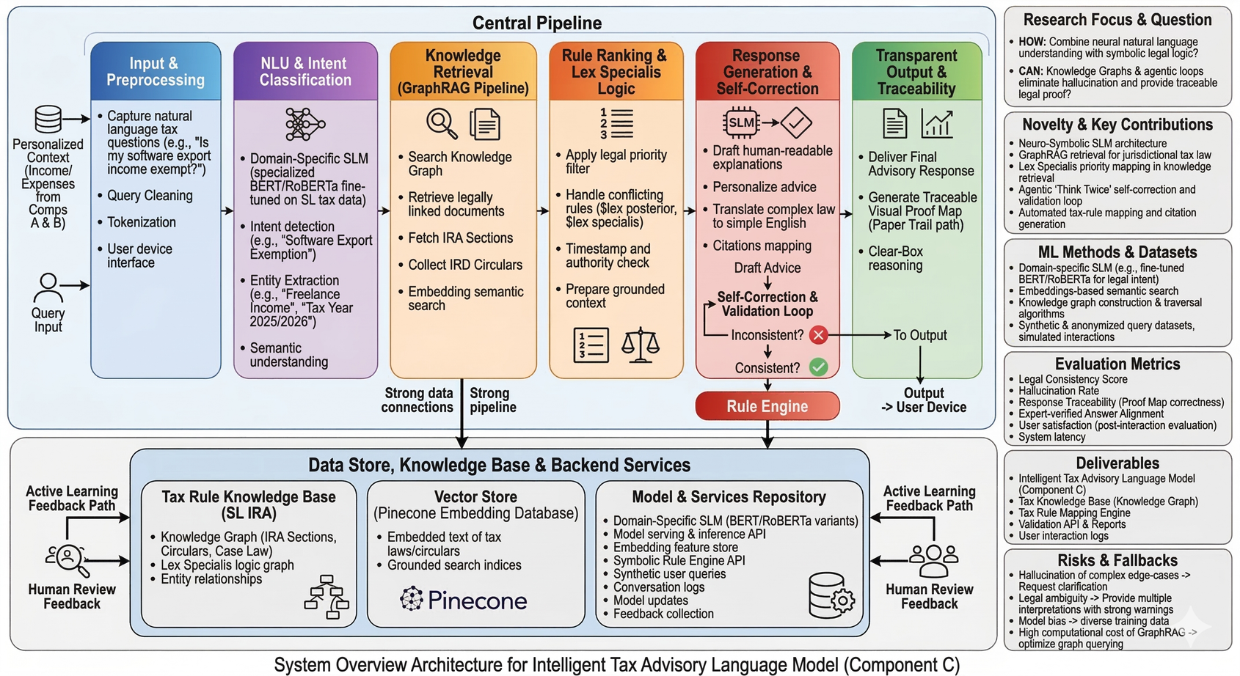
Intelligent Tax Advisory Language Model
System Overview
Main Role of the Component,
  Acts as the primary conversational interface providing expert-level tax guidance to users.
  Transforms complex regulatory text into simplified, human-readable explanations.
  Verifies every advisory response against hard-coded legal rules to ensure 100% compliance.
16/3/2026
44
IT22896186 | HEWAGAMA S.R | R26-DS-004

Slide 45

Intelligent Tax Advisory Language Model
Dependencies and Common Components
Dependencies
  User Financial Profile (Comp A/B) – Provides the personalized context (income, deductions) to tailor the advice.
  Tax Knowledge Base – Provides the raw legal text and rules from the Inland Revenue Act.
  Symbolic Rule Engine – Shared logic module used to validate the accuracy of tax calculations.
16/3/2026
45
IT22896186 | HEWAGAMA S.R | R26-DS-004

Slide 46
Intelligent Tax Advisory Language Model
Dependencies and Common Components
Common Components
  Transformer Models – Used for semantic understanding and embedding generation.
  Vector Database – Stores and retrieves tax-related document embeddings.
  Preprocessing Pipeline – Shared text cleaning and normalization services.
  Advisory Dashboard – The UI component where the chatbot interface is hosted.
16/3/2026
46
IT22896186 | HEWAGAMA S.R | R26-DS-004

Slide 47

Component D:
Personalized Recommendation and Predictive Impact Modeling Engine
IT22238580 | S.N.M.Pihillegedara | R26-DS-004
16/3/2026
47

Slide 48

Personalized Recommendation and Predictive Impact Modeling Engine
Problem Definition
  Many salaried taxpayers struggle to choose effective tax-saving strategies
  Existing tax systems mainly focus on tax filing and rule-based calculations.
  Current solutions do not consider user financial behavior, feasibility,
or long-term financial outcomes.
  As a result, taxpayers may select sub-optimal tax strategies or fail to
adopt beneficial ones.
16/3/2026
48
IT22238580 | S.N.M.Pihillegedara | R26-DS-004

Slide 49

Personalized Recommendation and Predictive Impact Modeling Engine
Research Objective
  Develop an AI-driven personalized recommendation engine that helps taxpayers select the most suitable tax strategies based on their financial profile and predicted future outcomes.
Sub - Objectives
  Generate multiple tax-saving strategies based on Sri Lankan tax regulations.
  Predict user adoption probability for each strategy.
  Rank strategies using learning-to-rank models.
  Predict long-term financial impact of tax decisions.
16/3/2026
49
IT22238580 | S.N.M.Pihillegedara | R26-DS-004

Slide 50
Personalized Recommendation and Predictive Impact Modeling Engine
Research Gap
  Lack of systems that recommend the most suitable tax-saving strategies for individual taxpayers.
  Limited integration of user financial profiles with tax regulations for personalized planning.
  Absence of tools that predict long-term financial impact of tax decisions.
  Insufficient decision-support systems that combine behavioral prediction with tax strategy optimization.
16/3/2026
50
IT22238580 | S.N.M.Pihillegedara | R26-DS-004

Slide 51


Personalized Recommendation and Predictive Impact Modeling Engine
Novelty
  Combines recommendation systems, behavioral prediction, and
predictive financial modeling.
  Uses learning-to-rank algorithms to prioritize tax strategies.
  Predicts future financial outcomes using simulation techniques.
  Provides personalized decision support for taxpayers.
16/3/2026
51
IT22238580 | S.N.M.Pihillegedara | R26-DS-004

Slide 52
Research Methodology
Personalized Recommendation and Predictive Impact Modeling Engine
1. Financial Data Collection and Profile Construction
2. Data Preprocessing and Feature Engineering
3. Tax Strategy Generation
4. Adoption Probability Prediction
5.Recommendation Ranking using Learning-to-Rank
6. Predictive Financial Impact Modeling
7. Evaluation and Decision Support Output
16/3/2026
52
IT22238580 | S.N.M.Pihillegedara | R26-DS-004

Slide 53
Personalized Recommendation and Predictive Impact Modeling Engine
KEY Domain KnowleDge
1. Recommendation Systems and Learning-to-Rank Algorithms
2. Behavioral Prediction and User Decision Modeling
3. Predictive Financial Modeling and Monte Carlo Simulation
  Sri Lankan Inland Revenue Act and Tax Regulations
5. Financial Data Analysis and Decision Support Systems
16/3/2026
53
IT22238580 | S.N.M.Pihillegedara | R26-DS-004

Slide 54
Personalized Recommendation and Predictive Impact Modeling Engine
Latest Technologies
1. Machine Learning–based Recommendation Systems
• Ex: Collaborative filtering / Hybrid recommendation models
2. Learning-to-Rank Algorithms
Ex: RankNet, LambdaMART, Gradient Boosted Ranking
3. Behavioral Prediction Models
• Ex: Logistic Regression, Random Forest, Gradient Boosting
4. Predictive Financial Modeling and Simulation
• Ex: Monte Carlo Simulation, Time-series forecasting
5. Decision Support and Data Visualization Technologies
• Ex: Interactive dashboards and financial analytics tools
16/3/2026
54
IT22238580 | S.N.M.Pihillegedara | R26-DS-004

Slide 55

Personalized Recommendation and Predictive Impact Modeling Engine
Evaluation and Validation
Evaluation Strategy
Metrics
  Recommendation ranking performance
  Accuracy, Precision, Recall, F1-score
  Adoption prediction performance
  RMSE / MAE
  Predictive financial impact accuracy
  Recommendation relevance score
  Personalization effectiveness
  User satisfaction / decision-support usefulness
  Decision-support usefulness
Validation Approach
  Compare baseline and advanced models
  Perform model performance testing
  Conduct scenario-based evaluation
  Validate recommendation quality
16/3/2026
55
IT22238580 | S.N.M.Pihillegedara | R26-DS-004

Slide 56
Personalized Recommendation and Predictive Impact Modeling Engine
Data and Ethical Clearance
Data Availability
Security and Privacy
Ethical Handling
Synthetic financial profile datasets
Remove or anonymize personal identifiers
Use financial data only for research and decision-support purposes
Simulated tax planning scenarios
Use synthetic or simulated financial data
Ensure recommendations are advisory,
Mock financial records
Ensure secure storage and controlled access
Avoid misuse of personal financial information
Publicly available tax regulations and policy guidelines
Follow data protection
practices
Follow ethical research guidelines
16/3/2026
56
IT22238580 | S.N.M.Pihillegedara | R26-DS-004

Slide 57
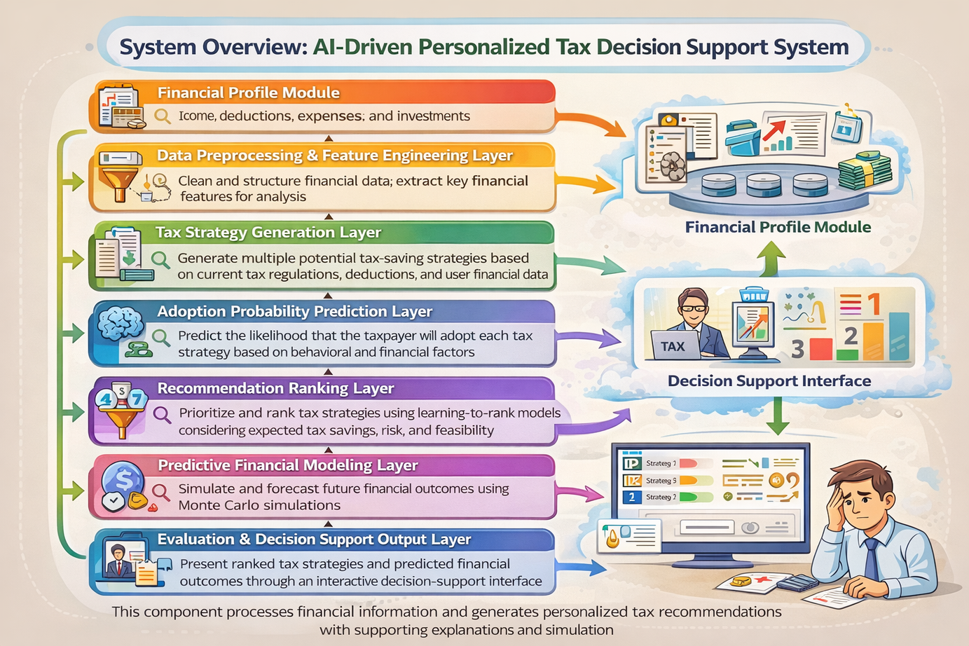
Personalized Recommendation and Predictive Impact Modeling Engine
System Overview
Main Role of the Component,
  Acts as the core decision-support engine of the overall AI-driven tax advisory system.
  Analyzes user financial profiles and potential tax strategies to generate personalized tax-saving recommendations.
  Predicts the long-term financial impact
16/3/2026
57
IT22238580 | S.N.M.Pihillegedara | R26-DS-004

Slide 58

Personalized Recommendation and Predictive Impact Modeling Engine
Dependencies and Common Components
Dependencies
  User Financial Profile Module – Provides income details, deductions, investments, and financial attributes required for tax strategy analysis.
  Tax Strategy Generation Module – Generates possible tax-saving strategies that will later be evaluated and ranked by the recommendation engine.
  Tax Regulation and Policy Data – Provides Sri Lankan tax rules, deduction policies, and compliance constraints used during strategy evaluation.
  Financial Data Preprocessing Module – Cleans and structures financial data before it is used for recommendation and predictive modeling.
16/3/2026
58
IT22238580 | S.N.M.Pihillegedara | R26-DS-004

Slide 59
Personalized Recommendation and Predictive Impact Modeling Engine
Dependencies and Common Components
Common Components
  Machine Learning Models – Used for adoption probability prediction and recommendation ranking.
  Learning-to-Rank Engine – Prioritizes tax strategies based on expected savings, feasibility, and user behavior patterns.
  Predictive Impact Modeling Module – Estimates future financial outcomes and tax liabilities using forecasting and simulation techniques.
  Decision Support Dashboard – Presents ranked tax strategies and predicted financial outcomes to users in an understandable format.
  Data Processing and Feature Engineering Pipeline – Extracts relevant financial features needed for model training and recommendation generation.
16/3/2026
59
IT22238580 | S.N.M.Pihillegedara | R26-DS-004

Slide 60
An Intelligent AI-Driven Decision Support System for Personalized Income Tax Compliance and Advisory in Sri Lanka
Commercialization
Target Market
  Individual taxpayers
  Freelancers & small businesses
  Tax consultants and accounting firms
Value Proposition
  Explainable AI-based tax analysis
  Automatic taxable income detection
  Reduced manual tax preparation
Commercialization & Pricing
  SaaS platform
  Freemium + subscription model
  Enterprise API licensing
Cost & Investment
  Development: 3–4 engineers
  Cloud infrastructure
  Estimated initial investment: LKR 4M – 6M
16/3/2026
60
R26-DS-004

Slide 61
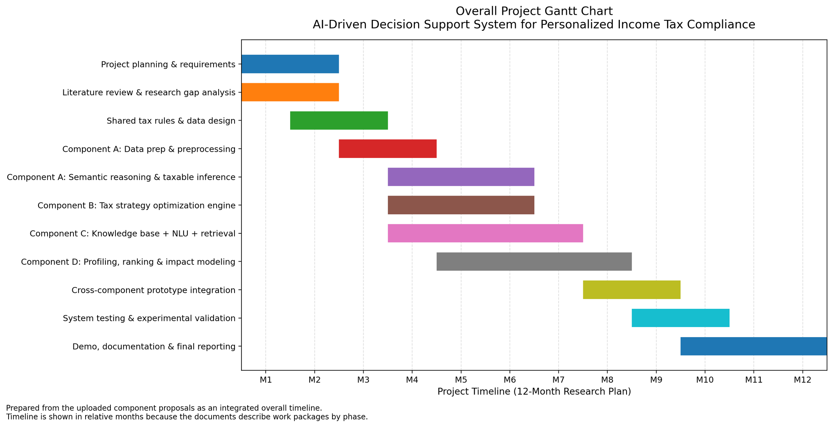
Gantt Chart
16/3/2026
61
R26-DS-004

Slide 62
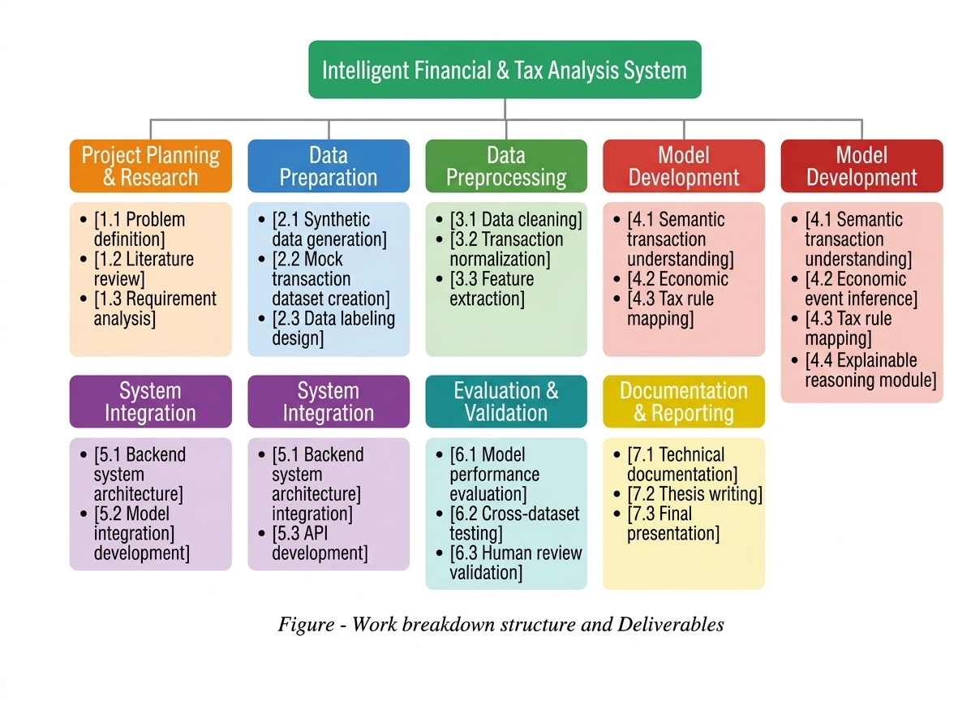
work breakdown structure
16/3/2026
62
R26-DS-004

Slide 63
Thank you
63

