Slide 1

An Intelligent AI-Driven Decision Support System For
Personalized Income Tax Compliance and
Advisory in Sri Lanka
Group Number : R26-DS-004

Slide 2
An Intelligent AI-Driven Decision Support System For Personalized Income Tax Compliance and Advisory in
Sri Lanka
Proposal Comments
How the Comments Were Addressed
Need a clearer understanding of the financial institution transaction data and expected dataset structure (~20K records)
Clarify data availability and feasibility of proceeding with real-world financial data
Address ethical clearance and privacy concerns related to financial transaction records
Define proper evaluation and validation strategies for all components
Improve explanation of AI workflow, including Knowledge Graphs, SLMs, and Learning-to-Rank approaches
Strengthen system practicality through industry collaboration and verified data sources
Collaborated with EY for financial data support and domain guidance
Improved understanding of financial transaction data and preprocessing methods
Added ethical handling using anonymized and synthetic datasets
Defined evaluation and validation methods for all components
Improved AI workflow and explainable recommendation process
Enhanced system feasibility with industry support and validation
R26-DS-004
1

Slide 3
An Intelligent AI-Driven Decision Support System For Personalized Income Tax Compliance and Advisory in
Sri Lanka
Problem, It's Impact / Gravity
Sri Lankan taxpayers struggle to understand complex income tax regulations
Existing tax systems mainly support filing and tax calculation only
Taxpayers depend heavily on auditors and tax consultants
Lack of personalized and explainable tax planning support
Person / Group / Society / Institution / Technology
Individual taxpayers and salaried employees
Freelancers and mixed-income earners
Tax consultants and auditors
Inland Revenue Department (IRD) Sri Lanka
Design Excellence of the Overall Solution
AI-driven personalized tax advisory system
Explainable and transparent tax recommendations
Intelligent tax strategy optimization and prediction
Integrated platform combining compliance, advisory, and recommendation modules
R26-DS-004
2

Slide 4

IT22118936 | Samarasinghe K.A.E.H.N
Individual Component 01
Financial Transaction Semantic Reasoning Taxable Income Inference
Data Science
IT22118936 | Samarasinghe K.A.E.H.N| R26-DS-004

Slide 5
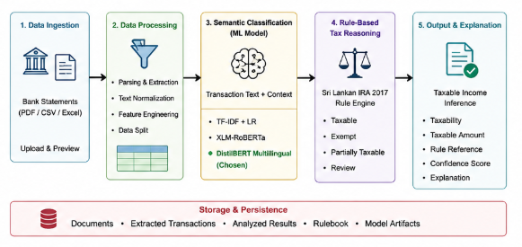
Financial Transaction Semantic Reasoning and Taxable Income Inference
Problem Addressed
Manual transaction review is slow and difficult
Bank transaction descriptions are unclear
Existing systems cannot accurately identify taxable income
Structured financial reasoning is needed for downstream modules
ML Architecture
Data Collection & Processing
Financial transaction data from bank statements
Features collected:
  Description
  Amount
  Date
  Transaction type
Preprocessing:
  Cleaning & normalization
  Feature extraction
  Train-test split
Why Distil BERT?
Strong multilingual text understanding
Good performance for transaction classification
Lightweight and efficient for deployment

Slide 6
Financial Transaction Semantic Reasoning and Taxable Income Inference​
​
How the Solution Addresses the Problem
Extracts and structures financial transactions
Classifies semantic income categories using AI
Applies Sri Lankan tax rules for taxability
Generates explainable tax reasoning
Flags uncertain transactions for review
Prototype Features
Document upload and transaction extraction
Transaction classification and taxability analysis
Taxable income summary generation
Batch transaction processing
Export and review functionality
Design Excellence / Contribution
Hybrid AI + rule-based tax reasoning architecture
Explainable and transparent taxability decisions
Supports multilingual financial transaction descriptions
Structured outputs for downstream advisory modules
Scalable and modular system design
User Feedback on Prototype
Users preferred automated transaction analysis
Explainable outputs improved user trust
Batch processing reduced manual effort
Tax summaries helped improve understanding

Slide 7

IT22064486 | Chalanika A.L.V
Individual Component 02
Tax Strategy Optimization & Explainable Decision Engine
Data Science
IT22064486 | Chalanika A.L.V| R26-DS-004

Slide 8
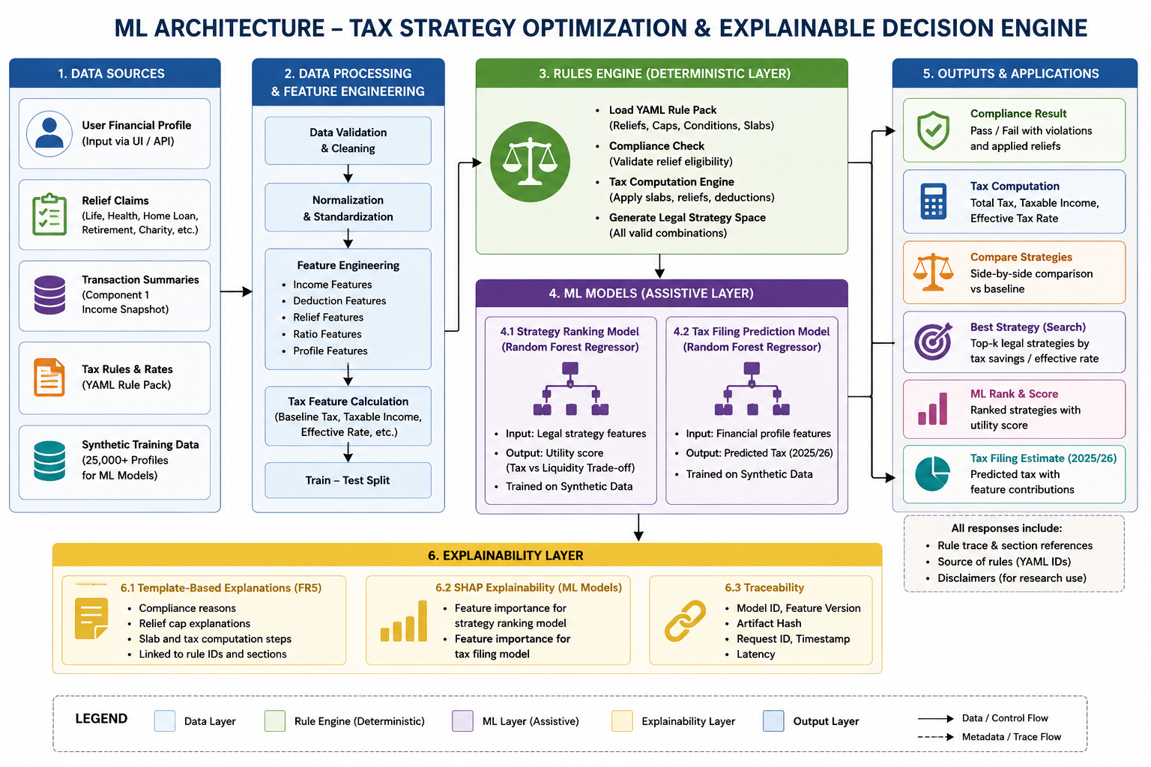
Tax Strategy Optimization & Explainable Decision Engine
Problem Addressed
Taxpayers struggle to identify legal tax-saving strategies
Many individuals depend on auditors for tax calculation and planning
Existing systems lack personalized tax optimization
Need explainable and optimized tax recommendations
ML Architecture
Data Collection & Processing
Synthetic taxpayer financial dataset generation
Features collected:
  Income & deductions
  Investments & liabilities
  Relief claims
Data preprocessing:
  Cleaning & normalization
  Train-test split
Why Random Forest + Shap?
Strong performance for optimum tax
Supports explainable decision-making
Effective strategy ranking capability
Efficient and scalable deployment

Slide 9
Tax Strategy Optimization & Explainable Decision Engine
How the Solution Addresses the Problem
Calculates tax using Sri Lankan tax rules
Identifies legal tax-saving opportunities
Compares and ranks tax strategies
Provides explainable and optimized tax guidance
Prototype Features
Tax compliance and calculation dashboard
Strategy comparison and optimization
Tax filing module
SHAP-based explainability visualization
Design Excellence / Contribution
ML optimization architecture
Explainable tax decision-making using SHAP
Personalized tax optimization and ranking
Modular and scalable system design
Transparent and legally compliant recommendations
User Feedback on Prototype
Users preferred automated tax calculation
Strategy comparison improved decision-making
Explainable outputs increased trust
Personalized recommendations were considered useful

Slide 10

IT22238580 | Pihillegedara S.N.M
Individual Component 03
Personalized Recommendation & Predictive Impact
Modeling Engine.
Data Science
IT22238580 | Pihillegedara S.N.M| R26-DS-004

Slide 11
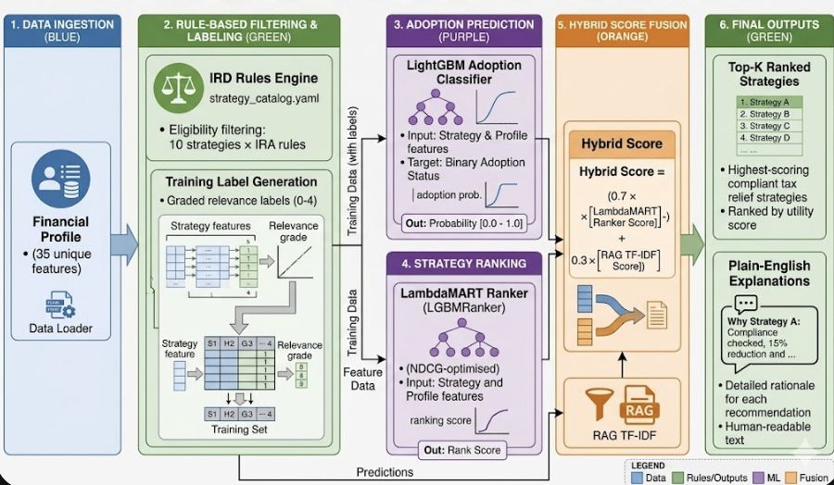
Personalized Recommendation & Predictive Impact Modeling Engine.
Problem Addressed
Limited awareness of legal tax-saving strategies
Generic tax advice lacks personalization
Complex IRD eligibility rules are difficult to understand
Need ranked and explainable strategy recommendations
ML Architecture
Data Collection & Processing
Synthetic taxpayer dataset generation
Features collected:
Income & expenses
Investments & deductions
Risk tolerance
Income sources
Data preprocessing:
Cleaning & normalization
Feature calculation
Train-test split
Why LightGBM + LambdaMART?
Strong performance for financial data analysis
Effective strategy ranking capability
Supports personalized recommendations
Efficient and scalable for deployment

Slide 12
Personalized Recommendation & Predictive Impact Modeling Engine.
How the Solution Addresses the Problem
Generates personalized tax-saving recommendations
Predicts suitable strategies based on financial profiles
Ranks strategies using AI-based recommendation models
Provides explainable and actionable tax guidance
Prototype Features
Financial profile creation and analysis
Strategy ranking and recommendation dashboard
Estimated tax savings and adoption probability
Hybrid recommendation and explanation module
Interactive recommendation interface
Design Excellence / Contribution
Hybrid AI + rule-based recommendation architecture
Combines ranking, prediction, and semantic retrieval
Explainable and transparent recommendation process
Personalized recommendations using financial behavior
Scalable and modular system design
User Feedback on Prototype
Users preferred personalized recommendations
Estimated savings improved decision-making
Explainable outputs increased trust
Interactive recommendations were considered useful

Slide 13

IT22896186 | Hewagama S R
Individual Component 04
Intelligent Tax Advisory Language Model
Data Science
IT22896186 | Hewagama S R | R26-DS-004

Slide 14
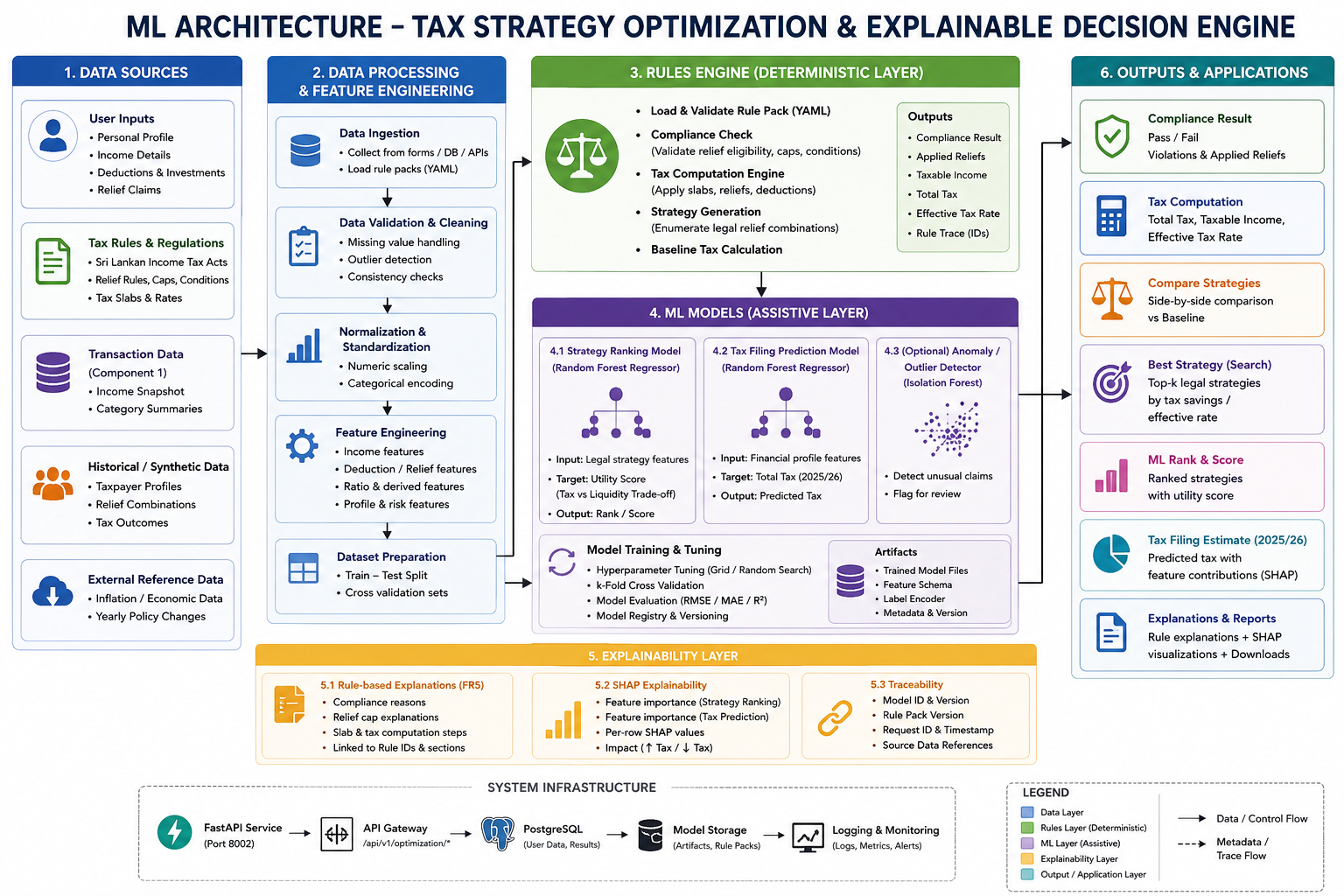
Intelligent Tax Advisory Language Model
Problem Addressed
Tax regulations are difficult for users to understand
Manual tax information lookup is time-consuming
General AI models may generate incorrect tax advice
Need explainable and legally grounded tax guidance
ML Architecture
Design Excellence / Contribution
IRD documents, circulars, and tax regulations collected
Features collected:
  Tax queries
  Legal references
  Regulatory content
Data preprocessing:
  Text extraction
  Chunking & normalization
  Intent classification preparation
Why TF-IDF + Knowledge Graph?
Efficient legal document retrieval
Supports explainable tax advisory responses
Lightweight and scalable deployment
Improves legal traceability and accuracy

Slide 15
Intelligent Tax Advisory Language Model
How the Solution Addresses the Problem
Retrieves relevant tax regulations and legal references
Understands user tax queries using AI models
Generates explainable and citation-based tax guidance
Provides structured and reliable advisory responses
Prototype Features
Tax query and advisory interface
Intent detection and legal retrieval
Citation-based response generation
Knowledge graph context display
Interactive advisory dashboard
Design Excellence / Contribution
Hybrid retrieval + AI advisory architecture
Explainable and legally grounded responses
Knowledge graph integration for tax reasoning
Modular and scalable system design
Supports multilingual tax queries
User Feedback on Prototype
Users preferred citation-based explanations
Explainable responses increased trust
Knowledge graph view improved understanding
Interactive advisory interface was useful

Slide 16
Commercialization / Sustainability of Solution
Customer Persona
Individual taxpayers
Freelancers & small businesses
Tax consultants and auditors
Financial institutions
Market Size
Sri Lankan digital tax-compliance market
Growing demand for AI-driven tax advisory
Potential enterprise and API expansion
What is Unique in Your Solution
Explainable AI-based tax advisory platform
Personalized tax optimization pipeline
Privacy-focused and ethically controlled system
Human-review support for uncertain cases
How will the cost be recovered?
SaaS subscription model
Enterprise licensing and API integration
Maintenance handled only by the research team
Long-term compliance and support services

Slide 17
THANK YOU

