Slide 1


AN INTELLIGENT
AI-DRIVEN Decision Support SYSTEM FOR PERSONALIZED INCOME TAX COMPLIANCE AND ADVISORY IN SRI LANKA
R26-DS-004
R26-DS-004
31/8/2026

Slide 2

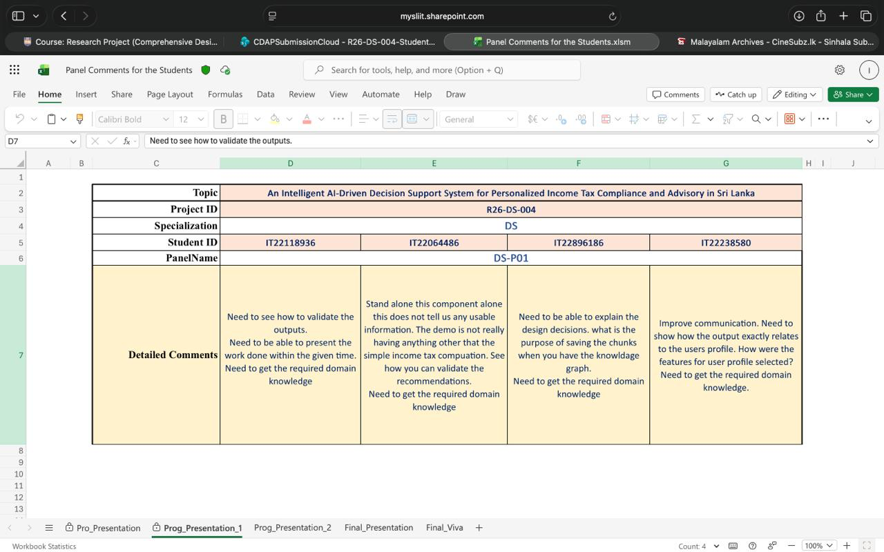
PP1 PANEL COMMENTS
R26-DS-004
31/8/2026

Slide 3
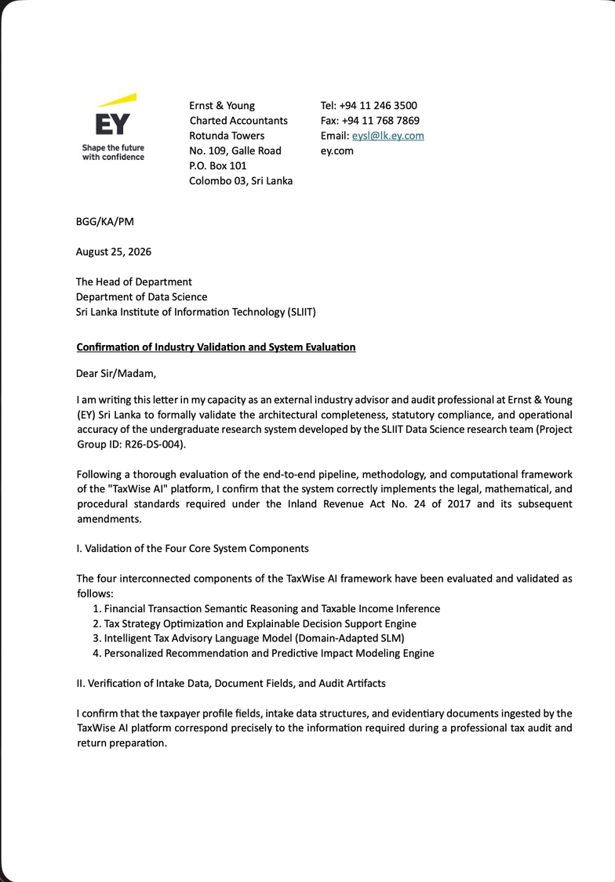
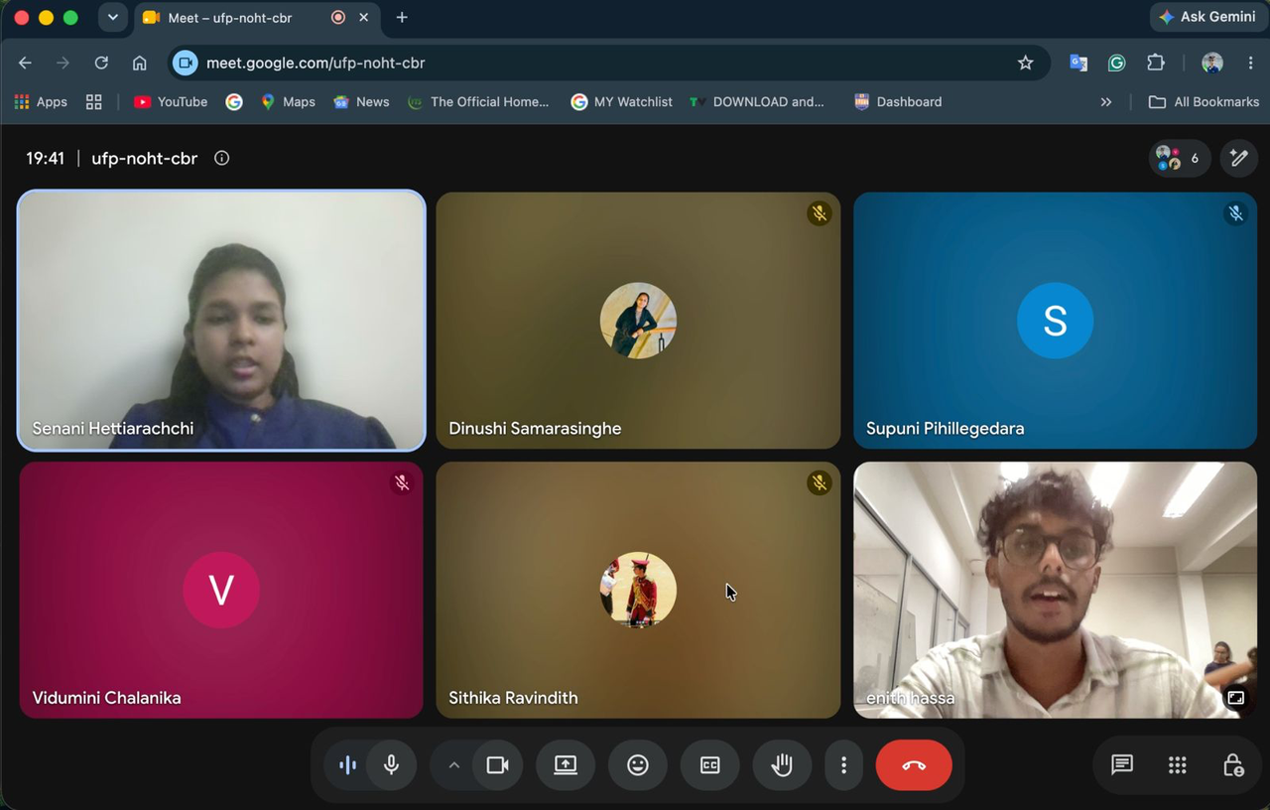
HOW WE ADDREESED
R26-DS-004
31/8/2026

Slide 4

PROBLEM STATEMENT
Sri Lankan personal income tax rules are complex and frequently change through Acts, amendments, reliefs, tax rates, and assessment-year-specific provisions. Existing tax calculators mainly provide a tax amount but often do not clearly explain which tax rules were applied, why a relief was allowed, or how the final amount was calculated.
R26-DS-004
31/8/2026

Slide 5
Therefore, the project aims to develop an AI-powered, personalized and explainable tax advisory system that can:
  Process taxpayer financial information and identify relevant income.
  Apply year-specific Sri Lankan tax rules.
  Calculate tax using reliable and deterministic tax logic.
  Provide personalized tax recommendations based on the user's financial profile.
  Answer tax-law questions using retrieved and cited legal sources.
  Provide explanations that allow users and auditors to understand and verify the results.
R26-DS-004
31/8/2026

Slide 6

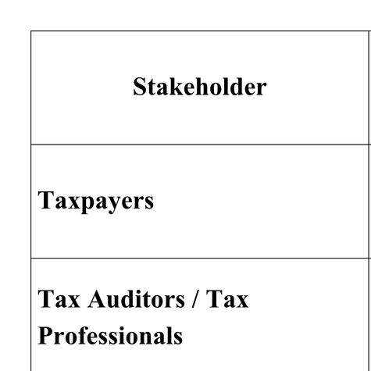
KEY STAKEHOLDERS
R26-DS-004
31/8/2026

Slide 7

RESEARCH OBJECTIVES & GAP ANALYSIS
A:Transaction Semantic Reasoning
  The Gap: Bank statements contain unstructured and ambiguous transactions, making it difficult to accurately identify income types and taxable transactions.
  Objective: Automatically classify financial transactions into relevant income and taxability categories while allowing auditor review and correction.
R26-DS-004
31/8/2026

Slide 8
RESEARCH OBJECTIVES & GAP ANALYSIS
B: Optimization & Explainable Engine
  The Gap: Existing tax calculators do not adequately handle changing tax laws or explain how tax amounts are calculated based on the applicable assessment year.
  Objective: Extract year-specific tax rules from official Acts and use deterministic calculations with traceable explanations and supporting legal sources.
R26-DS-004
31/8/2026

Slide 9
RESEARCH OBJECTIVES & GAP ANALYSIS
C: Intelligent Tax Advisory Language Model
  The Gap: Taxpayers may struggle to understand complex tax laws and obtain reliable answers to tax-related questions from existing sources.
  Objective: Provide relevant, understandable tax-law information using retrieval-based responses with supporting Act/IRD citations.
R26-DS-004
31/8/2026

Slide 10
RESEARCH OBJECTIVES & GAP ANALYSIS
D: Personalized Recommendation & Predictive Impact Modeling Engine
  The Gap: Generic tax-saving recommendations do not consider an individual's financial situation, risk, affordability, and ability to adopt a strategy.
  Objective: Generate and rank personalized tax strategies based on the user's financial profile and estimate their potential financial impact
R26-DS-004
31/8/2026

Slide 11

SOLUTION OVERVIEW
  An intelligent AI-driven tax advisory system that processes taxpayer financial information, applies Sri Lankan tax rules, provides personalized recommendations, and delivers explainable, law-grounded tax guidance.
Transaction Semantic Reasoning
  Automatically classifies bank transactions into relevant income and taxability categories, with auditor review
Optimization & Explainable Engine
  Extracts year-specific tax rules from Acts and provides deterministic tax calculations with traceable explanations
R26-DS-004
31/8/2026

Slide 12
SOLUTION OVERVIEW
Personalized Recommendation
  Generates personalized tax-saving strategies based on the user's financial profile, preferences, and potential impact
Intelligent Tax Advisory Language Model
  Retrieves relevant tax-law information and provides understandable answers supported by Act/IRD citations
R26-DS-004
31/8/2026

Slide 13
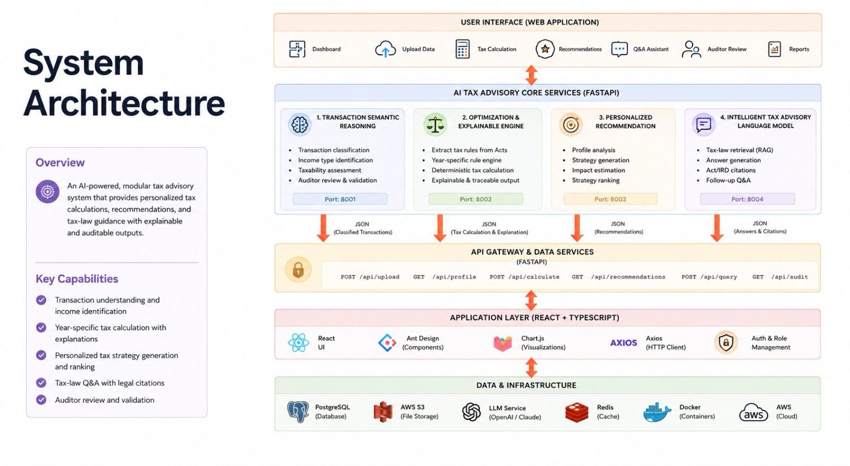
R26-DS-004
31/8/2026

Slide 14


NON FUNCTIONAL FORCUS
Performance:
•⁠ ⁠Efficient processing of tax data, document retrieval, and tax calculations.
Reliability:
•⁠ ⁠Consistent, traceable outputs with auditor validation and source-based tax rules.
Usability:
•⁠ ⁠Unified interface for tax calculation, recommendations, tax-law Q&A, and auditor review.
R26-DS-004
31/8/2026

Slide 15
PROJECT IMPLEMENTATION STATUS
100% implemented with all four components integrated through the common application, including transaction classification, year-specific tax calculation, personalized recommendations, and tax-law retrieval with explainable outputs.
R26-DS-004
31/8/2026

Slide 16
IMPACT
TARGET USERS
Primary Users
•⁠ ⁠Taxpayers
•⁠ ⁠Tax Auditors / Tax Professionals
•⁠ ⁠Researchers / Academic Users
Organizations
•⁠ ⁠Inland Revenue Department
•⁠ ⁠Tax Advisory Firms
•⁠ ⁠Financial / Accounting Organizations
R26-DS-004
31/8/2026

Slide 17
IMPACT
BENEFITS
•⁠ ⁠Accurate and year-specific tax calculations
•⁠ ⁠Personalized tax-saving recommendations
•⁠ ⁠Clear, explainable tax results
•⁠ ⁠Tax-law guidance with reliable citations
•⁠ ⁠Auditor review and validation
•⁠ ⁠Reduced manual effort in tax analysis
R26-DS-004
31/8/2026

Slide 18
COMMERCIALIZATION PLAN
Estimated Monthly Infrastructure Cost
Cloud Hosting → LKR 8,000–15,000
Database & Storage → LKR 6,500–13,000
AI / LLM API Usage → LKR 2,000–8,000
Monitoring & Backup → LKR 1,500–4,000
Total Estimate
LKR 18,000 – 40,000 / month
Depending on the number of users and system usage
R26-DS-004
31/8/2026

Slide 19
Adoption Plan: Next Steps
  Pilot Program
  Test with sample taxpayer cases
  Validate outputs with a tax auditor
  Performance Optimization
  Improve processing and response time
  Optimize AI/API and database performance
  Production Deployment
  Deploy to a cloud environment
  Support increasing numbers of taxpayers
  Continuously update tax rules and maintain the system
R26-DS-004
31/8/2026

Slide 20

THANK YOU!

