Slide 1
RESEARCH PROJECT • R26-DS-004
An Intelligent AI-Driven Decision Support System for Personalized Income Tax Compliance and Advisory in Sri Lanka
BSc (Hons) Information Technology — Data Science
SLIIT | Academic Year 2025/2026
01

Slide 2




Meet Our Team
02
MEMBER A
MEMBER B
MEMBER C
MEMBER D
Samarasinghe K.A.E.H.N
Chalanika A.V
Hewagama S.R.
Pihillegedara S.N.M.
IT22118936
IT22064486
IT22896186
IT22238580
Financial Transaction
Semantic Reasoning
Tax Strategy
Optimization
Intelligent Tax Advisory
Language Model
Personalized Recommendation
& Predictive Impact Modeling Engine
R26-DS-004 • SLIIT

Slide 3

Introduction to Problem
03
!
THE EXISTING PROBLEM
?
LIMITATIONS TODAY
Taxpayers struggle to interpret changing rules and identify applicable reliefs and deductions.
Standard calculators focus mainly on tax payable, not personalized decisions.
UNDERSTANDING TAX IS COMPLEX
✓
WHY THIS MATTERS
Generic advice may overlook financial circumstances or lack clear legal evidence. A reliable system should connect transactions, tax rules, tailored recommendations, and grounded explanations.
R26-DS-004 • SLIIT

Slide 4
Problem & Proposed Solution
04
!
PROBLEMS
✓
PROPOSED SOLUTION
• Difficult transaction interpretation
• Complex, year-dependent tax rules
• Generic recommendations
• Answers without clear legal evidence
Impact: uncertain or unsuitable tax decisions
• Classify financial transactions
• Calculate tax using versioned rules
• Rank eligible strategies by profile
• Answer questions with cited legal sources
Goal: personalized, traceable decisions
AI + RULES
R26-DS-004 • SLIIT

Slide 5
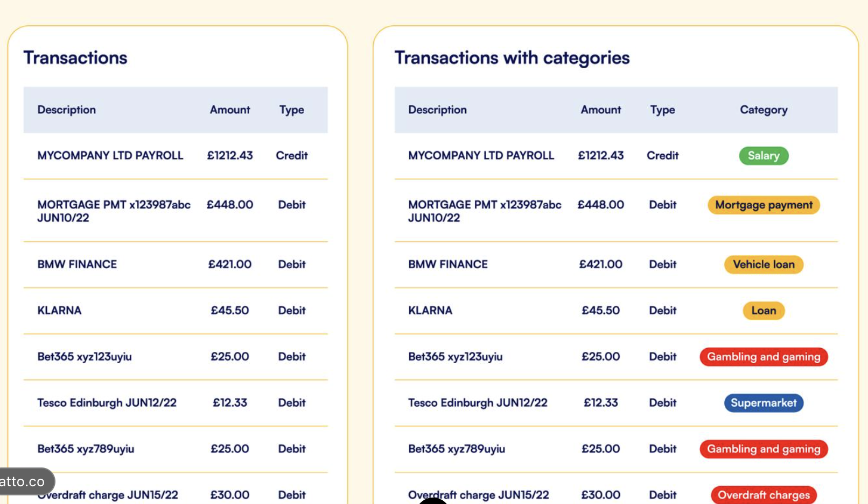
Financial Transaction Semantic Reasoning
05
Member A • IT22118936 • Samarasinghe K.A.E.H.N
OVERVIEW & KEY FEATURES
Converts transaction descriptions from bank statements and income documents into structured, tax-relevant records.
• Transaction category classification
• Taxability flag generation
• Inland Revenue reference association
• Structured outputs for other components
Models: TF-IDF + Logistic Regression, XLM-RoBERTa, multilingual DistilBERT.
CONTRIBUTION
Reduces manual interpretation of raw transaction text and provides structured inputs for tax computation and advisory.
Add latest held-out F1 here.
6
05
R26-DS-004 • SLIIT

Slide 6

Tax Strategy Optimization
Member B • IT22064486 • Chalanika A.V
OVERVIEW & KEY FEATURES
Calculates Sri Lankan income tax using assessment-year-specific rules and provides explanations supported by legal evidence.
- RAG-based retrieval of Inland Revenue Act passages
- GPT-4o tax-rule extraction with quote-gate verification
- Year-specific rules for reliefs, rates and limits
- Deterministic Python tax calculation
- Explainable results linked to relevant legal provisions
Core Technologies: Python, FastAPI, PostgreSQL, OpenAI GPT-4o and text-embedding-3-small.
DESIGN PRINCIPLE
The rule engine calculates taxes, while RAG retrieves legal evidence. GPT-4o extracts tax rules, which are verified through a quote gate and human review before approval.
06
R26-DS-004 • SLIIT

Slide 7
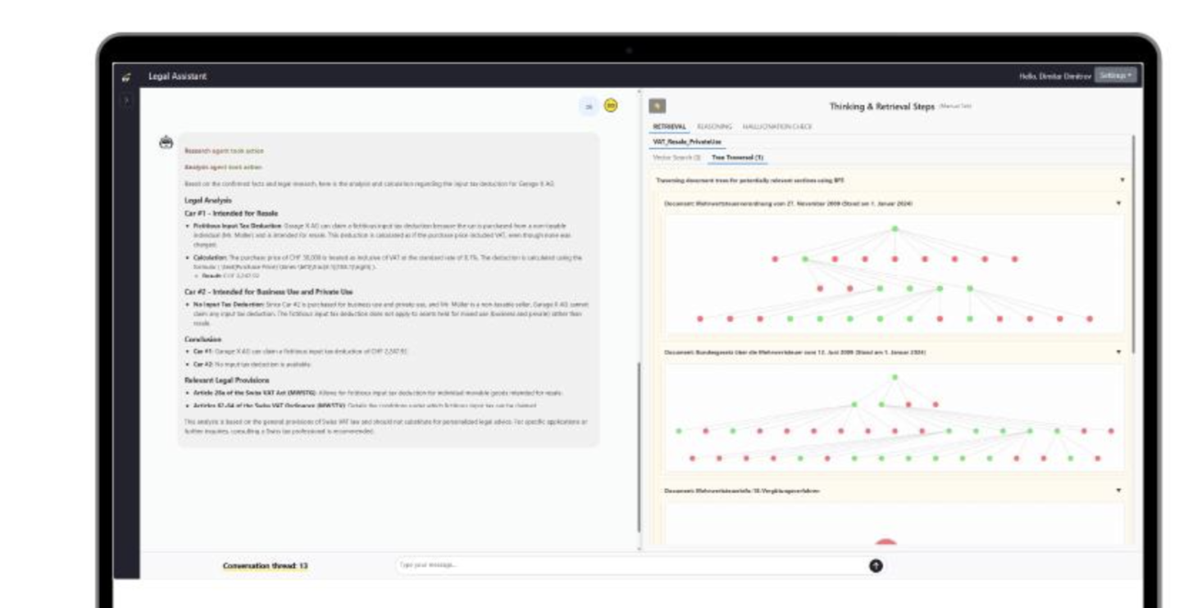
Intelligent Tax Advisory Language Model
Member C • IT22896186 • Hewagama S.R.
OVERVIEW & KEY FEATURES
Answers tax questions in natural language, including informal Sinhala-English, using retrieved Inland Revenue material.
• Query intent classification
• Retrieval and legal-source reranking
• Grounded natural-language answers
• Think Twice checks for supported figures
• Proof Map connecting answers to legal sections
CONTRIBUTION
Improves traceability by showing supporting legal passages and validation results instead of relying on fluent text alone.
07
R26-DS-004 • SLIIT

Slide 8

Personalized Recommendation & Predictive Impact Modeling Engine
Member D • IT22238580 • Pihillegedara S.N.M.
OVERVIEW & KEY FEATURES
Ranks eligible tax-saving strategies for each taxpayer based on their financial profile.
• Strategy ranking by tax fit
• Feasibility and risk assessment
• Adoption likelihood estimation
• SHAP-based explanations
• Monte Carlo outcome ranges
Technologies: LightGBM LambdaMART, adoption classifier, SHAP and Monte Carlo simulation.
CONTRIBUTION
Helps taxpayers compare strategies using personal priorities and a range of potential outcomes, not one falsely precise forecast.
08
R26-DS-004 • SLIIT

Slide 9
Commercialization
09
TARGET AUDIENCE
PROPOSED PLATFORM
• Individual taxpayers
• Salaried employees
• Self-employed professionals
• Small business owners
• Tax consultants and accountants
A web-based service combining:
• Transaction analysis
• Tax computation
• Personalized strategies
• Future-impact projections
• Grounded tax Q&A
A PLATFORM FOR TAX DECISIONS
POTENTIAL MODEL
Free basic guidance
Premium personalized features
Professional plans for practitioners
Pricing requires validation.
R26-DS-004 • SLIIT

Slide 10
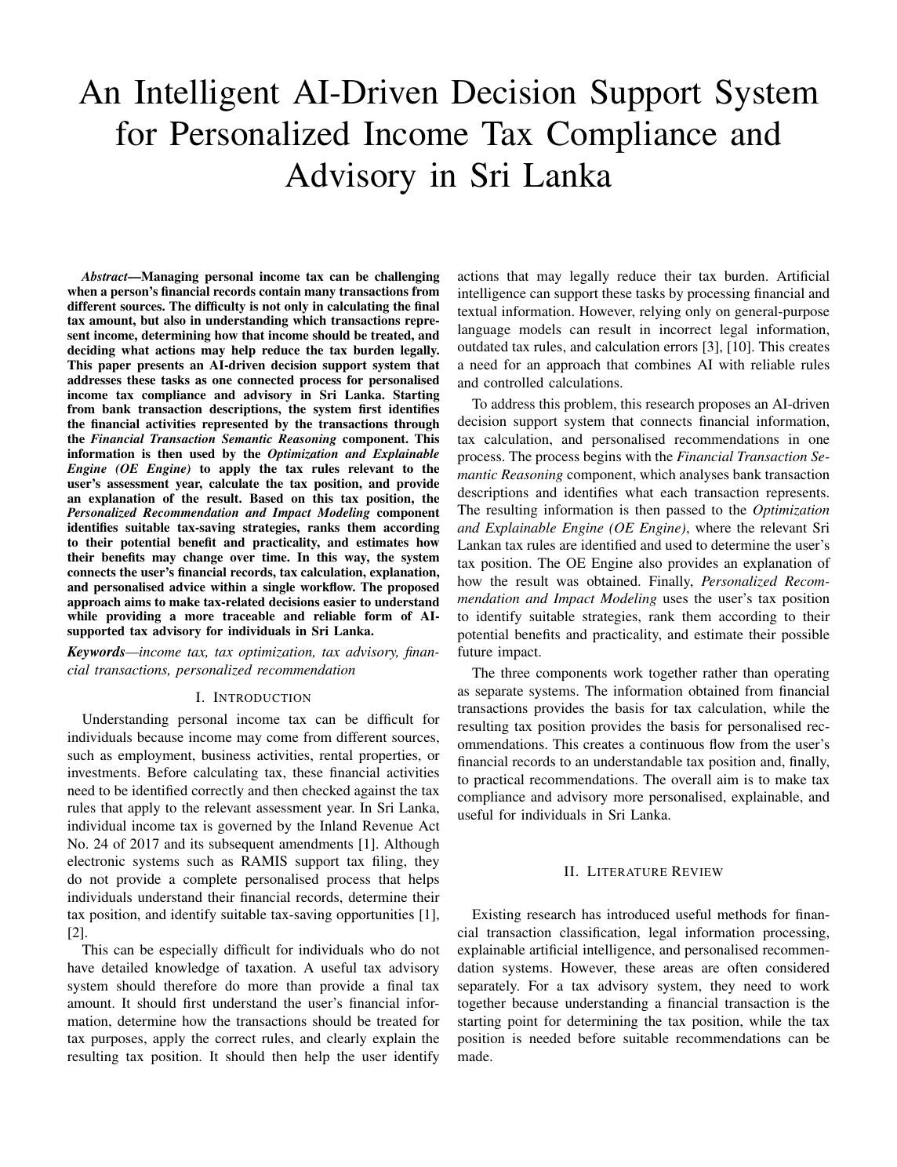
Research Paper
10
R26-DS-004 • SLIIT

Slide 11
Evidence & Validation
11
SYSTEM DEMONSTRATION
TESTING EVIDENCE
Include genuine outputs:
• Rule-engine test cases
• Transaction classification results
• Recommendation examples
• Retrieval and answer validation
Show actual screenshots of:
• Taxpayer profile
• Tax computation
• Eligible strategies
• Tax question and Proof Map
USER / EXPERT FEEDBACK
Add real feedback with permission. If external evaluation has not been conducted, state that clearly.
R26-DS-004 • SLIIT

Slide 12
Results & Performance Evaluation
12
Recall@8
MRR
0.91
with Lex Specialis reranking
0.74
with reranking
Intent macro-F1
Think Twice precision
0.82
eight intent classes
0.975
40-item adversarial set
HALLUCINATION RATE
OTHER COMPONENTS
30% without retrieval → 10% with retrieval → 5% with retrieval + Think Twice
Add actual transaction F1, rule-engine pass/fail counts and independent ranking evaluation.
Evaluation notes: 55 retrieval queries; Think Twice precision measured on 40 adversarial items. Verify before presenting.
R26-DS-004 • SLIIT

Slide 13
Current Limitations
13
Data Limitations: The availability of labelled real-world transaction and taxpayer data affects model evaluation.
Legal Coverage: Tax rules and reliefs must be maintained as Sri Lankan tax legislation changes.
Recommendation Reliability: Predicted adoption and future tax-saving outcomes require further validation.
Explanation Accuracy: Retrieved legal references and generated explanations need continuous verification.
R26-DS-004 • SLIIT

Slide 14
Future Improvements
14
Expert Validation: Collaborate with tax auditors and professionals to validate real-world tax cases.
Enhanced Datasets: Expand transaction datasets and obtain verified taxpayer examples with appropriate consent.
Updated Tax Rules: Improve coverage across assessment years and automate rule-update verification.
Improved Personalization: Validate recommendation rankings and adoption predictions using real user feedback.
Stronger Explainability: Improve legal citation verification and ensure responses remain consistent with authoritative sources.
R26-DS-004 • SLIIT

Slide 15
THANK YOU!
R26-DS-004 • SLIIT
14

