Slide 1
Comparative Analysis of Machine Learning Algorithms
for Elevation Dataset Regression
Work By:
Atchaya
Bhavatharni J
Dhivyashree M P
Enitha S
Geerthana G
Harshana D
CSE Department,
Sri Ramakrishna Engineering College.
Guided By,
Dr.R.Anuradha, Professor / CSE
Sri Ramakrishna Engineering College

Slide 2
CONTENTS
INTRODUCTION
ABOUT DATASET
LITERATURE SURVEY
METHODOLOGY
RESULTS AND DISCUSSION
CONCLUSION
REFERENCES

Slide 3
INTRODUCTION
Elevation datasets are crucial for various geospatial applications like environmental modeling, infrastructure planning, and disaster management
The study focuses on using four common machine learning algorithms for elevation dataset regression: Support Vector Machines (SVM), k-Nearest Neighbors (KNN), Random Forest, and Decision Tree.
The aim is to identify strengths and weaknesses of each algorithm in capturing complex relationships within elevation data, to aid selection of suitable algorithms.

Slide 4
ABOUT DATASET
Source of the dataset: Real-Time Kinematic Elevation Data - SHARP RTK Elevation Data 2015-2019)
Type of data: high-resolution elevation measurements using Real-Time Kinematic GPS technology
Geographic coverage: coastal regions
Features: year, latitude, longitude, elevation (as the target value)
Number of data points: 7796
Spatial Coverage: Geographic extent and distribution of measurement locations
Data Quality and Validation:
Potential sources of error or uncertainty (sensor accuracy, GPS positioning errors, environmental factors)
Elevation Unit: meters
— Marsh Size Considerations and Refinement to 5-Meter Spacing
— Adaptive spacing strategy for data collection in limited marsh areas
— Refinement to 5-meter spacing in compact surveyed regions

Slide 5
LITERATURE SURVEY
Saba Ameer et al [1] compared 4 techniques for air pollution prediction and found Random Forest regression to be
the best, with low error rates and processing times. Gradient Boosting performed the worst with high error rates and
slow processing.
Nahiyan Bin Noor et al [2] developed a non-invasive and low-cost technique to predict anemia using machine
learning algorithms on eye conjunctiva images, achieving 82.61% accuracy. The technique can enable affordable
anemia detection, especially for poor and remote populations, though some limitations exist due to dengue fever
outliers.
G. Sambasivam et al [3] compared 11 machine learning models for predicting the severity of vitamin D deficiency
and found random forest achieved the highest accuracy of 96%, outperforming other models. Our results
demonstrate machine learning, especially random forest, can accurately predict vitamin D deficiency severity.
Ramin Ghorbani et al [4]analyzed imbalanced student performance data using different resampling and
classification methods, finding SVM-SMOTE resampling and Random Forest classification achieved the best
performance for predicting all classes. Our work demonstrates properly handling imbalanced data can significantly
improve educational data mining.

Slide 6
METHODOLOGY
Machine learning algorithms are being used to improve accuracy and efficiency of elevation modeling.
The elevation dataset covers various geographical locations and terrains to assess algorithm performance across different landscapes.
The objectives are:
1) Use SVM, KNN, Random Forest, and Decision Tree for elevation dataset regression
2) Comparatively evaluate their performance.
The evaluation will assess algorithms' abilities to capture non-linear relationships, manage outliers, and deliver understandable outcomes.

Slide 7
METHODOLOGY
Data Preprocessing:
Cleaning the data (handling outliers, anomalies, and missing values)
Feature scaling and normalization
Splitting the dataset into training and testing sets
Model Development and Evaluation:
Support Vector Machines (SVM): Tuning kernel functions and hyperparameters
k-Nearest Neighbors (KNN): Optimizing the number of neighbors and distance metrics
Random Forest: Optimizing the number of trees and hyperparameters
Decision Tree: Pruning strategies and addressing overfitting
Residual Analysis:
Examining residual plots for each model
Identifying patterns, trends, and potential biases in the residuals

Slide 8
METRICS USED FOR EVALUATION
Performance Metrics:
Mean Squared Error (MSE)
R-Squared (R^2) and Adjusted R-Squared
Explained Variance Score...
Mean Absolute Error (MAE)
Mean Absolute Percentage Error (MAPE)

Slide 9
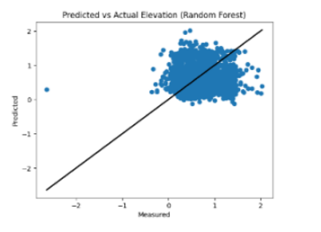
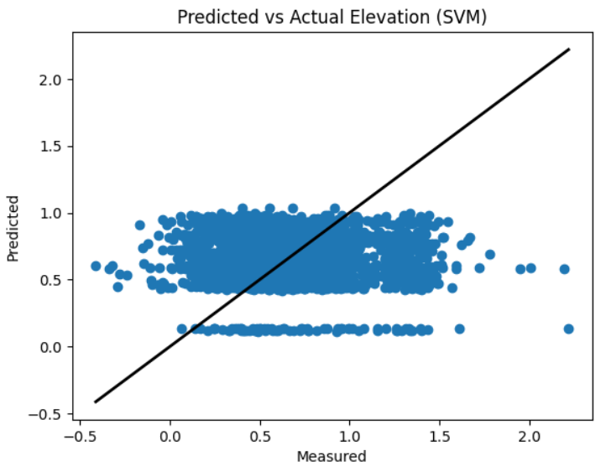
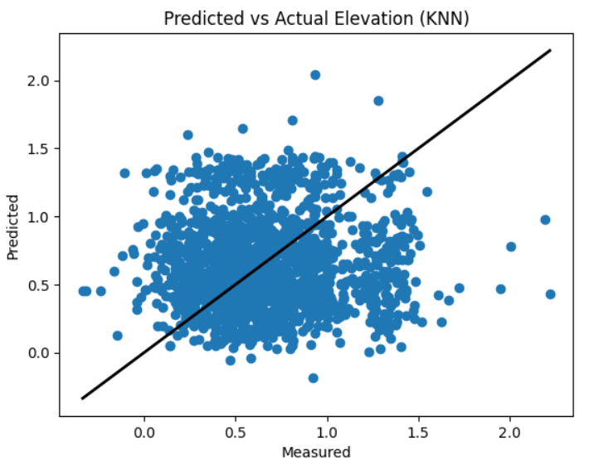
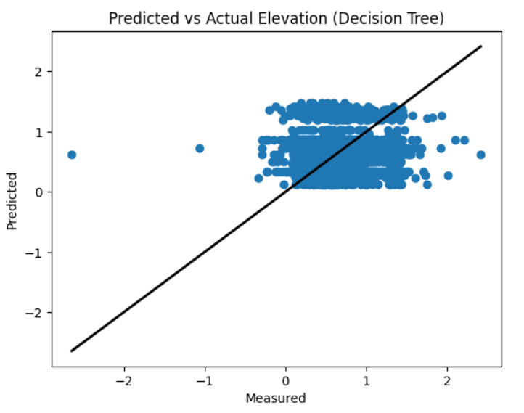
RESULTS AND DISCUSSION
Prediction vs. Accuracy Plot Observations:
Random Forest had the best performance, with points closely aligned to the line of perfect prediction and less variability.
SVM showed a unique pattern of horizontal lines, suggesting limitations in capturing data complexity or quantization effects.
KNN had a good distribution around the line but more variability than Random Forest.
Decision Tree had the widest spread of points, indicating difficulties in capturing underlying relationships effectively.

Slide 10
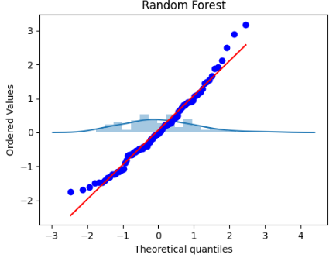
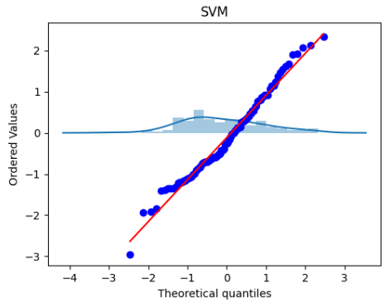
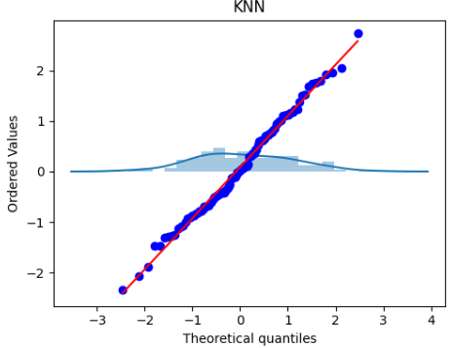
RESULTS AND DISCUSSION
Model Performance Comparison:
Random Forest performed the best overall, with the lowest errors (MSE, MAE, MAPE) and highest ability to explain the variance in the data (R^2, Adjusted R^2, Explained Variance Score).
Support Vector Machine (SVM) had the highest errors and lowest ability to capture the relationships in the data, performing the worst among the models.
K-Nearest Neighbors (KNN) had low MSE but high individual prediction errors (MAE, MAPE), indicating some inconsistency in performance.
Decision Tree had reasonable overall performance but suffered from high individual prediction errors and failure to capture variance for some data points.

Slide 11
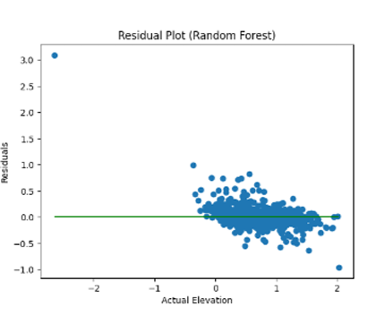
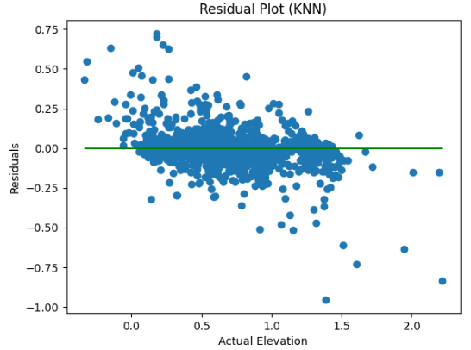
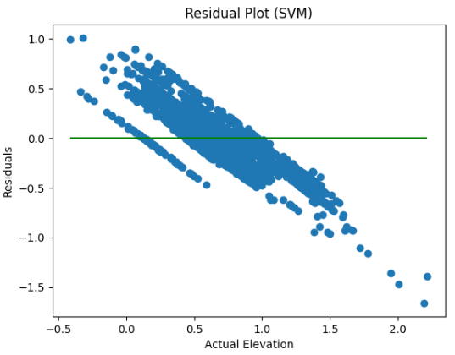
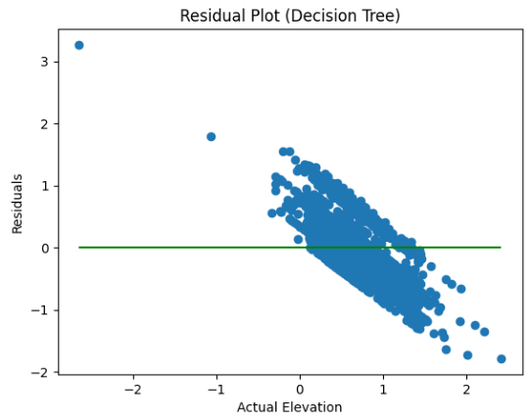
RESULTS AND DISCUSSION
Residual Plot Observations:
Random Forest and KNN had residuals closer to the red line, indicating a better fit, with some deviations at extreme values.
SVM had noticeable deviations from the red line, suggesting residuals were not normally distributed and poor model performance.
Decision Tree had residuals close to the red line, similar to KNN, with some slight deviations at extremes.

Slide 12
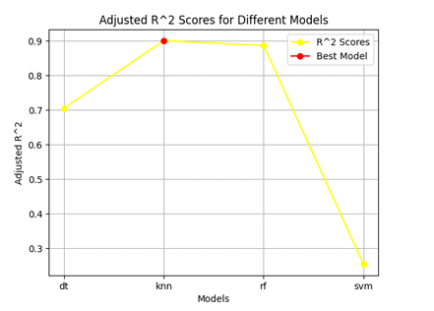
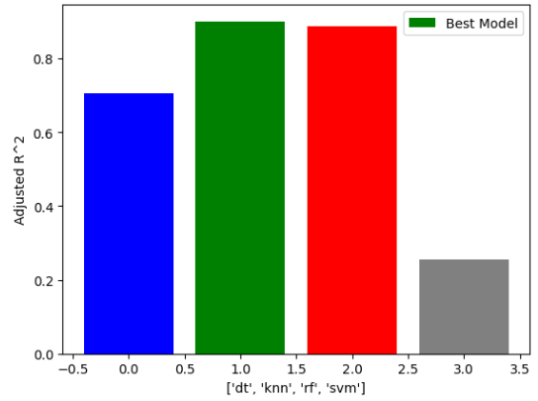
RESULTS AND DISCUSSION
Adjusted R^2 Score Comparison:
Random Forest and KNN had the highest Adjusted R^2 scores, close to 0.9, indicating the best fit to the data.
Random Forest was marked as the "Best Model" based on the highest Adjusted R^2 score.
Decision Tree had a moderate Adjusted R^2 score around 0.6.
SVM had the lowest Adjusted R^2 score, around 0.3, indicating a poor fit to the data.

Slide 13
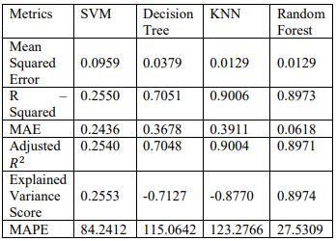
RESULTS AND DISCUSSION
Optimal Results:

Slide 14
CONCLUSION
The models from best to worst performance as follows:
Random Forest
KNN (K-Nearest Neighbors)
Decision Tree
SVM (Support Vector Machine)
Random Forest ----- lowest Mean Squared Error (0.0129), highest R-Squared (0.8973), highest Adjusted R-Squared (0.8971), highest Explained Variance Score (0.8974), and lowest Mean Absolute Percentage Error (MAPE) (27.5309), indicating superior overall performance.
KNN comes in second, with a Mean Squared Error tied with Random Forest (0.0129), a high R-Squared (0.9006), and a reasonably low MAPE (123.2766), though higher than Random Forest.
Decision Tree follows with a moderate Mean Squared Error (0.0379), R-Squared (0.7051), and Adjusted R-Squared (0.7048), but a relatively high MAPE (115.0642).
SVM performs the poorest, with the highest Mean Squared Error (0.0959), lowest R-Squared (0.2550), lowest Adjusted R-Squared (0.2540), lowest Explained Variance Score (0.2553), and a high MAPE (84.2412).

Slide 15
THANK YOU

