Slide 1
3D Projection Transformations and OpenGL
Soon Tee Teoh
CS 116A

Slide 2
Field of View q
The field of view angle q is the angle between the top and bottom clipping planes
View plane
q
Camera position

Slide 3
Field of View q
Relationship between field of view angle q and the dimensions of the clipping window
View plane
Clipping Window
q/2
h
h
d
q
Camera position
tan(q/2) = h/2d
d

Slide 4
Zoom
Field of view: Smaller angle means more zoom

Slide 5
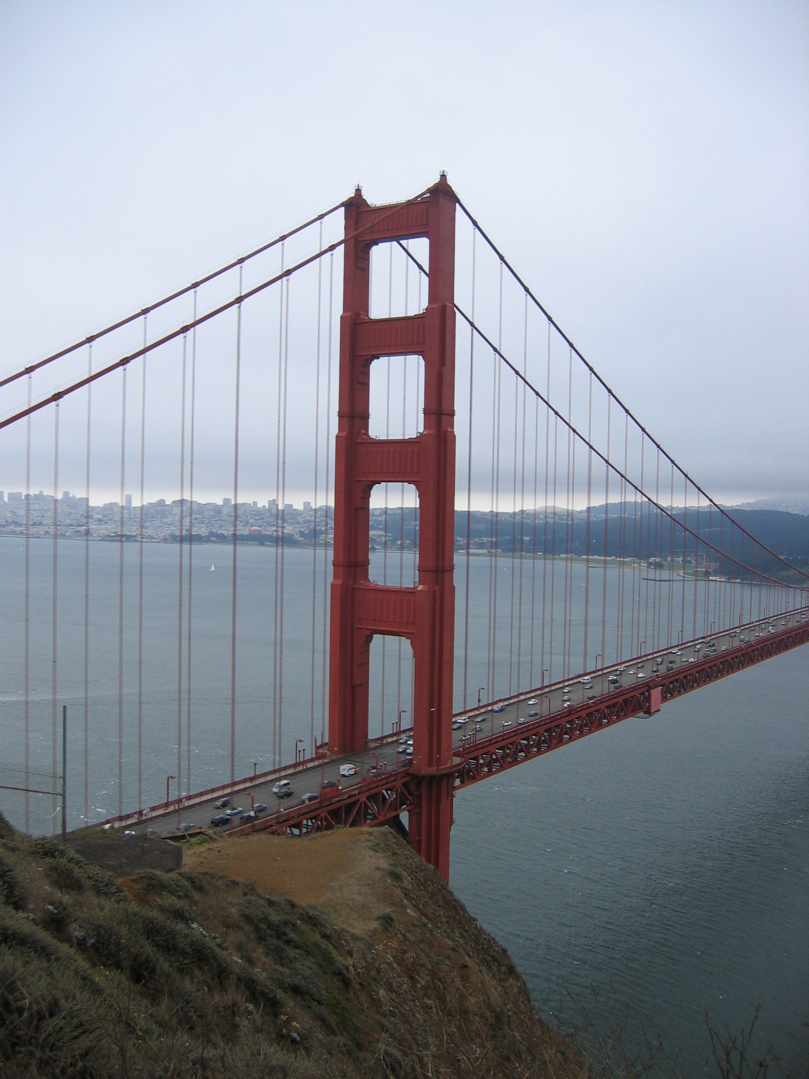
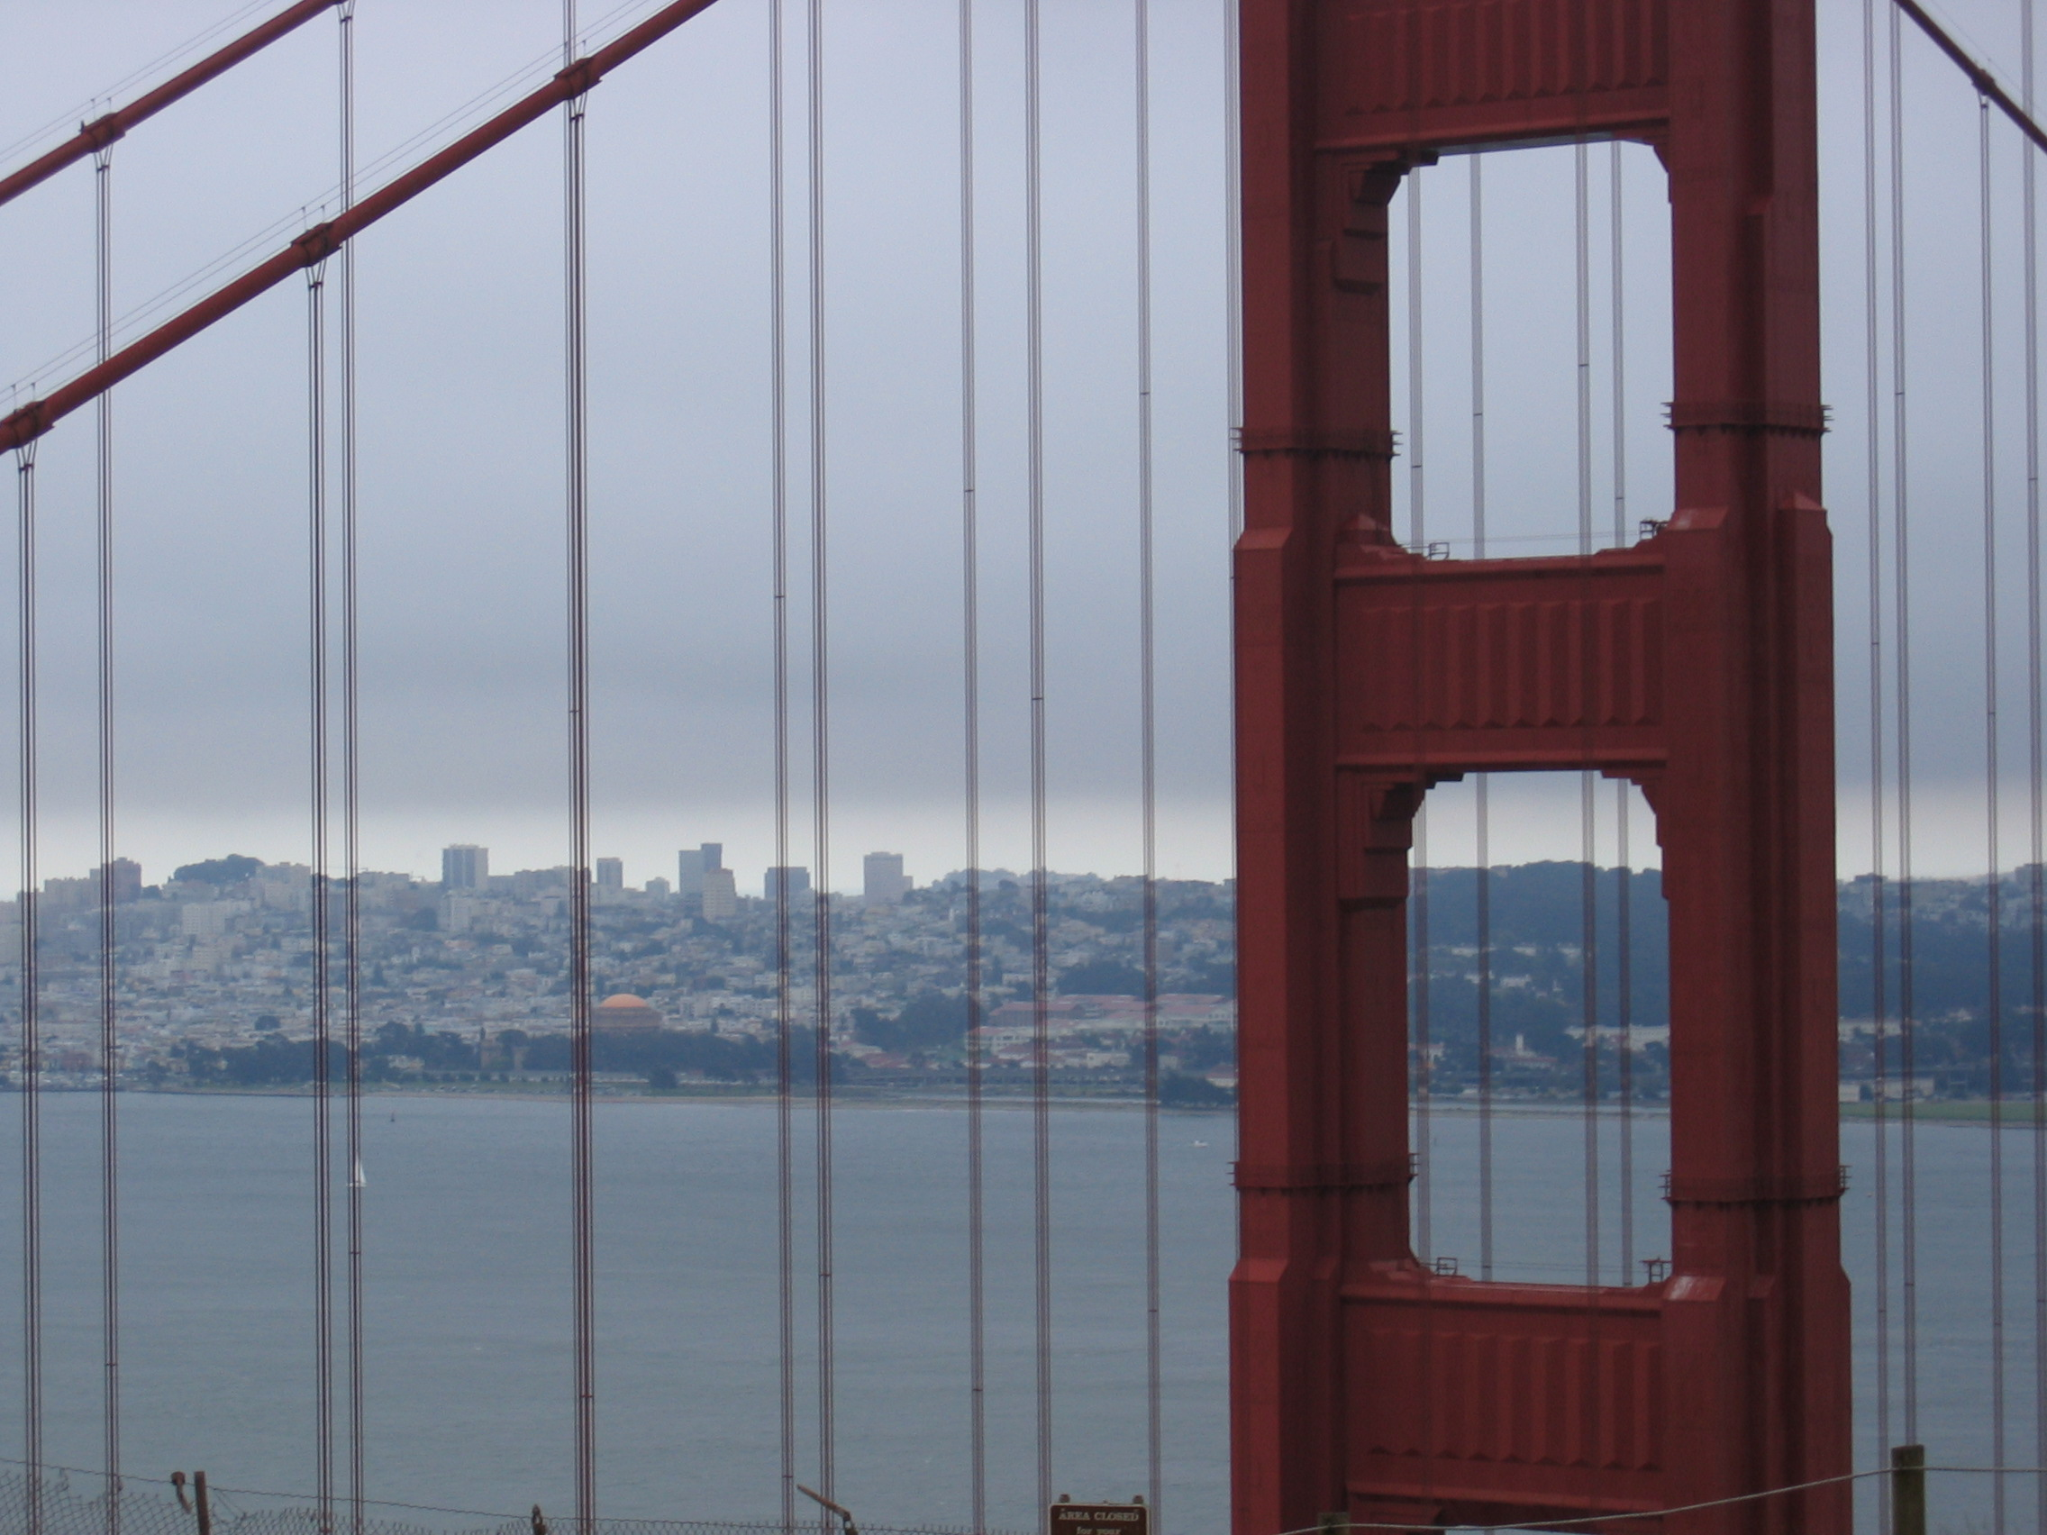
Zoom

Slide 6
Zoom

Slide 7
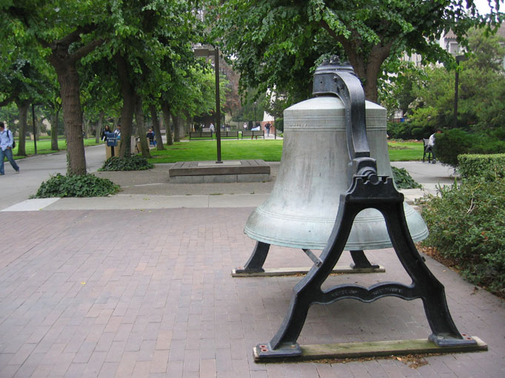
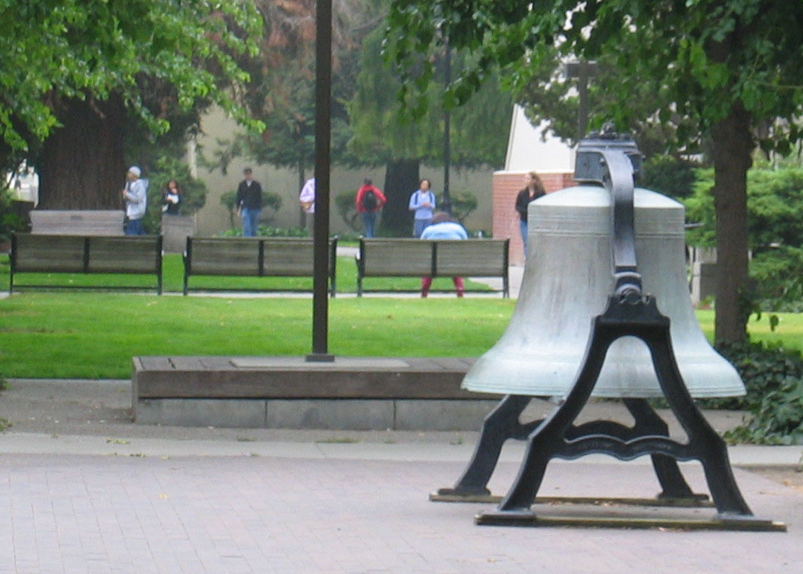
Zoom
Camera close to bell,
Wide angle
Camera further from bell,
Narrow angle
Notice the bench is much bigger in this picture.

Slide 8
OpenGL Projection
For orthographic projection
For perspective projection
Alternative perspective projection
Window parameters are with respect to view position and orientation
glMatrixMode(GL_PROJECTION);
glOrtho(xwmin,xwmax,ywmin,ywmax,dnear,dfar);
glMatrixMode(GL_PROJECTION);
gluPerspective(theta,aspect,dnear,dfar);
glMatrixMode(GL_PROJECTION);
glFrustum(xwmin,xwmax,ywmin,ywmax,dnear,dfar);
glMatrixMode(GL_MODELVIEW);
gluLookAt(x0,y0,z0,xref,yref,zref,Vx,Vy,Vz);
… other modelview transformations …
*Note: dnear and dfar are the distances from camera position to near and far planes respectively. They should be positive.

Slide 9
OpenGL Perspective Projection example using gluPerspective
glMatrixMode(GL_PROJECTION);
gluPerspective(theta,aspect,dnear,dfar);
glMatrixMode(GL_MODELVIEW);
gluLookAt(x0,y0,z0,xref,yref,zref,Vx,Vy,Vz);
// geometry
glBegin(GL_QUADS);
…
w
h
(xref,yref,zref)
(Vx,Vy,Vz)
q
(x0,y0,z0)
dnear
w/h = aspect

Slide 10
OpenGL Perspective Projection example using glFrustum
glMatrixMode(GL_PROJECTION);
glFrustum(xwmin,xwmax,ywmin,ywmax,dnear,dfar);
glMatrixMode(GL_MODELVIEW);
gluLookAt(x0,y0,z0,xref,yref,zref,Vx,Vy,Vz);
// geometry
glBegin(GL_QUADS);
…
ywmax
xwmax
(Vx,Vy,Vz)
(xref,yref,zref)
(x0,y0,z0)
dnear

Slide 11
OpenGL Orthographic Projection Example
glMatrixMode(GL_PROJECTION);
glOrtho(xwmin,xwmax,ywmin,ywmax,dnear,dfar);
glMatrixMode(GL_MODELVIEW);
gluLookAt(x0,y0,z0,xref,yref,zref,Vx,Vy,Vz);
// geometry
glBegin(GL_QUADS);
…
ywmax
xwmax
(Vx,Vy,Vz)
(xref,yref,zref)
dnear
(x0,y0,z0)

Slide 12
Clipping planes for orthographic projection
xwmax
ywmax
xwmin
ywmin
dnear
(x0,y0,z0) view position
dfar
xwmin, xwmax, ywmin, ywmax, dnear and dfar are with respect to view position

Slide 13
Clipping planes for perspective projection
xwmax
ywmax
xwmin
ywmin
dnear
(x0,y0,z0) view position
dfar
xwmin, xwmax, ywmin, ywmax, dnear and dfar are with respect to view position

Slide 14
Putting it all together …
How do we write a 3D OpenGL application?
How do we think about it?
We’ll use an example with a 3D model of a car.

Slide 15
Car’s Modeling Coordinates
y
// draw a car centered at x=0 and z=0, and with bottom y=0
// with y as the up direction
// with z as the front direction
// with length 2 and width 1
void DrawCar() {
// draw the driver
glPushMatrix();
glTranslatef(0.25,1.25,0.5);
glutSolidSphere(0.25,10,10); // r, nLatitudes, nLongitudes
glPopMatrix();
// draw the car
glPushMatrix();
glTranslatef(0.0,0.5,0.0);
glScalef(1.0,1.0,2.0);
glutSolidCube(1); // side length
glPopMatrix();
}
1
0.5
1
x
z
Note: glutSolidSphere draws a sphere with radius R, centered on (0,0,0)
Note: glutSolidCube draws a cube with side lengths L, centered on (0,0,0)

Slide 16
void sideGlutDisplay( void )
{
float light_ambient[4] = { 0.2, 0.2, 0.2, 1.0 }; // r, g, b, a
float light_diffuse[4] = { 0.8, 0.3, 0.1, 1.0 }; // r, g, b, a
float light_specular[4] = { 0.8, 0.3, 0.1, 1.0 }; // r, g, b, a
float light_position[4] = { -1.0, 0.0, 0.0 , 0.0 }; // x, y, z, w
float ad_col[4] = { 1.0, 0.5, 0.5, 1.0 }; // r, g, b, a
float ad_col2[4] = { 1.0, 1.0, 1.0, 1.0 }; // r, g, b, a
float spec_col[4] = { 1.0, 1.0, 1.0, 1.0 }; // r, g, b, a
glClearColor(0.0,0.0,0.0,0.0);
glClear( GL_COLOR_BUFFER_BIT | GL_DEPTH_BUFFER_BIT );
glMatrixMode(GL_PROJECTION);
glLoadIdentity();
gluPerspective(45.0,(float)sidewidth/(float)sideheight,5.0,5000.0);
// theta, aspect, dnear, dfar
glViewport(0,0,sidewidth,sideheight); // startx, starty, xsize, ysize
glMatrixMode(GL_MODELVIEW);
glLoadIdentity();
glEnable(GL_LIGHTING);
glEnable(GL_DEPTH_TEST);
glEnable(GL_NORMALIZE);
glLightfv(GL_LIGHT0, GL_AMBIENT, light_ambient);
glLightfv(GL_LIGHT0, GL_DIFFUSE, light_diffuse);
glLightfv(GL_LIGHT0, GL_SPECULAR, light_specular);
glLightfv(GL_LIGHT0, GL_POSITION, light_position);
glEnable(GL_LIGHT0);
Set up the projection matrix
Start the modelview matrix

Slide 17
glMaterialfv(GL_FRONT, GL_AMBIENT_AND_DIFFUSE, ad_col);
glMaterialfv(GL_FRONT, GL_SPECULAR, spec_col);
// viewer is at (-10,10,-10) looking towards the center of the terrain
gluLookAt(-10,10,-10,128,0,128,0,1,0);
// draw the terrain
// a 256x256 square with lower left corner (0,0,0)
// up direction is y
glBegin(GL_QUADS);
glNormal3f(0.0,1.0,0.0);
glVertex3f(0.0,0.0,0.0);
glVertex3f(256.0,0.0,0.0);
glVertex3f(256.0,0.0,256.0);
glVertex3f(0.0,0.0,256.0);
glEnd();
glMaterialfv(GL_FRONT_AND_BACK, GL_AMBIENT_AND_DIFFUSE, ad_col2);
// draw the first car at the origin pointing in the z direction
glPushMatrix();
DrawCar();
glPopMatrix();
// draw the second car at (0,0,10) pointing 45 degrees inwards
glPushMatrix();
glTranslatef(0.0,0.0,10.0);
glRotatef(45.0,0.0,1.0,0.0);
DrawCar();
glPopMatrix();
glutSwapBuffers();
}
Transform from world coordinates to viewing coordinates
World Coordinates
y
(-10,10,-10)
256
256
x
(128,0,128)
z

Slide 18
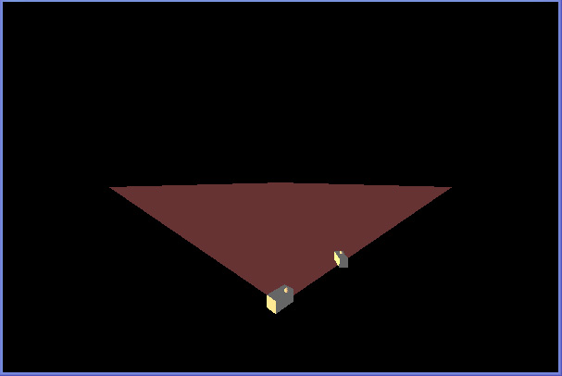
In world coordinate space
y
Car 1
Camera Position
Car 2
(-10,10,-10)
256
256
x
(128,0,128)
z
Look-at point
What you see on the screen

Slide 19
The Modeler’s Perspective:
How do we model the world?
The modeler begins by building models of individual objects in their own modeling space, we use the car as an example.
The car is designed in a convenient coordinate system where its base is at y=0, and its center is at x=0, z=0.
It is of length 2 and width 1, and the vertical direction is the y direction.
The lower left corner of the car model in the “Car Modeling Coordinates” is therefore (0.5,0,1).
y
1
0.5
1
x
z

Slide 20
The Modeler’s Perspective:
From Modeling Coordinates to World Coordinates
The modeler has decided to create a virtual 3D “world” where the vertical direction is y, and the terrain is at y=0, starting from (0,0,0) to (256,0,256).
The modeler has decided to place the second car at (0,0,10).
Therefore, the center of the second car in the “Car Modeling Coordinates” is at (0,0,0), while in the “World Coordinates”, it is at (0,0,10).
z
256
x
256

Slide 21
The Modeler’s Perspective:
From World Coordinates to Viewing Coordinates
The modeler places a camera at (-10,10,-10), looking in the direction (128,0,128), with the up direction (0,1,0).
This defines a right-handed coordinate system where the camera position is (0,0,0) in viewing coordinates, the up vector is the y axis in viewing coordinates, and the look-at direction becomes the negative z axis in viewing coordinates.
y_{world}
y_{viewing}
x_{world}
z_{viewing}
x_{viewing}
z_{world}

Slide 22
The Modeler’s Perspective:
From Viewing Coordinates to Projected Coordinates
The scene needs to be projected from 3D space to 2D space before being displayed on the screen.
The modeler needs to specify how to perform this projection, for example, whether to use parallel or perspective projection, and if using perspective projection, what the viewing parameters are.
The modeler has chosen to use
  gluPerspective(45.0,(float)sidewidth/(float)sideheight,5.0,5000.0);
  // theta, aspect, dnear, dfar
This determines which pixel a vertex is mapped to.
y_{viewing}
z_{viewing}
x_{viewing}

Slide 23
Programmer’s Perspective:
What series of transformations does a point go through?
The solid cube in Car 2 goes through this series of transformations from Modeling coordinates to World coordinates:
1. Scale by (1,1,2)
2. Translate by (0,5,0)
3. Rotate by 45 degrees about (0,1,0)
4. Translate by (0,0,10)
The gluLookAt() call then transforms it from world to viewing coordinates.
The gluPerspective() and glViewport() then together transforms it from viewing to projected normalized coordinates.
void sideGlutDisplay( void )
{
glMatrixMode(GL_PROJECTION);
glLoadIdentity();
gluPerspective(45.0,(float)sidewidth/(float)sideheight,5.0,5000.0);
// theta, aspect, dnear, dfar
glViewport(0,0,sidewidth,sideheight); // startx, starty, xsize, ysize
glMatrixMode(GL_MODELVIEW);
glLoadIdentity();
gluLookAt(-10,10,-10,128,0,128,0,1,0);
glPushMatrix();
DrawCar();
glPopMatrix();
glPushMatrix();
glTranslatef(0.0,0.0,10.0);
glRotatef(45.0,0.0,1.0,0.0);
DrawCar();
glPopMatrix();
glutSwapBuffers();
}
void DrawCar() {
glPushMatrix();
glTranslatef(-0.25,1.0,0.5);
glutSolidSphere(0.25,10,10);
glPopMatrix();
glPushMatrix();
glTranslatef(0.0,0.5,0.0);
glScalef(1.0,1.0,2.0);
glutSolidCube(1);
glPopMatrix();
}

Slide 24
OpenGL’s perspective:
The matrix stack
OpenGL is very efficient. It keeps two matrix stacks. One is the projection matrix stack, the other is the modelview matrix stack.
While processing the solid cube of the second car, there are three matrices on the modelview matrix stack. The top (or current) matrix is the composite matrix that effectively does the transformation from modeling coordinates to viewing coordinates.
Therefore, each vertex is transformed first by the current modelview matrix and then by the current projection matrix, and rendered at that pixel.
OpenGL reads the functions in forward order, and post-multiplies the current matrix by each new transformation.
Perspective and viewport
Projection Matrix Stack
gluLookAt x
glTranslate x
glRotate x
glTranslate x
glScale
gluLookAt x
glTranslate x
glRotate
gluLookAt
Modelview Matrix Stack

