Slide 1
e-Niyama Academia Basics to Brilliance

Slide 2
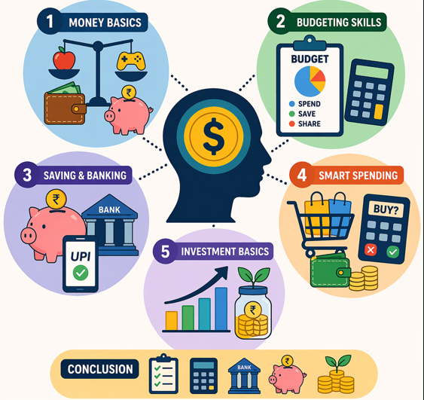
Summer Camp – Financial Literacy

Slide 3

Overview
Money Basics
Budgeting Skills
Saving & Banking
Smart Spending
Investment Basics
Moat
Conclusion

Slide 4
1. Money Basics
🍛 Needs: Food, Water
🎮 Wants: Toys, Chocolates
👉 Example: Books = Need
Headphones = Want
Asset: Gives money Liability: Takes money
👉 Example:
Gold = Asset
📌 Importance of Saving
Save ₹10 daily → ₹300/month

Slide 5
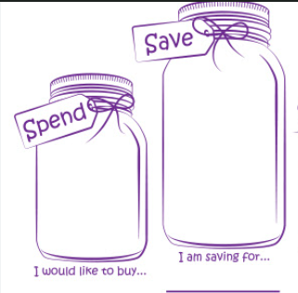
2. Budgeting Skills
🛒 Scenario: Grocery Budget Planning
A family plans to spend
₹1000 on groceries
for the week.
They divide the money
into Spend and Save to
manage their budget wisely.

Slide 6
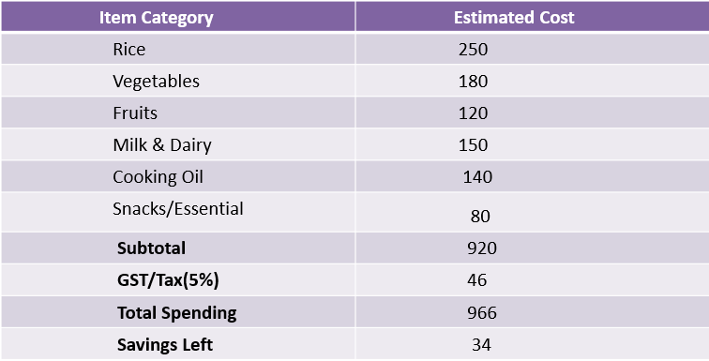
Budget Planning
Planning your budget helps avoid overspending and increases savings.

Slide 7

2. Budgeting Skills
📊 Monthly
Budget Planning
Track income and
expenses
👉 Like managing
mobile data 📱

Slide 8
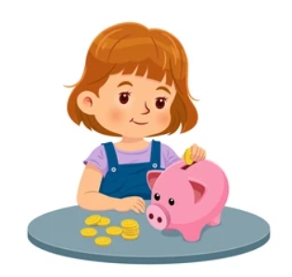

3. Saving & Banking
🏦 Bank vs Piggy Bank
Safe storage + Interest
📲 Digital Payments
UPI, Cards
👉 Pay using
phone instead of cash

Slide 9
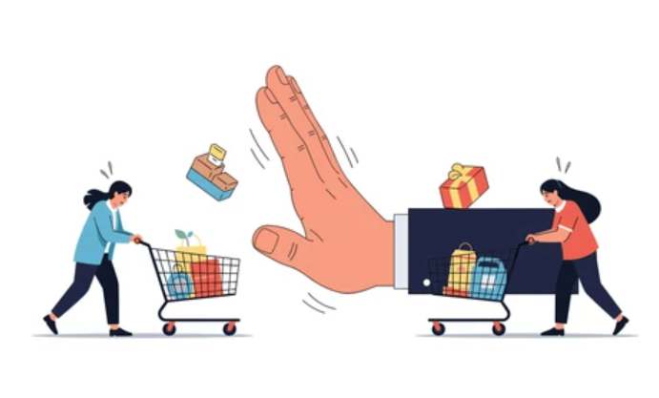

4. Smart Spending
🧠 Think Before Buying
Ask: Do I really need this?
⚠️ Avoid Impulse Buying
👉 Buying snacks without thinking
💼 Rich vs Wealthy
Earn vs Grow money
👨‍💼 Career Types
Employee | Business | Self-employed | Investor

Slide 10

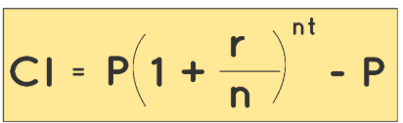

5. Investment Basics
🌱 What is Investment?
Money grows like a tree
💰 Saving vs Investing
Safe vs Growth
🚀 Compound Interest
Money grows faster (snowball effect)
📈 SIP & Stocks
Invest ₹100 regularly to turn small savings into big wealth through the power of compounding.

Slide 11
6.Moat
🛡️Moat:-A strong advantage that protects a company from competitors Like a castle moat 🏰 keeps enemies away
💡Helps company stay ahead of competitors Earn profits for long time
🚧 Types of Moat
⭐ Brand Power (e.g., famous companies)
💰 Cost Advantage (cheaper production)
🔐 Switching Cost (hard to change service)
🌐 Network Effect (more users = more value)

Slide 12
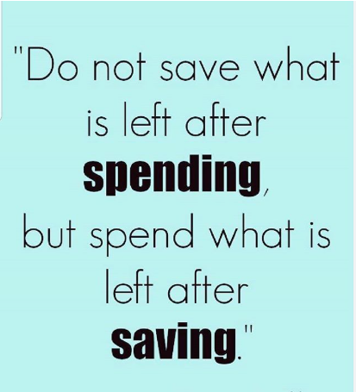
Conclusion
📚 Key Takeaways:
✔ Needs vs Wants
✔ Save regularly
✔ Plan spending
✔ Use banks
✔ Invest for future

Slide 13



