Slide 1

Top 10 PHP frameworks used by PHP developers

Slide 2

Introduction
PHP allows developers to develop complex code rapidly without compromising the reusability and organization of code.
Offering multiple frameworks to be explored, it empowers the developer fraternity with scalability and high-level security.
Object-oriented programming and MVC pattern separate logic and presentation of code.

Slide 3
1. laravel
Currently, 136,290Laravel websites are live across the globe
Laravel offers instant hosting and integration of deployment platform
Active community and Laracasts tutorials make complex Laravel developments very easy.
Laravel supports sessions, Caching, queuing and RESTful routing using templating engine “Blade”.

Slide 4
2. CakePHP
CakePHP is fueling 57K Live websites today.
As a progressive framework, the latest version of CakePHP 3.0 offers session management of enhanced levels.
Creation of standalone libraries is easy with CakePHP as it offers the decoupling advantage.
Higher security features like SQL injection, cross-site request forgery, and input validation makes CakePHP proficient platform.

Slide 5
3. Zend
Stability of Zend supports the existence of 42K websites that are complex in nature.
Rich of cryptographic tools and intuitive editor makes it a perfect online debugger tool.
Facilitating agile methodology, Zend supports the development of high- quality complex applications.

Slide 6
4. Yii 2
Among the fastest PHP frameworks, the lazy loading technique makes it an efficient framework.
PHP web development offers clean and logical code development.
AJAX features and JQuery allows easy customization of Yii solutions along with the prototyping.

Slide 7
5. CodeIgniter
A popular lightweight PHP framework has almost 268,876 live websites running on it.
The quick and easy installation makes CodeIgniter a popular PHP developer choice.
CodeIgniter framework supports almost all the PHP framework versions.
As a flexible framework, it offers freedom of coding and naming to build a lean framework using third party plugins.

Slide 8
6. Symfony
43k large-scale enterprise projects are running on Symfony.
The reusable components and an active community of developers make Symfony a popular framework.
Creation, the configuration of objects, authentication, routing and templating - all are offered by the reusable components of Symfony.
The components of Symfony add to the power of Laravel and Drupal projects.

Slide 9
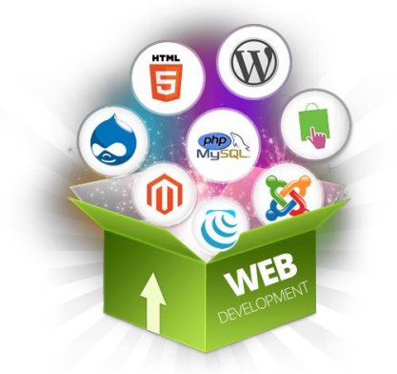


7. Phalcon
With a Model view control architecture, Phalcon is powerful
Based on C and C++ makes it versatile.
Phalcon is inherently capable of asset management, translation, caching, universal auto loader, and security.

Slide 10
8. Slim
Slim is a perfect framework for small and medium websites because of its micro yet efficient framework.
Slim is capable of providing the best features with RESTful APIs, and services.
It offers support for all the necessary features like URL routing, Client-side HTTP Caching,cookie routing, session and supports flash messages.

Slide 11
9. Fuel PHP
One of the most extendable and flexible frameworks makes it extremely popular
Backed by MVC architecture, FuelPHP supports full stack solution development.
It offers advanced Hierarchical Model-View-Controller (HMVC).
It is capable of supporting end-to-end web solution development irrespective of the complexity handling required.

Slide 12
10. Aura
A rich component library symbolizes Aura.
Each component finds its use in any type of code.
If your project requires writing the code from scratch, Aura is the right one for you.

