Slide 1
The DOM tree

Slide 2
According to the Document Object Model (DOM), every HTML tag is an object
Nested tags are “children” of the enclosing one. The text inside a tag is an object as well.
Document is the root object
So, document.body is the object representing the <body> tag.

Slide 3
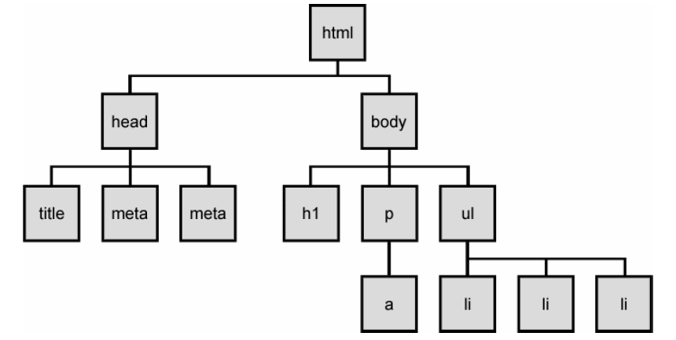
The DOM tree
Notes:
The elements of a page are nested into a tree-like structure of objects
the DOM has properties and methods for traversing this tree

Slide 4



Types of DOM nodes
<p>
This is a paragraph of text with a
<a href="/path/page.html">link in it</a>.
</p> HTML
element nodes (HTML tag)
can have children and/or attributes
text nodes (text in a block element)
attribute nodes (attribute/value pair)
text/attributes are children in an element node
cannot have children or attributes
not usually shown when drawing the DOM tree

Slide 5
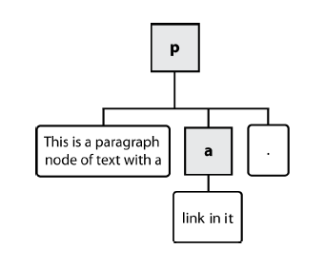
Types of DOM nodes
<p>
This is a paragraph of text with a
<a href="/path/page.html">link in it</a>.
</p> HTML

Slide 6
Traversing the DOM tree
name(s) | description
firstChild, lastChild | start/end of this node's list of children
childNodes | array of all this node's children
nextSibling, previousSibling | neighboring nodes with the same parent
parentNode | the element that contains this node

Slide 7
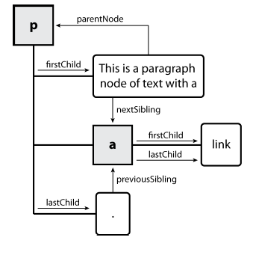
DOM tree traversal example
<p id="foo">This is a paragraph of text with a
<a href="/path/to/another/page.html">link</a>.</p> HTML

Slide 8
Elements vs text nodes
<div>
<p>
This is a paragraph of text with a
<a href="page.html">link</a>.
</p>
</div> HTML
Q: How many children does the div above have?
A: 3
an element node representing the <p>
two text nodes representing "\n\t" (before/after the paragraph)
Q: How many children does the paragraph have? The a tag?

Slide 9
If there are spaces (just like any character) in the document, then they become text nodes in the DOM, and if we remove them, then there won’t be any.
For Ex:
<!DOCTYPE HTML>
<html><head><title>About elk</title></head><body>The truth about elk.</body></html>
There are No text nodes with \t
Also if the browser encounters malformed HTML, it automatically corrects it when making the DOM.

Slide 10
Other nodes are
Comment nodes
Attribute nodes: Generally not shown in DOM

Slide 11
NodeType
The nodeType property provides one more, “old-fashioned” way to get the “type” of a DOM node.
It has a numeric value:
elem.nodeType == 1 for element nodes,
elem.nodeType == 3 for text nodes,
elem.nodeType == 9 for the document object,

Slide 12
Example
<body>
<script>
let elem = document.body;
// let's examine what it is?
alert(elem.nodeType); // 1 => element
// and the first child is...
alert(elem.firstChild.nodeType); // 3 => text
// for the document object, the type is 9
alert( document.nodeType ); // 9
</script>
</body>

Slide 13
To sum up
In practice we work with 4 types of nodes:
document – the “entry point” into DOM.
element nodes – HTML-tags, the tree building blocks.
text nodes – contain text.
comments – sometimes we can put information there, it won’t be shown, but JS can read it from the DOM.

Slide 14
Prototype's DOM tree traversal methods
method(s) | description
ancestors, up | elements above this one
childElements, descendants, down | elements below this one (not text nodes)
siblings, next, nextSiblings, previous, previousSiblings, adjacent | elements with same parent as this one (not text nodes)
Notes:
Prototype strips out the unwanted text nodes
notice that these are methods, so you need ()

Slide 15
Selecting groups of DOM objects
methods in document and other DOM objects for accessing descendants:
name | description
getElementsByTagName | returns array of descendents with the given tag, such as "div"
getElementsByName | returns array of descendants with the given name attribute (mostly useful for accessing form controls)

Slide 16
Getting all elements of a certain type
var allParas = document.getElementsByTagName("p");
for (var i = 0; i < allParas.length; i++) {
allParas[i].style.backgroundColor = "yellow";
} JS
<body>
<p>This is the first paragraph</p>
<p>This is the second paragraph</p>
<p>You get the idea...</p>
</body> HTML

Slide 17
Combining with getElementById
var addrParas = document.getElementById(“address");
for (var i = 0; i < addrParas.length; i++) {
addrParas[i].style.backgroundColor = "yellow";
} JS
<p>This won't be returned!</p>
<div id="address">
<p>1234 Street</p>
<p>Atlanta, GA</p>
</div> HTML

Slide 18
Prototype adds methods to the document object
(and all DOM element objects) for selecting groups of elements:
getElementsByClassName | array of elements that use given class attribute

Slide 19
Creating new nodes
name | description
document.createElement("tag") | creates and returns a new empty DOM node representing an element of that type
document.createTextNode("text") | creates and returns a text node containing given text
// create a new <h2> node
var newHeading = document.createElement("h2");
newHeading.innerHTML = "This is a heading";
newHeading.style.color = "green";
document.body.appendChild(newHeading); JS
merely creating a node does not add it to the page
you must add the new node as a child of an existing element on the page...

Slide 20
Modifying the DOM tree
name | description
appendChild(node) | places given node at end of this node's child list
insertBefore(new, old) | places the given new node in this node's child list just before old child
removeChild(node) | removes given node from this node's child list
replaceChild(new, old) | replaces given child with new node
var p = document.createElement("p");
p.innerHTML = "A paragraph!";
Document.getElementById(“PARA”).appendChild(p); JS

Slide 21
Removing a node from the page
function slideClick() {
var bullets = document.getElementsByTagName("li");
for (var i = 0; i < bullets.length; i++) {
if (bullets[i].innerHTML.indexOf("children") >= 0) {
bullets[i].remove();
}
}
} JS
each DOM object has a removeChild method to remove its children from the page
Prototype adds a remove method for a node to remove itself

Slide 22
Common HTML Events
Event | Description
onchange | An HTML element has been changed
onclick | The user clicks an HTML element
onmouseover | The user moves the mouse over an HTML element
onmouseout | The user moves the mouse away from an HTML element
onkeydown | The user pushes a keyboard key
onload | The browser has finished loading the page

Slide 23
Example
<!DOCTYPE html> <html> <body> <p>Click the button to display the date.</p> <button onclick="displayDate()">The time is?</button> <p id="demo"></p> </body> </html> | <script> function displayDate() { document.getElementById("demo").innerHTML = Date(); } </script>

Slide 24
What is the output?
<div id="divid"> </div>
<script type="text/javascript">
var hold = document.getElementById("divid");
var checkbox = document.createElement('input');
checkbox.type = "checkbox";
checkbox.name = "chkbox1";
checkbox.id = "cbid";
var label = document.createElement('label');
var tn = document.createTextNode("Not A RoBot");
label.htmlFor="cbid";
label.appendChild(tn);
hold.appendChild(label);
hold.appendChild(checkbox);
</script>

Slide 25
Javascript Exercises
Create a webpage with an of Homer Simpson image at the center of the page. Develop a script that prints an alert: “Duh, you are hovering!!” every time the mouse crosses over the image.
Add 5 buttons to your webpage: red, yellow, green, black, and silver. Every time you click on one of these buttons the background should take the corresponding color.

