Slide 1

^{제4차 졸업프로젝트 전시회}
Performance Improvement of LSM-Tree based Storage Engine
^{전공 : 컴퓨터소프트웨어(담당교수 : 정형수)}
^{팀원 : 박정호, 김현정}
이 페이지는
제목, 전공, 팀원만 내용기재하시기 바랍니다.

Slide 2
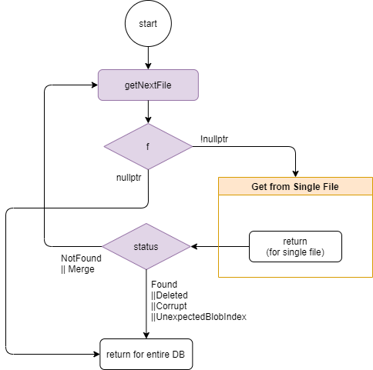
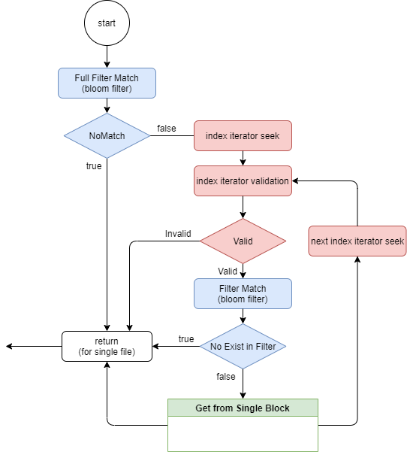
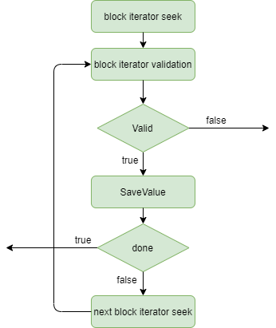
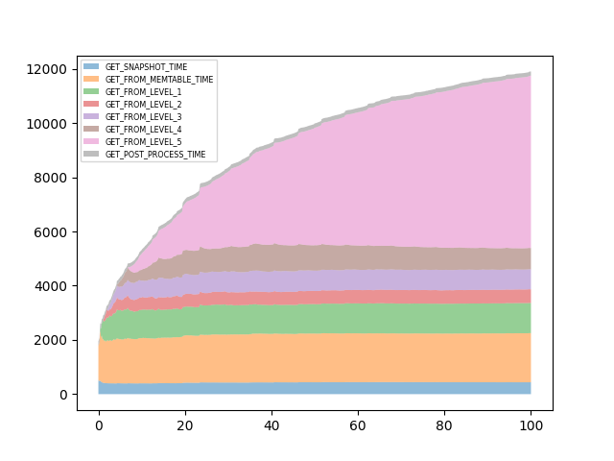
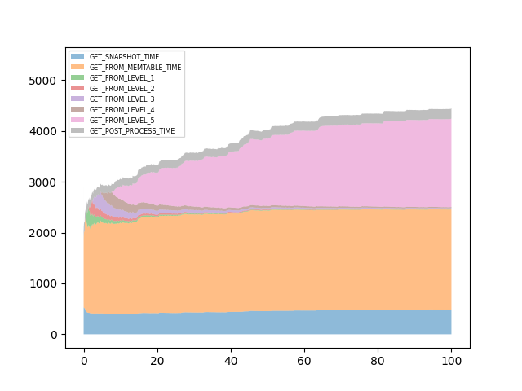
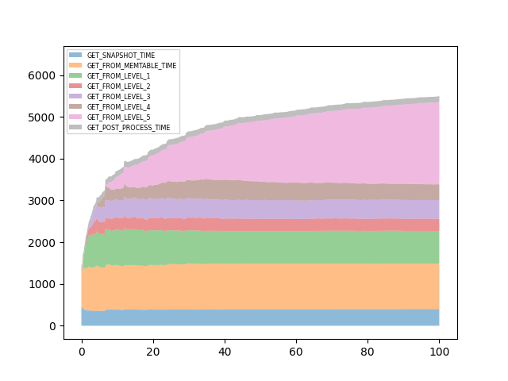
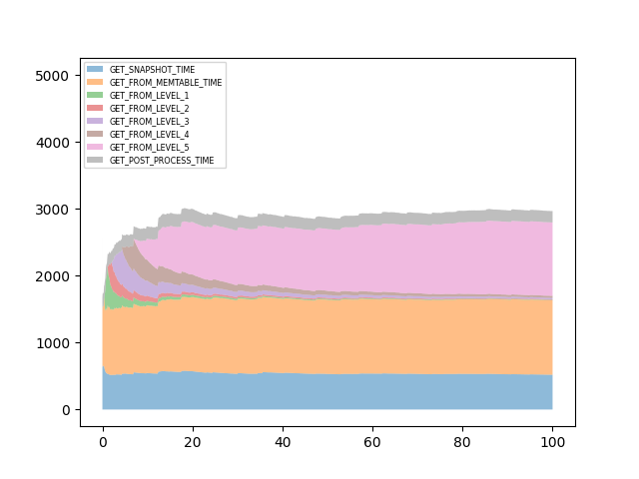
Motivation
Experiment Result
Database is essential part of IT industry’s product and services. And storage engine’s performance is one of main factor of database’s performance.
RocksDB is one of famous storage engine which is used in many services like Netflix, LinkedIn, Pinterest, etc.
In last year, our seniors’ project pointed out RocksDB has read amplification problem while using snapshot isolation. But there was no solution about this problem
We focused on this problem, and suggested new method to solve this problem, which is called “Sequence Filter”.
Hardware Setting - CPU : Intel® Xeon® CPU E5-2630 v4 - Memory : 256GB - Storage : Samsumg ssd 850 pro 1TB
RocksDB Basic Setting - Key Size : 4 Bytes - Value Size : 1KB - Bloom Filter : 10bits
RocksDB Options - write_buffer_size : 4MB - max_bytes_for_level_base : 8MB - max_bytes_for_level_multiplier : 2 - level0_file_num_compaction_trigger : 2 - level0_slowdown_writes_trigger : 3 - level0_stop_writes_trigger : 4
이 페이지는 내용을 기입하는 곳입니다.
제목 바는 유동적으로 움직여 사용하십시오.
한 단락 내용이 끝
나고 나서는 여백을
어느 정도 여유 있게
주어야 합니다.
꼭 내용만 기입하십시오. (제목과 이름은 첫장에 기입하시기 바랍니다.)
첨부된 PDF 파일을 꼼꼼히 읽은 후 작업바랍니다.
Read Amplification Problem
VALIDATION!
Original System
Sequence Filter
To find visible snapshot, transaction traverses SST file in level-order.
If the key is found, it checks the record’s visibility with its sequence number.
if the record is not visible to the transaction, it continues traversing next SST files.
Since visibility check is done at the end of each find, and SST File’s level is ordered by sequence number(which is equivalent with timestamp), If transaction’s lifetime is too long, it could traverse whole SST files in database.
This problem is called “read amplification”
Experiment with Uniform Workload
Original System
Sequence Filter
Experiment with Skewed Workload
Our Solution – Sequence Filter
We used two types of workload – uniform and skewed distribution.
In both workload, we can see that Sequence Filter reduces file reads, especially unnecessary file reads
The performance is tripled when handling uniform workload, while is doubled when handling skewed workload.
Minimum Sequence Number Per Key
 | XXXX
 | YYYY
 | ZZZZ
IT EXISTS!
IS IT VISIBLE?
HASH
Maximum Visible Sequence
WWWW
결론 및 기대효과
USER KEY
We suggested in-memory Sequence Filter based on mapping table structure.
Sequence Filter can reduce overhead of traversing file contents.
Sequence Filter can solve read amplification problem by skipping unnecessary file traversing.
Since building Sequence Filter is very heavy process, we aim to suggest the persistent storing method for Sequence Filter to reduce its overhead.
“Sequence Filter” is an in-memory mapping table of user key and minimum sequence number for each key. We used std::unordered_map as hash table.
Sequence Filter is created when SST File is newly opened, by scanning whole records of file.
By checking Sequence Filter, transaction can know whether key exists in current file. If key does not exists, then traversing this SST File is meaningless, so it is skipped.
If key exists, then check its minimum sequence number to check visibility. If key is not visible, then traversing this SST File is meaningless, so it is skipped.
Sequence Filter check is applied right after checking bloom filter.

