Slide 1
You will learn how to write HTML code to create webpages, link webpages together, display images, format text and format backgrounds.
You will use the software Notepad to develop your website design skills. Notepad is a simple text-editing program that can also be used to author webpages. It will allow you to type in the code and save the document that you create as a webpage. You will then be able to view your webpage using a web browser.
The first website to go online was the website http://info.cern.ch . It went online on 6 August 1991.

Slide 2
Open Notepad (PC / Windows)
Open the Start Screen (the window symbol at the bottom left on your screen)
Type Notepad
Open TextEdit (Mac)
Open Finder > Application > TextEdit
Also change some preferences to get the application to save files correctly. In Preferences > Format > choos ‘Plain Text’
Then under ‘Open and Save’, Only check the box that says ‘Display HTML files as THML code instead of formatted text’.
FYI: https://www.w3schools.com/html/html_editors.asp

Slide 3
Website: a collection of webpages.
Webpage: a single page in a website.
You will need to pay close attention to detail as if you make a small error in any of the code you will find that items on your webpage won't display properly.
User-friendly design that means the website can make the experience of using it a positive and pleasing one for the user.

Slide 4

Clear, well-thought-out navigation is one of the best opportunities a site has to create a good impression.
清晰、深思熟虑的导航是一个网站创造良好印象的最佳机会之一。
If you can’t make something self-evident, you at least need to make it self-explanatory.
如果你不能让一个页面不言而喻，你至少应该让它自我解释。
It doesn’t matter how many times I have to click, as long as each click is a mindless, unambiguous choice.
我点击多少次并不重要，只要每次点击都是一个无需思考的、明确的选择。
《点石成金》

Slide 5

Make use of white space. If there is too much information squeezed onto a webpage, it can make it very difficult for the user to find what they are looking for.
Think carefully about where each piece of text or image is placed on the webpage. Usually the important information is placed near the top of the page.
Consider to make sure a website design is effective, is that it maybe viewed on many different devices such as PC, laptop, tablet and mobile phone.

Slide 7
What is HTML?
HTML is short for Hypertext Markup Language. It is one of the coding languages that can be used to create a webpage. Other coding languages are JavaScript, CSS and PHP, but HTML is one of the oldest and most widely used.
The HTML code is interpreted (read) by a web browser.
Some people use templates to create a webpage. But you are going to learn how to create a new webpage from the beginning.

Slide 8
Setting up a webpage
The HTML code that you write is called the webpage source code.
You will need to type the following lines of HTML code into the new Notepad document.
If you are using MacBook, the first step is to Format - Make Plain Text.
<!DOCTYPE html>
<html>
<head>
</head>
<body>
</body>
</html>

Slide 9
<!DOCTYPE html>
<html>
<head>
</head>
<body>
</body>
</html>
The code that you have typed is the basic structure for the webpage. It is important to be very accurate when typing the code. Any small errors will often mean that the webpage will not be displayed correctly. This includes making sure that there are no spaces between the angular bracket <>.
<!DOCTYPE html> tells that the type of document you are creating is a HTML document and it will be a webpage.
The angular brackets (<>) at the start and the end of each line of code create a tag. You use tags in Notepad to tell the software what you want it to display and how you want it to be displayed.

Slide 10
<html> is an opening tag. This is used to tell the software where the webpage starts.
</html> is a closing tag. This is used to tell the software where the webpage ends. And its tag starts with a forward slash (/).
<head> is an opening tage for the header section. It is used for things such as the title of the page, and will appear in the tab at the top of the webpage.
</head> is a closing tag for the header section.
<body> is an opening tag for the body section. It is where all the content for the webpage is written.
</body> is the closing tag for the body section.

Slide 11
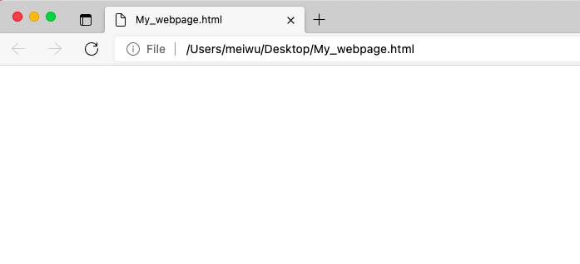
Saving the document as a webpage
To be able to see the webpage you have created, you need to save the document in a special way. It needs to be saved as an HTML file.
File - Save
Type in a suitable filename for the webpage followed by '.html'. e.g. My_webpage.html

Slide 12
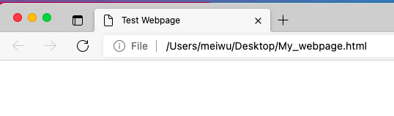
Adding a title
One of the first things that you should add to each webpage is a title. This won't appear on the actual webpage, it will appear on the tab in the web browser when the webpage is opened.
<!DOCTYPE html>
<html>
<head>
<title>Test Webpage</title>
</head>
<body>
</body>
</html>

Slide 13
Task:
Create a folder in a suitable place on your computer and name it 'Website'. Inside this folder, create another folder and name it 'Images'.
Set up a webpage with the title 'Homepage'. The homepage is the main webpage of a website. Remenber to save your code in your website folder.

Slide 14
Adding text to a webpage
There are two kinds of text: heading text and paragraph text. They are inserted between the <body> start tag and </body> end tag.
Heading text is what you will use to add any titles or subtitles to your webpages.
Paragraph text is what you will use to add all other text to your webpages.
To add a title to your webpage you will use the heading tag <h1>.
<h1> is the largest heading title and <h6> is the smallest heading title.
To add all other text to your webpage you will use the paragraph tag <p>.
<hr> is used to create a horizontal line.

Slide 15
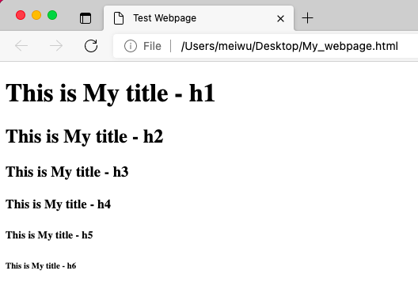
<!DOCTYPE html>
<html>
<head>
<title>Test Webpage</title>
</head>
<body>
<h1>This is My title - h1</h1>
<h2>This is My title - h2</h2>
<h3>This is My title - h3</h3>
<h4>This is My title - h4</h4>
<h5>This is My title - h5</h5>
<h6>This is My title - h6</h6>
</body>
</html>

Slide 16
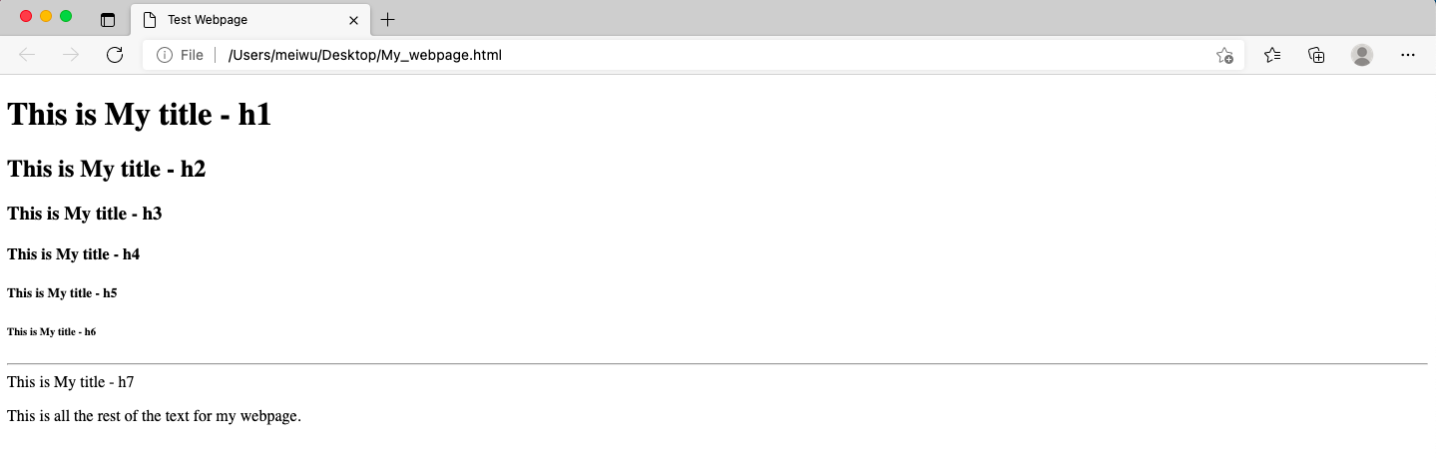
<!DOCTYPE html>
<html>
<head>
<title>Test Webpage</title>
</head>
<body>
<h1>This is My title - h1</h1>
<h2>This is My title - h2</h2>
<h3>This is My title - h3</h3>
<h4>This is My title - h4</h4>
<h5>This is My title - h5</h5>
<h6>This is My title - h6</h6>
<hr>
<h7>This is My title - h7</h7>
<p>This is all the rest of the text for my webpage.</p>
</body>
</html>

Slide 17
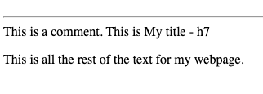
Adding a comment
<!>
It will ignored by the web browser. Adding comments is easier for people to understand what its goal is.
<!DOCTYPE html>
<html>
<head>
<title>Test Webpage</title>
</head>
<body>
<h1>This is My title - h1</h1>
<hr>
This is a comment.
<!-- This is a comment. -->
<h7>This is My title - h7</h7>
<p>This is all the rest of the text for my webpage.</p>
</body>
</html>

Slide 19
Adding a hyperlink
Now you have learnt how to create a webpage, you will need a way to connect you webpages to create a website. You will do this using hyperlinks(links).
You need to think of the navigation for user to find what they aer looking for and move between the different webpages in the website.

Slide 20
<a href='Bees_Homepage.html'>Hoempage</a> #href: hypertext reference
The opening tag means that you want to add a link.
The 'href' attribute tells the software where you want to link to. In this case it is to a file called 'webpage.html'.
You need to make sure that all the webpages that you create are saved in the same folder. If they are then you can just use the name of the file for the link.
The 'link text' is the word(s) you want the user to click on as the navigation. This is called the anchor.
Attribute: this is a characteristic of an element that is added to the webpage.
Anchor: the text that is used for a link. It is the anchor text that is clicked to follow the link.

Slide 21
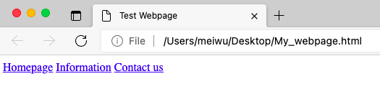
To create navigation for your website you will need to think of a suitable name for eahc webpage that you create.
For example: A website could have three webpages: a Homepage, an information page and a Contact us page.
Each of these could be made into a link that will take the user to the correct page when the link is clicked.
<!DOCTYPE html>
<html>
<head>
<title>Test Webpage</title>
</head>
<body>
<a href='Homepage.html'>Homepage</a>
<a href= 'Information.html'>Information</a>
<a href='Contact.html'>Contact us</a>
</body>
</html>

Slide 22
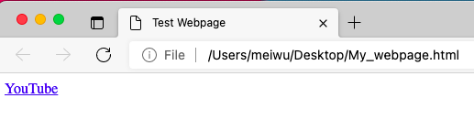
You can also linkto other websites in this way as well.
<!DOCTYPE html>
<html>
<head>
<title>Test Webpage</title>
</head>
<body>
<a href='https://www.youtube.com'>YouTube</a>
</body>
</html>

Slide 23
Activity
You will use the following webpage: 'Bees_Homepage.html', 'Bees_Info.html' and 'Bees_Contact.html'.
Open the file 'Bees_Homepage.html' and add the following text to the top, just below the body tag:
Homepage Information Contact us
Make each page a link to the correct webpage. 'Information' should link to the webpage 'Bees_Info.html' and 'Contact us' should link to 'Bees_Contact.html'.
Make sure that you have all three webpages saved in the same folder.
Add the same link to the webpages 'Bees_Info.html' and'Bees_Contact.html'. You could simply copy and paste the code that you created for 'Bees_Homepage.html' into the correct place for the other two webpages.

Slide 24
Open the file 'Bees_Homepage.html' again. Look for the text:
'for more information about bees click here.'
Make the text 'click here' a link to a website about bees. Use the internet to find a suitable website that gives information about bees.

Slide 26
Adding a image to a webpage
To add an image to a website you will need to have the image saved in the correct place. You need to save the image in the Images folder that you created earlier. You need to save the image with a suitable filename.
When choosing your image, you need to think about the quality of the image. If you choose a low-quality image, it won't look very good on your webpage. If you choose a high-quality image, the file size will be a very large and it may take a long time for someone to open the webpage.
Image quality: this is how good an image looks.

Slide 27
Absolute path & Relative path
Absolute path
C:2020/website1/demo1/page_1.html
https://www.youtube.com
<a href='C:2020/website1/demo1/page_1.html'>
<a href='https://www.youtube.com'>

Slide 28
Relative path
test1
page_6.html
page_1.html
demo1
page_2.html
website1
page_3.html
2022
website2
demo2
page_4.html
page_5.html
page_1.html LINK to others html files.
All files start from the page_1.html to be reference.

Slide 29
Relative path
test1
page_6.html
page_1.html
demo1
#In same folder
<a href='page_2.html'>
#In Parent / Upper folder using ../
<a href='../page_3.html'>
<a href='../../website2/demo2/page_4.html'>
<a href='../../page_5.html'>
#In Child / Lower folder
<a href='test1/page_6.html'>
page_2.html
website1
page_3.html
2022
website2
demo2
page_4.html
page_5.html
page_1.html LINK to others html files.
All files start from the page_1.html to be reference.

Slide 30
<img src='file path' title='information' alt='description'>
# img src: image source
<img src="2022-2023/demo/Heroes.jpg" title="click on it to forward..." alt="image couldn't load..."> # Relative path
This line of code doesn't need a closing tag as the content that gets displayed is put inside the opening tag. such as <hr>, <div>, <br>. They are called void elements.
The part in the quotation marks is the place where the image is saved and the filename that it is saved as.
title attribute: The text will appear if the cursor is hovring on the image.
alt attribute: The text will appear if the image could not load.

Slide 31
The image will display on the webpage at the size that it is saved.
The width and the height are the size in pixels that you want to display the image.
Pixel: this is a tiny dot or point. Lots of pixels make up an image.
<img src="2022-2023/demo/Heroes.jpg" title="click on it to forward..." alt="image couldn't load..." width='700' height='500'>
Be careful when changing the size of an image that you do not distort it.

Slide 32
You may want to change where the image is displayed on the webpage. It will automatically display at the left side of the webpage.
<img src="2022-2023/demo/Heroes.jpg" title="click on it to forward..." alt="image couldn't load..." width='700' height='500' style='float:right'>
You need to make sure that the line of code for the image is placed above the line of code for the text that you want to display it at the side of.
<body>
<h1>This is My title - h1</h1>
<hr>
<p>text--------------------</p>
<img src="2022-2023/demo/Heroes.jpg" width='700' height='500' style='float:right'>
<!-- change 'right' to 'left' to see what would happen -->
<p>text11111111111111111111</p>
<p>text11111111111111111111</p>
<p>text11111111111111111111</p>
</body>

Slide 33
Activity
Download a image in the Images folder that you created earlier. Save it with the filename 'My_Website_Image.jpg'.
Type the HTML code into your webpage to display the image below the text. Remember to include the full location of the image. # Absolute path
Set the image to display at a size of 700 pixels by 500 pixels. # width * height
Set the image to display at the right side of the paragraph of text you wrote earlier.
Save your code and check how it looks when you open it in a web browser. This will show you the effects of all of your changes.

Slide 35
Changing the text formatting
<!DOCTYPE html>
<html>
<head>
<title>Test Webpage</title>
</head>
<body>
<h1 style='font-family:Arial;'>This is my title</h1>
</body>
</html>
The font-family information tells the software that you want to display the text in a specific font.
A semicolon (;) is always added to the end to tell the software that it is the end of the formatting for the section.

Slide 36
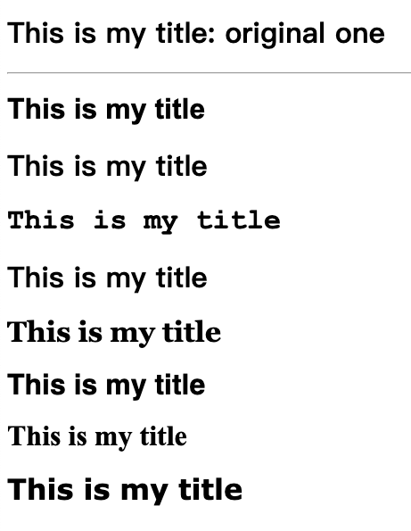
A web browser will only support certain font styles. The most commonly supported fonts are:
Arial
Bookman Old Style
Courier New
Garamond
Georgia
Helvetica
Times New Roman
Verdana

Slide 37
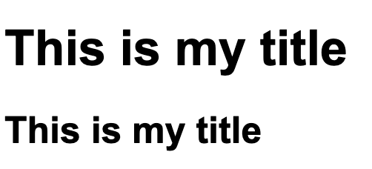
Changing the size of the text
<!DOCTYPE html>
<html>
<head>
<title>Test Webpage</title>
</head>
<body>
<h1 style='font-family:Arial;font-size:50pt;'>This is my title</h1>
<h1 style='font-family:Arial;font-size:50px;'>This is my title</h1>
</body>
</html>
Each formatting choice should be separated by a semicolon and all the formatting choices should be inside the quotation marks.

Slide 38
Changing the colour of the text
<!DOCTYPE html>
<html>
<head>
<title>Test Webpage</title>
</head>
<body>
<h1 style='font-family:Arial;font-size:50px;color:blue;'>This is my title</h1>
</body>
</html>
You need to note the spelling of 'colour'. It is spelt the American way as 'color' and not 'colour'.
You can type a color such as red, green, lightblue and darkblue.

Slide 39
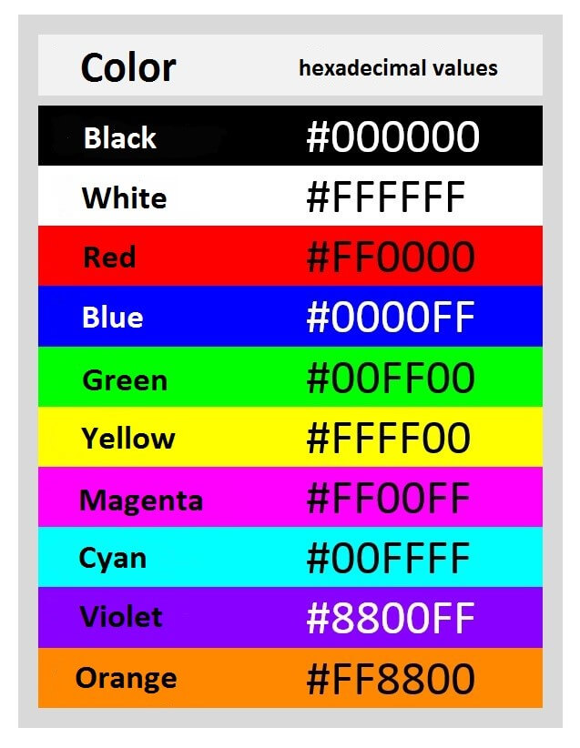
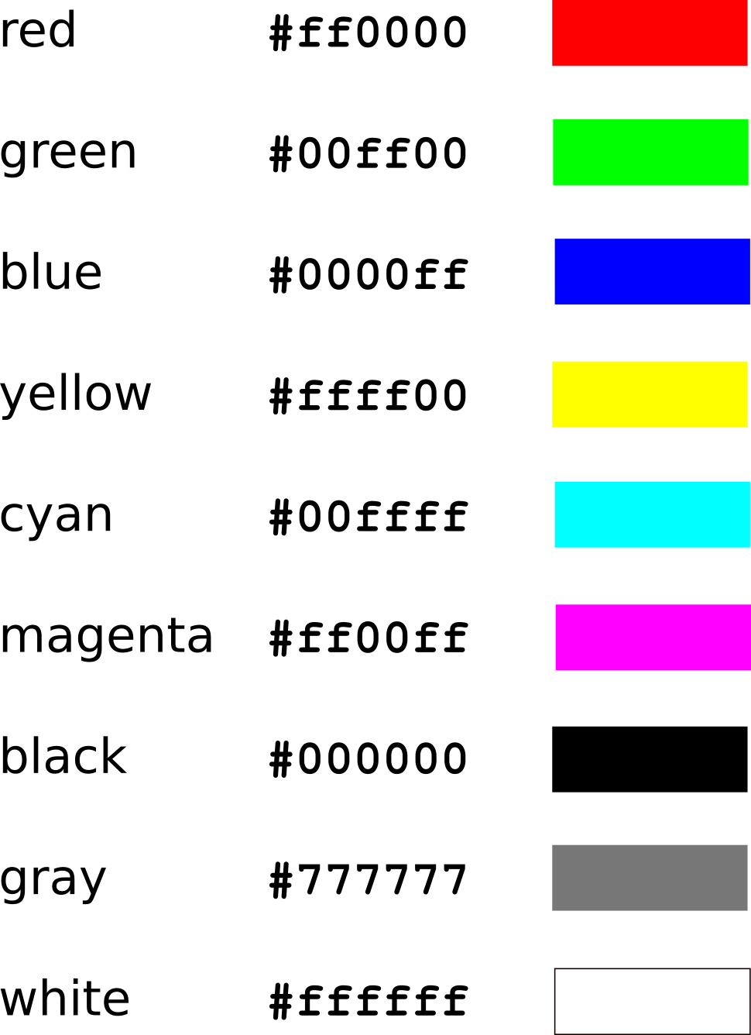
You can also use something called a hexadecimal colour code. This is a special code that is given to each colour. The code is usually made up of numbers and letters.

Slide 40
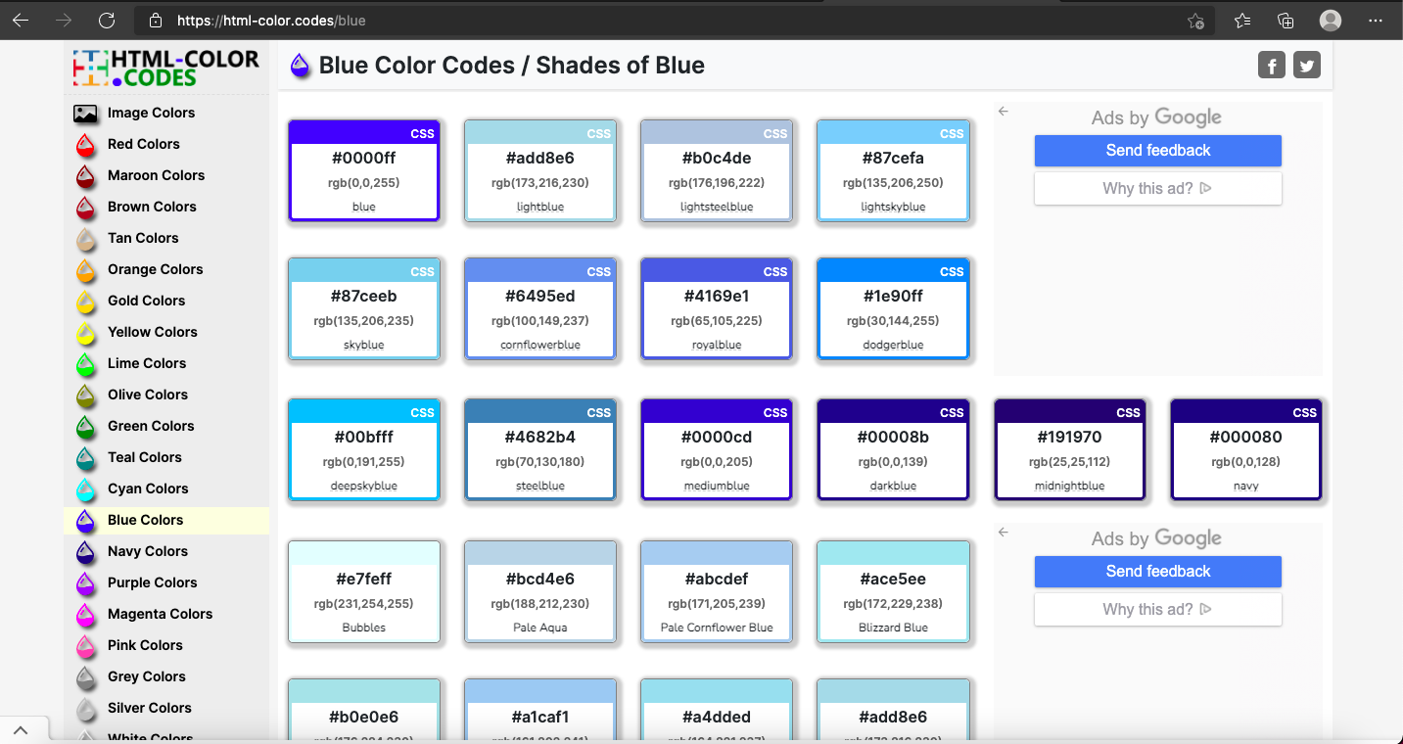
The first two hexadecimal values are the amount of red, the second two the amount of blue, the last two the amount of green.

Slide 41
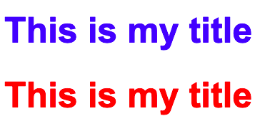
<!DOCTYPE html>
<html>
<head>
<title>Test Webpage</title>
</head>
<body>
<h1 style='font-family:Arial;font-size:50px;color:blue;'>This is my title</h1>
<h1 style='font-family:Arial;font-size:50px;color:#ff0000;'>This is my title</h1>
</body>
</html>

Slide 42
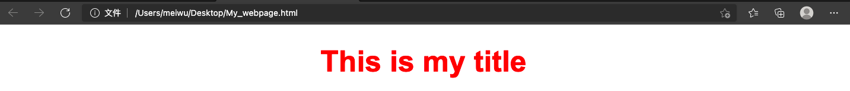
Positioning text
You can also change where the text appears on the page. This is called changing the alignment of the text. Alignment could be left, center or right. Text will automatically display at the left if no alignment is set.
<!DOCTYPE html>
<html>
<head>
<title>Test Webpage</title>
</head>
<body>
<h1 style='font-family:Arial; font-size:50px; color:#ff0000; text-align:center;'>This is my title</h1>
</body>
</html>
Note: 'center' not 'centre'.

Slide 43

Formatting the background of a webpage
<!DOCTYPE html>
<html>
<head>
<title>Test Webpage</title>
</head>
<body style='background-color:lightblue'>
<h1 style='font-family:Arial; font-size:50px; color:#ff0000; text-align:center;'>This is my title</h1>
</body>
</html>
Make sure that the background color doesn't make the text on website difficult to read.
Although you can read while text on a dark background, it would be tiring to read a lot of text like that. It is often more suitable for headings rather than your main paragraphs of text.

Slide 44
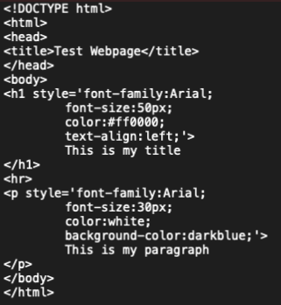
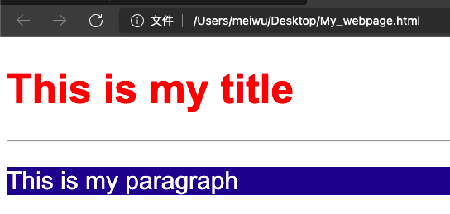
You can also change the background color behind any heading or paragraph of text. You can use the same code and place it inside the tag for the text.

Slide 46
Look at the following lines of HTML code. Write down how they will display the text.
<h1 style='font-family:Arial; font-size:32px; color:blue; text-align:center'>Title</h1>
The text will be displayed in font style Arial, at font size 32px, in the color blue and in the center of the page.
<h1 style='font-family:Garamond; font-size:24pt; color:#FF0000; text-align:right;'>Title</h1>
<p style=”font-family:Verdana; font-size:18px; color:lightgreen; text-align:right;”>Paragraph</p>

Slide 47
Look at the following lines of HTML, they contain errors. Find the errors.
<h1 style=font-family:Arial;font-size:24pt,colour:red;text-align:center;>This Is My Heading<h1>
<p style=”font-family:Garamond;font-size 18pt;
color:darkblue;text-align:left>This is my paragraph</p>

Slide 49
Scenario
Open the file 'Heroes_Homepage.html'. Make the title of the webpage dark blue, size 36pt and Arial.
Make the other text on the webpage black, size 18pt and Garamond.
Insert the image 'Heroes.jpg'. Change the size of the image to be 500 pixels wide by 300 pixels high. Display the image at the right side of the webpage and the text at the left side.
Make the background colour of the website light blue.
Find the text 'List of Superheroes'. Make this text a link to a website that has a list of superheroes, or use the list of superheroes on the Encyclopaedia Britannica website.

Slide 50
Adding a list
You can create two kinds of lists on a website, these are called ordered lists and unordered lists.
An ordered list will have numbered bullet points, e.g.
item 1
item 2
item 3
An unordered list will just have simple bullet points, e.g.
item 1
item 2
item 3

Slide 51
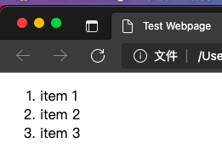
To create an ordered list, you will need to use the followig code:
<ol>
<li>item 1</li>
<li>item 2</li>
<li>item 3</li>
</ol>
The ol tag means that you want to add an ordered list.
The li tag means that you want to add an item to the list.
<!DOCTYPE html>
<html>
<head>
<title>Test Webpage</title>
</head>
<body>
<ol>
<li>item 1</li>
<li>item 2</li>
<li>item 3</li>
</ol>
</body>
</html>

Slide 52
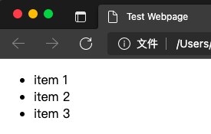
You create an unordered list in a similar way, but rather than using the ol tag you need to use the ul tag instead. This means that it is an unordered list.
<!DOCTYPE html>
<html>
<head>
<title>Test Webpage</title>
</head>
<body>
<ul>
<li>item 1</li>
<li>item 2</li>
<li>item 3</li>
</ul>
</body>
</html>

Slide 53
Publishing to the World Wide Web
For everyone else to be able to see a website that has been created, it needs to be published to the WWW. When it's published it will be given a domain name. This is the name that is given to the webpage that people can type into the address bar of their web browser, to find the webpage.
Domain name: the name used to identify an IP address.
IP address: a unique address given to a device when it connects to the internet.
To publish a website, you need to find someone to host it. When a website is hosted it is placed on a webserver and given a special address, called an IP address, so that other people can access the website.
Host: to store a website on a computer connected to the internet, usually in return for payment

Slide 54
A special computer, called a Domain Name Server, will match the domain name for the website that the user types in, to the IP address, so that the correct webpage information is sent to the user.
Domain Name Server: a directory or database of all the domain names and their matching ip address.
In this module, you will not be going as far as publishing the webpages that you create. If you were to publish your website, there are several things that you would need to think about.

Slide 55
Do you need to get any permission to publish the text that you have included?
Do you need to get any permission to publish any images that you have included?
Is the information that you have included non-offensive to different people and cultures?
Have you included any information about yourself that could put you at risk?
Have you included any information about anyone else that could put them at risk?
By making sure that you have thought about these things, you have shown ethical behaviour when publishing a website.
Ethical behaviour: behaving in a way that shows moral principles. It is seen as good and hoest behaviour.

Slide 57
CSS (Cascading style sheets)
HTML - structure
CSS - layout

Slide 58
<!DOCTYPE html>
<html>
<head>
<title>Test Webpage</title>
<style type='text/css'>
img{
position:absolute;
left:350px;
top:130px;
}
</style>
</head>
<body>
<img src="2022-2023/demo/Heroes.jpg" title="click on it to forward..." alt="image couldn't load..." width='700' height='500'>
</body>
</html>

Slide 59
Final projetc
Add navigation links to each webpage to make sure that the user can navigate to and from each webpage.

