Slide 1
Intermediate LaTeX
SciPS course
17 Mar 2010

Slide 2
Outline and outcomes
By the end of the session, you should…
  Have finished your thesis*
  Have a good working knowledge of bibliographies, figures, tables
  Know where to go for further information
* apart from the content

Slide 3
LaTeX
Very widely used in the sciences for document preparation - almost universally used in some disciplines
Encourages you to focus on the content rather than the appearance (which it takes care of very well)
Takes a little effort to get up to speed, but saves hours of tweaking the layout
Runs very quickly even on large documents
Excellent for figures, tables, citations…

Slide 4
How to use LaTeX
Many people use a text editor (e.g., Emacs) and compile the LaTeX source using the command line
  “pdflatex my_document” -> mydocument.pdf
There are good, friendly LaTeX GUI applications around, for Windows, Linux and Mac

Slide 5
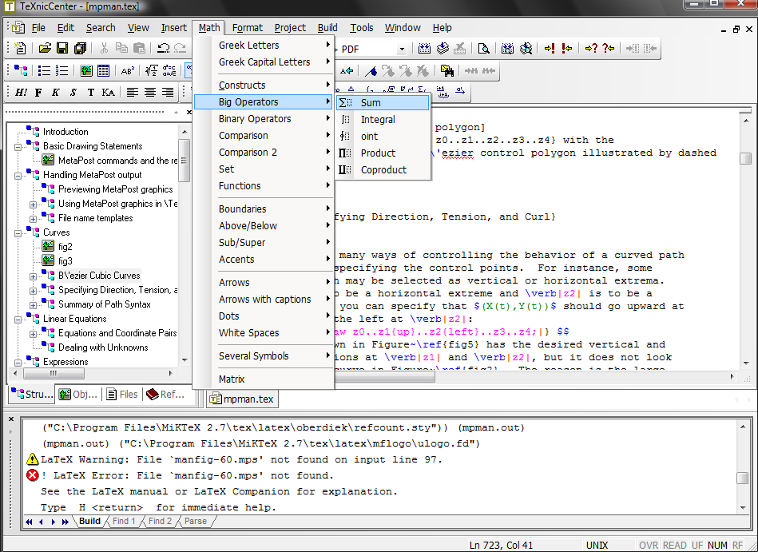
TeXnicCenter: for Windows

Slide 6
Sussex University thesis template
University has regulations about the format of theses: margins, preamble, etc.
  Though probably no one will notice…
Simple template available
http://astronomy.sussex.ac.uk/~anthonys/latex/usthesis/

Slide 7
Types of LaTeX file
“*.tex” - LaTeX source file
“*.bib” - LaTeX bibliography database
“*.cls” - LaTeX class file
“*.sty” - old LaTeX style file
Other files created automatically when the output is created

Slide 8
Structure of a .tex file
Preamble: before \begin{document}
  Packages to include
  Define handy macros
  Layout of the document
  The style of the document
Document body: \begin…\end{document}
  The content of the document

Slide 9
Making the output file
In the old days, people used DVI (DeVice Independent) and Postscript files for output
Now we know better, and use PDF files
The old way:
  “latex my_document”
  “dvips my_document”
The new way:
  “pdflatex my_document”
Look for options in the GUI applications

Slide 10
Managing large documents
Easier if each chapter is in its own file
Exercise…

Slide 11
Bibliographies
If you intend on writing more than one scientific document in your life, it’s very handy to keep bibliographic data in a database.
LaTeX does that using BibTeX
Have a look at bib.bib

Slide 12
Adding to bib.bib
Have a look on the course page for a suitable online source of BibTeX data for your field
Try to find a relevant paper, and find the BibTeX entry
Copy and paste into bib.bib
Include a citation in your new chapter
Build thesis.tex (twice!)

Slide 13
Figures
LaTeX places figures in sensible places and can handle cross-references easily
  Never enter “Figure 1” … what if you add another figure before “Figure 1”?
  Instead, use “Figure \ref{descriptive_name}” and inside the figure caption put “\label{descriptive_name}”
  See thesis.tex for an example…
Download the figures from the course page and try it out…

Slide 14
Tables
Easy within LaTeX
Your favourite data analysis package may output data in LaTeX format
  “&” between columns
  “\\” at end of lines
Try making a table using the sample data on the course page

Slide 15
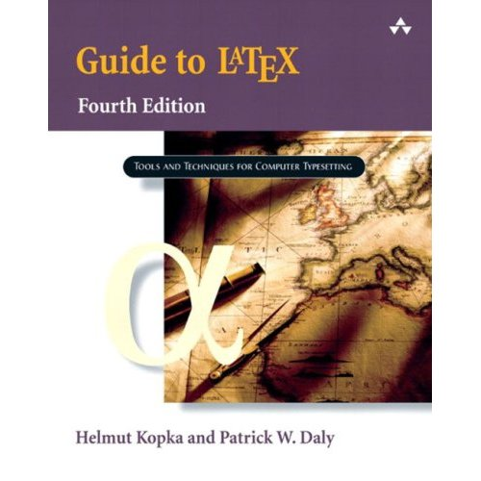
That’s all…
Other miscellaneous exercises on the sheet
Further information in books/online
Feel free to email me…

