Slide 1

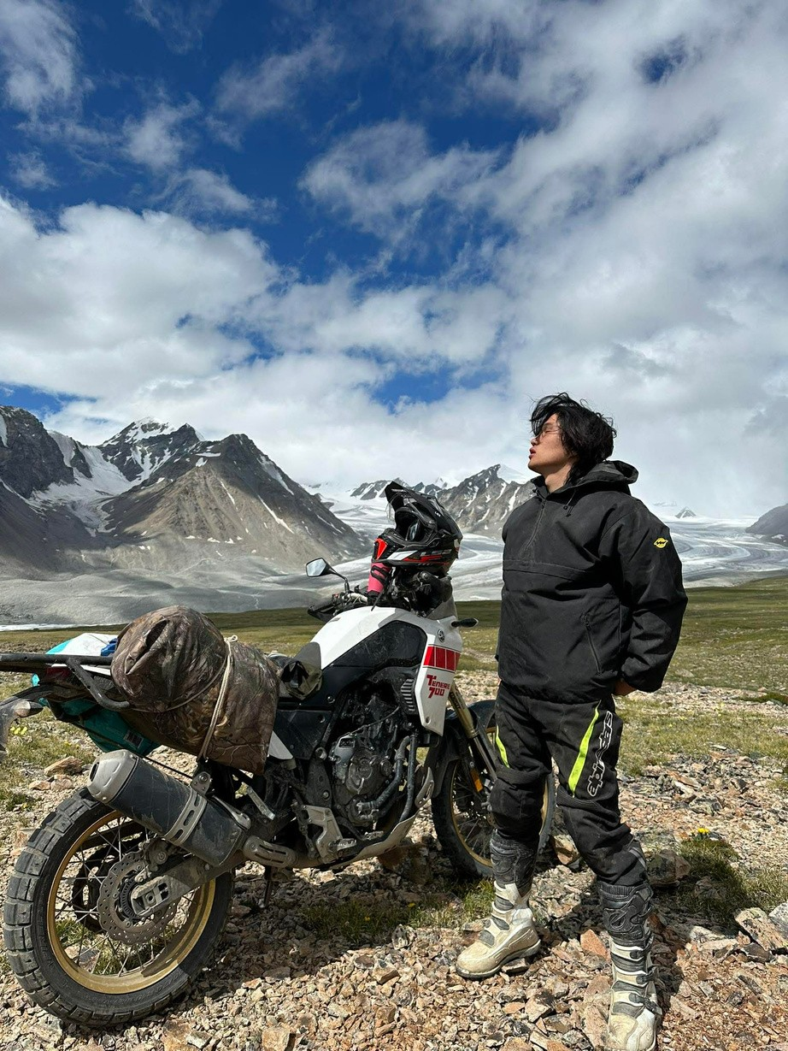

Purevkhuu Enkhbayar
Riding a Motorcycle
m y h o b b y i s r i d i n g a m o t o r c y c l e

Slide 2

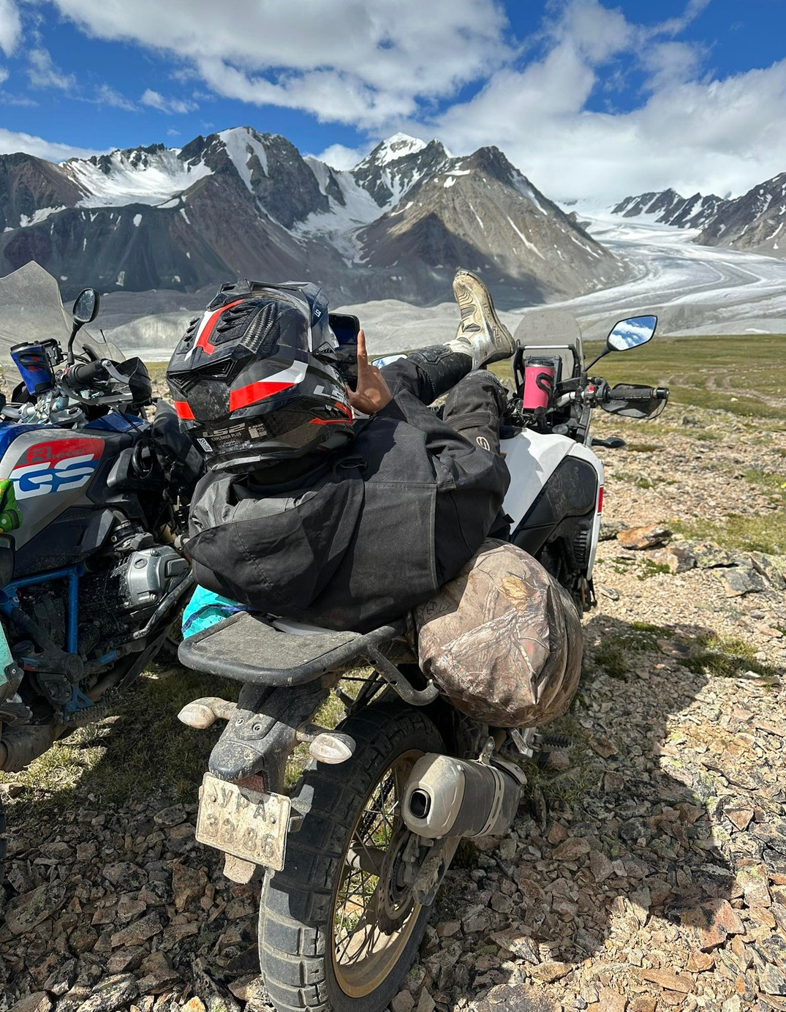



Introduction
Exciting and fun
Makes me feel free
Reduces stress

Slide 3


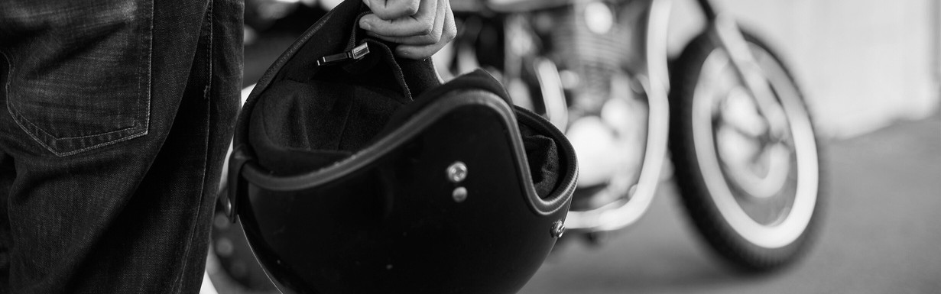
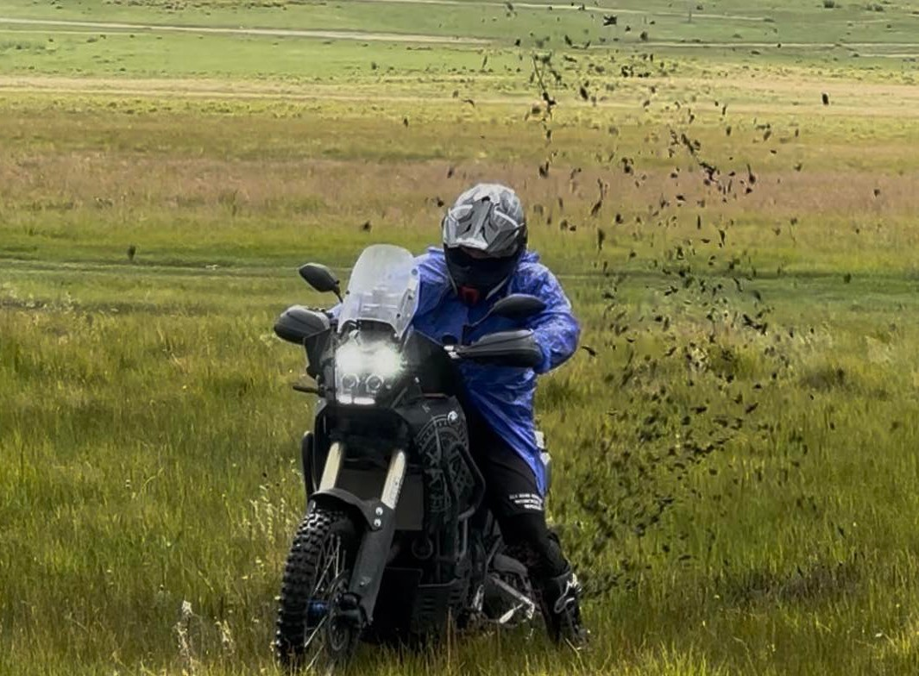

Places
Road or countryside
Safe and not crowded
Good roads are important

Slide 4
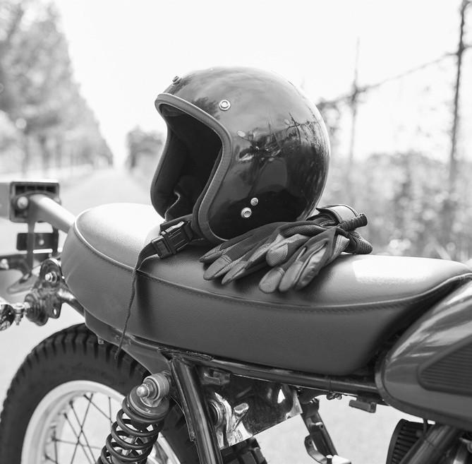

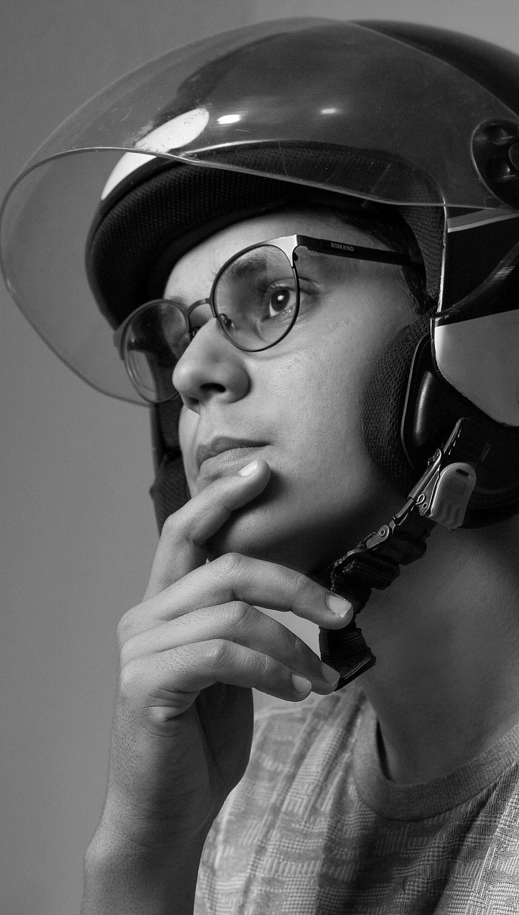



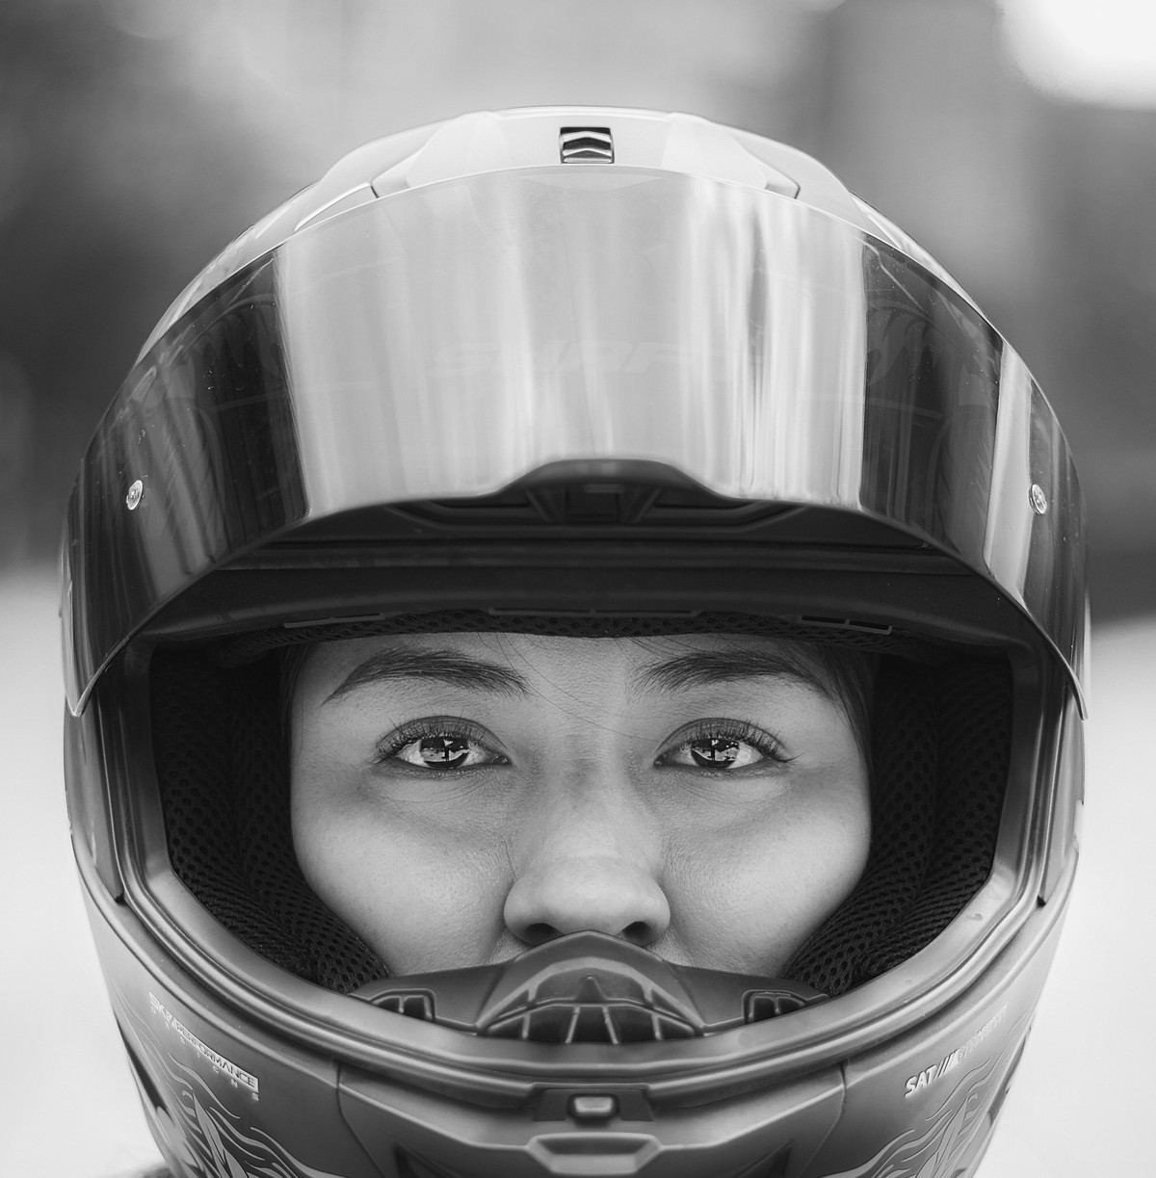
items
Helmet for safety
Gloves to protect hands
Jacket for riding

Slide 5




More exciting than gaming
Faster than cycling
More fun than walking
Most exciting hobby
Compare

Slide 6
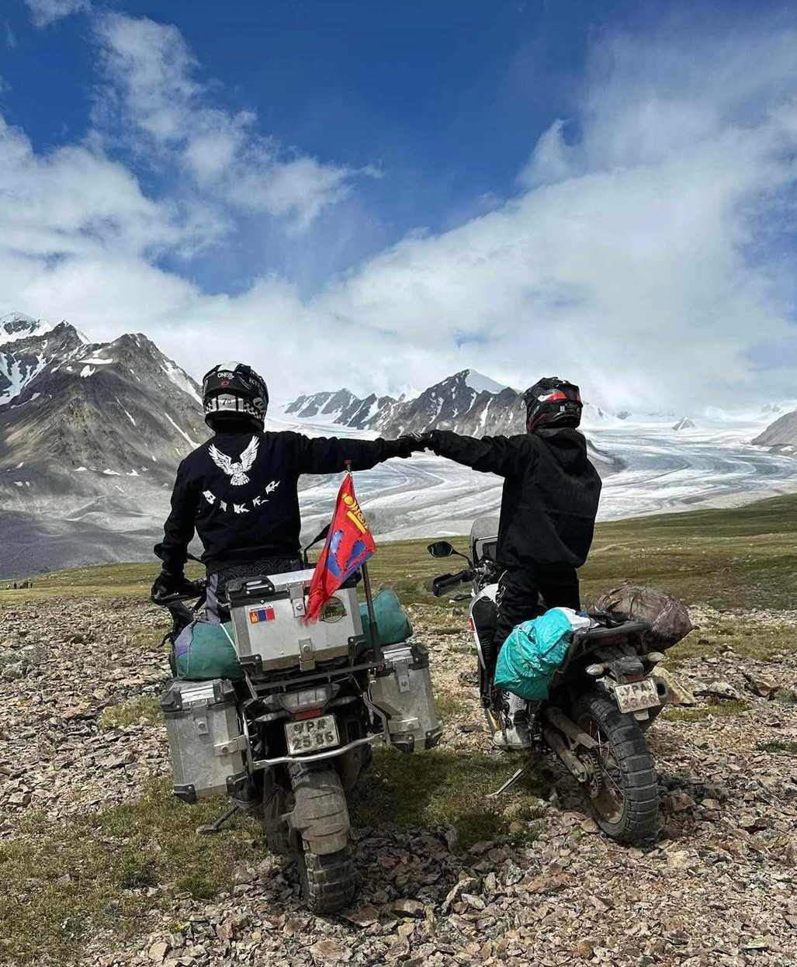



Conclusion
Great hobby
Exciting and relaxing
Best way to feel free
Recommended

