Slide 1
IETF 122 IPPM
18 March 2025
This session is being recorded
Internet Engineering Task Force
© 2025 IETF Trust
Production by Meetecho

Slide 2
Note Well
This is a reminder of IETF policies in effect on various topics such as patents or code of conduct. It is only meant to point you in the right direction. Exceptions may apply. The IETF's patent policy and the definition of an IETF "contribution" and "participation" are set forth in BCP 79; please read it carefully.
As a reminder:
By participating in the IETF, you agree to follow IETF processes and policies.
If you are aware that any IETF contribution is covered by patents or patent applications that are owned or controlled by you or your sponsor, you must disclose that fact, or not participate in the discussion.
As a participant in or attendee to any IETF activity you acknowledge that written, audio, video, and photographic records of meetings may be made public.
Personal information that you provide to IETF will be handled in accordance with the IETF Privacy Statement.
As a participant or attendee, you agree to work respectfully with other participants; please contact the ombudsteam (https://www.ietf.org/contact/ombudsteam/) if you have questions or concerns about this.
Definitive information is in the documents listed below and other IETF BCPs. For advice, please talk to WG chairs or ADs:
BCP 9 (Internet Standards Process)
BCP 25 (Working Group processes)
BCP 25 (Anti-Harassment Procedures)
BCP 54 (Code of Conduct)
BCP 78 (Copyright)
BCP 79 (Patents, Participation)
https://www.ietf.org/privacy-policy/(Privacy Policy)
Notes:
The IETF Note Well should be shown at the start of every IETF working session. The guidance below is adapted from IETF legal counsel presentation during IETF 120
DO
Do make sure people have enough time to read through the slide before you move on,
Do give a high-level summary of what’s covered in the Note Well: “IETF policies on conduct, privacy and IPR.”,
Do encourage people to read through all the linked policies & documents in detail before participating or contributing,
Do explain where people can direct questions or concerns (IETF Executive Director or Ombudsteam).
DON'T
Don’t dismiss the importance or relevance of any of the information on the Note Well.
Don’t interpret the meaning or get into the substance of any of the topics or content of the policies.
Don’t communicate that the Note Well conveys all the information participants need to know.
Don’t address questions or concerns in the meeting itself.

Slide 3
Note Really Well
IETF meetings, virtual meetings, and mailing lists are intended for professional collaboration and networking, as defined in the IETF Guidelines for Conduct (RFC 7154), the IETF Anti-Harassment Policy, and the IETF Anti-Harassment Procedures (RFC 7776). If you have any concerns about observed behavior, please talk to the Ombudsteam, who are available if you need confidentiality to raise concerns confident about harassment or other conduct in the IETF.
The IETF strives to create and maintain an environment in which people of many different backgrounds and identities are treated with dignity, decency, and respect. Those who participate in the IETF are expected to behave according to professional standards and demonstrate appropriate workplace behavior.
IETF participants must not engage in harassment while at IETF meetings, virtual meetings, social events, or on mailing lists. Harassment is unwelcome hostile or intimidating behavior—in particular, speech or behavior that is aggressive or intimidates.
If you believe you have been harassed, notice that someone else is being harassed, or have any other concerns, you are encouraged to raise your concern in confidence with one of the Ombudspersons.

Slide 4
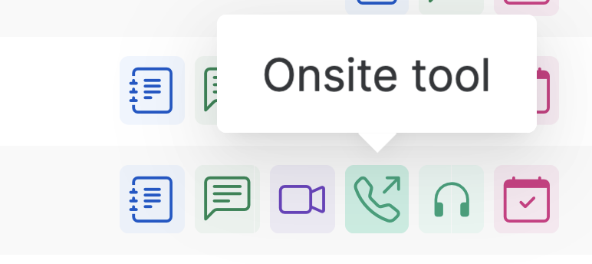
IETF 122 Meeting Tips
This session is being recorded
In-person participants
Make sure to sign into the session via Datatracker or the QR Code in this session.
Use Meetecho (usually the “Meetecho lite”) client to:
join the mic queue
participate in shows of hands
Keep audio and video off if not using the onsite version.
Remote participants
Make sure your audio and video are off unless you are chairing or presenting during a session.
Use of a headset is strongly recommended.

Slide 5
Notetaker
We need a volunteer for notetaking.
https://notes.ietf.org/notes-ietf-122-ippm

Slide 6
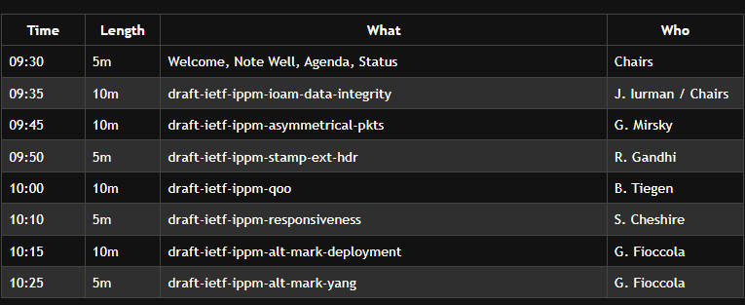
Agenda – Working Group Documents

Slide 7
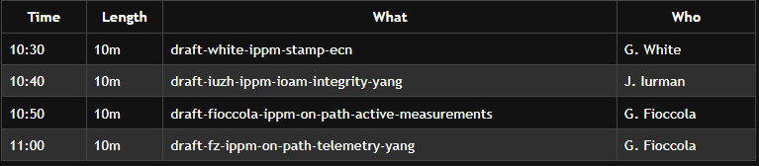
Agenda – Proposed Work

Slide 8
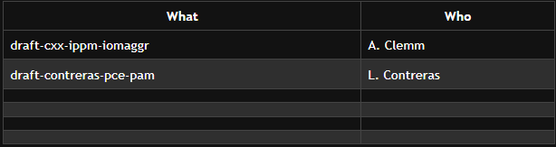
Agenda – Lightning Talks
draft-ietf-opsawg-oam-characterization
T. Graf

Slide 9
IPPM Organizational Update
Tommy Pauly to step down as IPPM chair after IETF 122
Thomas Graf has joined as new chair
Thank you Tommy!
Welcome Thomas!

Slide 10
Document Updates Since IETF 121
WG last call concluded for draft-ietf-ippm-capacity-protocol
See next slide for status update.
WG last call concluded for draft-ietf-ippm-hybrid-two-step
Shepherd writeup underway.
draft-ietf-ippm-alt-mark-yang has been adopted.

Slide 11
Status of Capacity Protocol
Halfway through AD review comment clearing (meaning draft -13 is certainly not final, most changes present consented text).
AD comments are minors, editorials and nits...but many. Will take some weeks.
Introduced an optional UDP checksum Intended for environments where UDP data integrity may be uncertain (if, e.g., standard UDP checksum is disabled to improve performance by a low-end device).
Removed security related text which doesn’t specify or discuss features applied by theTest Protocol for One-way IP Capacity Measurement - E.g., section “OPTIONAL Fully Encrypted mode - For Information Only”

Slide 12
Resources for IETF 122 Bangkok
Agenda https://datatracker.ietf.org/meeting/agenda
Meetecho and other information: https://www.ietf.org/how/meetings/preparation
If you need technical assistance, see the Reporting Issues page: http://www.ietf.org/how/meetings/issues/

