Slide 1
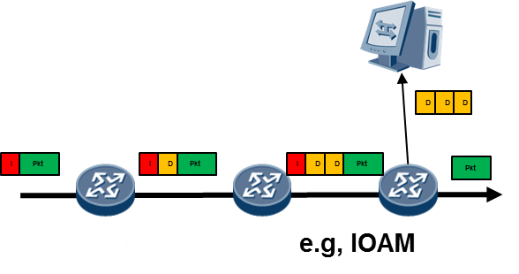
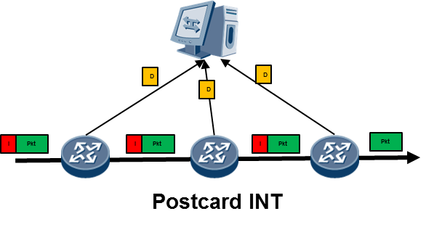
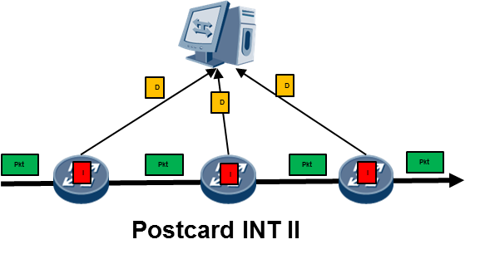
On-Path Telemetry for Data Plane
Difference in the handling of the telemetry instruction & data in packets
Tradeoffs
Performance Impact
Encapsulation and Overhead
Security
Configuration and correlation
Drop location identification
Data as passport stamps
IOAM Trace Mode
Data as postcards
Data as postcards
Postcard by Instruction (PBT-I)
Postcard by Marking (PBT-M)
Could be another mode of IOAM (Per-Hop Postcard)
A standalone approach

Slide 2
MPLS Extension Header for IOAM Encapsulation
MPLS Label Stack
Extension Header Indicator (EHI)
R
EH Count = N
EH Total Length
Next Header = h1
Header of Extension Headers (HEH)
H1
Next Hdr = h2
Header Length
N Extension Headers
HN
Next Hdr = UL
Header Length
UL
Original Inner Packet
EH is a normalized and scalable mechanism to support network instruction headers and metadata
EH is stackable to support other in-network services in parallel

