Slide 1
Extended OAM to Convey In-situ OAM Configuration State draft-xiao-ippm-ioam-conf-state-01
Xiao Min xiao.min2@zte.com.cn
Greg Mirsky gregimirsky@gmail.com
IETF-103 Nov 2018, Bangkok

Slide 2
Intention of this draft
Provide a method for the IOAM encapsulating node to determine IOAM header
Static configuration is a potential method, but it's uneasy and inflexible, especially when the IOAM encapsulating node is a host
Dynamic acquisition is proposed in this draft, traditional OAM mechanisms such as ICMP Ping or MPLS LSP Ping can be used to convey IOAM configuration state

Slide 3
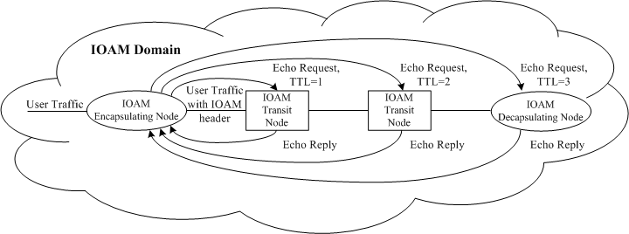
Principle of this draft
the principle of this draft is straightforward
IOAM configuration data is conveyed from the IOAM transit/decapsulating nodes to the IOAM encapsulating node, by specific OAM probe packets

Slide 4
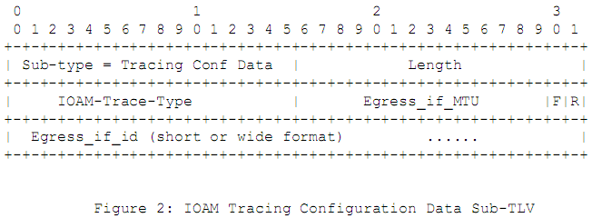
Two changes (1) – MTU
MTU is a key issue for In-situ OAM
In section 4.2 of [draft-ietf-ippm-ioam-data-04] it says “The maximum number of hops and the minimum path MTU of the IOAM domain is assumed to be known”
This change provides a mechanism to know the minimum path MTU of the IOAM domain

Slide 5
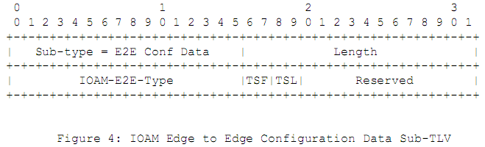
Two changes (2) – Time Stamp
In the 02 version of [draft-ietf-ippm-ioam-data] it introduced support for new formats of time stamp, whose formats currently include PTP, NTP and POSIX
This change enables the IOAM encapsulating node to know the format and length of time stamp configured at the decapsulating node

Slide 6
Next steps
Ask for more reviews and comments
Revise this draft to resolve comments
Ask for WG adoption

