Slide 1
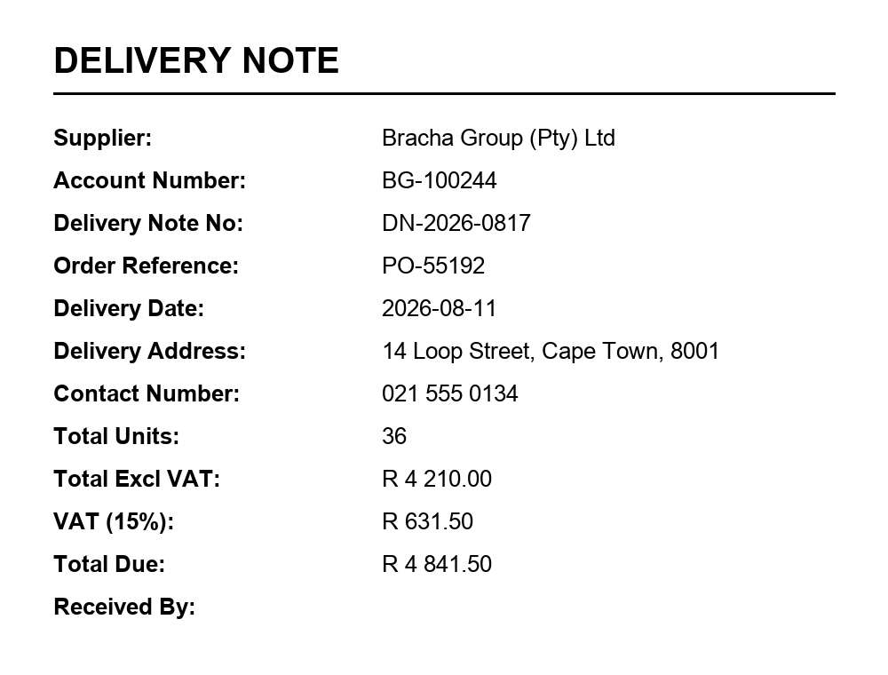
THE INPUT · samples/delivery-note.png
KNOWLEDGE SHARE · DOCUMENT AI · CASHBACKS PLATFORM
Reading a document,
two ways.
One image. One question: what does it say?
A purpose-built OCR client and a single vision prompt both answer it — and they fail in completely different ways. Here is the honest comparison.
Both approaches get this exact PNG. Neither is told what is on it.
A Document Intelligence
prebuilt-layout · SDK client
B Foundry prompt
vision model · one call
Cashbacks.Ocr / .NET 8 / Azure AI

Slide 2
01 / UNDER THE HOOD
Same PNG in. Very different machinery.
One reads the page. The other interprets it. That single difference explains every pro and con that follows.
A
Azure AI Document Intelligence
prebuilt-layout + keyValuePairs · API 2024-11-30
B
Azure AI Foundry prompt
vision model + JSON schema · one call
01
Submit
The SDK posts the file (or a public URL) and polls the long-running operation until Azure is finished.
01
Attach
The image travels as base64 content in the same message as your instructions. No document service involved.
02
Read
A dedicated OCR engine de-skews the page and finds every word, line, table and checkbox — with coordinates.
02
Ask
“Return invoiceNumber, issuedOn as ISO-8601, totalInclVat as a number.” The schema is the prompt.
03
Relate
The layout model links label → value wherever that relationship physically exists on the page.
03
Reason
The model reads, interprets and normalises in one pass, then emits JSON in the shape you asked for.
options.Features.Add(DocumentAnalysisFeature.KeyValuePairs);
await client.AnalyzeDocumentAsync(WaitUntil.Completed, options);
content: [ { type: "image", source }, { type: "text", text } ]
response_format: { type: "json_schema", strict: true }
RETURNS · ANALYZERESULT.KEYVALUEPAIRS
"Invoice Number" → "34278587"
confidence 0.997 · page 1 · bounding polygon
RETURNS · YOUR OWN OBJECT
{ "invoiceNumber": "34278587", "issuedOn": "2017-06-18" }
no coordinates · no confidence · no evidence
Document Intelligence vs. Foundry prompt · Cashbacks.Ocr
02

Slide 3
02 / THE TRADE-OFFS
What each is great at — and exactly where it hurts.
Neither is simply “better”. They have opposite strengths, and only one of them fails quietly.
Azure AI Document Intelligence the SDK client
Azure AI Foundry prompt one vision call
✓ STRENGTHS
✕ WHERE IT HURTS
✓ STRENGTHS
✕ WHERE IT HURTS
Deterministic
The same file returns the same JSON on every run. Diffable, testable, cacheable.
Reads, never infers
A landscape photo or a page of prose comes back with zero pairs.
You define the shape
Ask for your field names and get precisely that JSON back.
Probabilistic
The same image can answer differently. Needs temperature 0, evals and a golden set.
The document's vocabulary
You get “Inv. No”, not invoiceNumber. Mapping to your model is your problem.
Reads and reasons
Normalises dates, currencies, synonyms and totals inside the same call.
Evidence attached
Confidence, page number and a bounding polygon for every pair it returns.
Hallucination is the failure
A plausible invoice number that was never on the page — stated confidently.
No semantics
It will not normalise a date, convert a currency or total a column.
Owns the long tail
Photos, screenshots, handwriting, prose — where the client returns nothing.
Built for bad paper
Skew, low contrast, tables, checkboxes, multi-page PDF, 100+ languages.
No boxes, no confidence
Nothing to highlight in a review UI, and a thin audit trail.
Named fields are billed
queryFields is a premium add-on, capped at 20 fields you must know upfront.
Minutes, not sprints
Iterate in the Foundry playground before a line of code ships.
Cost tracks pixels
Tokens scale with resolution and page count; model upgrades shift the output.
Predictable cost
Billed per page — and keyValuePairs is a free add-on on the 2024-11-30 API.
Document Intelligence vs. Foundry prompt · Cashbacks.Ocr
03

Slide 4
03 / HEAD TO HEAD
Ten dimensions, scored.
Five dots is best in class. Neither column wins outright — they win different rows.
DIMENSION
DOCUMENT INTELLIGENCE
FOUNDRY PROMPT
Raw OCR on poor scans
Purpose-built engine
Good, fades on faint scans
Tables, checkboxes, long PDFs
Native and structured
Drifts on dense tables
Photos, prose, handwriting
Returns no pairs at all
Its home turf
Output matches your schema
The document's own keys
You dictate the JSON
Determinism, run to run
Byte-stable
Varies without pinning
Confidence + bounding boxes
On every pair
Not available
Resistance to hallucination
Reports only what it read
Real, and silent
Cost profile
Per page, predictable
Per token, tracks pixels
Latency
Polled long-running op
Variable under quota
Time to first result
Provision, SDK, code
One prompt
Document Intelligence vs. Foundry prompt · Cashbacks.Ocr
04

Slide 5
04 / THE PATTERN WE RECOMMEND
Ground it first, then let the model think.
The client supplies the truth; the prompt supplies the shape. Each covers the other's failure mode.
Image or PDF
Receipt, invoice, statement — any of it.
Document Intelligence
OCR text, layout, tables, boxes, confidence.
Foundry prompt
Map that text into your schema. Text in, not pixels.
Validate
Every value must trace back to the OCR text.
Typed record
Your object, plus the evidence behind each field.
→
→
→
→
The guardrail: if a field the model returned does not appear in the OCR text, it is a hallucination — reject it, or route it to a human. That one rule turns a probabilistic reader into an auditable one.
Reach for the client
when the answer must be defensible
Reach for the prompt
when the input refuses to be a form
· The value ends up in a ledger, a claim or an audit trail.
· The document is a photo, a screenshot, a note or free-flowing prose.
· Volume is high and the layout is stable — invoices, statements, forms.
· You need your schema — normalised dates, currencies, categories — not the page's labels.
· A reviewer needs to see where on the page the number came from.
· You are exploring: prove the value today, harden the pipeline later.
Document Intelligence vs. Foundry prompt · Cashbacks.Ocr
05

Slide 6
05 / TAKEAWAY
Don't pick a winner.
Pick the failure mode you can live with.
Silence vs. invention
The client fails loudly — zero pairs, and you know it. The prompt fails quietly — a confident value that was never on the page. Silence is the cheaper bug.
Evidence is the product
Confidence scores and bounding boxes are not extras. They are what lets a human review a decision, and what an auditor will ask for.
Ship the hybrid
Grounded extraction, then a prompt to map it into your schema, then validation against the OCR text. Cheaper than defending either extreme.
Try it on your own file: dotnet run --project src/Cashbacks.Ocr -- samples/delivery-note.png --json
Bracha Group · Cashbacks platform · Document AI
06

