Slide 1
Library system
MPP project by
Ammanuel desta, mekuanent , enkuslase

Slide 2
Introduction to the library system
the project performs the basic usecases of a library system.
In this project books and members are basically managed
The two major actors to the system are the librarian and the admin
It also supports actor with both rolls and its called a super admin.
The development lifecycle consisted identifying the static and dynamic behaviors for analysis and design and developing and testing fully functional desktop application.

Slide 3
Functions of the system
Addition of new books
Addition of new book copies
Addition of new members
Checkout a copy of a book to a member
Track overdue checkout records
Grants 3 types of rolls Librarian, Admin, and Super admin
Display members list
Display books list
Display checkout list
Las but not leas log in and logout to/from system

Slide 4
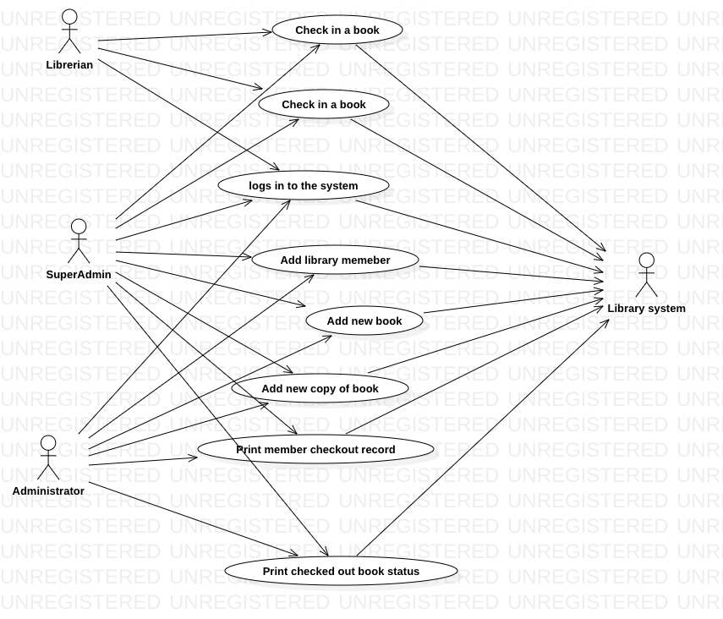
Usecase diagram
Three types of actors participate in the system
Admin has all administrative rolle
Super admin ihas both rolls together

Slide 5
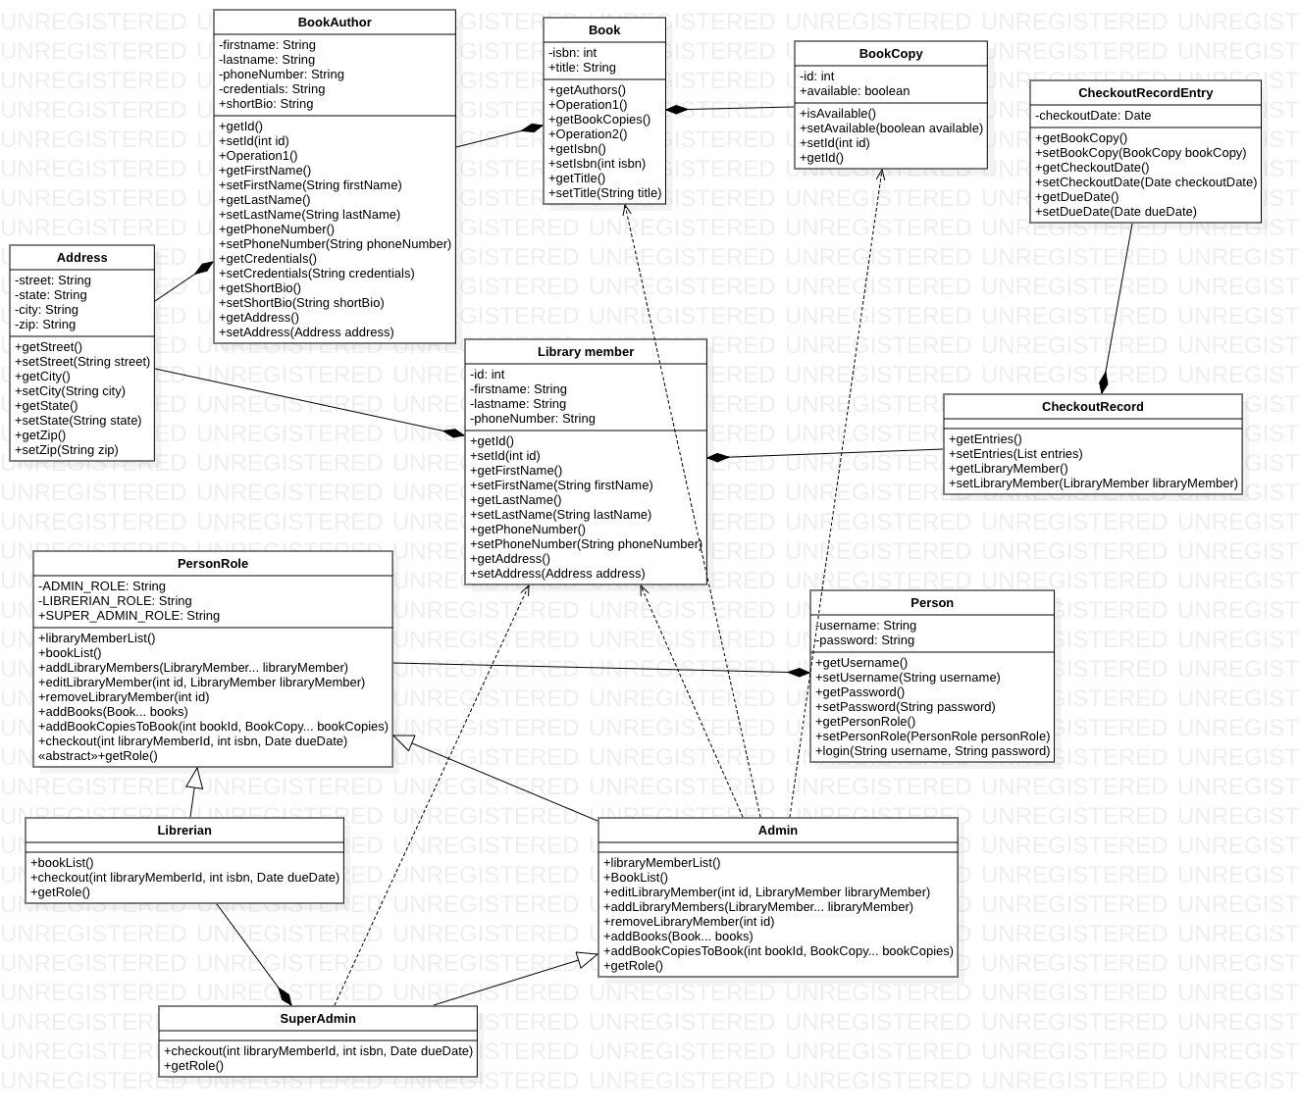
Classs diagram analysis phase
Person class contains Roll class
Roll class have all possible actions performed by all rolls
And librarian,admin extend the abstract class Personroll inoprder to overrde their preferd rolls
Super admin extends admin and adds a checkout method for super admin roll.

Slide 6
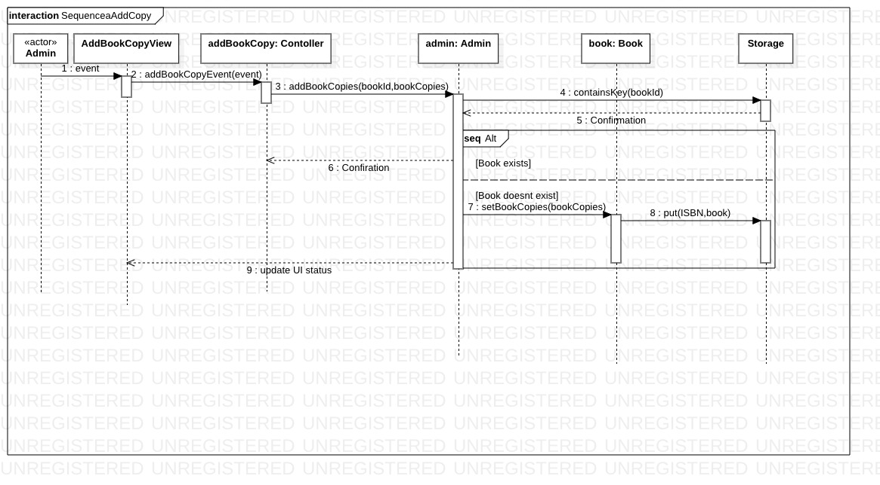
Sequence diagram for add book copy during analysis phase
A use case’s work flow is controlled by a controller class
Controller class contains action to be performed by the system whe a user triggers an event in ui button
In this scenario the admin clicks the add book copy button

Slide 7
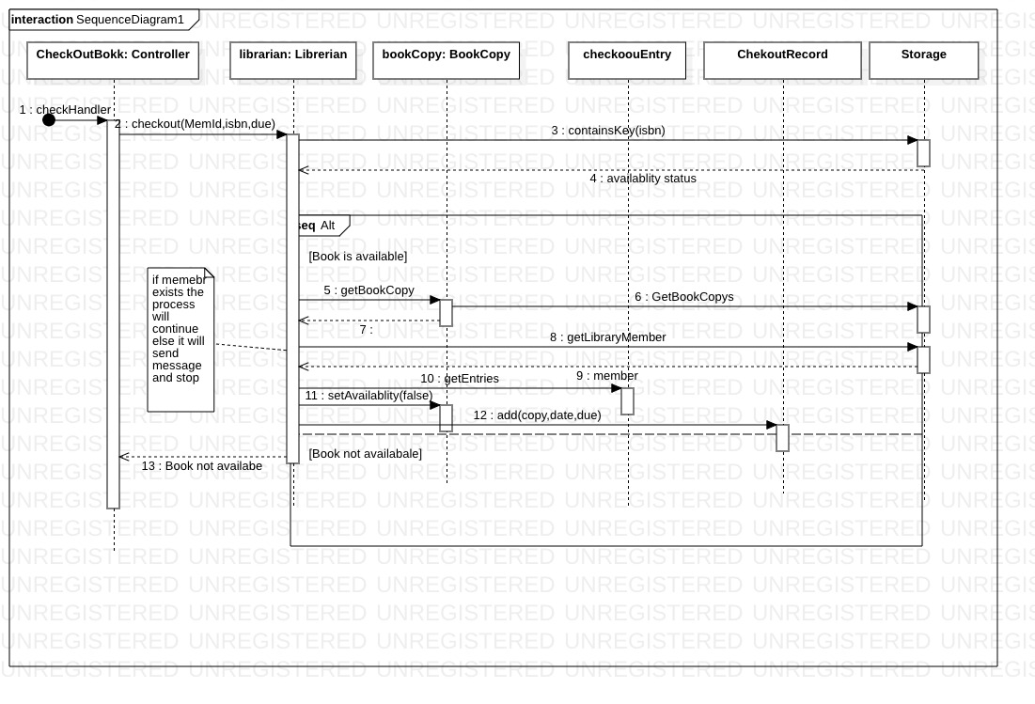
Sequence diagram for checkout book.
Action is triggered when a user clicks the button on UI.
The action is handled on checkout controller
The workflow is controlled an the ui is updated by the controller
This approach is decentralized to handle all the sequences in a use case

Slide 8
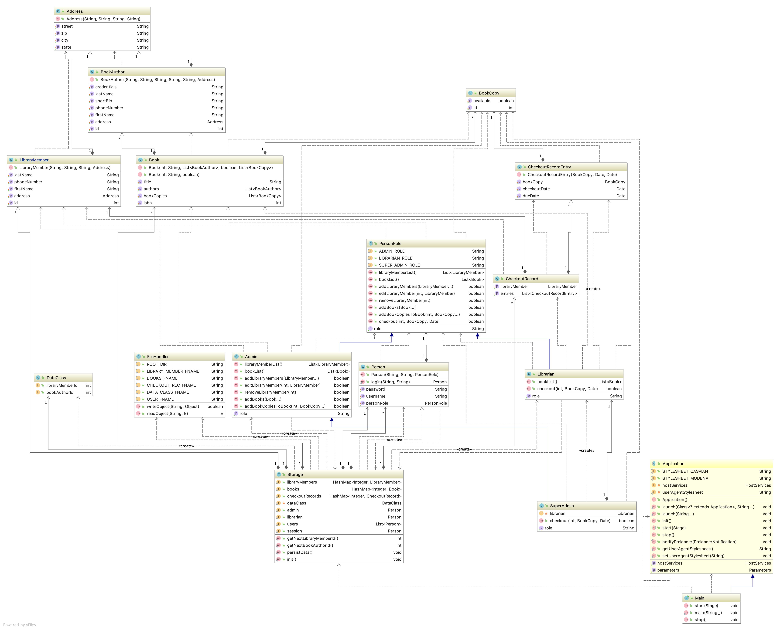
Final class diagram of the domain classes

Slide 9
Project structure
Views
Contains all javaFX ui components
Contains styling css files
Controllers
Contains all controllers that are assigned to each use cases
Each controller communicates with the UI start and accomplish a designated usecase.
Utility
Contains utility classes
Classes here are used for ruoutin services like storage, conversions, file handlers, transitions…
Used by all components of the system

Slide 10
Continued….
Data access
Contains all domain objects and entity classses
This objects are used by controllers to get a job done in a use case
DTO view
Contained inside data access
Used to communicate view data with the UI
The UI uses this objects to transfer data from the system to display it on status tables components.

Slide 11
UI features involved in the usecases
All use case actions are triggered by buttons
all forms that require input form are used by pop-up dialogue forms
The main UI maintains and views the list of books,
All list tables are access by tab panels
The UI is developed by JavaFX and uses a styling theme for attractive look

