Slide 1



Air Quality Monitoring Dashboard
202355675 Enkhbayar Enkhsaikhan

Slide 2
Monitor and display air quality data (AQI) for selected cities.
• Real-time AQI and pollutant levels.
• Dynamic charts for trends visualization.
• Interactive map for city-specific data.
• Responsive and user-friendly design

Slide 3
Key Features
Real-time Air Quality Data:
Metrics: Temperature, Humidity, NOx, NH3, SO2, VOC, CO2, AQI.
Location Selector:
Drop-down menu to choose cities (e.g., Seoul, Busan, Jeju).
Interactive Map:
Heatmaps for air quality visualization using Leaflet.js.
Dynamic Charts:
Bar and doughnut charts for trend analysis.

Slide 4
Tools and Technologies Used
• OpenWeatherMap API for air quality and weather data.
• Chart.js for visualizing data.
• Leaflet.js for interactive maps.
• Gridstack.js for responsive layouts.

Slide 5

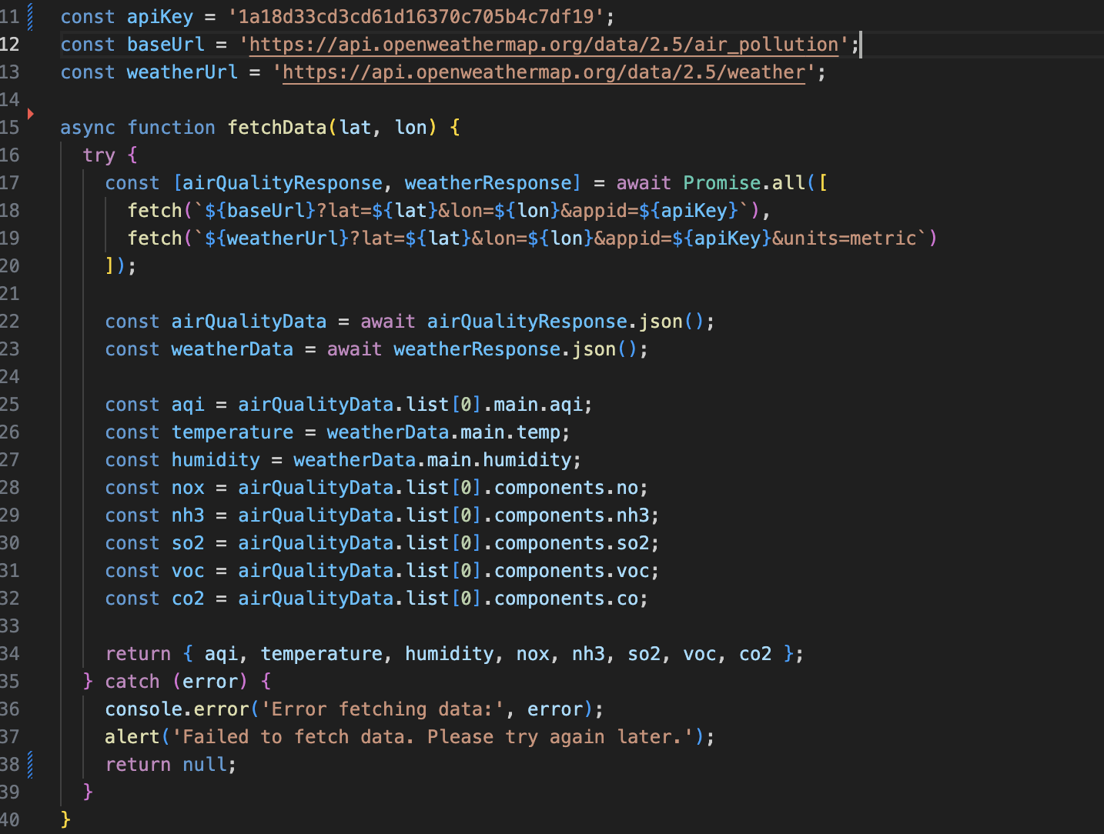
API Integration:
• Fetch data from OpenWeatherMap using fetch() in JavaScript.
• Process JSON responses for AQI and pollutants.

Slide 6
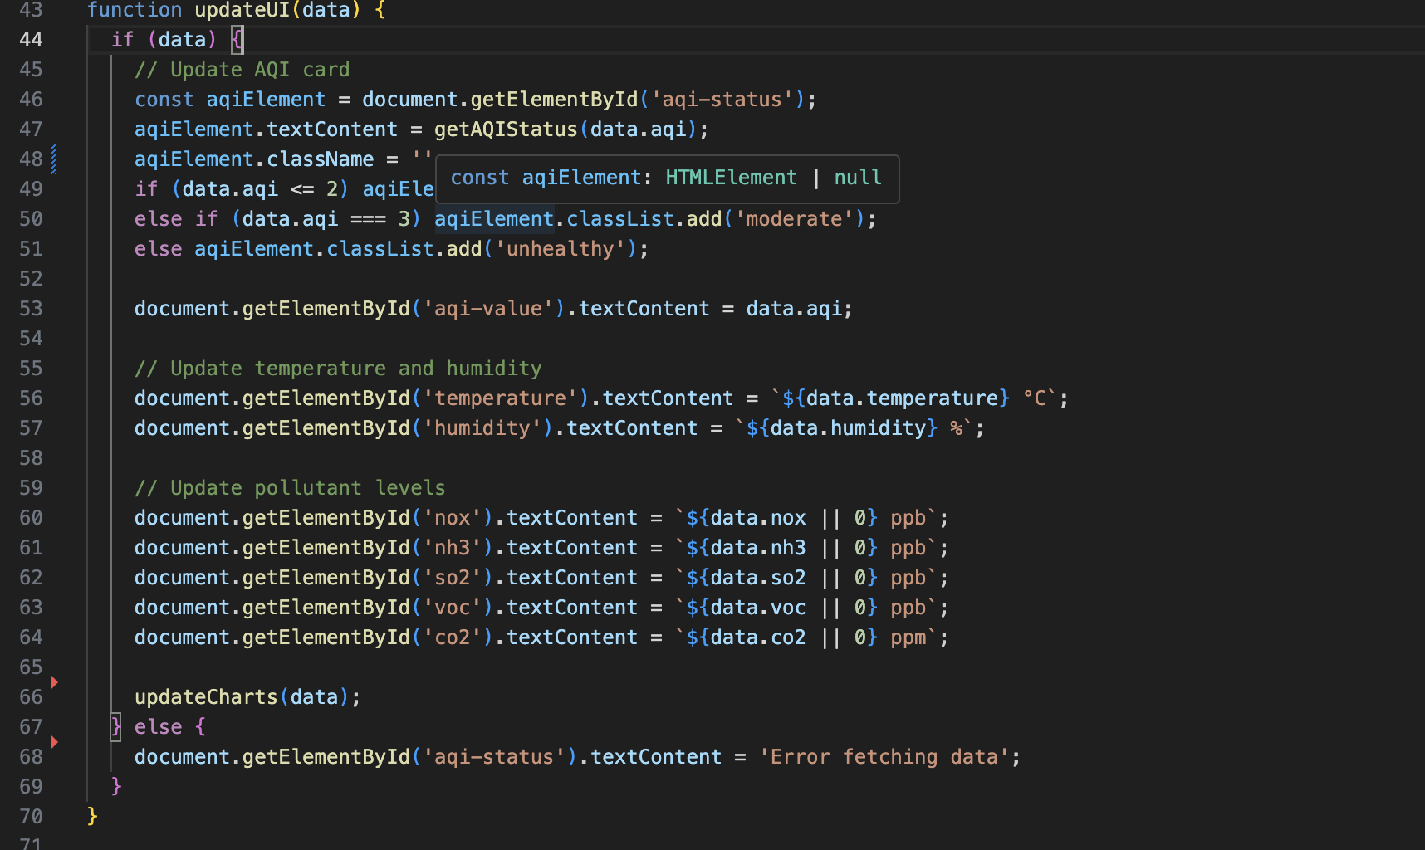
. Dynamic Updates:
• Updated DOM elements dynamically using JavaScript.
• Implemented dropdown for city selection.

Slide 7
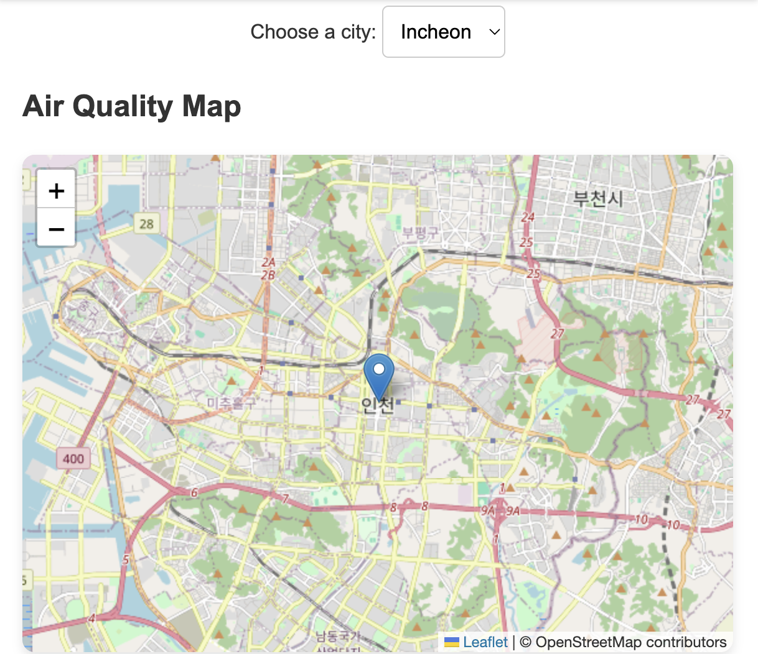
Map Integration:
Displayed city-specific locations using Leaflet.js.
Updated map markers dynamically based on city selection.

Slide 8
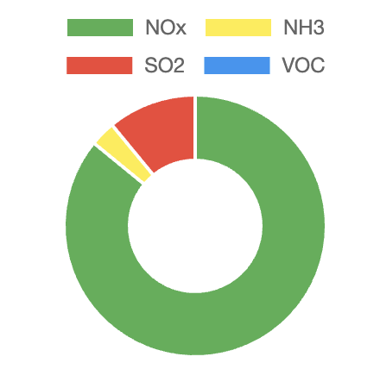
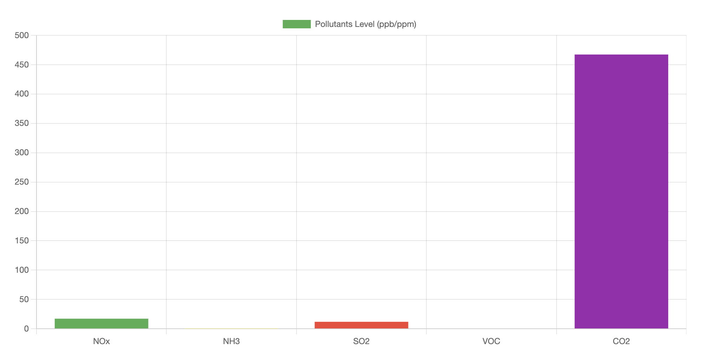
Charts and Visualization:
• Used Chart.js to render bar and doughnut charts.
• Updated charts dynamically with fetched data.

Slide 9
Future updates
• Allow users to save favorite cities or customize dashboards.
• Introduce login features for personalized settings.
• Develop a mobile application for better accessibility on smartphones.
• Use machine learning models to predict future air quality trends based on historical data.

Slide 10
THANK YOU!

