Slide 1
Intelligent Interaction Analytics Platform (IIAP)
Our speech analytics solution

Slide 2
Enrich Business process insights using speech Analytics and SensAI
HOW
WHAT
01
HOW
WHY IIAP
02
WHAT IS THE NEED
03
WHY IIAP

Slide 3


Overview of the IIAP Solution
IIAP – Intelligent Interaction Analytics Platform
Pre-
processed Data
Develop STT Engine
Decode
New Calls
Design Rules & Present Insights
Language
Corpus
Acoustic
Data
Probabilistic Models on Processed Output
Apply NLP rules on Transcriptions
Use Decoder to transcribe new voice data
Original Transcription
Speaker Data
Lexicon
Processed Output
Acoustic Model
Language Model
Transcription
Transcription
Decoder
Processed Output

Slide 4



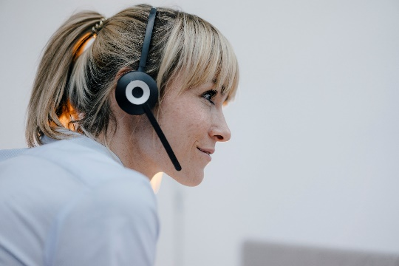
Interaction Analytics
Unified dashboard - combine Voice, Text and Structured Data
Automatic Speech Recognition tool kit developed in-house
NLP rules designed to analyze text and VOC response
Other data sources integrated to arrive at comprehensive insights
FEATURES
Use Cases
Automated analytics to support Customer Complaints & Opportunity Identification
On premise/On cloud access
Batchwise
Real time
Calls
Speech to Text
Text Mining
CRM
VOC/Metrics
Insights
Transcription
Enhance customer experience thru the opportunity to reduce repeat calls by 5%
Time Stamps
Pure Voice & Non-voice time
Speaker Diarization
Voice analytics to sustain and optimize call handling with opportunity to improve efficiency by 5%
Domain Spec Models
Search Bar & keyword spotting
Customized NLP rules
Customized business insights
Smart formatting
Customized Vocab
Optimized upstream & downstream processes reducing Transferred calls up to 10%
Auto-filter & auto-redact

Slide 5






IIAP and the Market
COMPETITOR PRODUCTS | IIAP | Calabrio | Amazon Transcribe | Google Cloud STT | IBM Watson STT | Microsoft Speech (ACS) | Speech Transcription
Standalone or Embedded ? | Both | Both | Both | Both | Both | Both | Both
RT Transcription
Speaker Diarization
Speaker Recog/ID
Global Language Support
Intent Recognition
Domain Spec models
Containers for on premises ?
Available via API
Pure Voice vs Non-Voice Time
Key Word spotting in Audio with Time
Average cost Per hour | $0.23/hour | … | $0.95/hour | $4.65/hour | $1.2/hour | $1.2/hour | $1/hour

Slide 6


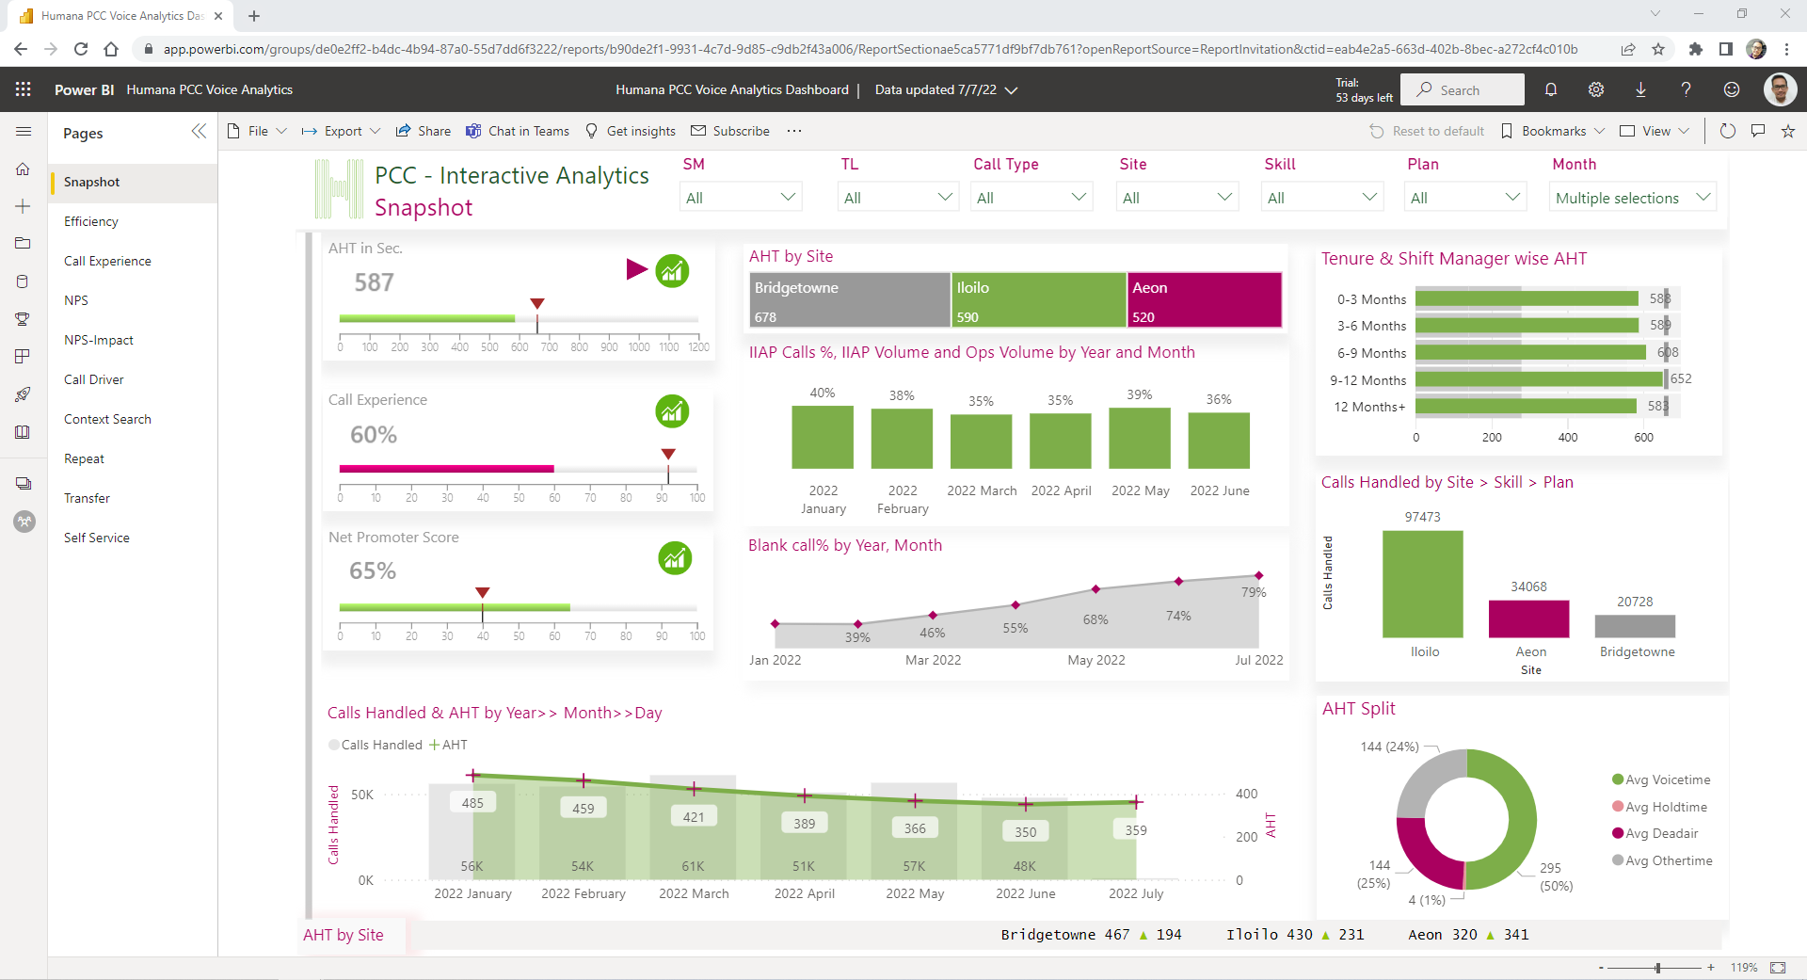
DEMO
Context Search
Call Drivers
NPS
Correlation
Influencers
Transfer & Repeat

Slide 7
AQEP Lifecycle
NLP Life Cycle
1.
Client
5.
NLP Rules Modelling/
Training
6.
NLP Rules
Testing
4.
NLP Rules, Keywords/
Lexicons
Refinement
3.
Problem Definition, Scope, NLP Rules Understanding
2.
Requirement
Gathering
Ground Truth Validation & Accuracy Evaluation TAT is High.
Verification
&
Approval
Publish Insights To Dashboard
Multiple Iterations
1..2..N
Difference in Understanding.
SMEs needed on both ends.
Ambiguity in agreement between stack holders, leads to multiple refinement.
Lack of transparency.
Specific, fixed model training.
Inertia for change management.
Change management is hard.
Increased TAT

Slide 8
Another Business Process Usecase
What is Quality Audit
Examples : Greetings, Call Closing, Professionalism
Scoring for agent performance
Switching
Between Multiple Tools
10-12
Manual Audits Per Day
~ 45 Minutes
for Single Audit

Slide 9



Evolution of Solutions
Manual Business Processing
IIAP
SensAI

Slide 10
3x Performance
60% Automated QA Audits *
1/3 Deployment Cost
1/3 TAT for business operations
50% reduction in audit time
155%
Increase in Audits (Validations)
Customization
WYSWYG
SensAI Benefits
* Note: Automated QA audits numbers varies depending on availability of CRM integration, however sampling rate for automated QA audits near to 100%

Slide 11

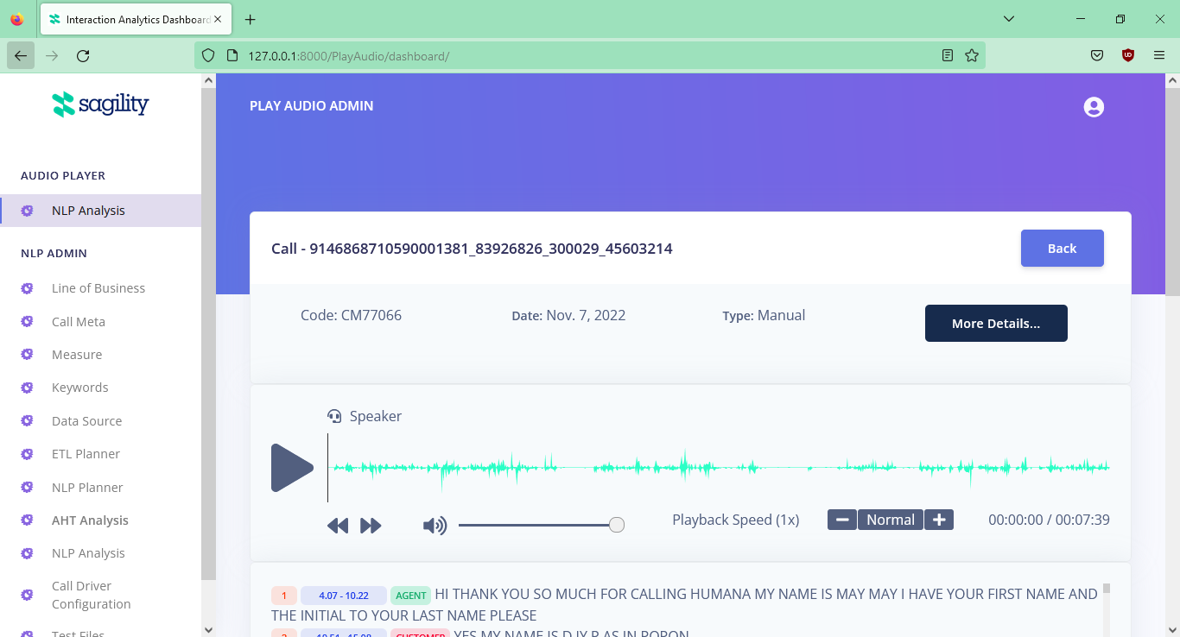
DEMO

Slide 12


SensAI Features
AQEP Audit Page
Meta Data Management
NLP Analysis
Data Source Management
CRM Data Validation
Event Logging
AHT Analysis
LOB Management
Keywords Management
Scheduler
VOC Analysis
User/Roles Management
Content Search
NLP Trace Rule
Measures/KPIs Management
Tenant Management
Call Driver Prediction
ETL Planner
NLP Accuracy Validation
Bulk Upload
Audio Player
NLP Planner
Advanced Filter Based Search
Test Files

Slide 14
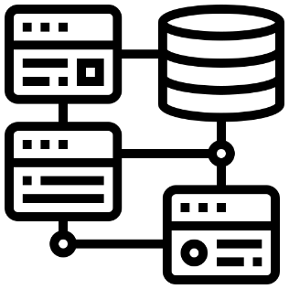
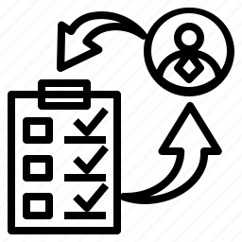
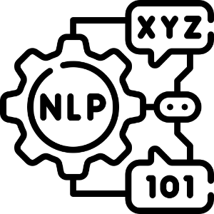







SensAI Architecture
SensAI Application
Rules/KPIs Management
Automated QA
DB
CRM Validation
Data Management
Power BI/
Dashboard
Data Source
Files
Predicted
Analysis Output
Scheduler
Stream
Clean Data
Data
Warehouse
Cloud
Data

Slide 15
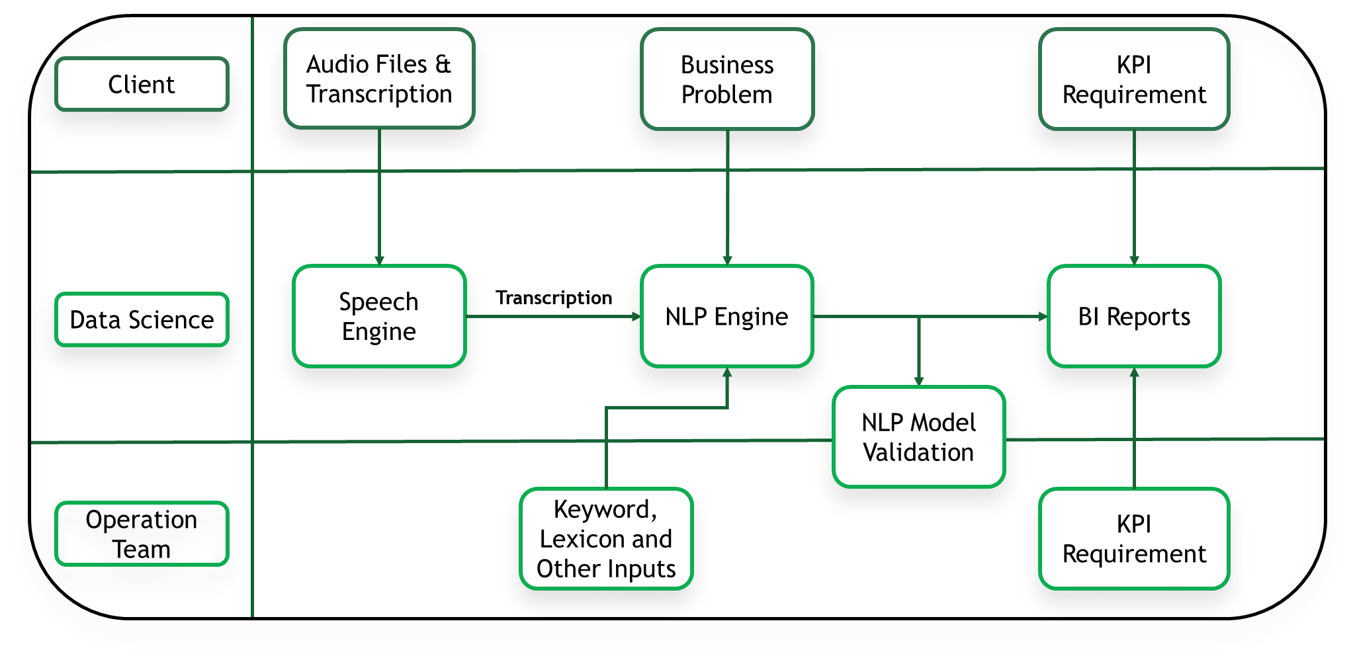
Process Flow

Slide 16

Implementation Timelines
Support required from Client:
Client
Sagility
Approval to access and ingest the Sagility calls into our IIAP solution
10 to 12 weeks
6 to 8 weeks
interval per iteration
4 to 6 weeks
In Contact SPOC identification to discuss set-up and process to ingest the calls
Timeline considerations:
Automated dashboards and analytics design & development
Access to call recordings
Speech to text call transcription
Model training and testing
Model iterations
Up to 3 iterations for critical tracks (Call Drivers, Repeat calls, etc.)
Go-LIVE
Leveraging of existing lexicons relevant for Client – potential reduction
As early as 3-4 months

Slide 17

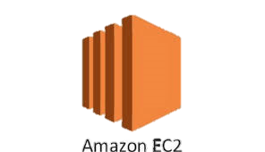




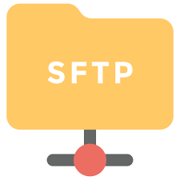


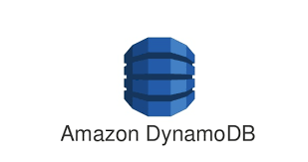

Speech Analysis AWS Architecture
AWS Cloud
Amazon CloudWatch
User
Code Source Repository
Speech Engine
NLP Engine
AWS Lambada
Artifacts
Power BI Connector
Power BI
AWS Client Cloud
Audio Files
Audio Files

Slide 18
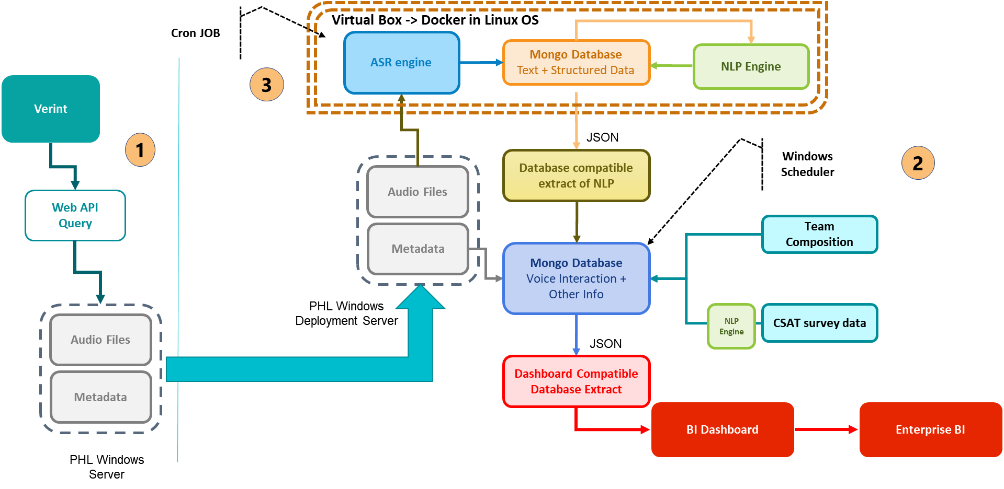
Architecture – On Premises

