Slide 1
Shared memory

Slide 2
Shared memory
Physical Memory
Process A
Process B
Instruction memory
Instruction memory
Share
Data
Share
Share
Virtual address space B
Data
Virtual address space A

Slide 3
Create a shared memory region
Create a shared memory region
Attach a process with the shared memory
Use
Detach a process from the shared memory

Slide 4
Create a shared memory region
Create a shared memory instance
int shmget(key_t key, int size, int msgflg)
Flag (IPC_CREAT, IPC_EXCL, read, write permission)
Shared memory identifier
Name of the shared memory
#of bytes

Slide 5
int main()
{
int shmid;
key_t key;
key=131;
shmid=shmget(key,20, IPC_CREAT|0666);
printf("\nq=%d",shmid);
}
ipcs –m displays the message queue information in the system
Keys ShmID owner permission bytes nattach

Slide 6
Physical Memory
Process A
Process B
Share
Share
Shared memory
Virtual address space B

Slide 7
Create a shared memory region
Attach a process with the shared memory
Use
Detach a process from the shared memory

Slide 8
Physical Memory
Process A
Process B
Attach
Share
Attach
Share
Share
Virtual address space B

Slide 9
void *shmat(int shmid, const void *shmaddr, int shmflg);
SHM_RDONLY,
SHM_RND
attach occurs at the address shmaddr
Virtual address of the shared memory segment
shmat() attaches the shared memory segment identified by shmid to the address space of the calling process.

Slide 10
#include <sys/types.h>
#include <sys/ipc.h>
#include <sys/shm.h>
char *ptr
key = 10
size = 20
shmflg =
shmid = shmget (key, size, shmflg));
ptr=(char*)shmat(shmid, NULL, 0);

Slide 11
int main()
{
int shmid,f,key=2,i,pid;
char *ptr;
shmid=shmget((key_t)key,100,IPC_CREAT|0666);
ptr=shmat(shmid,NULL,0);
printf("shmid=%d ptr=%u\n",shmid, ptr);
pid=fork();
if(pid==0)
{
strcpy(ptr,“hello\n");
}
else
{
wait(0);
printf("%s\n",ptr);
}
}
Child writes “Hello” to the shared memory
Parent reads “Hello” from the shared memory

Slide 12
example
writer.c
reader .c
int main()
{
int shmid,f,key=3,i,pid;
char *ptr;
shmid=shmget((key_t)key,100,IPC_CREAT|0666);
ptr=shmat(shmid,NULL,0);
printf("shmid=%d ptr=%u\n",shmid, ptr);
strcpy(ptr,"hello");
i=shmdt((char*)ptr);
}
int main()
{
int shmid,f,key=3,i,pid;
char *ptr;
shmid=shmget((key_t)key,100,IPC_CREAT|0666);
ptr=shmat(shmid,NULL,0);
printf("shmid=%d ptr=%u\n",shmid, ptr);
printf("\nstr %s\n",ptr);
}
ptr
Shared memory

Slide 13
int main()
{
struct databuf *ptr;
int shmid,f,key=2,i,pid;
//char *ptr;
shmid=shmget((key_t)key,100,IPC_CREAT|0666);
ptr=(struct databuf*)shmat(shmid,NULL,0);
printf("shmid=%d ptr=%u\n",shmid, ptr);
pid=fork();
if(pid==0)
{
ptr->nread=read(0,ptr->buf,10000);
}
else
{
wait(0);
printf("parent\n");
write(1,ptr->buf,10000);
}
struct databuf
{
int nread;
char buf[1000];
};

Slide 14
File descriptor table
File descriptor (integer) | File name
0 | stdin
1 | stdout
2 | stderr
Use open(), read(), write() system calls to access files
Open() creates a file and returns fd (minimum value)
fd=open(path, O_WRONLY|O_CREAT|O_TRUNC, mode)

Slide 15
Disassociate process from memory
Physical Memory
Process A
Process B
Share
Share
Share
Virtual address space B

Slide 16
Disassociate process from memory
int shmdt(const void *shmaddr);
int main()
{
shmid=shmget((key_t)key,100,IPC_CREAT|0666);
ptr=shmat(shmid,NULL,0);
printf("shmid=%d ptr=%u\n",shmid, ptr);
strcpy(ptr,"hello");
printf("\nstr is %s",ptr);
i=shmdt((char*)ptr);
}

Slide 17
example
writer.c
reader .c
int main()
{
int shmid,f,key=3,i,pid;
char *ptr;
shmid=shmget((key_t)key,100,IPC_CREAT|0666);
ptr=shmat(shmid,NULL,0);
printf("shmid=%d ptr=%u\n",shmid, ptr);
strcpy(ptr,"hello");
i=shmdt((char*)ptr);
}
int main()
{
int shmid,f,key=3,i,pid;
char *ptr;
shmid=shmget((key_t)key,100,IPC_CREAT|0666);
ptr=shmat(shmid,NULL,0);
printf("shmid=%d ptr=%u\n",shmid, ptr);
printf("\nstr %s\n",ptr);
}
ptr
Shared memory

Slide 18
Kernal data structure
/* One shmid data structure for each shared memory segment in the system. */
struct shmid_ds {
struct ipc_perm shm_perm; /* operation perms */
int shm_segsz; /* size of segment (bytes) */
time_t shm_atime; /* last attach time */
time_t shm_dtime; /* last detach time */
time_t shm_ctime; /* last change time */
unsigned short shm_cpid; /* pid of creator */
unsigned short shm_lpid; /* pid of last operator */
short shm_nattch; /* no. of current attaches */
/* the following are private */
unsigned short shm_npages; /* size of segment (pages) */
unsigned long *shm_pages; /* array of ptrs to frames -> SHMMAX */
struct vm_area_struct *attaches; /* descriptors for attaches */
};

Slide 19
struct ipc_perm {
key_t key;
ushort uid; /* user euid and egid */
ushort gid;
ushort cuid; /* creator euid and egid */
ushort cgid;
ushort mode; /* access modes see mode flags below */
ushort seq; /* slot usage sequence number */ };

Slide 20
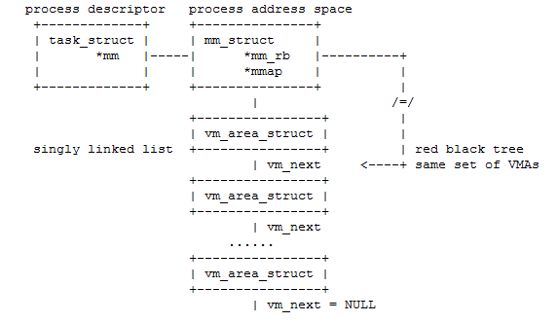
$pmap –x pid

Slide 21
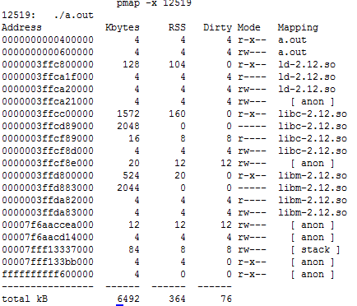

Slide 22
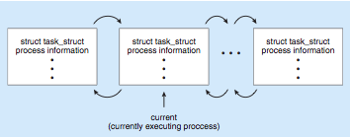
Process Representation in Linux
Represented by the C structure task_struct pid t pid; /* process identifier */ long state; /* state of the process */ unsigned int time slice /* scheduling information */ struct task struct *parent; /* this process’s parent */ struct list head children; /* this process’s children */ struct files struct *files; /* list of open files */ struct mm_struct *mm; /* address space of this pro */
Doubly linked list

Slide 23
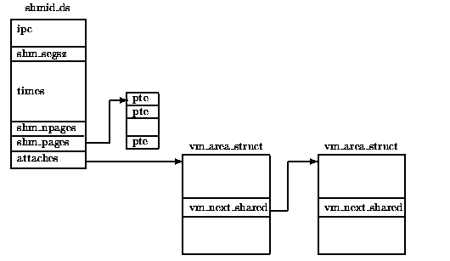

Slide 24
struct vm_area_struct {
struct mm_struct *vm_mm; /* associated mm_struct */
unsigned long vm_start; /* VMA start, inclusive */
unsigned long vm_end; /* VMA end, exclusive */
unsigned long vm_flags;
struct vm_area_struct *vm_next; /* points to next VMA */
struct vm_operations_struct *vm_ops; /* associated ops */
...
}

Slide 25
int shmctl(int shmid, int cmd, struct shmid_ds *buf);
IPC_STAT
IPC_SET
IPC_RMID
Remove shared memory
struct shmid_ds set;
shmctl(shmid, IPC_STAT, &set);
shmctl(shmid, IPC_SET, &set);
shmctl(shmid, IPC_RMID, 0);

